Slide 1

Dr. Sajid Iqbal
Department of Computer Science
Bahauddin Zakariya University, Multan

Slide 2
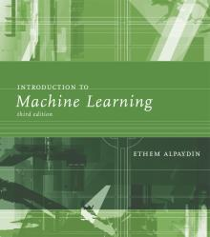
INTRODUCTION TO Machine Learning 3rd Edition
ETHEM ALPAYDIN
© The MIT Press, 2014
alpaydin@boun.edu.tr
http://www.cmpe.boun.edu.tr/~ethem/i2ml3e

Slide 3
CHAPTER 1: Introduction

Slide 4
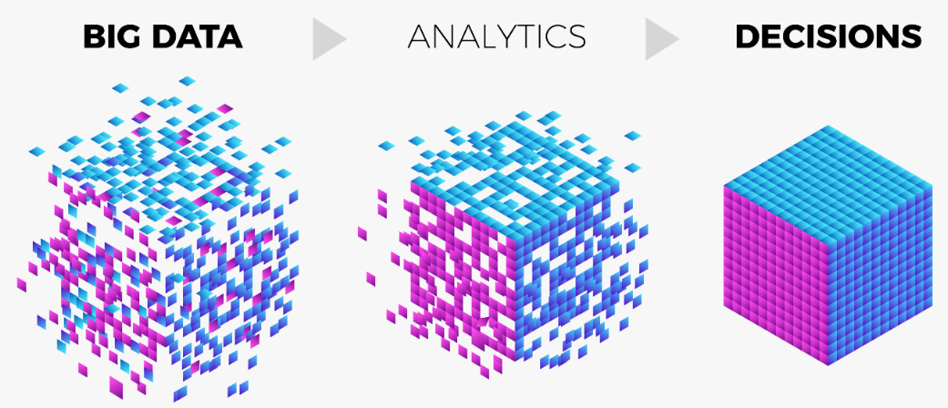
Big Data
Widespread use of personal computers and wireless communication leads to “big data”
We are both producers and consumers of data
Data is not random, it has structure, e.g., customer behavior, change in oil prices
Well designed algorithms are required to solve such problems
We need “big theory” to extract that structure from data for
Understanding the process
Making predictions for the future

Slide 5
The nature of data
For simple tasks we have well defined data and we can produce exact output
For example, power of a number, list of customers who bought a product from a super store
For some tasks, we do not have even an algorithm.
For example, predicting customer behavior; spam emails from legitimate ones
We know the input and out put but we do not know the process
We want to enable our machines to extract the process by looking at input and output

Slide 6

Why “Learn” ?
Machine learning is programming computers to optimize a performance criterion using example data or past experience.
There is no need to “learn” to calculate payroll
Learning is used when:
Human expertise does not exist (navigating on Mars),
Humans are unable to explain their expertise (speech recognition)
Solution changes in time (routing on a computer network)
Solution needs to be adapted to particular cases (user biometrics)

Slide 7
What is “Learning”
Learning general models (algorithms) from a data of particular examples
Data is cheap and abundant (data warehouses, data marts)
knowledge is expensive and scarce.
Example in retail: Customer transactions to consumer behavior:
People who bought “Blink” also bought “Outliers” (www.amazon.com)
Build a model that is a good and useful approximation to the data.

Slide 8
Data Mining
Application of Machine Learning to large databases
Retail: Market basket analysis, Customer relationship management (CRM)
Finance: Credit scoring, fraud detection
Manufacturing: Control, robotics, troubleshooting
Medicine: Medical diagnosis
Telecommunications: Spam filters, intrusion detection
Bioinformatics: Motifs, alignment
Web mining: Search engines
...

Slide 9
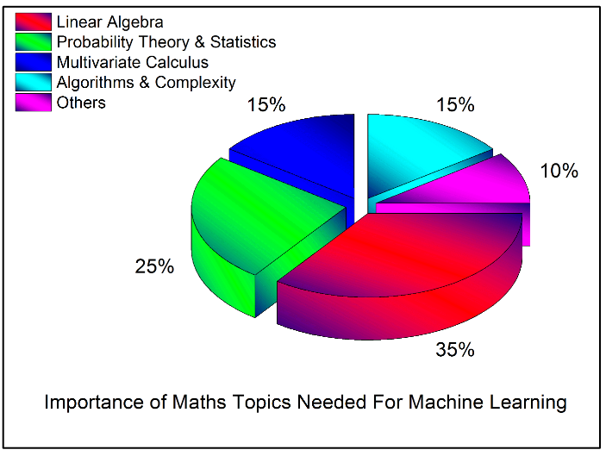
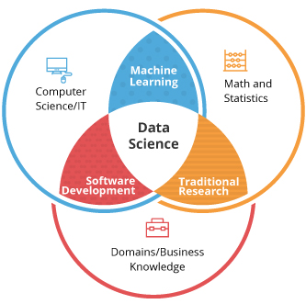
What is Machine Learning?
Machine Learning is more than data mining
Optimize a performance criterion using example data or past experience.
Role of Statistics: Inference from a sample
Role of Computer science: Efficient algorithms to
Solve the optimization problem
Representing and evaluating the model for inference

Slide 10
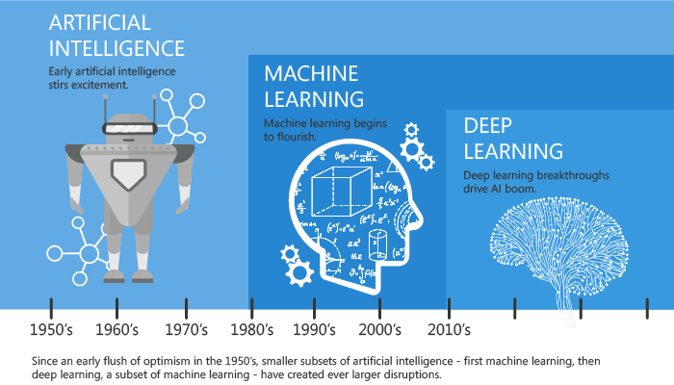
AI vs ML vs DL

Slide 11
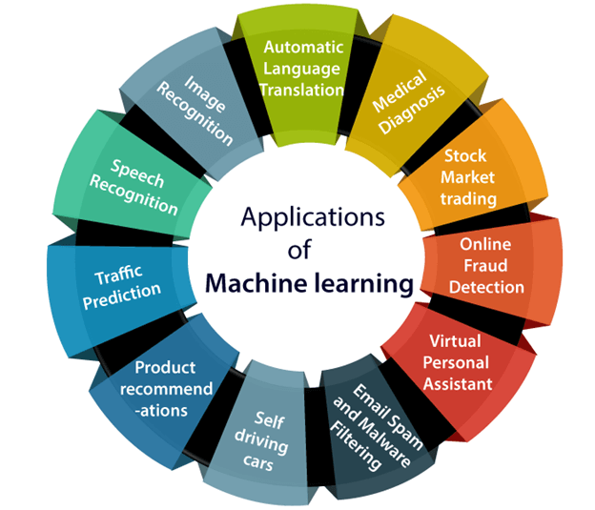
Industrial Applications

Slide 12
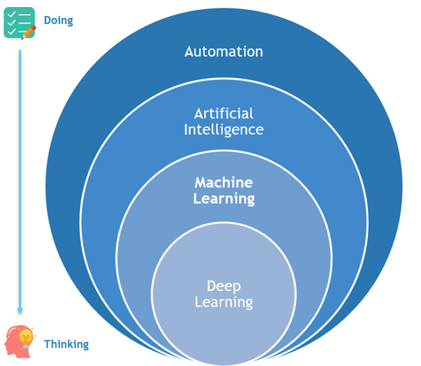
Categorical Applications
Association
Supervised Learning
Classification
Regression
Unsupervised Learning
Reinforcement Learning

Slide 13
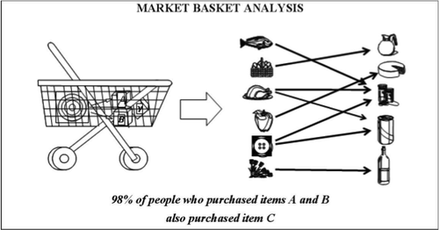

Learning Associations
Basket analysis:
$P(Y|X)$ probability that somebody who buys $X$ also buys $Y$ where $X$ and $Y$ are products/services.
Example: $P(cold_drink|burger) = 0.7$

Slide 14
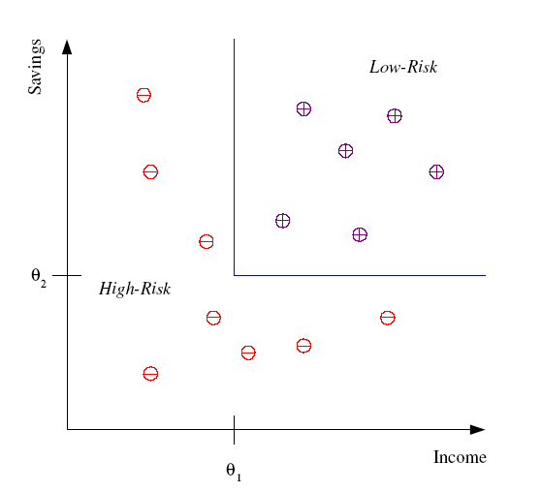
Classification
Example: Credit scoring
Differentiating between low-risk and high-risk customers from their income and savings
Discriminant: IF income > θ₁ AND savings > θ₂
THEN low-risk ELSE high-risk

Slide 15
Classification: Applications
Aka Pattern recognition
Face recognition: Pose, lighting, occlusion (glasses, beard), make-up, hair style
Character recognition: Different handwriting styles.
Speech recognition: Temporal dependency.
Medical diagnosis: From symptoms to illnesses
Biometrics: Recognition/authentication using physical and/or behavioral characteristics: Face, iris, signature, etc
Outlier/novelty detection:

Slide 16








Face Recognition
Training examples of a person
Test images
ORL dataset,
AT&T Laboratories, Cambridge UK

Slide 17
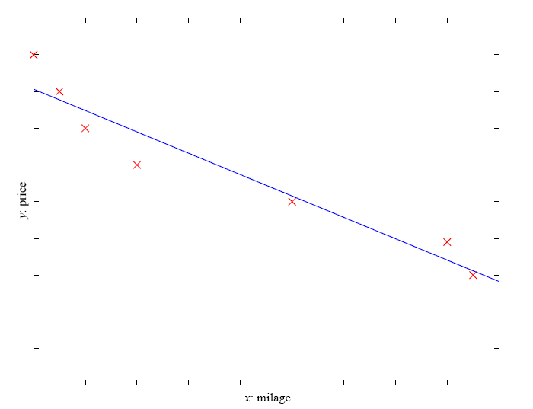
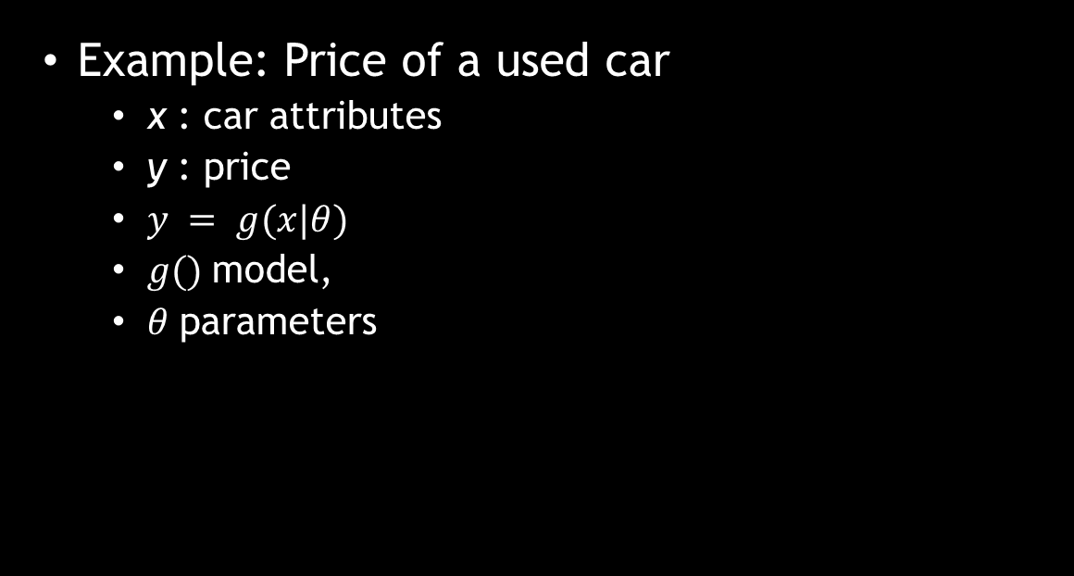

Regression
Example: Price of a used car
x : car attributes
y : price
$y = g(x|θ)$
$g()$model,
$θ$ parameters
$$y = w_{1}x+w0$$

Slide 18

Regression Applications
Navigating a car: Angle of the steering
Kinematics of a robot arm
(x,y)
$$α1= g1(x,y)$$
$$α2= g2(x,y)$$
α2
α1
Response surface design

Slide 19

Supervised Learning (SL)
It is task of learning a function $f(x)$ that maps an input to an output based on example input-output pairs
It infers function from labelled training data consisting of set of examples
Input is in the form of pair $(X,y)$
An SL algorithm analyzes the training data and produces an inferred function, which can be used for mapping new examples

Slide 20
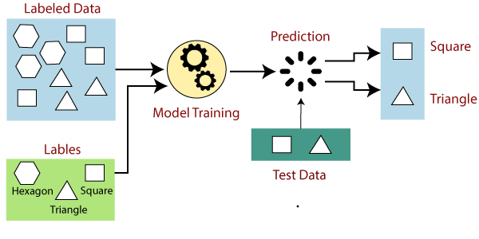
Supervised Learning

Slide 21
Supervised Learning: Uses
Prediction of future cases: Use the rule to predict the output for future inputs
Knowledge extraction: The rule is easy to understand
Compression: The rule is simpler than the data it explains
Outlier detection: Exceptions that are not covered by the rule, e.g., fraud

Slide 22
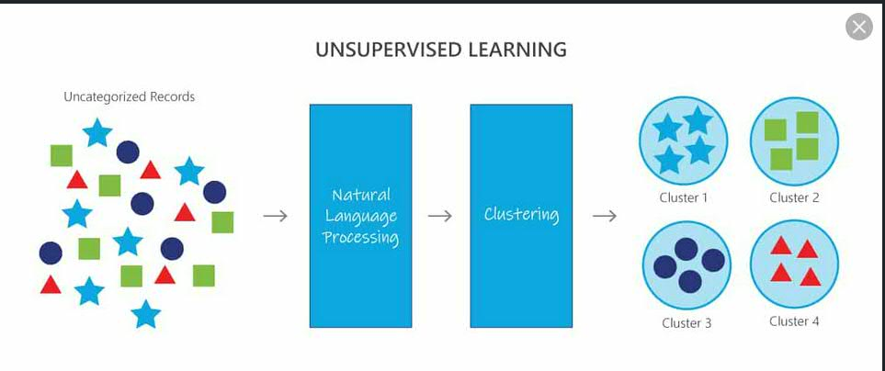
Unsupervised Learning
Clustering

Slide 23
Unsupervised Learning
Learning “what normally happens”
No output
Clustering: Grouping similar instances
Example applications
Customer segmentation in CRM
Image compression: Color quantization
Bioinformatics: Learning motifs

Slide 24
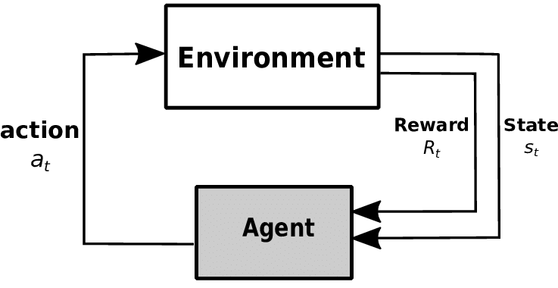
Reinforcement Learning

Slide 25
Reinforcement Learning
Learning a policy: A sequence of outputs
No supervised output but delayed reward
Credit assignment problem
Game playing
Robot in a maze
Multiple agents, partial observability, ...

Slide 26
Tools Required
Python 3.x
Pycharm, Jupyter Notebook, Spyder …
You must do the tutorials on above tools
Learn
For python
Basic language constructs i.e. data types, variables, if-stmt, loops, functions, data structures like arrays, dictionaries, lists, tuples, sets, file handling
Use of libraries like numpy, pandas
Writing notebooks in Jupyter notebook
Writing programs in pycharm IDE
Installing and removing libraries in python
Running, debugging and trouble shooting python scripts

Slide 27
Data and Machine Learning
Machine learning is all about finding the patters from data
Data is required for ML algorithms to operate upon
There are many online data repositories
You can develop your own dataset
Every dataset is different from other in one or other context
So you need data

Slide 28
Resources: Datasets
UCI Repository: http://www.ics.uci.edu/~mlearn/MLRepository.html
Statlib: http://lib.stat.cmu.edu/
Kdnuggets.com
Openml.org
Kaggle.com
Nature.com
Dataquest.io
And there are many general and special purpose repositories

Slide 29
Assignment-1
Solve the exercises of chapter one
Write the summary of following paper
Applications of Machine Learning and Rule Induction
By Pat Langley and Herbert A. Simon
Present in the folder of slides

Slide 30



Thanks for watching
Dr. Sajid Iqbal
Assistant Professor
Department of Computer Science
Bahauddin Zakariya University, Multan
sajidiqbal.pk@gmail.com
https://github.com/sajjo79/Design_and_Analysis_of_Algorithms
Allah Hafiz
COMEDXD

