Slide 1

Dr. Sajid Iqbal
Department of Computer Science
Bahauddin Zakariya University, Multan

Slide 2

INTRODUCTION TO Machine Learning 3rd Edition
ETHEM ALPAYDIN
© The MIT Press, 2014
alpaydin@boun.edu.tr
http://www.cmpe.boun.edu.tr/~ethem/i2ml3e

Slide 3
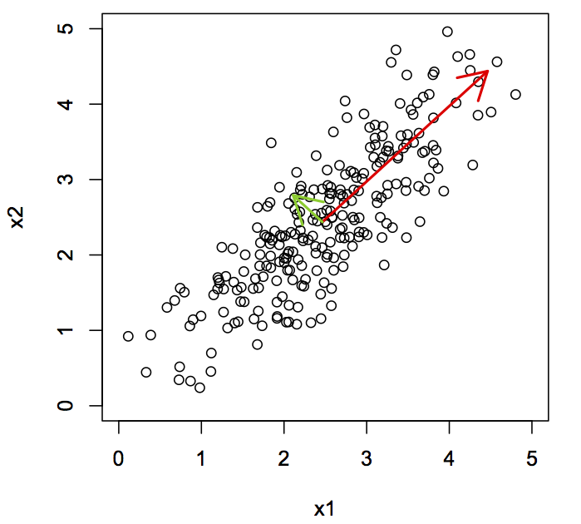
Principal Component Analysis
Chapter six – Dimensionality Reduction

Slide 4
Required Linear Algebra

Slide 5
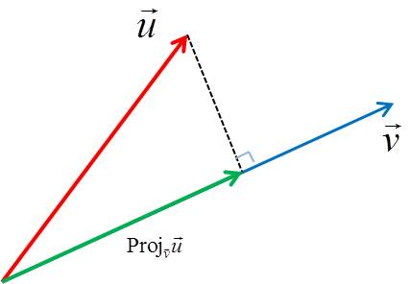
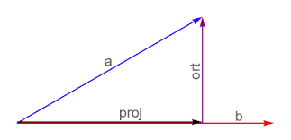
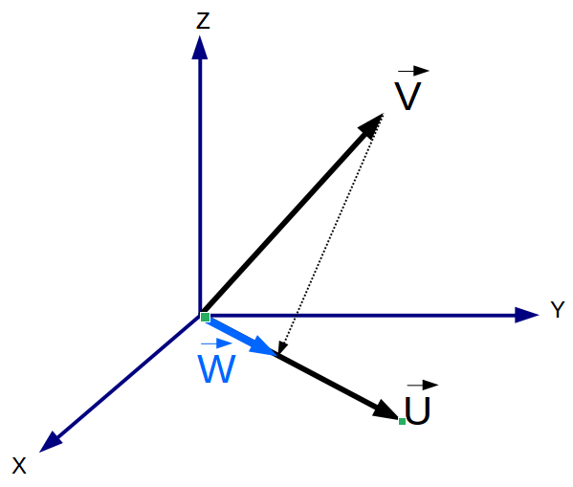

Projection Methods
A projection is mapping of one set of values to another set of values
A projection is a mapping of a set (or other mathematical structure) into a subset (or sub-structure)
Projection methods helps to
find a mapping from the $d$-dimension inputs (in $d$-dimensional space) to new $k$-dimension ($k$-dimensional space) outputs with minimum information loss
The projection of $x$ on the direction of $w$ is $z=w^{T}x$

Slide 6




Dot Product through matrix multiplication
$$z=w^{T}x=w_{4}x_{4}+w_{3}x_{3}+w_{2}x_{2}+w_{1}x_{1}$$
$w=\left[\begin{matrix}w_{4} \\ w_{3} \\ \begin{aligned}w_{2} \\ w_{1}\end{aligned}\end{matrix}\right]$ and $x=\left[\begin{matrix}x_{4} \\ x_{3} \\ \begin{aligned}x_{2} \\ x_{1}\end{aligned}\end{matrix}\right]$
$$x=\left[\begin{matrix}x_{4} \\ x_{3} \\ \begin{aligned}x_{2} \\ x_{1}\end{aligned}\end{matrix}\right]$$
$$w^{T}=\left[\begin{matrix}w_{4} & w_{3} & w_{2} & w_{1}\end{matrix}\right]$$
$$w^{T}x=\left[\begin{matrix}w_{4} & w_{3} & w_{2} & w_{1}\end{matrix}\right]\left[\begin{matrix}x_{4} \\ x_{3} \\ \begin{aligned}x_{2} \\ x_{1}\end{aligned}\end{matrix}\right]$$
$$w^{T}x=w_{4}x_{4}+w_{3}x_{3}+w_{2}x_{2}+w_{1}x_{1}$$
$$z=w^{T}x$$

Slide 7
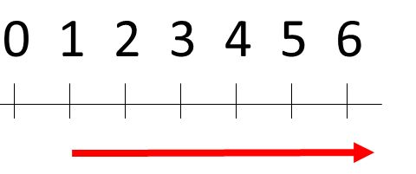
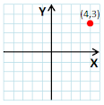
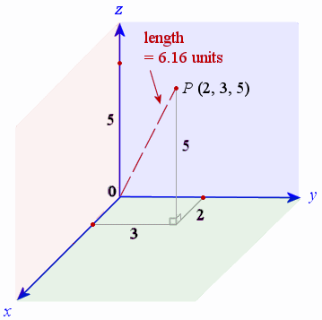

Euclidian Norm
It is also called Euclidian Length that measures the length of the vector
If $p=(p_{1},p_{2},….,p_{n})$ describes a point in nD space
$\left\|p\right\|=\sqrt{p_{1}^{2}+p_{2}^{2}+…+p_{n}^{2}}$
Can be calculated using formula $p^{T}p$
Example
In 1D a point is represented with one value and that is its magnitude too
In 2D a point is represented with two points and its magnitude is given by
$\left\|p\right\|=\sqrt{4^{2}+3^{2}}=\sqrt{16+9}=\sqrt{25}=5$
In 3D a point is represented with three points and its magnitude is
$\left\|p\right\|=\sqrt{2^{2}+3^{2}+5^{2}}=\sqrt{4+9+25}=\sqrt{38}=6.16$
Let $p=\left[\begin{matrix}2 \\ 3 \\ 5\end{matrix}\right]$ then $p^{T}=\left[\begin{matrix}2 & 3 & 5\end{matrix}\right]\left[\begin{matrix}2 \\ 3 \\ 5\end{matrix}\right]=2^{2}+3^{2}+5^{2}=38$

Slide 8
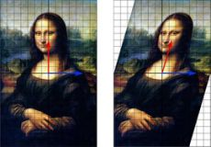






Eigen Vector and Eigen Value
Let $X^{T}=[20,60,80]$and it is linearly transformed as $Y^{T}=[1,3,4]$then
If there is some scalar $λ$ such that $x=λy$ then $λ$ is eigen value
For nxn matrix A, if $Ax=λx$ then $x$ is eigen vector
Let $A=\left[\begin{matrix}1 & 1 \\ −2 & 4\end{matrix}\right]$ then we find a matrix x that fulfills the condition
$$X=\left[\begin{matrix}20 \\ 60 \\ 80\end{matrix}\right]$$
$$Y=\left[\begin{matrix}1 \\ 3 \\ 4\end{matrix}\right]$$
$$\left[\begin{matrix}1 & 1 \\ −2 & 4\end{matrix}\right]\left[\begin{matrix}6 \\ 6\end{matrix}\right]=\left[\begin{matrix}12 \\ 12\end{matrix}\right]$$
$$\left[\begin{matrix}1 & 1 \\ −2 & 4\end{matrix}\right]\left[\begin{matrix}6 \\ 6\end{matrix}\right]=2\left[\begin{matrix}6 \\ 6\end{matrix}\right]$$
$Ax=λx$
So x is eigen vector

Slide 9

More Linear Algebra
$AA^{T}$ and $A^{T}A$ share the same nonzero eigenvalues
The eigenvalues of $AA^{T}$ and $A^{T}A$ are nonnegative numbers
Rank of a matrix is $rxc$ for r-rows and c-columns
A matrix is singular if its determinant is zero i.e. for a matrix $A$, $\left|\begin{matrix}A\end{matrix}\right|=0$

Slide 10
Required Statistics

Slide 11





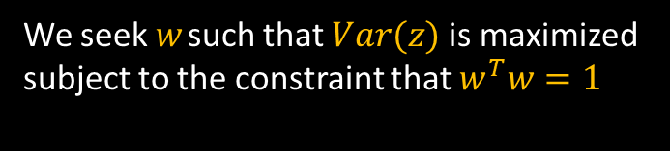
Some basic formulas
$$μ_{i}=\overline{x_{i}}=\sum_{i}{\frac{x_{i}}{N}}$$
$$z=w^{T}x$$
$$covariance\left(x_{i},x_{j}\right)=\frac{\sum{(x_{i}−\overline{x_{i}})(x_{j}−\overline{x_{j}})}}{N}$$
$$Var\left(z\right)=w^{T}Σw$$
$$where \overline{x_{i}} and \overline{x_{j}} are means of featurs i and j$$
$$Var\left(z\right)=\left[\begin{matrix}w_{1} & w_{2}\end{matrix}\right]\left[\begin{matrix}σ_{1}σ_{1} & σ_{1}σ_{2} \\ σ_{2}σ_{1} & σ_{2}σ_{2}\end{matrix}\right]\left[\begin{matrix}w_{1} \\ w_{2}\end{matrix}\right]$$
$$variance\left(x_{i},x_{i}\right)=\frac{\sum{(x_{i}−\overline{x_{i}})(x_{i}−\overline{x_{i}})}}{N}=\frac{\sum{{\left(x_{i}−\overline{x_{i}}\right)}^{2}}}{N}$$
We seek $w$ such that $Var(z)$is maximized subject to the constraint that $w^{T}w=1$
If X is 2-dimensional then its covariance matrix is given as
$$Cov\left(X\right)=\left[\begin{matrix}σ_{1}σ_{1} & σ_{1}σ_{2} \\ σ_{2}σ_{1} & σ_{2}σ_{2}\end{matrix}\right]$$

Slide 12
Principal Component Analysis

Slide 13
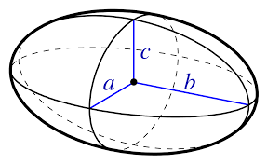
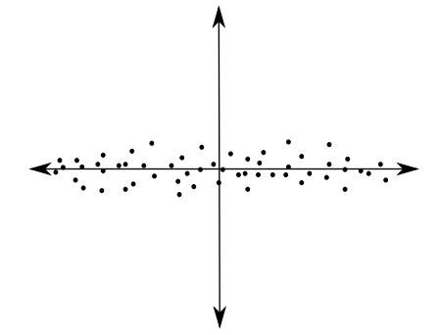
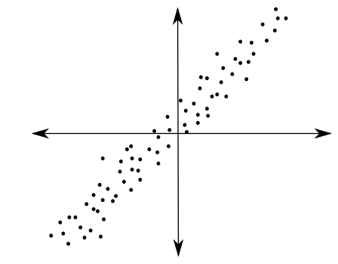




Principal Component Analysis
PCA can be considered as mapping a p-dimensional ellipsoid to the data where
Each axis of ellipsoid represents the principal component
Greater the variance along a side, greater the PC
The Process
Normalize the data
Find covariance matrix $Σ$
Find eigen value and eigen vector of this covariance matrix
Each of the mutually orthogonal unit eigen vectors are interpreted as an axis of the ellipsoid
It will transform the $Σ$ to diagonalized form.
The diagonal elements represent the variance of each axis
By dividing the each eigen value by the sum of all eigen values, proportion of the variance that each eigen vector represents can be obtained
PCA will provide a mechanism to recognize this geometric similarity through algebraic means
$$\left[\begin{matrix}σ_{11} & σ_{12} \\ σ_{21} & σ_{22}\end{matrix}\right]→\left[\begin{matrix}σ_{11} & 0 \\ 0 & σ_{22}\end{matrix}\right]$$
$$Σ=\left[\begin{matrix}95 & 1 \\ 1 & 5\end{matrix}\right]$$
$$Σ=\left[\begin{matrix}50 & 40 \\ 40 & 50\end{matrix}\right]$$

Slide 14

Principal Component Analysis - PCA
PCA is an unsupervised method which attempts to maximized the variance.
If given data sample $X$ of $d$-features is projected to a value $w_{1}$ of $k$-features and this projection produces most spread (variance) of sample, $w_{1}$ is called the principal component (PC)
the difference between the sample points becomes most apparent
For a unique solution and to make the direction the important factor, we require $\left\|w_{1}\right\|=1$ (norm of vector)
We know that for normal distribution (chapter 5)
if $z_{1}= w_{1}^{T}x$with $Cov(x)=Σ$then $Var(z_{1})=w_{1}^{T}Σw_{1}$

Slide 15
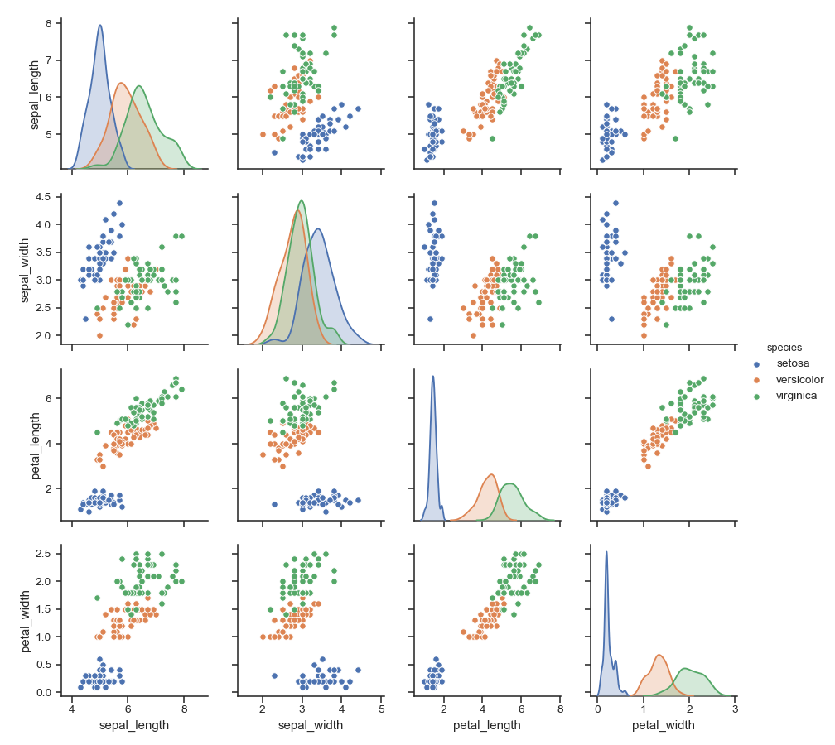
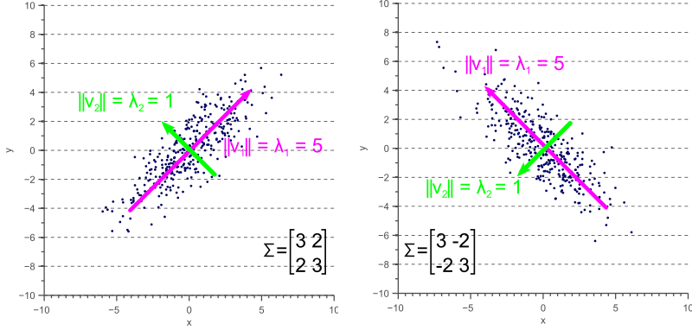

Slide 16
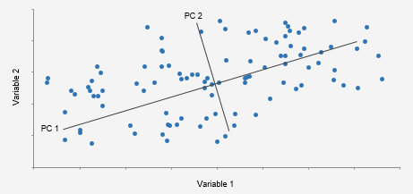

First Principal Component
The eigen vectors of given dataset are principals components
The Problem:
We seek $w$ such that $Var(z)$is maximized subject to the constraint that $w^{T}w=1$(l2 norm)
The solution
Writing this as a Lagrange problem, we have
$argmax_{w}\left[ \left(w^{T}Σw\right)−(α\left(w^{T}w\right)−1)\right]=0$
Taking the derivative with respect to $w$
$2Σw−2αw= 0$, and therefore $Σw = αw$
Where $α$is eigen value and $w$ is eigen vector
Choose the eigenvector with the largest eigenvalue for the variance to be maximum
The principal component is the eigenvector of the covariance matrix of the input sample with the largest eigenvalue, $λ_{1} = α$.
$W$ is known as first principal component. Let we call it as $W_{1}$

Slide 17
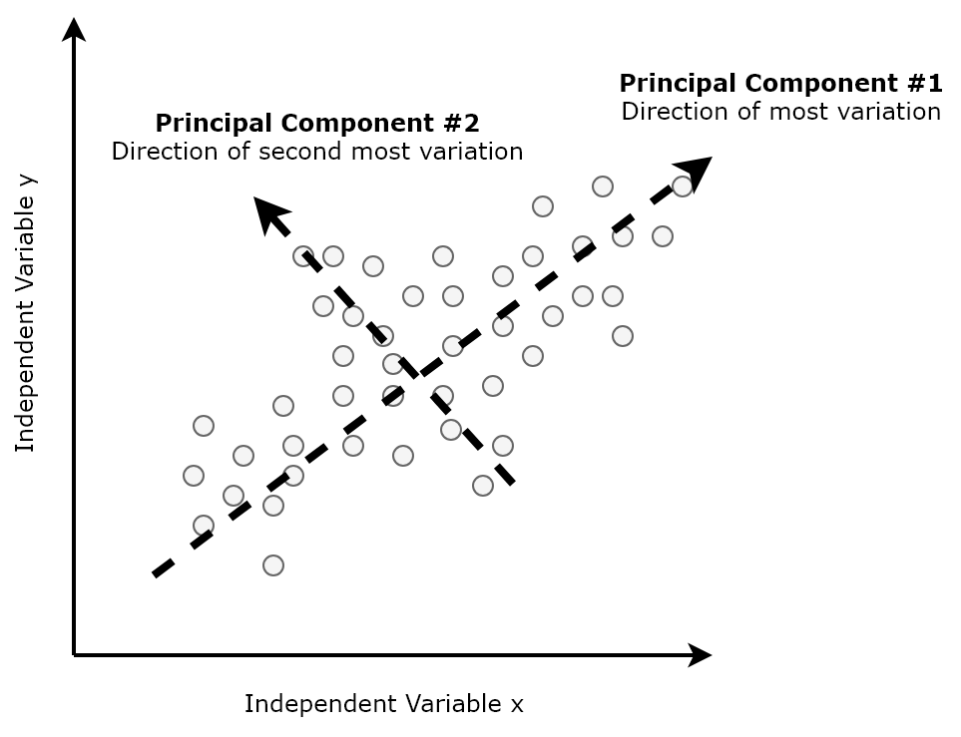

Second Principal Component
Let $w_{2}$ be the second principal component then
It should maximize the variance
Must be of unit length
Must be orthogonal to w1. As the projection of $z_{2}=w_{2}^{T}x$is uncorrelated with $z_{1}$
For the 2nd principal component, we have
$\max_{w_{2}}{(w_{2}^{T}Σw_{2}−α\left(w_{2}^{T}w_{2}−1\right)−β(w_{2}^{T}w1−0)}$
Taking the derivative with respect to w2 and setting it equal to 0
$2Σw_{2}−2αw_{2}−βw_{1} = 0$
Premultiply by $w_{1}^{T}$ and we get
$2w_{1}^{T}Σw_{2}−2αw_{1}^{T}w_{2}−βw_{1}^{T}w_{1} = 0$

Slide 18

Second Principal Component
$$\begin{aligned}2Σw_{2}−2αw_{2}−βw_{1} = 0 \#16−1\end{aligned}$$
$\text{D}\text{ot} \text{product} \text{of} \text{two} \text{orthogonal} \text{vectors} \text{is} \text{zero} i.e. w_{1}^{T}w_{2}=0$
$w_{1}^{T}Σw_{2}$is a scalar so equal to its transpose $w_{2}^{T}Σw_{1}$
As $w_{1}$ is the leading eigenvector of $Σ, and Σw_{1}=λ_{1}w_{1}$therefore
$w_{1}^{T}Σw_{2}=w_{2}^{T}Σw_{1}=λ_{1}w_{2}^{T}w_{1} = 0$then
$2w_{1}^{T}Σw_{2}−2αw_{1}^{T}w_{2}−βw_{1}^{T}w_{1} = 0 →0−0−βw_{1}^{T}w_{1}=0 →βw_{1}^{T}w_{1}=0→β=0$
Eq 16-1 reduces to
$2Σw_{2}=2αw_{2}→$ $Σw_{2}=αw_{2}$
Here $w_{2}$ is eigen vector of $Σ$ with eigen value $α$
$w_{2}$ is the second principal component of given dataset

Slide 19
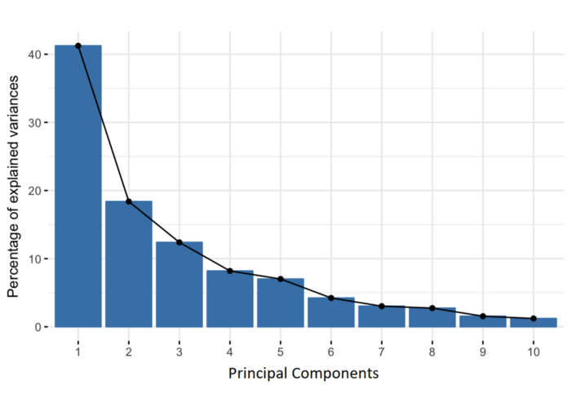

Principal Components
If $Σ$ is symmetric with different values then eigen vectors are orthogonal
All eigen values are positive it If $Σ$ is positive definite ($x^{T}Σx > 0$, for all nonnull $x$)
If $Σ$ is singular then its rank is $k<d$ where $λ_{i}, i=k+1, k+2, …,d$ are zero
The k eigenvectors with nonzero eigenvalues are the dimensions of the reduced space
The eigen vectors from 1-k are arranged in descending order
First PC explains largest variance
2nd explains the 2nd largest and so on…

Slide 20

Let $z=W^{T}(x−m)$
$S$ is estimator to $Σ$ and $k$ columns of $W$ are the $k$ leading eigenvectors of $S$
Subtract the sample mean m from x before projection to center the data on the origin
This linear transformation gives k-dimensional space with dimensions given by eigenvectors
Variance over these new dimensions are equal to the eigenvalues
To normalize variances, divide them by the square roots of the eigenvalues

Slide 21

PCA Example
Let there is class of student with grades on five courses
Let we want to order them according to courses
It is projection of the data onto one dimension such that difference between the data becomes more apparent
The eigenvector with highest eigenvalue is the direction that has the highest variance
Eigenvalues have little contribution to variance and may be discarded
Practically we use k-leading components that explains more than 90% of the variance
Proportion of variance explained by the k principal components is
$$Proportion of σ^{2}=\frac{λ_{1}+λ_{2}+…+λ_{k}}{λ_{1}+λ_{2}+λ_{3}+…+λ_{d}}$$

Slide 22
Highly corelated dimensions
There will be small eigen vectors with large eigen values
K will be much smaller than d. A lot of dimensionality reduction
Image and speech data usually shows this correlation
PCA will only be effective if there is correlation among data features

Slide 23
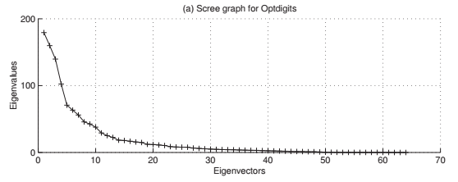
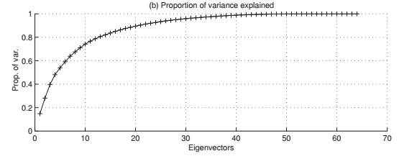
Selecting the eigen vectors
Scree Graph
It is the plot of variance explained as a function of the number of eigenvectors kept
Visual analysis can also help in finding the value k
(a) Scree graph. (b) Proportion of variance explained

Slide 24

Selecting the Eigen Vectors
Filter out the eigen vectors whose eigenvalues are less than average input variance
Given that $\sum_{i}{λ_{i}}=\sum_{i}{S_{i}^{2}}$ (equal to the trace of $S, tr(S)$), the average eigenvalue is equal to the average input variance
To keep eigenvectors with variance higher than average input variance
Keep eigenvectors with eigenvalues higher than average eigenvector
If the variance of original dimensions change considerably, they affect the direction of the principal components more than correlation
Two solutions
Normalize the data with zero mean and unit variance before applying PCA
Use the eigenvectors of the correlation matrix, R, instead of the covariance matrix, S
for the correlations to be effective and not the individual variances

Slide 25
Robust Estimation Methods – RE Methods
PCA explains variance and is sensitive to outliers
A few outliers will have large effect on the variances resulting same effect on eigenvectors
RE methods allow calculating parameters in the presence of outliers
Calculate the Mahalanobis distance of the data points and discard the distance points

Slide 26
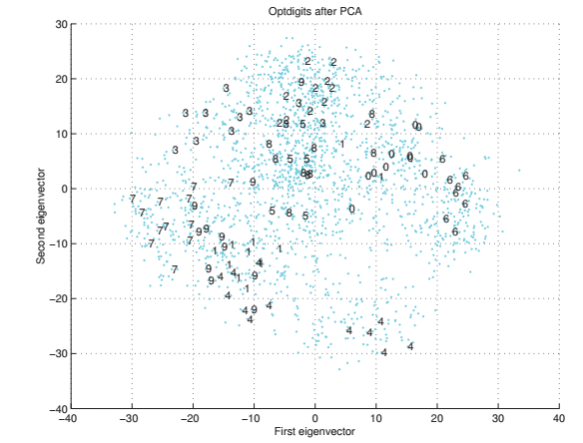
Selecting the Eigen Vectors – Visual Analysis
Plot the data in 2D space and search visually for patterns like structures, groups, outlier, normality and so forth
Meaningful information can be expressed by looking at the dimensions of the principal components
For image data, eigen vectors can be represented as images known as eigen faces or eigen digits

Slide 27

Reconstruction Error
If X is d-dimension normally distributed data then
Projected k-dimension data will also be normal
As all $z_{j}= W_{j}^{T}x_{j}$are uncorrelated then
new covariance matrices will be diagonal
And if they are normalized to have unit variance,
Euclidean distance can be used in this new space, leading to a simple classifier
If $z^{t}=W^{T}x^{t}$is projected as $z^{t}=W^{T}(x^{t}−μ)$ such that $WW^{T}=I$ (W is orthogonal matrix)
The back projection could be given as
$\hat{x}−μ=Wz^{t} →\hat{x}=Wz^{t}+μ$
During dimensionality reduction, some eigenvectors are dropped
Therefore the reconstruction process will contain error known as reconstruction Error and is given by
$RE={\sum_{t}{\left\|x^{t}−\hat{x^{t}}\right\|}}^{2}$

Slide 28



Thanks for watching
Dr. Sajid Iqbal
Assistant Professor
Department of Computer Science
Bahauddin Zakariya University, Multan
sajidiqbal.pk@gmail.com
https://github.com/sajjo79/Design_and_Analysis_of_Algorithms
Allah Hafiz
COMEDXD

