Slide 1

Dr. Sajid Iqbal
Department of Computer Science
Bahauddin Zakariya University, Multan

Slide 2

INTRODUCTION TO Machine Learning 3rd Edition
ETHEM ALPAYDIN
© The MIT Press, 2014
alpaydin@boun.edu.tr
http://www.cmpe.boun.edu.tr/~ethem/i2ml3e

Slide 3
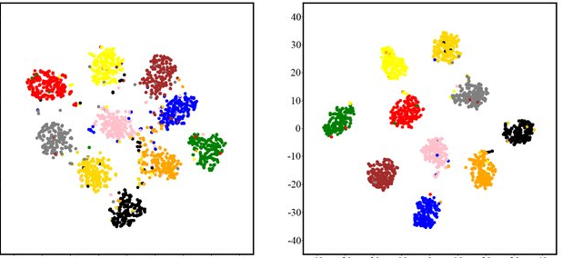
Feature Embedding
Chapter six – Dimensionality Reduction

Slide 4
Required Linear Algebra

Slide 5

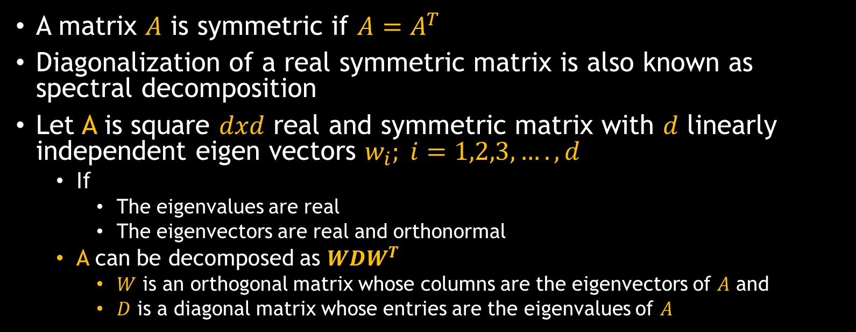
Eigen (Spectral) Decomposition
A matrix $A$ is symmetric if $A=A^{T}$
Diagonalization of a real symmetric matrix is also known as spectral decomposition
Let A is square $dxd$ real and symmetric matrix with $d$ linearly independent eigen vectors $w_{i}; i=1,2,3,….,d$
If
The eigenvalues are real
The eigenvectors are real and orthonormal
A can be decomposed as $WDW^{T}$
$W$ is an orthogonal matrix whose columns are the eigenvectors of $A$ and
$D$ is a diagonal matrix whose entries are the eigenvalues of $A$
$$D=\left[\begin{matrix}x & 0 \\ 0 & y\end{matrix}\right]$$

Slide 6
Feature Embedding

Slide 7
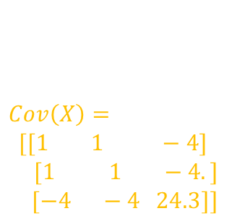


Background
Let $X$ is the $N × d$data matrix
where $N$ is the number of instances and $d$ is the input dimensionality
The $Σ$ of $x$ is $d×d$ and if $X$ is centered to have zero mean, it is equal to $X^{T}X$
PCA uses the eigenvectors of $X^{T}X$
The spectral (eigen) decomposition is $X^{T}X = WDW^{T}$where
$W$ is $d×d$and contains the eigenvectors of $X^{T}X$ in its columns
$D$ is a $d×d$diagonal matrix with the corresponding eigenvalues
Let the eigenvectors are sorted according to their eigenvalues
The first column of $W$ is the first eigenvector
If $X^{T}X$ has rank $k<d$, then $D_{ii} = 0$for $i > k$(no variance beyond k)
$X=[2,3,4,$
$5,6,7,$
$8,9,0]$
$$Cov\left(X\right)=$$
$$[[1 1 −4]$$
$[1 1 −4.]$
$[−4 −4 24.3]]$
$$\left[\begin{matrix}x & 0 & 0 & 0 \\ 0 & x & 0 & 0 \\ 0 & 0 & x & 0 \\ 0 & 0 & 0 & 0\end{matrix}\right]$$

Slide 8
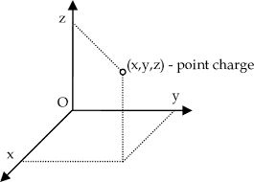
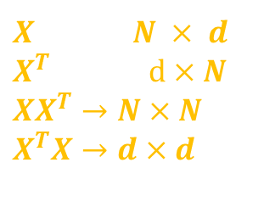

Feature Embedding
Map to the new $k$-dimensional space by taking a dot product of the original inputs with the eigenvectors
$z_{i}^{t}=w_{i}^{T}x^{t}, i = 1, . . . , k, t = 1, . . . , N$
Given that $λ_{i}$ and $w_{i}$ are the eigenvalues and eigenvectors of $X^{T}X$
$\left(X^{T}X\right)w_{i}=λ_{i}w_{i}$
Pre-multiplying by $X$, we find $\left(XX^{T}\right)Xw_{i}=λ_{i}Xw_{i}$
$Xw_{i}$ must be the eigenvectors of $XX^{T}$ with the same eigenvalues
Note that $X^{T}X$ is $d×d$, whereas $XX^{T}$ is $N×N$
Its spectral decomposition is $XX^{T} = VEV^{T}$
$V$ is the $N×N$matrix containing the eigenvectors of $XX^{T}$ in its columns
$E$ is the $N×N$diagonal matrix with the corresponding eigenvalues
The k $N$-dimensional eigenvectors of $XX^{T}$ are the coordinates in the new feature embedding space and is known as feature embedding
$X$ is the $N × d$
$X^{T}$ is the $d×N$
$XX^{T}→N×N$
$X^{T}X→d×d$

Slide 9

Eigenvectors are usually normalized to have unit length, so if the eigenvectors of $XX^{T}$ are $v_{i}$
$v_{i}=Xw_{i}/λ_{i}, i = 1, . . . , k$
Sum of squares of $Xw_{i}$ is $λ_{i}$
So if we have $v_{i}$ (column $i$ of $V$) calculated and we want to get $Xw_{i}$
multiply with the square root of the eigenvalue
$z_{i}^{t}=V_{i}^{t} \sqrt{E_{tt}} t = 1, . . . , N, i = 1, . . . , k$
$z_{i}^{t}=V_{i}^{t} \sqrt{λ_{tt}}$
If $d < N$, it is simpler to work with $X^{T}X$, use PCA
If $d > N$and it is easier to work with $XX^{T}$

Slide 10

Example
Let there are $40$ images face images
Each of size 256×256 = 65536-dimensional
Let rank of matrix is number of eigen vectors having associated eigen values greater than 0
Although the covariance matrix is 65536 × 65536,
The rank can never exceed 40
Hence we can work with the 40 × 40 matrix using the new coordinates in this forty-dimensional space
Contrary to PCA, we do not learn a projection model but get the coordinates directly.
If we have new test data, we should add them to X and redo the calculation

Slide 11

The element $(i, j)$of $XX^{T}$ is equal to the dot product of instances $i$ and $j$; that is, ${\left(x_{i}\right)}^{T}(x_{j}),$where $i, j = 1, . . . , N$.
If dot product is similarity measure between two vectors then $XX^{T}$ is $NxN$ matrix of pairwise similarities
So feature embedding is a method of placing instances in a k-dimensional space such that pairwise similarities in the new space respect the original pairwise similarities

Slide 12



Thanks for watching
Dr. Sajid Iqbal
Assistant Professor
Department of Computer Science
Bahauddin Zakariya University, Multan
sajidiqbal.pk@gmail.com
https://github.com/sajjo79/Machine-Learning
Allah Hafiz
COMEDXD

