Slide 1

Dr. Sajid Iqbal
Department of Computer Science
Bahauddin Zakariya University, Multan

Slide 2

INTRODUCTION TO Machine Learning 3rd Edition
ETHEM ALPAYDIN
© The MIT Press, 2014
alpaydin@boun.edu.tr
http://www.cmpe.boun.edu.tr/~ethem/i2ml3e

Slide 3
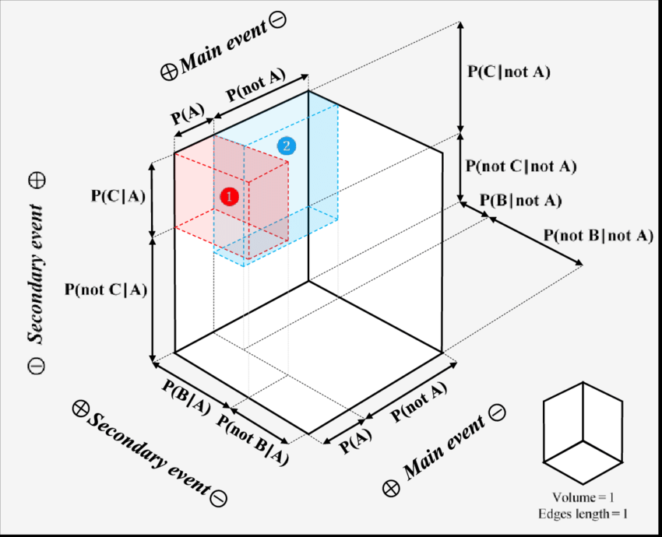
Bayesian Decision Theory
Chapter Three

Slide 4
3.1 Introduction

Slide 5

Introduction
Dataset are prepared from the process which is not completely known
We do not know exactly the data distribution
We model the process as random process (and probabilistic)
Consider the example of roulette table
It is a random experiment
We can guess if different parameters are known
The exact composition of the wheel
Its initial position
Force and its direction that is applied to it
Where and how it is started
…

Slide 6


Introduction
Observable variable: The variables whose values are given
Unobservable variables: Extra information that can help in predicting the output of random experiment
$x=f(z)$: deterministic function that defines the outcome from the unobservable pieces of knowledge
we cannot model the process this way
Define the outcome X as a random variable drawn from a probability distribution P(X = x) that specifies the process

Slide 7

Modeling Data Distribution
The outcome of tossing a coin is head or tail
Define a random variable that takes one of two values
Let X = 1 denotes the head and X = 0 denotes tail
We know that Bernoulli distribution deals with such type of variables where
$P\left(X=1\right)=p_{0} and P\left(X=0\right)=1−p_{0}$
If we know $p_{0}$
Prediction will be head if $p_{0}>1/2$ otherwise tail

Slide 8
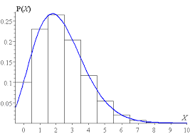
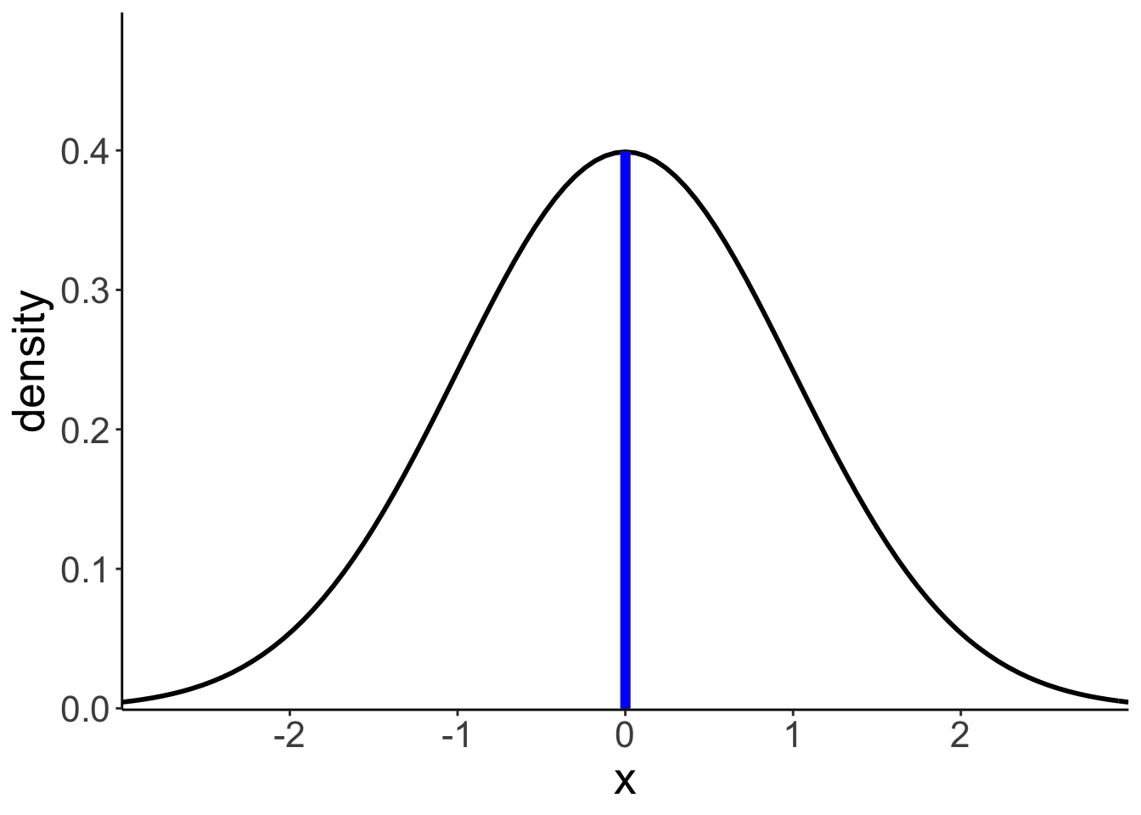

Modeling Data Distribution
We estimate P(x) from data if P(x) is not known
Use sample (given dataset) to estimate the probability distribution
Let dataset X is drawn from some unknown probability distribution p(x)
Using X, we try to build an estimator of this probability $\hat{p}(x)$
For coin tossing example
Sample contains the outcomes of the past N tosses
Using X, we can estimate $p_{0}$, parameter to uniquely specifies the distribution.
${\hat{p}}_{0}=\frac{\# of tosses with outcome as head}{Total tosses}$
Let $x^{t}$ is our random variable to denote outcome of an experiment
$sample = \{head, head, head, tail, head, tail, tail, head, head\}$
$X = \{1, 1, 1, 0, 1, 0, 0, 1, 1\}$
${\hat{p}}_{0}=\sum_{t=1}^{N}{\frac{x^{t}}{N}=\frac{6}{9}}$

Slide 9
3.2 Classification

Slide 10
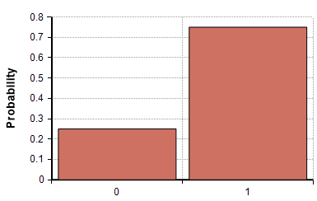

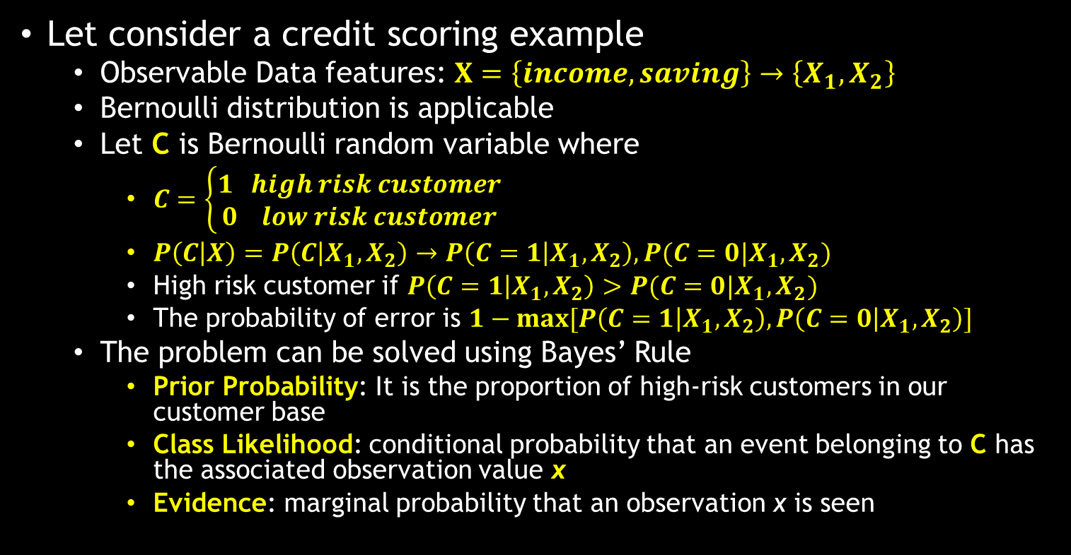



Classification
Let consider a credit scoring example
Observable Data features: $X=\left\{income, saving\right\}→\left\{X_{1},X_{2}\right\}$
Bernoulli distribution is applicable
Let C is Bernoulli random variable where
$C=\left\{\begin{aligned}1 high risk customer \\ 0 low risk customer \end{aligned}\right.$
$P\left(C | X\right)=P\left(C | X_{1},X_{2}\right)→P\left(C=1 | X_{1},X_{2}\right), P(C=0|X_{1},X_{2})$
High risk customer if $P\left(C=1 | X_{1},X_{2}\right)>P(C=0|X_{1},X_{2})$
The probability of error is $1−max[P\left(C=1 | X_{1},X_{2}\right),P\left(C=0 | X_{1},X_{2}\right)]$
The problem can be solved using Bayes’ Rule
Prior Probability: It is the proportion of high-risk customers in our customer base
Class Likelihood: conditional probability that an event belonging to C has the associated observation value x
Evidence: marginal probability that an observation x is seen
$$P\left(C | X\right)=\frac{P\left(X | C\right)P\left(C\right)}{P\left(X\right)}$$
$$Prior prob.=P(C=1)$$
$$Class likelihood=P(X|C)$$
$$Evidence=P(X)$$

Slide 11
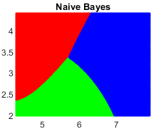
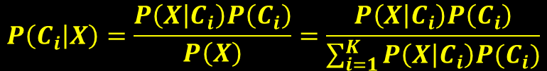


Multi-classification using Bayes’ Theorem
Let there are K mutually exclusive and exhaustive classes
$C_{i}, i = 1, . . . , K$
$P\left(C_{i}\right)≥0 and \sum_{i=1}^{K}{P\left(C_{i}\right)=1}$
For minimum error, the Bayes’ classifier chooses the class with the highest posterior probability
$$P\left(C_{i} | X\right)=\frac{P\left(X | C_{i}\right)P\left(C_{i}\right)}{P\left(X\right)}=\frac{P\left(X | C_{i}\right)P\left(C_{i}\right)}{\sum_{i=1}^{K}{P\left(X | C_{i}\right)P(C_{i})}}$$
$$C_{i} if P\left(C_{i} | X\right)=\max_{i}{P(C_{i}|X)}$$

Slide 12
Losses and Risks

Slide 13
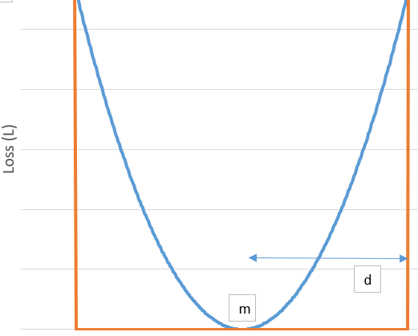

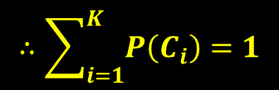

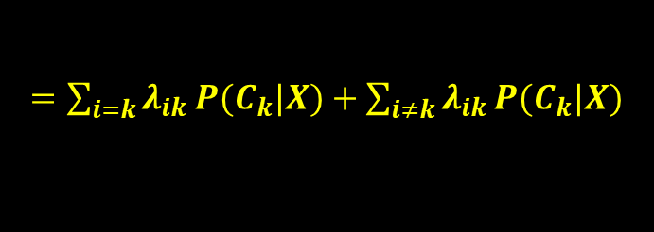
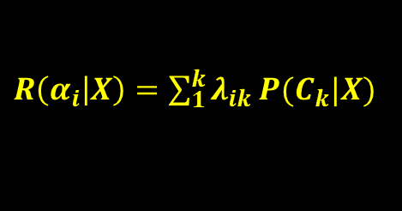

Losses and Risks
The total risk by assigning each class to given data x is
$R\left(α_{i} | X\right)=\sum_{1}^{k}{λ_{ik}}P(C_{k}|X)$ where
$α_{i}$: Action taken to decide in favor of class $C_{i}$
$λ_{ik}$: loss incurred by taking this action $I,k$=predicted, actual class
Choose $α_{i} if R\left(α_{i} | X\right)=\min_{k}{R(α_{k}|X)}$
For a special case of 0/1 output and all correct decisions have no loss and all errors are equally costly
$λ_{ik}=\left\{\begin{aligned}0 if i=k \\ 1 if i≠k\end{aligned}\right.$
$R\left(α_{i} | X\right)=\sum_{1}^{k}{λ_{ik}}P(C_{k}|X)$
$$∴\sum_{i=1}^{K}{P\left(C_{i}\right)=1}$$
$=\sum_{i=k}{λ_{ik}}P(C_{k}|X)+\sum_{i≠k}{λ_{ik}}P(C_{k}|X)$
$$=\sum_{i≠k}{λ_{ik}}P\left(C_{k} | X\right)=\sum_{i≠k}{.}P(C_{k}|X)$$
$∴λ_{ik}$=1
$$=1−P\left(C_{i} | X\right)$$

Slide 14
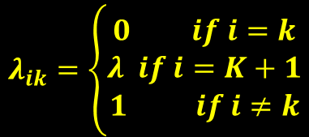

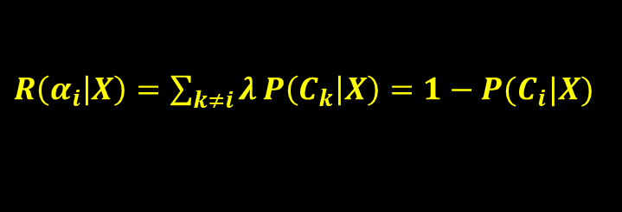
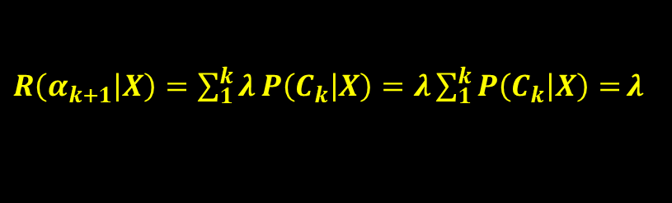
Loss function and Doubt Cases
In some applications wrong decisions—misclassifications— may have very high cost
$C_{k+1}$ class is chosen i.e. reject (non-existent class is chosen)
In such a case, we define an additional action of reject or doubt
where $0<λ<1$is the loss incurred for choosing the ${\left(K+1\right)}^{st}$action of reject
And risk of choosing $C_{i}$ class
$$λ_{ik}=\left\{\begin{aligned}0 if i=k \\ λ if i=K+1 \\ 1 if i≠k\end{aligned}\right.$$
$R\left(α_{k+1} | X\right)=\sum_{1}^{k}{λ}P\left(C_{k} | X\right)=λ\sum_{1}^{k}{P\left(C_{k} | X\right)=}λ$
$R\left(α_{i} | X\right)=\sum_{k≠i}{λ}P\left(C_{k} | X\right)=1−P(C_{i}|X)$

Slide 15

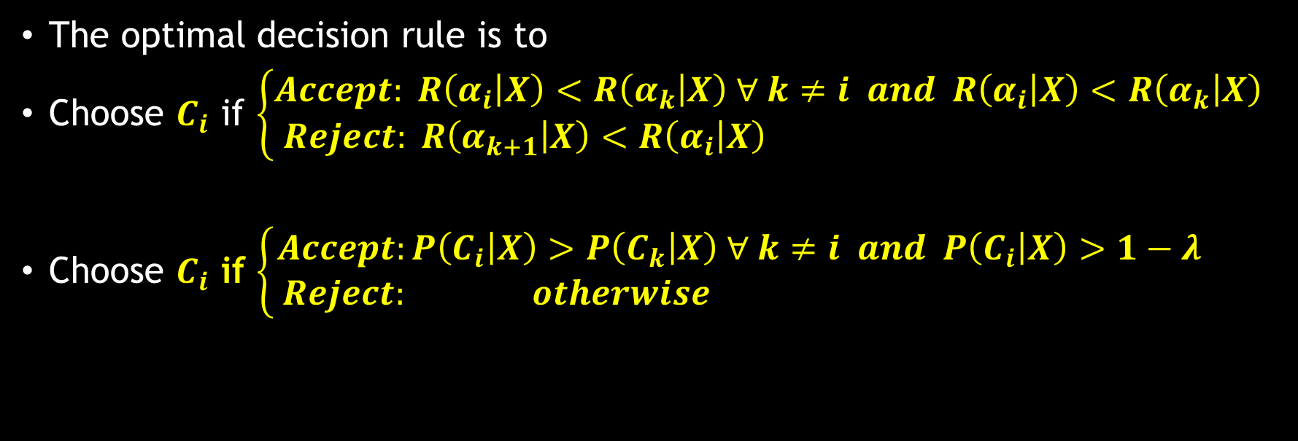
Loss Function
$$\begin{aligned}λ_{ik}=\left\{\begin{aligned}\begin{aligned}0 if i=k \\ λ if i=K+1 \\ 1 if i≠k\end{aligned}\#\#\end{aligned}\right.\#\left(1\right)\end{aligned}$$
The optimal decision rule is to
Choose $C_{i}$ if $\left\{\begin{aligned}Accept: R\left(α_{i} | X\right)<R\left(α_{k} | X\right) ∀ k≠i and R\left(α_{i} | X\right)<R\left(α_{k} | X\right) \\ Reject: R\left(α_{k+1} | X\right)<R\left(α_{i} | X\right) \end{aligned}\right.$
Choose $C_{i}$ if $\left\{\begin{aligned}Accept:P\left(C_{i} | X\right)>P\left(C_{k} | X\right) ∀ k≠i and P\left(C_{i} | X\right)>1−λ \\ Reject: otherwise \end{aligned}\right.$
This whole approach is meaningful if 0 < λ < 1
If λ = 0, we always reject; a reject is as good as a correct classification
If λ ≥ 1, we never reject; a reject is as costly as, or costlier than, an error

Slide 16
3.4 Discriminant Functions

Slide 17
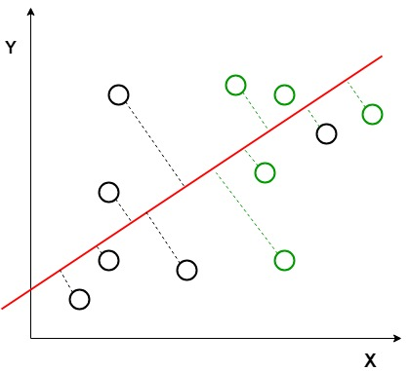

Discrimination Function
Classification can also be seen as implementing a set of discriminant functions
$g_{i}\left(x\right), i=1,2,3,4,,k$ such that
Choose $C_{i} if g_{i}\left(x\right)=\max_{k}{g_{k}\left(x\right)}$
Bayes’ classifier can be represented as $g_{i}\left(x\right)=−R(α_{i}|x)$
maximum discriminant function corresponds to minimum conditional risk
When we use the 0/1 loss function, we have
$g_{i}\left(x\right)= P\left(C_{i} | x\right)=P\left(x | C_{i}\right)P(C_{i})$ by ignoring common normalizing term $p(x)$

Slide 18
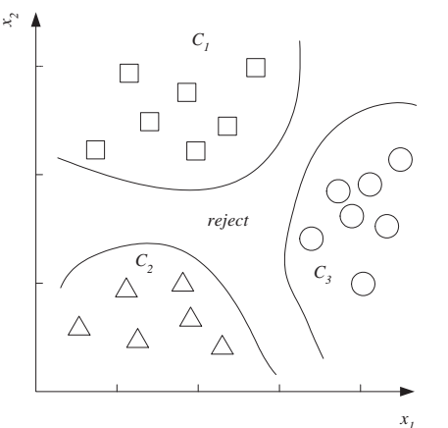
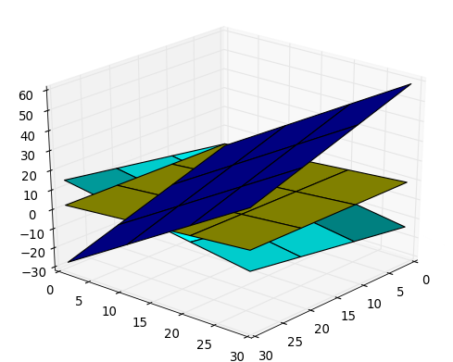

Decision Regions
Divide the feature space into k decision regions
$R_{1}, R_{2}, R_{3},…,R_{n}$
The regions are separated by decision boundaries
Lines in plane
Planes in space
When K = 2, the classification system is a dichotomizer
K ≥ 3, it is a polychotomizer

Slide 19



Thanks for watching
Dr. Sajid Iqbal
Assistant Professor
Department of Computer Science
Bahauddin Zakariya University, Multan
sajidiqbal.pk@gmail.com
https://github.com/sajjo79/Design_and_Analysis_of_Algorithms
Allah Hafiz
COMEDXD

Slide 20
Assignments

