Slide 1
Case Study 1: Beer
By: Rob Burigo and Satvik Ajmera
Ds 6306 – Spring 2021
03/04/21

Slide 2
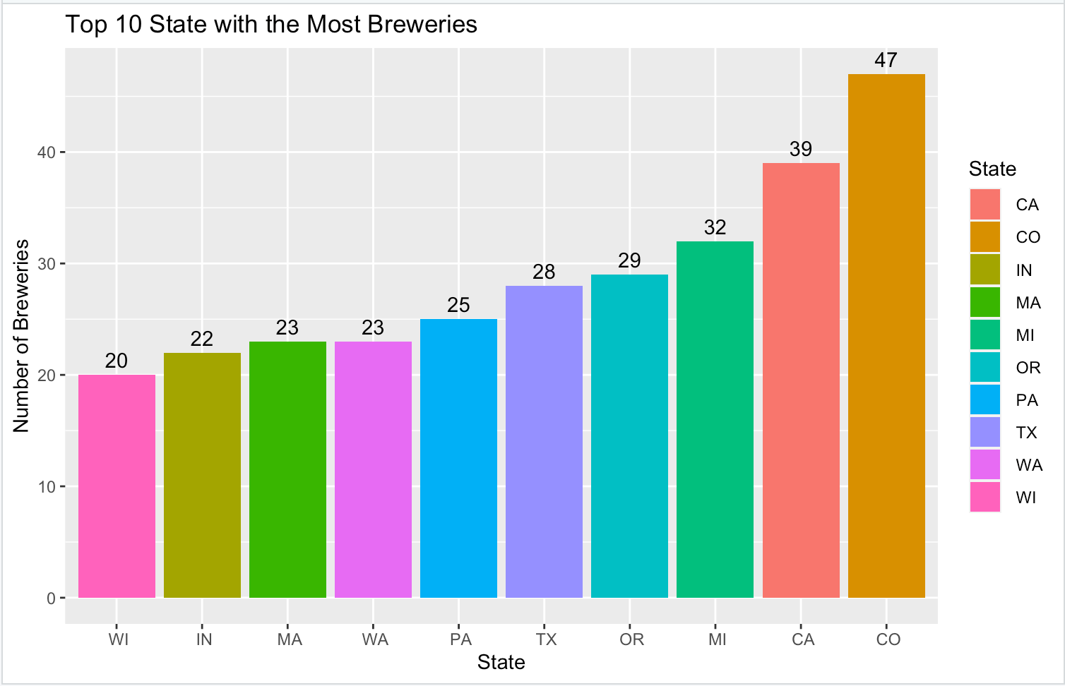
The Number of Breweries Per State
While calculating the breweries per state, it is more beneficial to show the top 10.
The state with the highest number of breweries is Colorado with 47.
California is second with 39.
Michigan is third with 32.

Slide 3
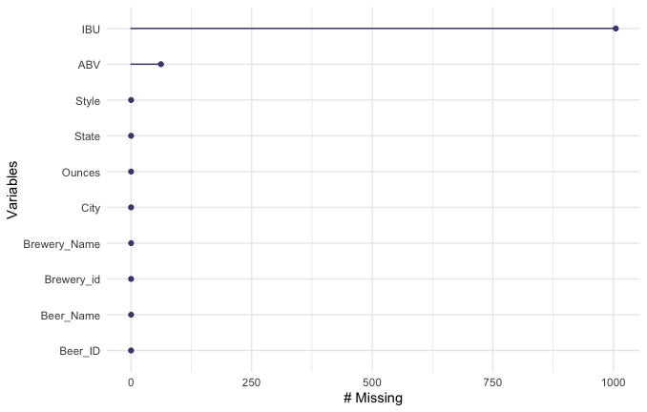
Addressing the Missing Values
After merging the beer and breweries dataset, we found the sum of missing values for each column.
There are 1005 missing values in the `IBU` column and 25 missing values in the `ABV` column.
Proceeding forward, we removed all rows containing these missing values.

Slide 4
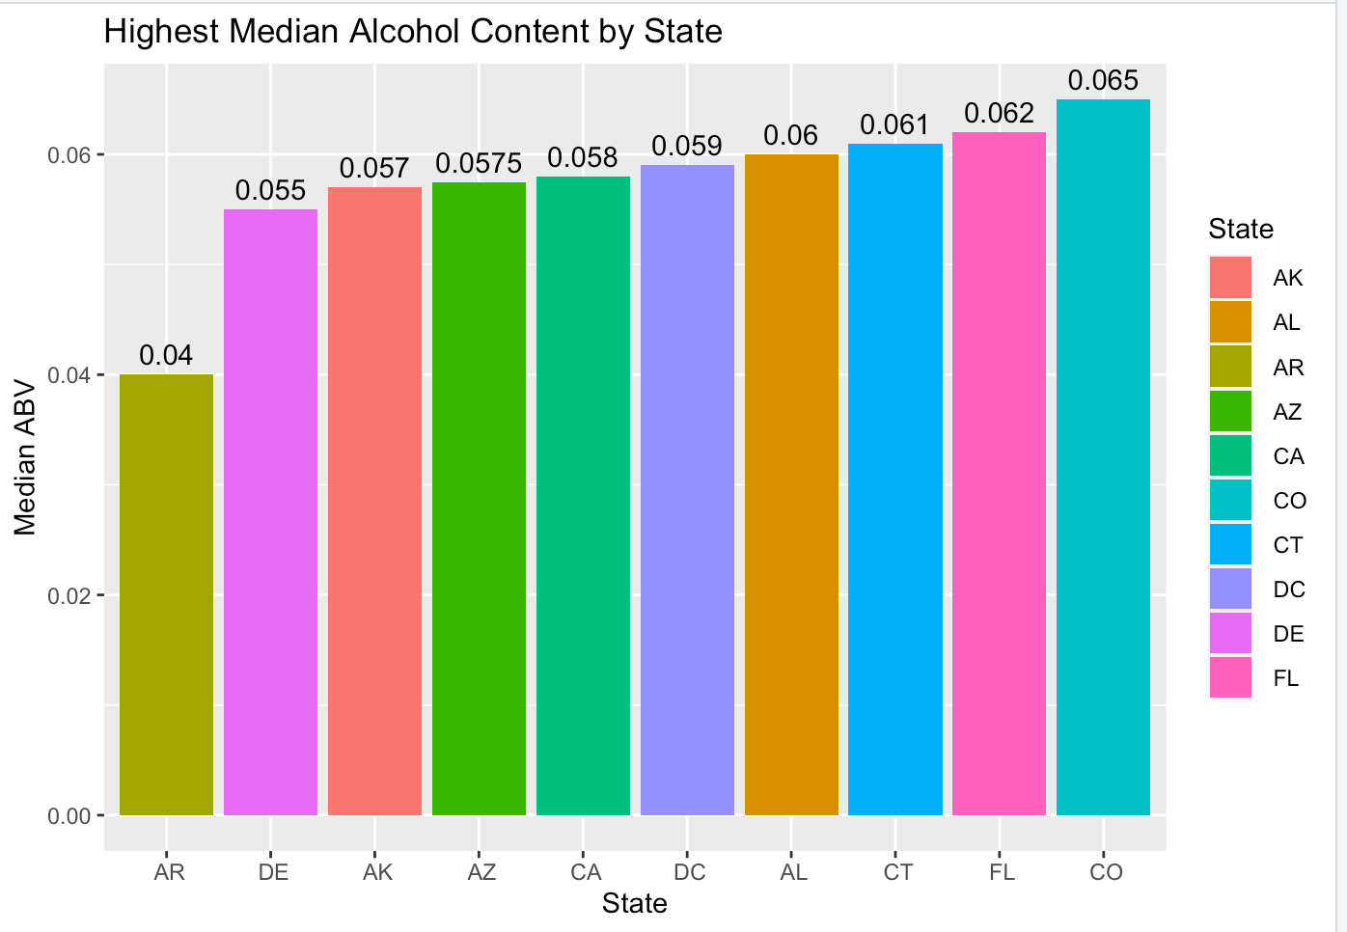
Median ABV Per State
We focused on the top ten states with the highest median alcohol content.
The state with the highest median ABV is Colorado with 6.5%, followed by Florida with 6.2% and Connecticut with 6.1%.
If we plan on making beer with high alcohol content with should sell to these states.

Slide 5
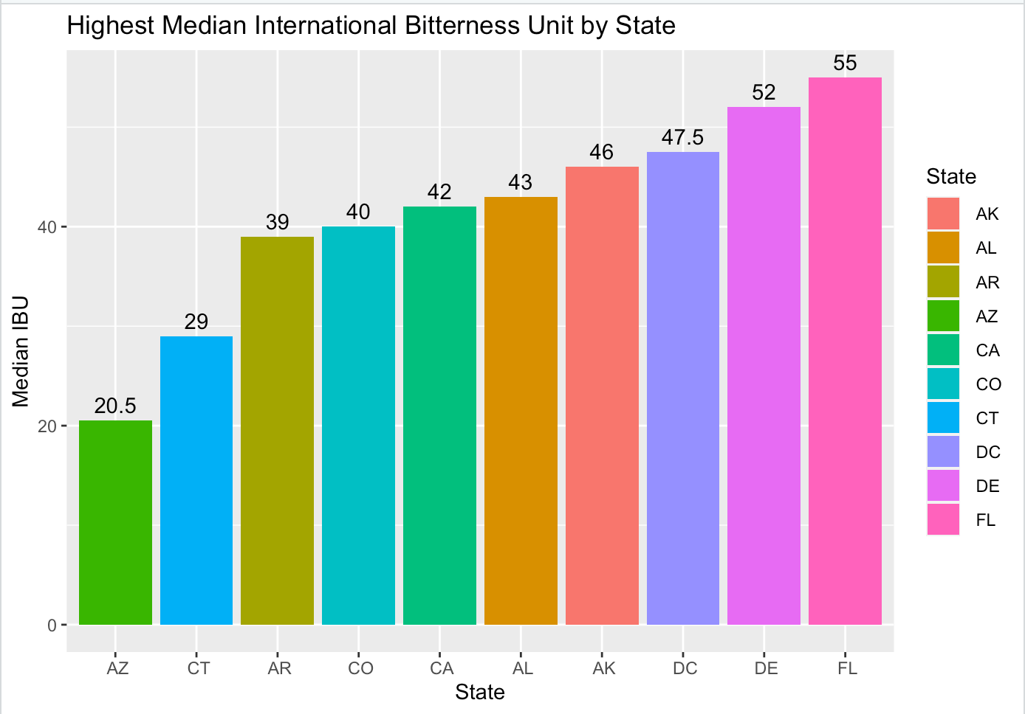
Median IBU Per State
We focused on the top ten states with the highest median international beer units.
The state with the highest median IBU is Florida with 55, followed by Delaware with 52 and District of Columbia with 47.5

Slide 6
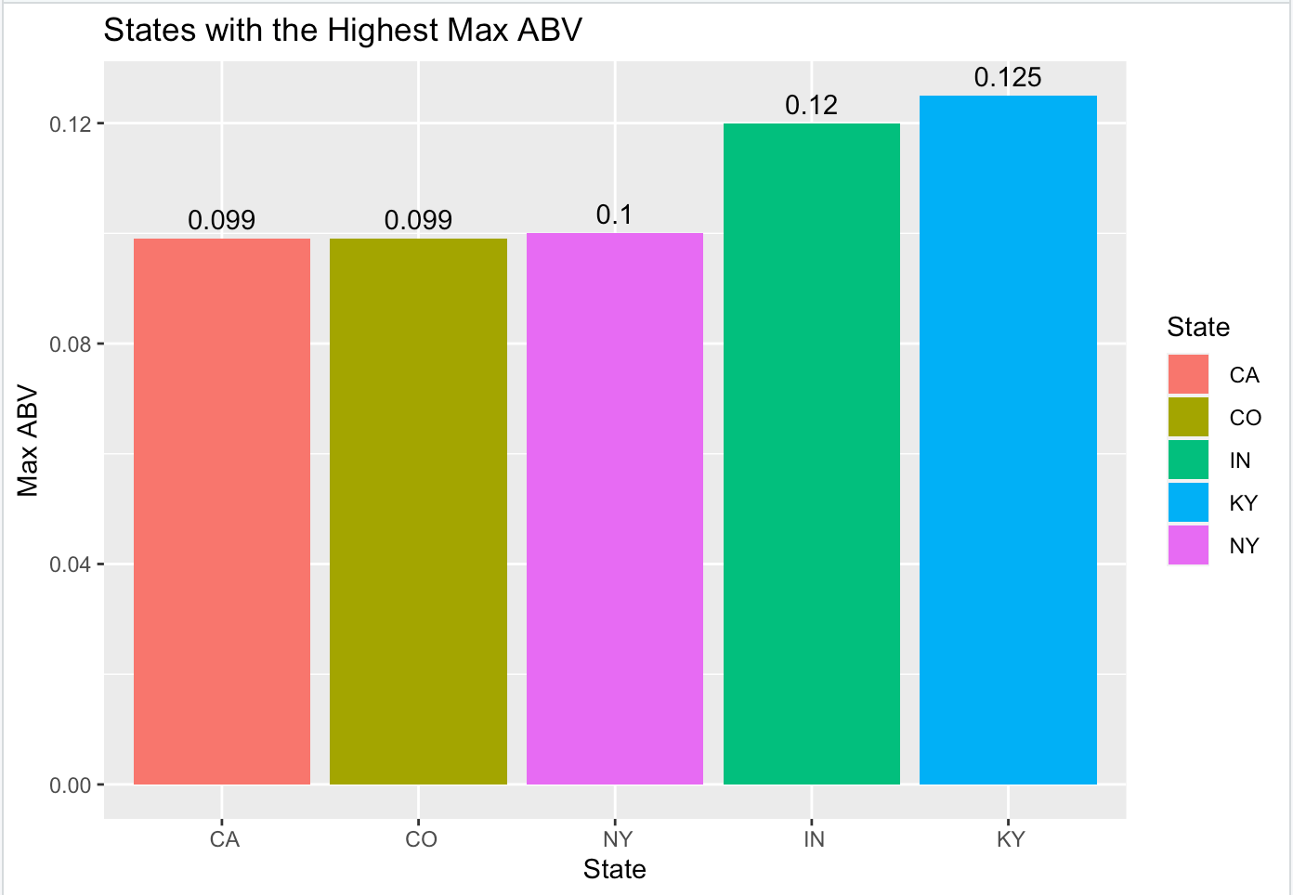
Maximum ABV Per State
Kentucky has the maximum alcohol beer with an ABV of 12.5%.
Indiana is second with 12%.
New York is third with 10%.

Slide 7
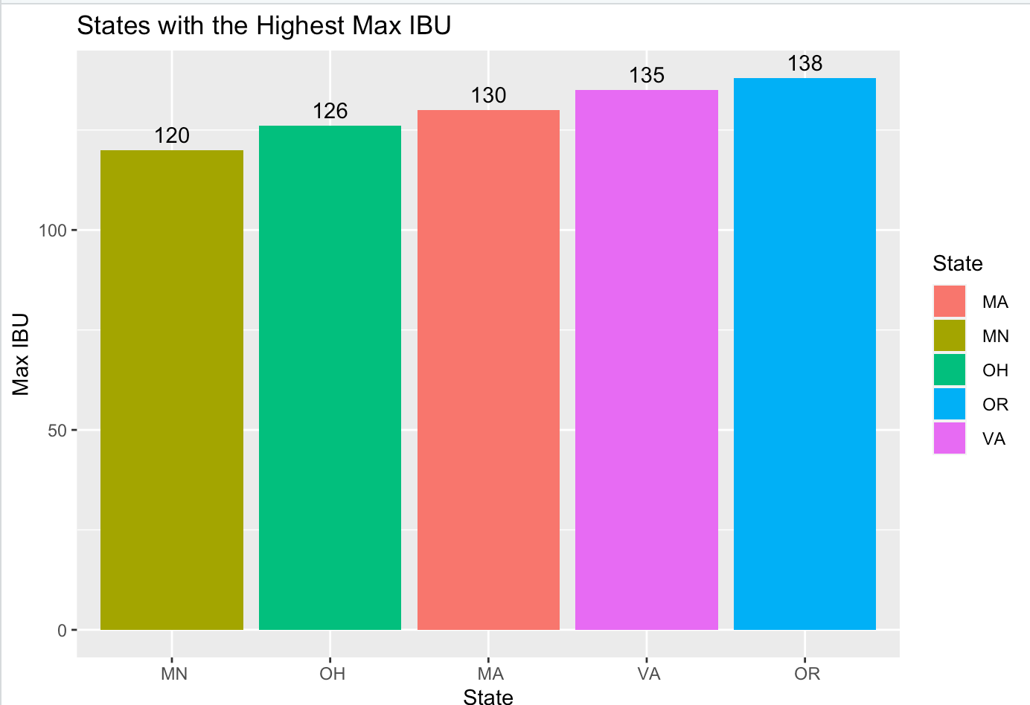
Maximum IBU Per State
Oregon has the most bitter beer with an IBU of 138.
Virginia has the second most bitter beer with an IBU of 135.
Massachusetts has the third most bitter beer with an IBU of 130.

Slide 8
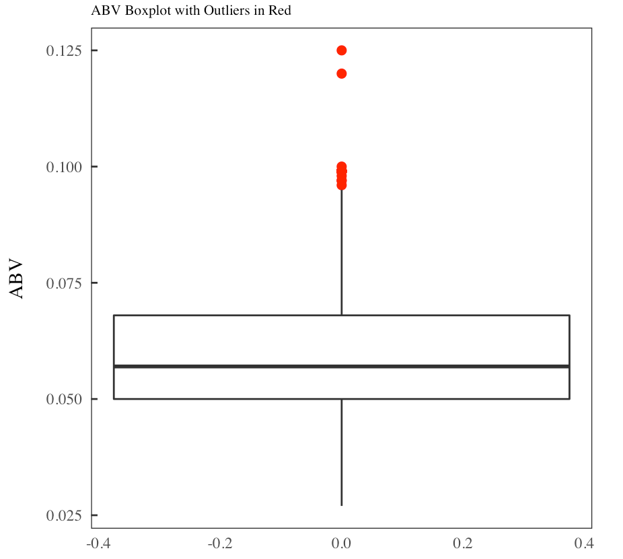
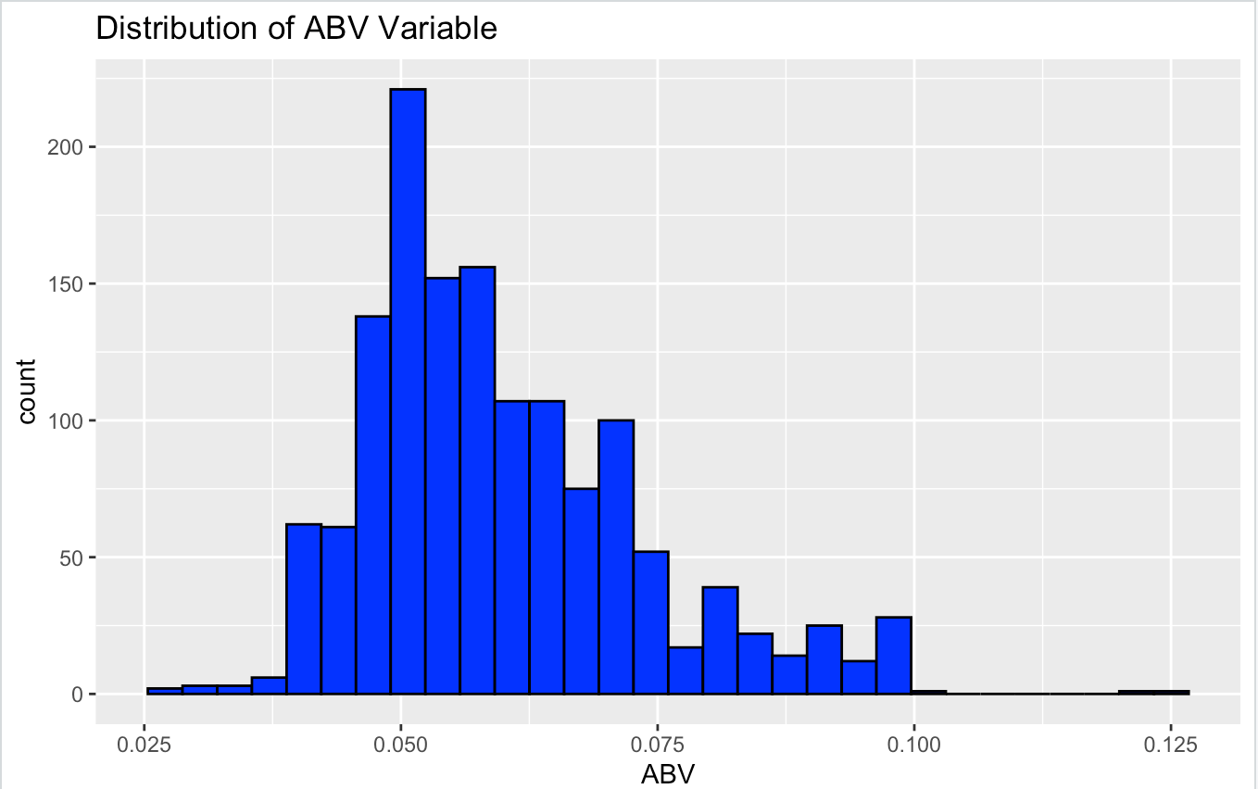
Summary statistics and Distribution of the ABV
The distribution of ABV appears to be right-skewed.
The maximum is 12.5% ABV, while the minimum is 2.5% ABV
It appears the most common ABV is about 5%.
There are some outliers that are contributing to the right skewness of ABV.

Slide 9
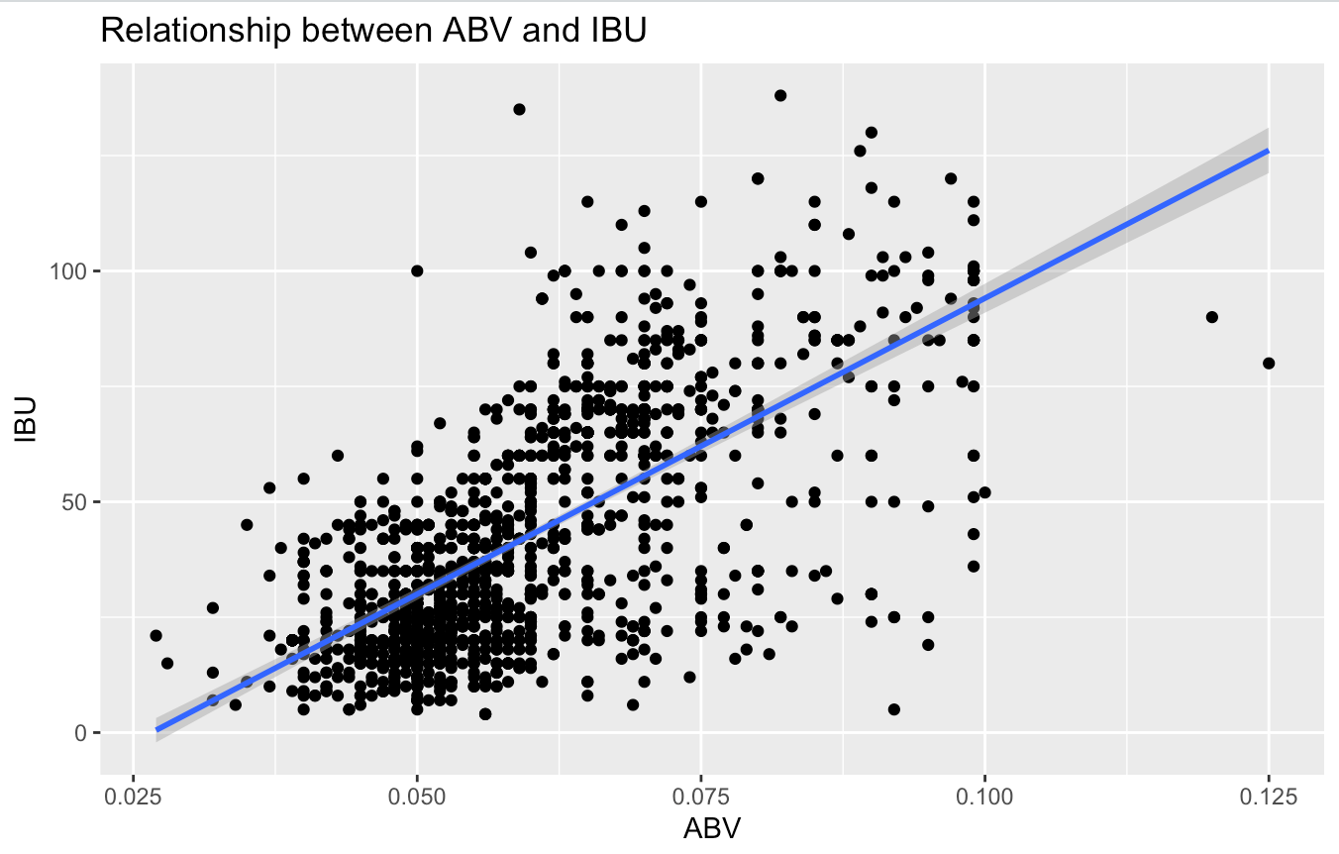
Relationship between ABV and IBU
The scatterplot to the right shows the relationship between IBA and ABV.
Just looking at the plot there is evidence of a positive relationship between ABV and IBU. Meaning if you have a beer with higher IBU it is likely to have a higher ABV (and vice-versa).
Additionally, we plotted the linear regression line to prove even further of the positive relationship (slope of line is positive).

Slide 10
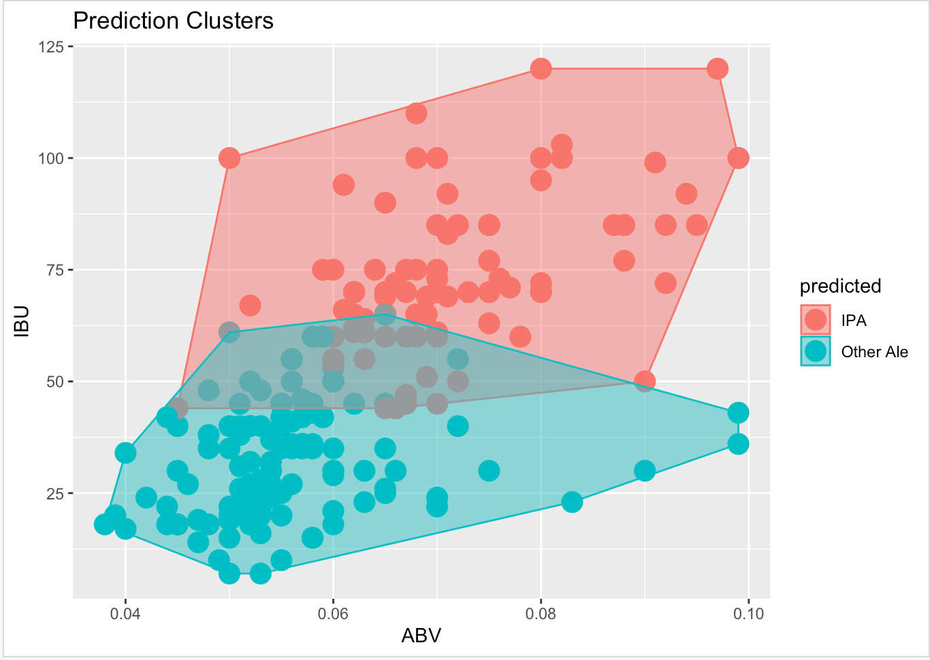
Understanding IBU and ABV: Using the Knn Classifier
Problem statement:
We want to investigate how a KNN classifier can be used to predict India Pales Ales and other Ales.
Step 1: Tidying the Data
Using string functions to find and rename all Ales to “Other Ales”, find and rename all IPAs to “IPA.
Then, filter out other types of beers
Using the KNN Classifier (with 75%-25% Training-Test Split)
After running a loop with different train/test splits, we found that our best k is 5.
We were able to predict India Pale Ales and other Ales with an accuracy of approximately 84.75%

Slide 11
Using KNN to Predict Which Region our beer Comes from

Slide 12
The End

