Slide 1
Case Study 1: Beer
By: Rob Burigo and Satvik Ajmera
Ds 6306 – Spring 2021
03/06/21
Satvik’s Youtube Presentation: https://youtu.be/qmtEkoYRh-s
Rob’s youtube Presentation: https://www.youtube.com/watch?v=XdspTMDJiMM
Notes:
Hi, I’m Satvik Ajmera. Today, we’re taking a deep dive into the beer and breweries dataset by answering some questions of interest and using these insights to make better beer.

Slide 2
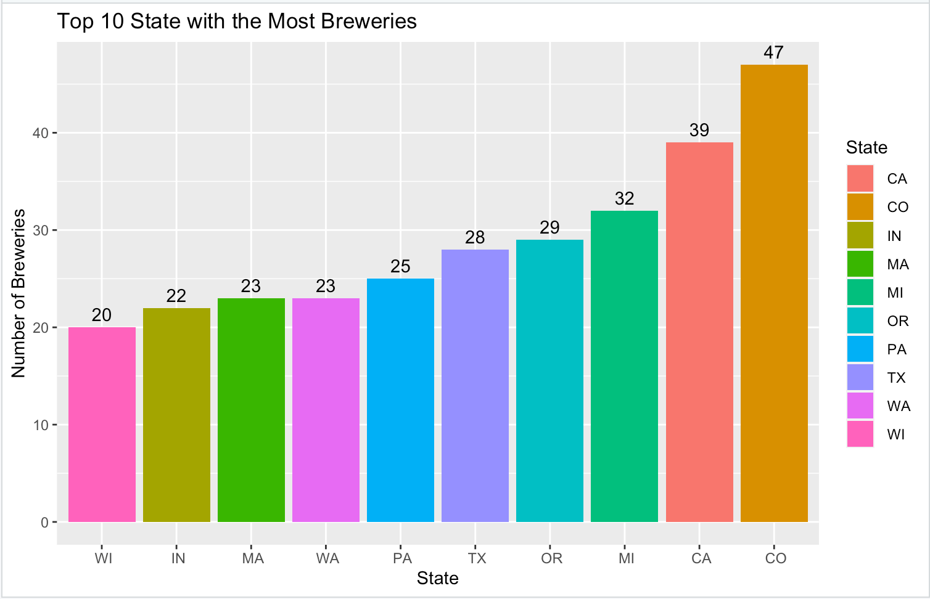
The Number of Breweries Per State
While calculating the breweries per state, it is more beneficial to show the top 10.
The state with the highest number of breweries is Colorado with 47.
California is second with 39.
Michigan is third with 32.

Slide 3
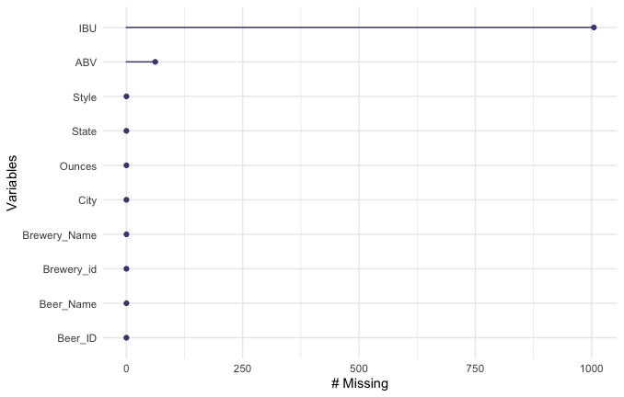
Addressing the Missing Values
After merging the beer and breweries dataset, we found the sum of missing values for each column.
There are 1005 missing values in the `IBU` column and 25 missing values in the `ABV` column.
Proceeding forward, we removed all rows containing these missing values.

Slide 4
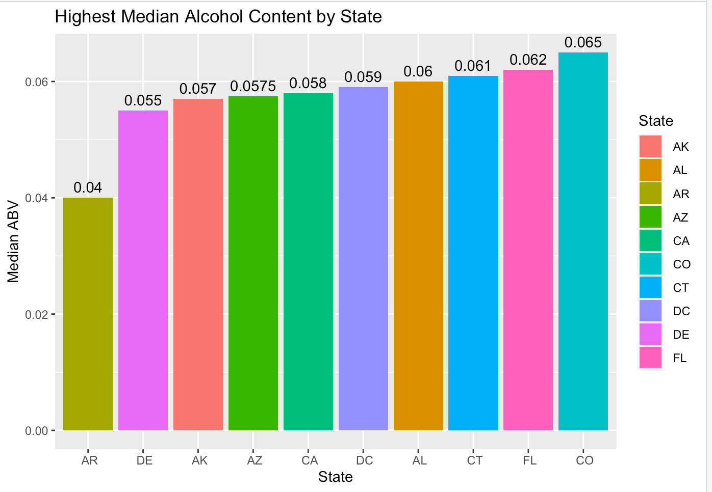
Median ABV Per State
We focused on the top ten states with the highest median alcohol content.
The state with the highest median ABV is Colorado with 6.5%, followed by Florida with 6.2% and Connecticut with 6.1%.
If we plan on making beer with high alcohol content with should sell to these states.

Slide 5
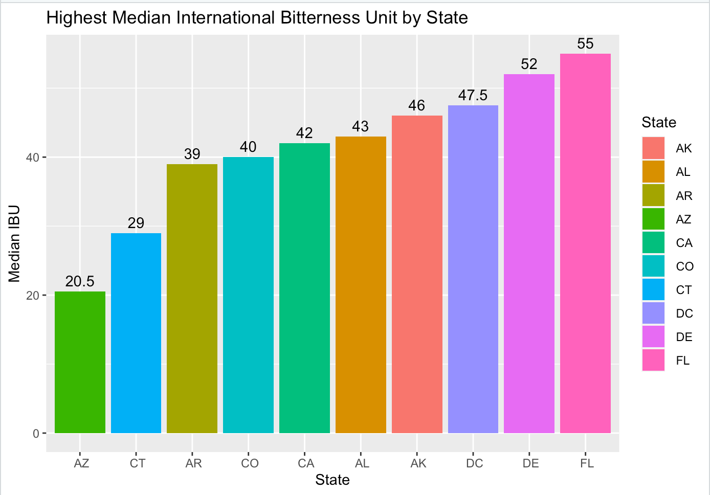
Median IBU Per State
We focused on the top ten states with the highest median international beer units.
The state with the highest median IBU is Florida with 55, followed by Delaware with 52 and District of Columbia with 47.5

Slide 6
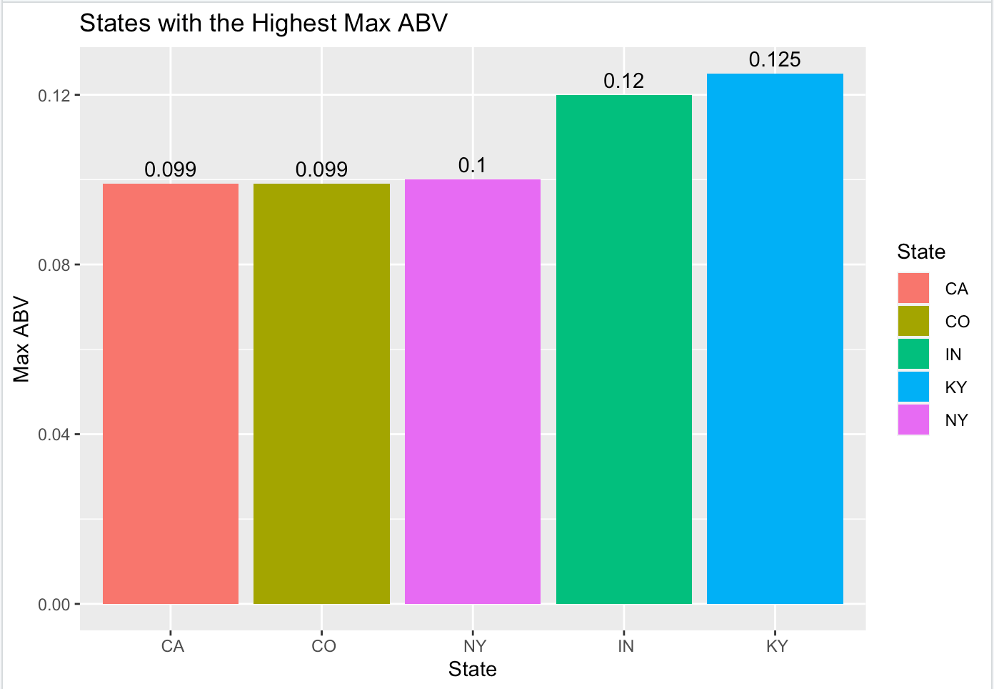
Maximum ABV Per State
Kentucky has the maximum alcohol beer with an ABV of 12.5%.
Indiana is second with 12%.
New York is third with 10%.

Slide 7
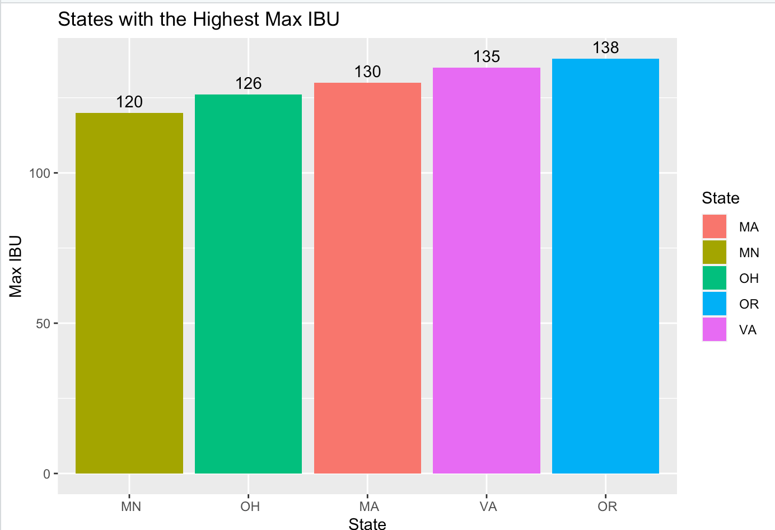
Maximum IBU Per State
Oregon has the most bitter beer with an IBU of 138.
Virginia has the second most bitter beer with an IBU of 135.
Massachusetts has the third most bitter beer with an IBU of 130.

Slide 8
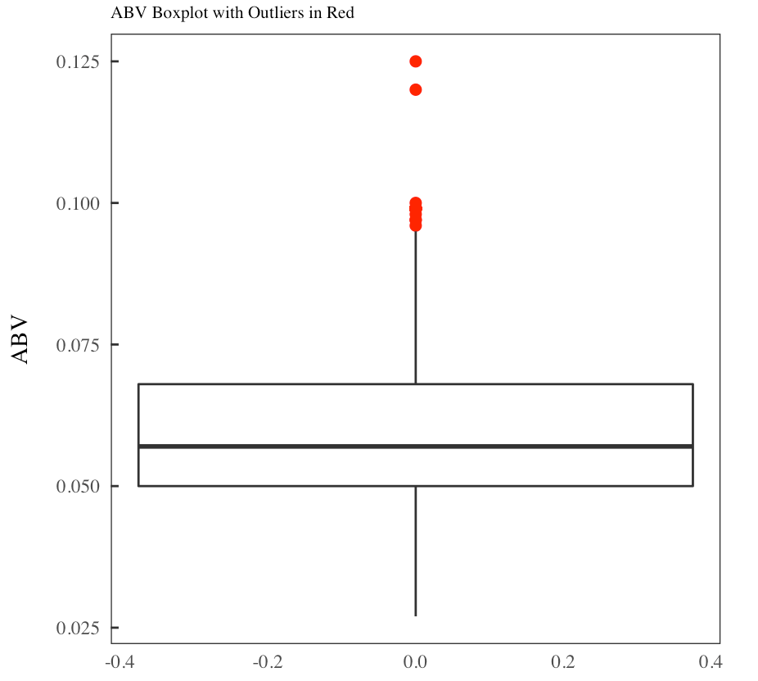
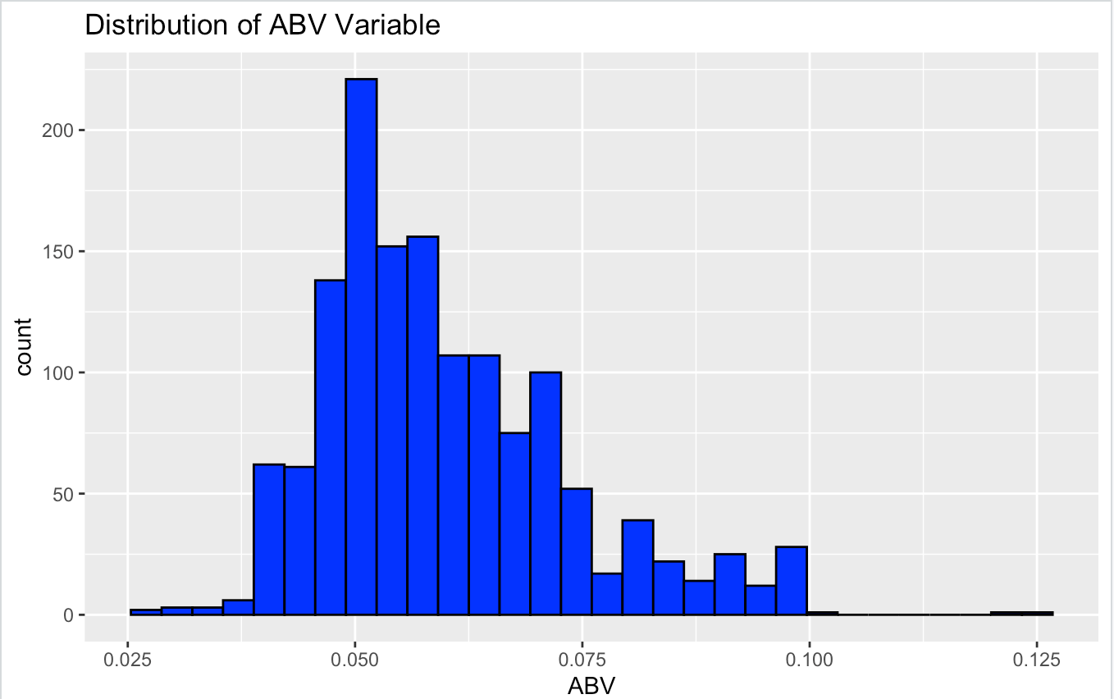
Summary statistics and Distribution of the ABV
The distribution of ABV appears to be right-skewed.
The maximum is 12.5% ABV, while the minimum is 2.5% ABV
It appears the most common ABV is about 5%.
There are some outliers that are contributing to the right skewness of ABV.

Slide 9
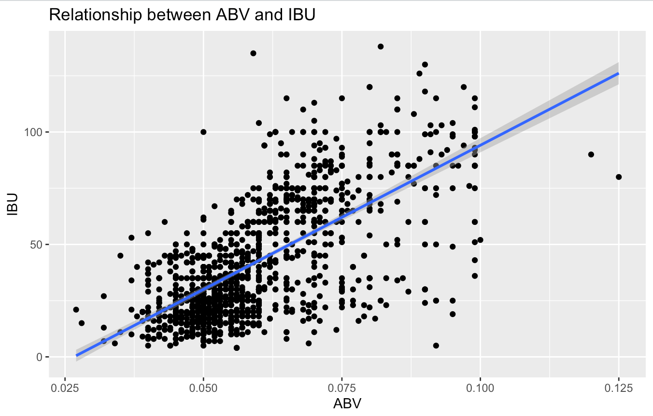
Relationship between ABV and IBU
The scatterplot to the right shows the relationship between IBU and ABV.
Just looking at the plot there is evidence of a positive relationship between ABV and IBU. Meaning if you have a beer with higher IBU it is likely to have a higher ABV (and vice-versa).
Additionally, we plotted the linear regression line to prove even further of the positive relationship (slope of line is positive).
Key Takeaway:
Those who want bitter beer would also want high alcohol content in their beer.

Slide 10
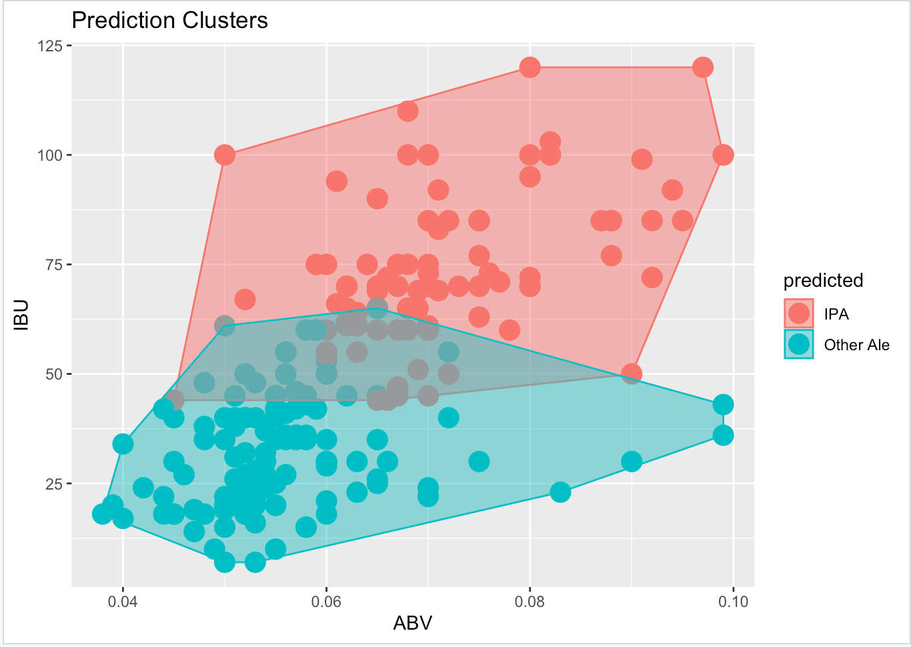
Understanding IBU and ABV: Using the Knn Classifier
Problem statement:
We want to investigate how a KNN classifier can be used to predict India Pales Ales and other Ales.
Step 1: Tidying the Data
Using string functions to find and rename all Ales to “Other Ales”, find and rename all IPAs to “IPA.
Then, filter out other types of beers
Using the KNN Classifier (with 75%-25% Training-Test Split)
After running a loop with different train/test splits, we found that our best k is 5.
We were able to predict India Pale Ales and other Ales with an accuracy of approximately 84.75%
Takeaways
The graph on the right plots the predictions based on ABV and IBU.
While both predictors appear to influence IPA vs Other Ale, visually we can see that IBU has a slightly stronger effect.

Slide 11
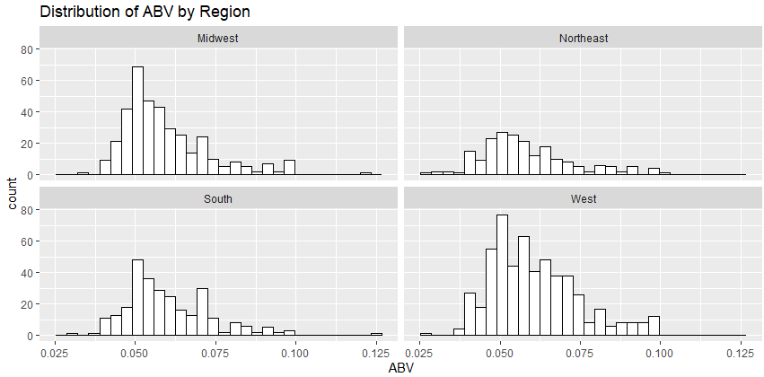
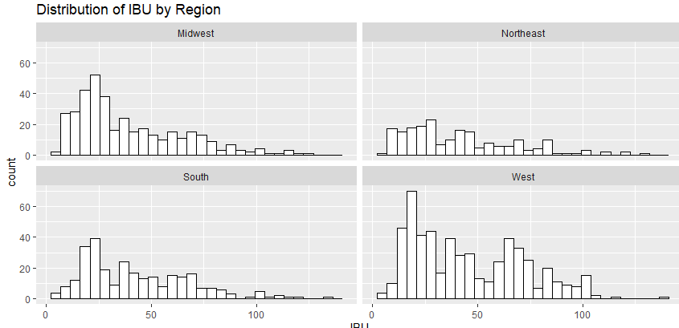
Explore the Relationship between ABV/IBU and Region of the Beer
This is an important question to answer as it will enable sales/operations to scale based on region
If we know the approximate components of a beer in specific regions, it will help understand what that region expects in a beer.
On the right there is the histogram of both ABV and IBU by region.
ABV appears to follow a somewhat normal distribution among regions with the most common being around .06
IBU appears to follow a right skewed distribution among regions with the most common being around 20.
To conclude, just looking at the distributions of ABV and IBU, components of a beer don’t appear to differ based on region.

Slide 12
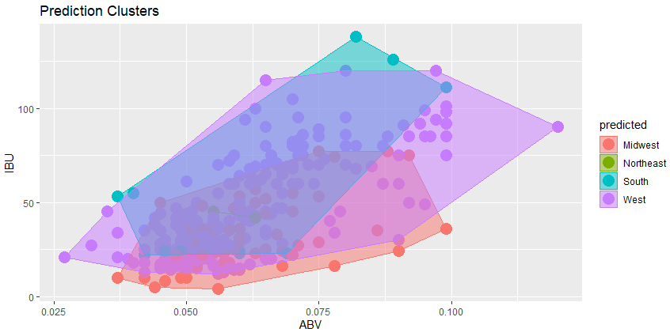
Understanding the Region: Prediction Region with KNN
Problem statement:
We want to investigate how a KNN classifier can be used to predict the Region of the Beer.
Step 1: Tidying the Data
Trim whitespace in the State field in order to be able to match state to region
Using lists and string functions, add a column to the data set that shows what region the beer is from (based on state of brewery)
Using the KNN Classifier (with 75%-25% Training-Test Split)
After running a loop with different train/test splits, we found that our best k is 30.
We were able to predict Region with an accuracy of approximately 42.17%
This is a slight improvement over 25% (random guessing).
Takeaways
While there is some increased ability to predict the region of a beer based on ABV and IBU, we still are not that accurate. Marketing and Operations don’t need to differ based on region (for ABV and IBU).
The Northeast region has potential for market penetration due to having no unique characteristics. This means there is a change to establish a unique beer to the region with a strong brand

Slide 13
The End

