Slide 1
Doing Data Science: Case Study 2
Satvik Ajmera
MSDS 6306
04/17/21
Notes:
Hi, I'm Satvik and today, our client, DDS Analytics would like learn more about the key factors that lead to attrition.
Then, we will use machine learning to build two models that predict Attrition and Salary.
Lets dive into it.

Slide 2
About the Data
There are 870 observations and 36 features. There are no missing values in the dataset.
Each employee has an observation.
Some features are ordinal such as Job Satisfaction, and Environment Satisfaction. For example, Performance Rating is on a scale of 1 to 4 (Assuming 4 is the best)
Other features can be categorical variables like Attrition (Yes or No), Gender (Male or Female), and Marital Status (Divorced, Married or Single).
There are continuous variables that include Monthly Income (in dollars), Total Years Worked, Distance From Home.
140 out of 870 employees or 16% of employees have left due to attrition.
So, what contributes to employees voluntarily leaving and why did these 140 employees leave?
Notes:
There are 870 observations and 36 features and no missing values in the dataset.
Each employee has a unique observation
consisting of ordinal, categorical and continuous features.
Each employee can have ordinal features like Performance Rating which is on a scale of 1 to 4.
Each employee can also have categorical features like attrition labelled “Yes” or “No” .
Finally each employee has a continuous variable such as Monthly Income or Distance from home.
Finally, its important to know that 140 of 870 employees of 16 percent of employees have left due to attrition.
Proceeding forward, we’ll explore why employees could have left due to attrition.

Slide 3
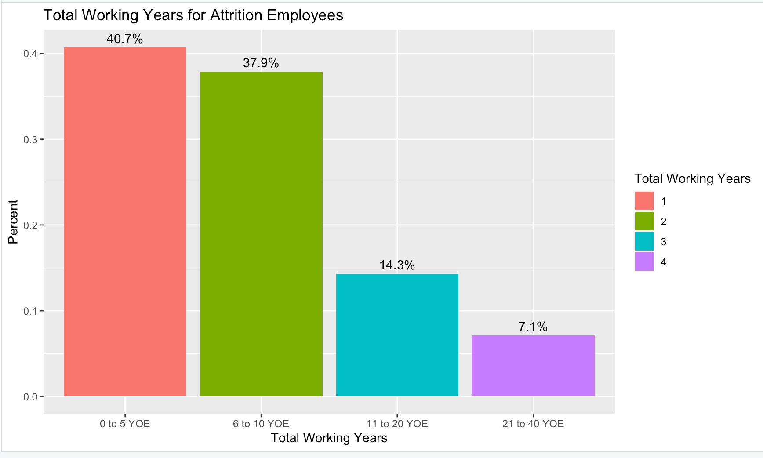
Looking at The Total Working years of Attrition Employees
40.7% of the employees that due to attrition have between 0 to 5 total working years.
78.6% percent of employees that left have 0 to 10 total working years.
Attrition employees with lower experience are more likely to leave.
Notes:
Here is a visualization of the total working years of the attrition employees.
We can see that 40.7% of employees have only 0 to 5 total working years.
Collectively, over 78% of employees have 0 to 10 total working years.
So key takeaway here is that employees with lower experience are more likely to leave

Slide 4
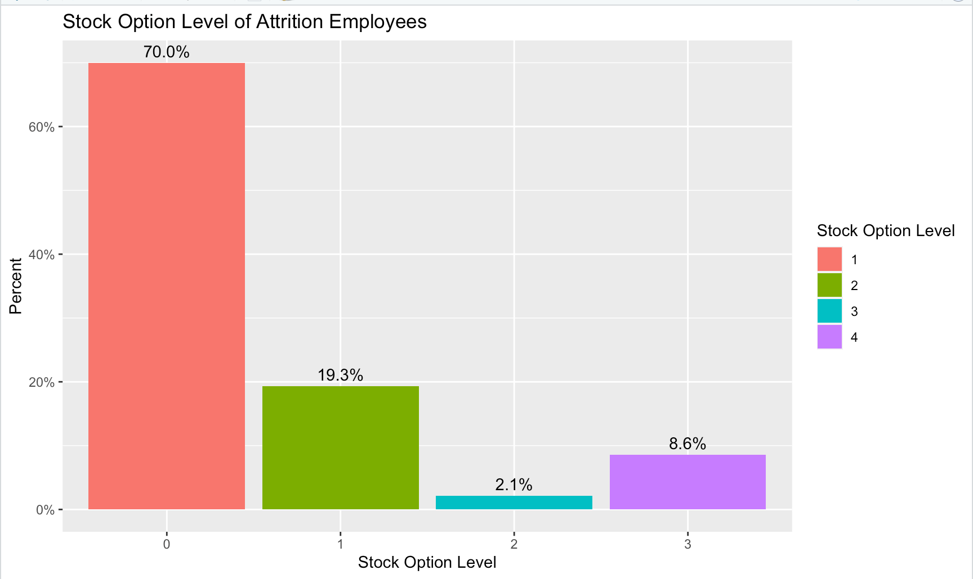
Stock Option Level’s Impact on Employee Attrition
70% of employees have no stock options.
In other words, 98 out of 140 employees didn’t have stock options.
To better retain talent, giving employees more stock options is a good strategy moving forward.
Notes:
Here is a visualization of the stock option level for attrition employees.
70% attrition employees didn't any stock options.
To better retain talent, giving employees more stock options is a good strategy moving forward.

Slide 5
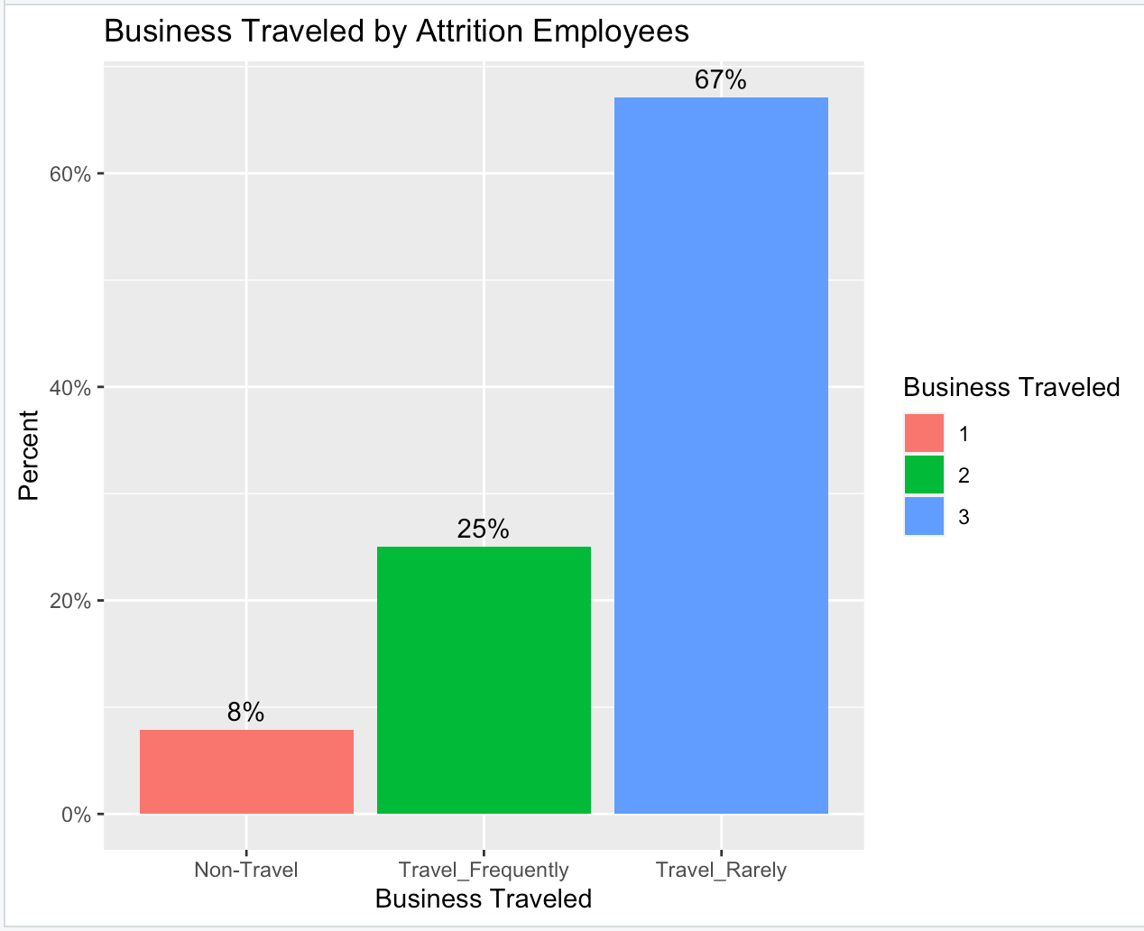
Can Business Travel explain Attrition?
8% of employees never travel for business.
(11 out of 140 employees)
25% of employees travel frequently for business
(35 out of 140 employees)
67% of employees travel rarely for business
(94 out of 140 employees)
To retain talent and prevent attrition in the future, it is important to consider the value of business travel.
Notes:
Here is visualization of the percent of business travel for attrition employees.
Over 67% attrition employees travel rarely for business.
To retain talent in the future, it is important to consider the value of business travel.

Slide 6
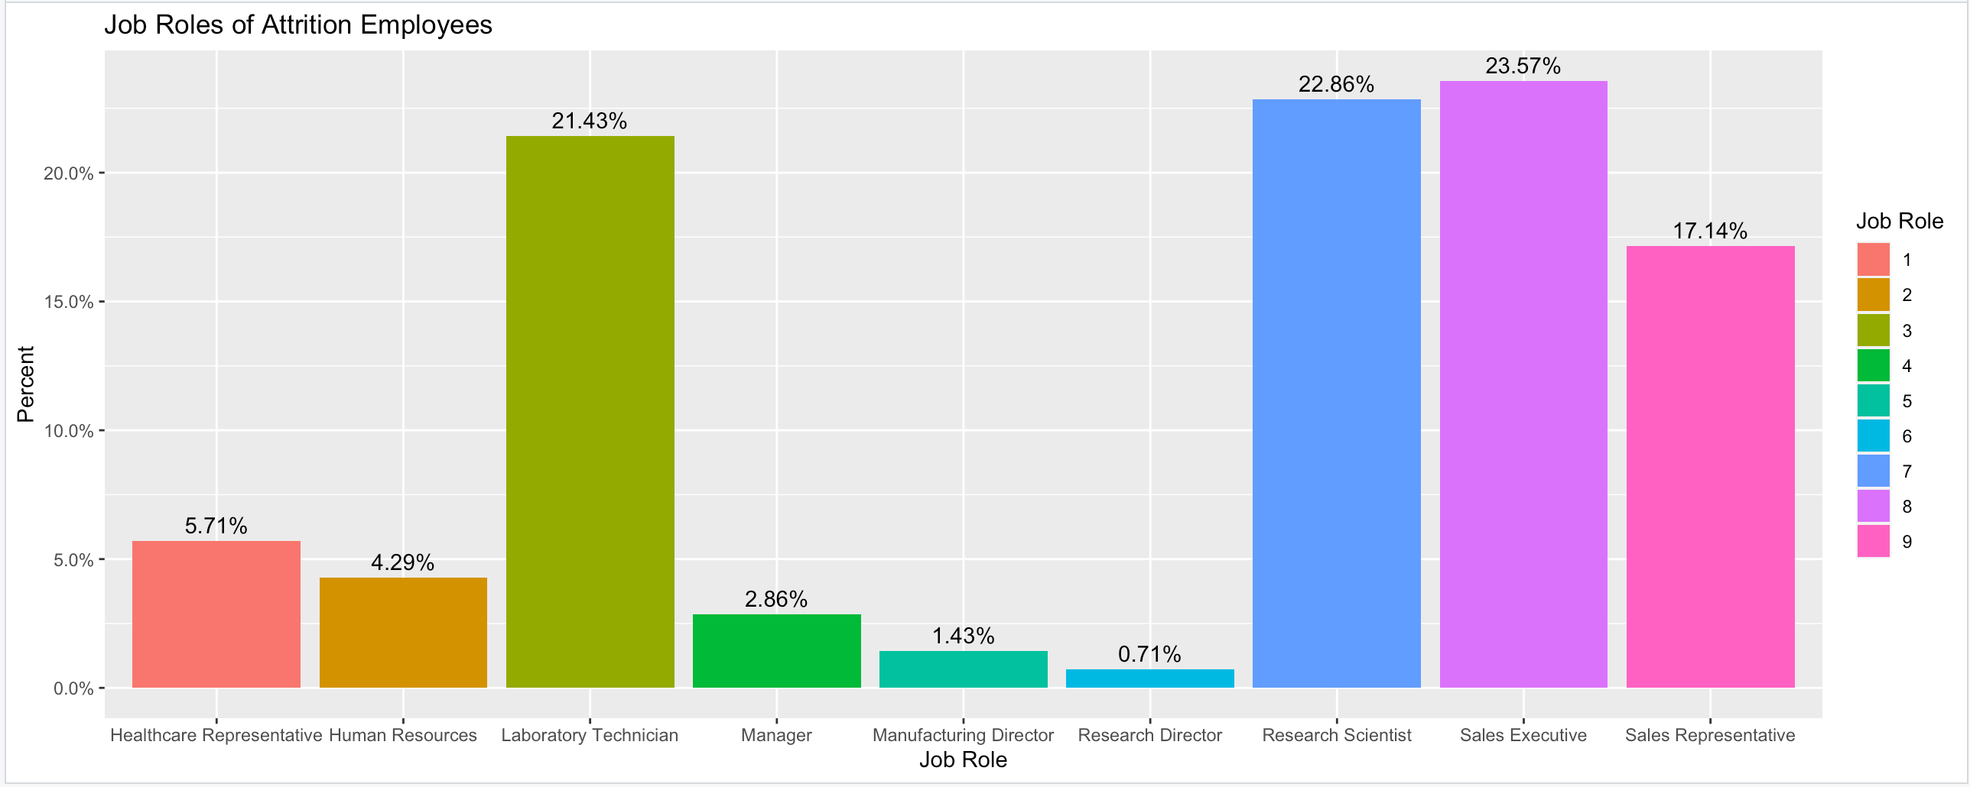
Importance of Job Role in Attrition
Laboratory Technician, Research Scientist, Sales Executive and Sales Representative job roles had the most turnover.
24 out of 29 or 82% of Sales Representatives left due to attrition.
Job Role is a great predictor of attrition.
Notes:
[read bullet one]
Important to note that 82% Sales Representative left due to attrition.
Job Role is great predictor of attrition.

Slide 7
Using Naïve Bayes to Predict Attrition
Problem statement:
We want to investigate how to predict attrition using the Naïve Bayes Classifier. We use specific features in our model to classify attrition employees as “Yes” and non-attrition employees as “No”.
Step 1: the Naïve Bayes Classifier (with 70%-30% Training-Test Split)
Using 20 features of 35 features to predict attrition. (List on the right)
Using different train/test splits, the model predicted attrition with a mean sensitivity of 85%, a mean specificity of 61%, and a mean accuracy of 81%.
Takeaways
We were able to remove 15 features from our model to increase the sensitivity and specificity.
Monthly Income, Job Role and Stock Option Level were noticeably important in improving sensitivity.
Age | Monthly Income
Business Travel | Number of Companies Worked
Daily Rate | Over Time
Education Field | Percent Salary Hike
Environment Satisfaction | Total Working Years
Hourly Rate | Training Times Last Year
Job Involvement | Work Life Balance
Job Level | Years At Company
Job Role | Years In Current Role
Stock Option Level | Years With Current Manager

Slide 8
Using Multiple Linear Regression to Predict Employee Salary
Problem statement:
We want to investigate how to predict Monthly Income for all employees. We build and fit a custom multiple linear regression model that aims for a RMSE of less than 3000.
Step 1: the Custom Multiple Regression Model
Using a backwards elimination of a p-value of 0.05, its was able to remove 25 variables.
The final model used Job Level, Job Role, Daily Rate, and Total Working Years.
Takeaways
The final model was able to predict salary with a RMSE of 984.3 and an adjusted R-squared of 0.9542.

Slide 9
The End

