Slide 1







Stack Overflow Developer Survey 2019​
SAJNA
25 dec 2022

Slide 2



OUTLINE
Executive Summary
Introduction
Methodology
Results
  Visualization – Charts
  Dashboard
Discussion
  Findings & Implications
Conclusion
Appendix

Slide 3

EXECUTIVE SUMMARY
The following slides summarize key findings from an analysis of data collected as part of the 2019 Stack Overflow Developer Survey. ​
Insights regarding the following:​
Most popular languages, databases, and other technologies​
Attitudes reflecting which technologies will become most popular in the future​
Demographics (e.g., the gender gap among developers)​

Slide 4

INTRODUCTION
Since 2011, the online programming knowledge sharing platform, Stack Overflow, has been conducting the Stack Overflow Annual Developer Survey.​
The primary objective of the annual surveys is to gather data regarding technology usage and trends among developers. ​
In this analysis, a subset of the 2019 dataset was examined (present dataset: N = 11, 398; original dataset N ≈ 90,000). ​
Audience: Developers (current and aspiring), HR professionals, educators, policy makers​

Slide 5

METHODOLOGY
Data Source: ​
2019 Stack Overflow Developer Survey ​
Data Wrangling: ​
A portion of the dataset (provided by IBM) was loaded and cleaned using SQL and Python’s panda library. ​
Cleaning procedure: ​
Duplicates removal, data imputation, data normalization .
Analysis & Visualization:​
EDA and data visualization were conducted using various Python libraries and Cognos. ​
Technologies (i.e., languages, databases, platforms, and web frames) used in 2019 .​
Demographics (i.e., gender, country, age, and education).​

Slide 6
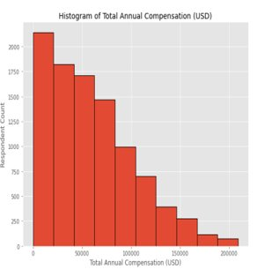
RESULTS:COMPENSATION&DEMOGRAPHICS​
First, descriptive statistics regarding demographics and total annual compensation were computed. ​​
Sample size after compensation outlier removal: N =10,519 (vs. before removal: N = 11,398). ​
The respondents had a median age of 29, and were predominantly male (i.e., 93.5% male vs. 6.5% female).​
Median compensation: $52,704 USD per year.​
Compensation and Age were positively correlated: r =40​​
Median compensation was higher for women: $54,956 than men: $52,339.​

Slide 7
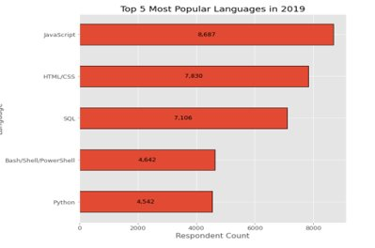
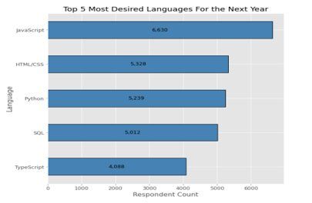
PROGRAMMING LANGUAGE TRENDS
Current Year
Next Year

Slide 8
PROGRAMMING LANGUAGE TRENDS - FINDINGS & IMPLICATIONS
Findings
Javascript ,SQL and HTML/CSS were the most popular in 2019 and will likely remain so the following year.​
Increasing interests in Python and TypeScript.​
Decreasing interest in PowerShell/Bash. ​
Implications
Web development is still in high demand, and Javascript and HTML/CSS remain the dominant languages, however, TypeScript may catch up in the future.​
SQL remains the preferred language for big data storage and querying it’s not likely to go away anytime soon. ​
Python’s rising popularity likely reflects the growth of AI and ML work.​

Slide 9
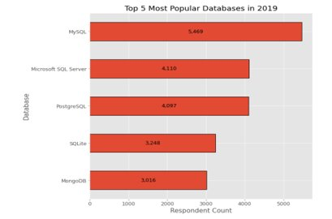
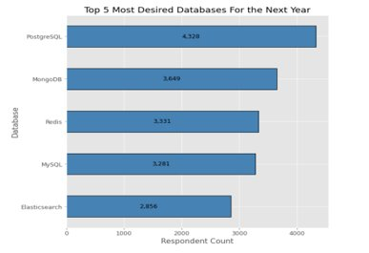
DATABASE TRENDS
Current Year
Next Year

Slide 10
DATABASE TRENDS - FINDINGS & IMPLICATIONS
Findings
SQL database programs were the most popular in 2019.​
PostgreSQL is gaining popularity over other SQL database programs, and it was the overall most desired database for the next year. ​
MongoDB was popular in 2019 and gaining interest. ​
Increasing interest in Elasticsearch. ​
Implications
There appears to be increasing developer preference toward open-source database programs. ​
NoSQL database programs are gaining popularity, which likely reflects a growing need to handle nonrelational and unstructured data. ​
Current and aspiring data analysts should develop competence in NoSQL in addition to SQL database programs.​

Slide 11

DASHBOARD
The following link contains the full, interactive Cognos dashboard summarizing (a) current technology use, (b) future technology trend, and (c) demographics of the survey respondents:
Click here to open the dashboard (https://dataplatform.cloud.ibm.com/dashboards/97264d4c-3e92-4b03-91e6-be8206b01309/view/441ef87f3b8e03d574ceb1e407cc2f5375372155b5bbd602848c7b495c347597f36913c7c8271809da145063f3eb165f98)

Slide 12
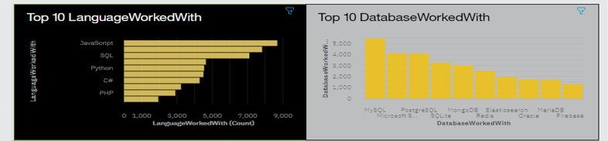
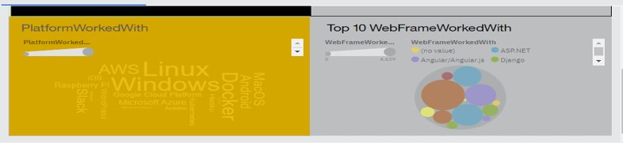
DASHBOARD1:CURRENT TECHNOLOGY USE

Slide 13
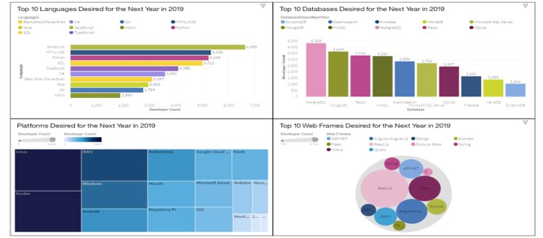
DASHBOARD2:FUTURE TECHNOLOGY TREND

Slide 14
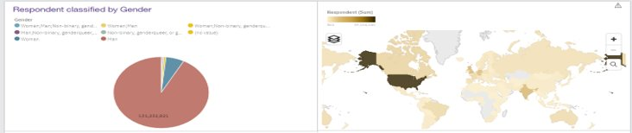
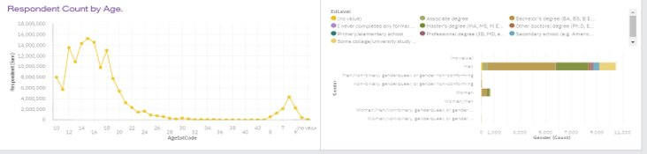
DASHBOARD3:DEMOGRAPHICS​

Slide 15
DISCUSSION
Taken together, the findings yield insights into the following questions: ​
What kinds of developer technologies are in top demand?​
Which technologies should prospective developers and data professionals be learning?​
Which technologies should educators place more emphasis on teaching in upcoming years? ​
What does the distribution of annual compensation for developers look like? ​
What is the developer demographic like? Is there a gender representation gap? ​

Slide 16
OVERALL FINDINGS & IMPLICATIONS
Findings
High usage and interest in Javascript and HTML/CSS remain high usage. There’s also increasing interest in Typescript.​
Increasing interest in Python.
High usage and interest in SQL. MySQL had the highest usage in 2019.​
NoSQL database programs gaining interest, of which MongoDB was the most used in 2019 and desired for the next year. ​
A severe gender representation gap (in favor of men), despite median compensation being slightly higher for women.
Implications
Web development is still in high demand. Current and prospective developers may consider picking up Typescript in addition to Javascript and HTML/CSS.​
To handle big data and perform AI and ML work, data professionals should continue to enhance SQL , also enhance competence with NoSQL database programs and Python.​
Policy makers, educators, and organizations should work to minimize the gender representation gap in addition to the technology divide between countries​

Slide 17

CONCLUSION
A subset of data collected as part of the 2019 Stack Overflow Developer Survey was examined. ​
Numerous insights finds into the technologies most used and desired by developers in addition to the developer demographic. ​
These insights should be particularly relevant for current and prospective developers aiming to remain competitive, businesses aiming to upskill their talent, educators in the field, and policy makers aiming to address gender and economic issues. ​

Slide 18
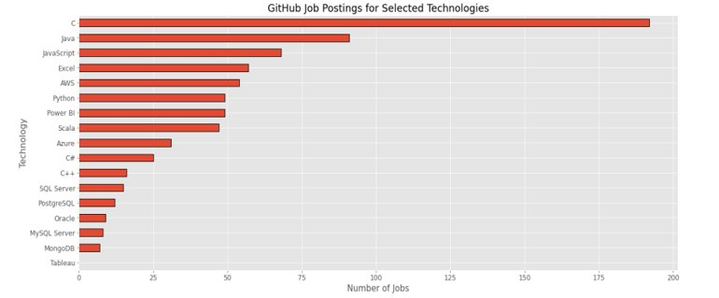
APPENDIX:JOB POSTINGS​

Slide 19
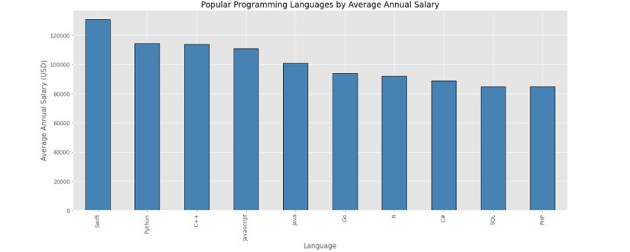
APPENDIX:POPULAR LANGUAGES​

