Slide 1
ETL Data Pipeline Using Distributed Streaming Platform
Group id: 01
Student id: 21166006 Name: Sazal Kanti Kundu

Slide 2
Title Slides | 01
Outline | 03
Introduction | 04
Literature Review | 08
Our Ideas | 10
Workflow | 12
Limitations | 13
Conclusion | 14
Reference Slides | 15
Project Proposal Presentation Outline

Slide 3
Introduction
01
02
03
Objective
Implementation of ETL data pipeline using distributed streaming platform like Kafka.
Motivation
Complex frameworks and proprietary system for building ETL data pipeline
Our Ideas
Building data pipeline with streaming platform that can stream and store data reliably and provide better throughput.

Slide 4
Objective
ETL components connected by Kafka
01
02
Components decoupled from each other
Producers and Consumers can be scaled independently
03
04
Build a pipeline that can move data faster

Slide 5
Motivation
ETL processes are complex
01
02
Complex frameworks
03
Proprietary software
04
Producers and consumers are tightly coupled
05
Scaling independently is hard

Slide 6
Motivation
Adopting micro-service based architecture is hard
06
Message queue can’t store messages after delivery
07
08
Requires other data stores
09
No support for stream processing
10
Message queues are not distributed by nature

Slide 7
Literature review
Theory 01
Proprietary ETL tools.
Theory 02
ETL solution based on MapReduce framework (Apache Hadoop) called ETLMR.
Theory 03
ETL solution based on CloudETL framework. Apache Hadoop for parallelizing ETL processes and Apache Hive for data processing

Slide 8
Literature review
Theory 04
P-ETL(Parallel ETL) platform based on Apache Hadoop frameworks. It provides a GUI to set the ETL process and the parallel/distributed environment.
Theory 05
Centralized ETL process approach and Distributed ETL process approach.

Slide 9
Our Ideas
Implementation of a system
Use kafka as a distributed streaming platform
Use kafka as a data store
Kafka will sit in between ETL components.

Slide 10
Our Ideas
Partition kafka topics and distribute across the cluster
Independent producer and consumer
Scaling producer and consumer based on the need

Slide 11
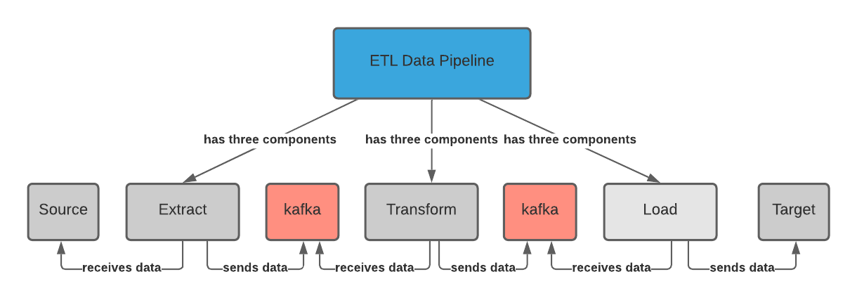
Workflow

Slide 12
Limitations
1. Requires ci/cd tools
2. Requires cloud infrastructure

Slide 13
Conclusion
ETL is the core component of decision support systems since all the data dedicated for analysis pass through this process
Implement ETL data pipeline using Kafka
The proposed idea decoupled ETL components and can be handled independently
Kafka acts as a buffer between the components which stores data reliably and stream data in real time.

Slide 14
References
X. Liu, C. Thomsen, and T. B. Pedersen, “Etlmr: a highly scalable di-mensional etl framework based on mapreduce,” in Data Warehousingand Knowledge Discovery. Springer, 2011, pp. 96–111.
S. Misra, S. K. Saha, and C. Mazumdar, “Performance comparison ofhadoop based tools with commercial etl tools–a case study,” in BigData Analytics. Springer, 2013, pp. 176–184.
1
3
C. Thomsen and T. Bach Pedersen, “pygrametl: A powerful pro-gramming framework for extract-transform-load programmers,” inProceedings of the ACM twelfth international workshop on Datawarehousing and OLAP. ACM, 2009, pp. 49–56.
M. Bala, O. Boussaid, and Z. Alimazighi “Big-ETL: Extracting-Transforming-Loading Approach for Big Data”
2
4

Slide 15
QUESTIONS

Slide 16
THANK YOU !
Toxic Comment Classification Implementing NLP and CNN
Combining Word Embedding Technique

