Slide 1
The Google File System
Sanjay Ghemawat, Howard Gobioff, and Shun-Tak Leung
Presented By
Sazal Kanti Kundu
Group no: 01
Student Id: 21166006

Slide 2
Introduction
GFS or Google File System is a distributed file system implemented by Google to meet their rapidly growing demands of data processing needs. GFS shares some of the same goals as previous distributed file systems such as performance, scalability, reliability, and availability. But GFS has been designed based on the observations of application work-loads and technological environments that reflect a marked departure from some earlier file system design assumptions.

Slide 3
Design assumptions
The system is built from many inexpensive commodity components that often fail.
The system stores a modest number of large files along with small files.
Multi-GB files are the common case and should be managed efficiently
The workloads primarily consist of two kinds of reads: large streaming reads and small random reads
The system must efficiently implement well-defined semantics for multiple clients that concurrently append to the same file
High sustained bandwidth is more important than low latency.

Slide 4
Architecture
Single master and multiple chunk servers
Files are divided into chunks of 64 MB
Clients talk with master for chunk locations.
Chunks are replicated across the chunk servers based on replication level
The master stores the meta data like file namespaces, file to chunk mapping, locations of each chunks, etc.
File namespaces and file to chunk mapping are kept persistent by logging mutations to an operation log.
The master scans through its in memory state periodically to implement garbage collection, re-replication in
the presence of of chunkserver failures and chunk migration to balance load and disk space.
The master recovers its file system state by replaying the operation log
The master creates checkpoint and switches to a new log file if operation log grows beyond a certain size.
Operation logs are also replicated to avoid any unusual events.

Slide 5
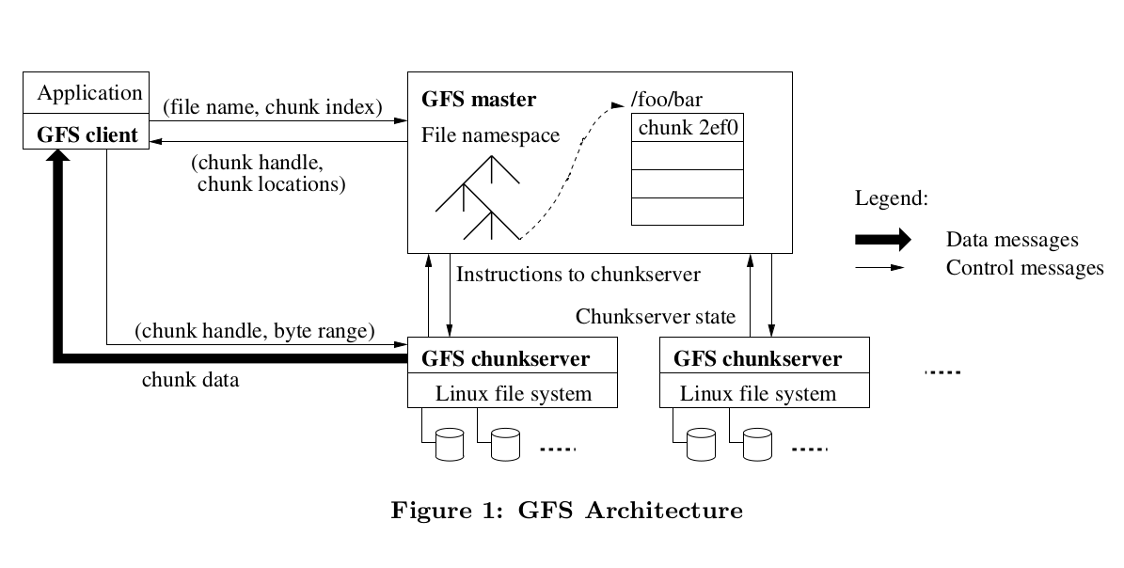
Architecture

Slide 6
Leases and Mutation Order
The client asks the master which chunkserver holds the current lease for the chunk and the locations of the other replicas.
The master replies with the identity of the primary and the locations of the other secondary replicas.
The client pushes the data to all the replicas. Each chunk server stores the data in an internal LRU buffer cache until the data is used or aged out.
The client sends write request to the primary.
Primary assigns the serial number to all the mutations and apply the mutations to its local state.
Primary forwards the write request to all the replicas.
Secondary replicas writes and replies back to primary and then primary replies to client.

Slide 7
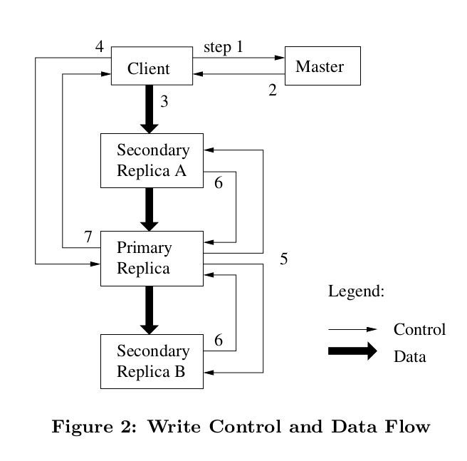

Slide 8
Consistency Model
GFS has a relaxed consistency model
It uses checksums to verify the data stored in the chunk.
Data mutations may be write or records appends.
A record append causes data (the “record”) to be appended atomically at least once even in the presence of concurrent mutations
After a sequence of successful mutations, the mutated file region is guaranteed to be defined and contain the data written by the last mutation
GFS apply mutations to a chunk in the same order on all the replicas.
It also uses chunk versions to detect any replica that has become stale

Slide 9
Other features
Garbage collection
Snapshot
Namespace management and locking
Replica placement through a chain of server carefully chosen across the racks.
Stale replica detection
Fault tolerance
Data integrity

Slide 10
Experience
GFS performed well while they did the micro-benchmark
But there were operational and technical issues mostly related to disk and linux
Drive and kernel did not agree on the drive state and hence there were inconsistencies
They had to use checksum for data integrity and modify the kernel to handle protocol mismatch problem
They used linux kernel 2.2 and that lead to a high cost of fsync() which is proportional to the file size
As a workaround they migrated to 2.4 and introduced operations likes synchronous writes and checkpoints

Slide 11
Conclusion
The Google File System demonstrates the qualities essential for large-scale data processing on commodity hardware.
Component failure was taken as a norm rather exception.
GFS provides fault tolerance by constant monitoring, replicating crucial data, and fast and automatic recovery.
Chunk replication allows GFS to tolerate chunkserver failures.
GFS design delivers high aggregate throughput to many concurrent readers and writers performing a variety of tasks.
GFS has successfully met google’s storage needs and is widely used withing Google as the storage platform for research and development as well as production data processing.

