Slide 1


Riding The Apache Camel
By Nafi, Sazal

Slide 2
Agenda
What is apache camel?
Enterprise Integration Patterns
A little bit camel insight
Demo

Slide 3
What is Apache Camel?
  Apache camel is a versatile open-source integration frameworks based on known enterprise integration patterns to make integration
    easier
    productive
    fun

Slide 4
Integration
  Enterprises are typically comprised of many applications
  Custom built, acquired from third party, part of a legacy system
  Evolving paradigm client-server communication, service oriented architecture, cloud computing
  Emerging protocols, technology
  All of these different applications have to communicate to work together to make a better product.

Slide 5
Enterprise Integration Pattern
  Patterns are not copy paste code samples
  Patterns are nuggets of advice that describe solutions to frequently recurring problems
Gregor Hohpe, Bobby Woolf
http://www.enterpriseintegrationpatterns.com/

Slide 6
Integration Alternatives
  Custom solution
Integration framework
Enterprise Service Bus (ESB)

Slide 7
Features
Routing and mediation engine
Enterprise Integration Patterns
Domain-specific language (DSL)
Extensive component library
Payload-agnostic router
Modular and pluggable architecture

Slide 8
Features
POJO model
Easy configuration
Automatic type converters
Light weight core
Test kit
Vibrant community

Slide 9
Problem
  A customer has two ways of submitting orders
  to the Rider Auto Parts order-handling system:
  either by uploading the raw order file to an FTP
  server or by submitting an order through the
  Rider Auto Parts web store. All orders are
  eventually sent via JMS for processing at Rider
  Auto Parts.

Slide 10
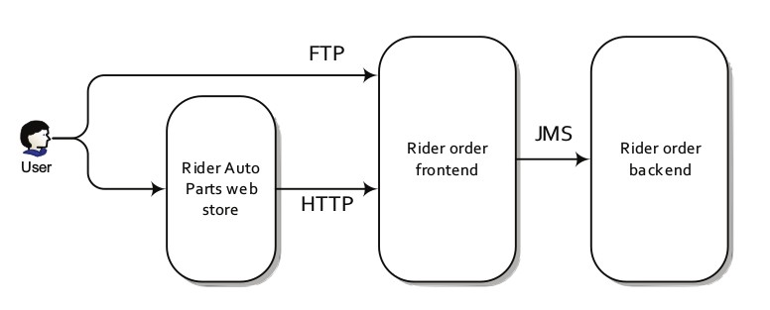
Routing with camel

Slide 11
Dealing FTP
Polling the FTP server and downloading new orders
Converting the order files to JMS messages
Sending the messages to the JMS incomingOrders queue

Slide 12
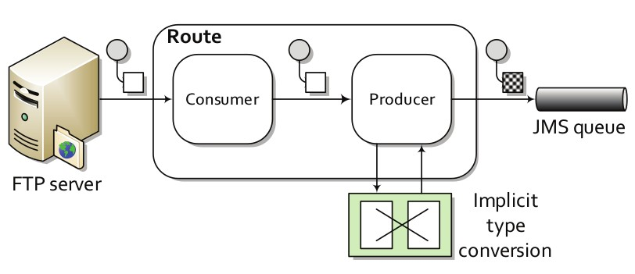
View From Camel

Slide 13
Route
Core abstraction for camel
Specifies a route in which a message will pass
through
Provide flexible way to add extra processing
Decouples source and destination; client and
server

Slide 14
DSL
- Domain specific language
- Define a route
- Camel provides DSL in regular programming
languages like java, groovy, scala and xml.
- Allows developers to focus on integration
problem rather than on the tools.

Slide 15
DSL
Java DSL
from("file:data/inbox").to("jms:queue:order");
Spring DSL
<route>
<from uri="file:data/inbox"/>
<to uri="jms:queue:order"/>
</route>
Scala DSL
from "file:data/inbox" -> "jms:queue:order"

Slide 16
Dealing FTP : Java DSL
from("ftp:example.com/orders?username=***&password=***") .to("jms:incomingOrders");

Slide 17
Dealing FTP : Spring DSL
<route>
<from uri="ftp://example.com/orders?username=***&amp;password=***"/>
<to uri="jms:queue:incomingOrders"/>
</route>

Slide 18
Processor
Simple interface
Gives full access to message exchange
Gives all the power to do anything with payload, headers

Slide 19
Processor : Java
from("ftp:example.com/orders?username=***&password=***")
.process(new FTPToJmsProcessor())
.to("jms:queue:incomingOrders")
public void process(Exchange exchange) throws Exception {
System.out.println("File name : " +
exchange.getIn().getHeader("CamelFileName"));
}

Slide 20
Processor : Spring
<bean id="ftpToJmsProcessor" class="camelride.FTPToJmsProcessor"/>
<route>
<from uri="ftp:example.com/orders?username=***&password=***"/>
<process ref="ftpToJmsProcessor"/>
<to uri="jms:queue:incomingOrders"/>
</route>

Slide 21
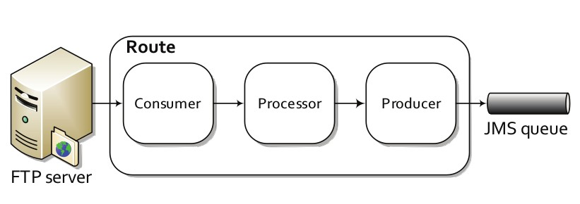
Processor

Slide 22
Endpoints
  Endpoint is an abstraction that models
  the end of a message channel through
  which a system can send and receive
  messages.

Slide 23
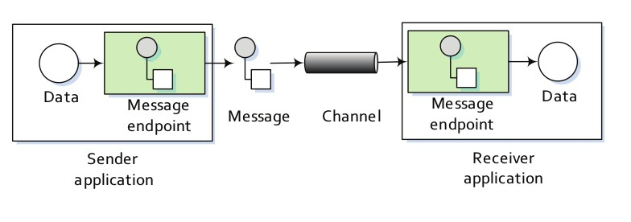
Endpoints

Slide 24
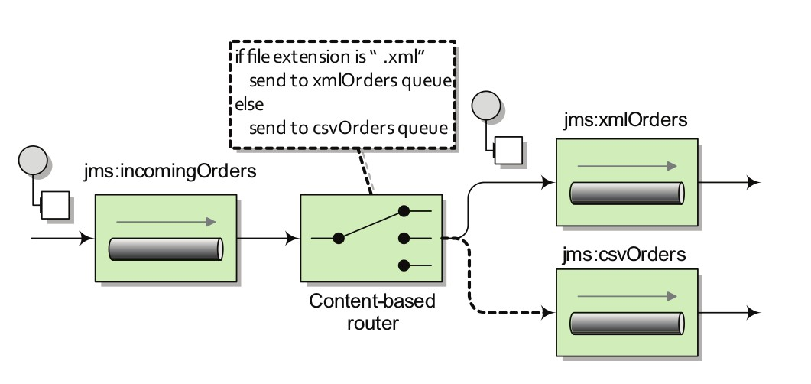
Content Based Router
Routes a message based on content type
Anything in the message exchange can be a content
Header, Payload data type or part of the payload

Slide 25
Content Based Router
Java DSL
from("jms:queue:incomingOrders")
.choice()
.when(header("CamelFileName").endsWith(".xml"))
.to("jms:queue:xmlOrders")
.when(header("CamelFileName").endsWith(".csv"))
.to("jms:queue:csvOrders");

Slide 26
CBR : Spring DSL
<route>
<from uri="jms:queue:incomingOrders"/>
<choice>
<when>
<simple>${header.CamelFileName} regex '^.*xml$'</simple>
<to uri="jms:queue:xmlOrders"/>
</when>
<when>
<simple>${header.CamelFileName} regex '^.*(csv|csl)$'</simple>
<to uri="jms:queue:csvOrders"/>
</when>
</choice>
</route>

Slide 27
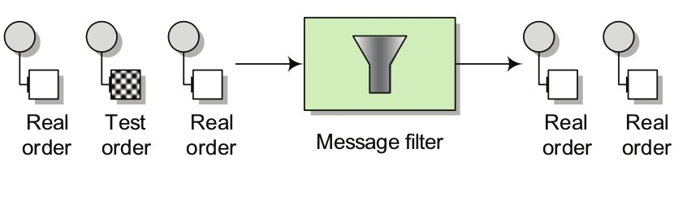
Message Filter
Filters the message
If message passes the condition it is good to go
If fails then it is dropped

Slide 28
Message Filter
<?xml version="1.0" encoding="UTF-8"?>
<order name="motor" amount="1" customer="foo" test="true"/>
from("jms:queue:xmlOrders")
.filter(xpath("/order[not(@test)]"))
.process(..)

Slide 29
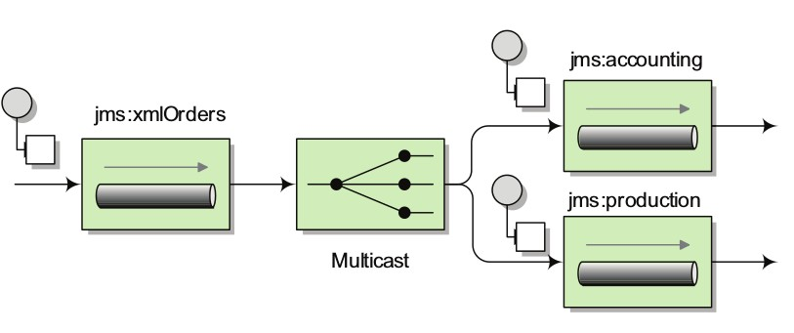
Multicasting
Distribute copy of a message to multiple destinations
Sequential multicasting
Parallel multicasting

Slide 30
Multicasting : Sequential
from("jms:queue:xmlOrders")
.filter(xpath("/order[not(@test)]"))
.process(..)
.multicast()
.to("jms:queue:accounting","jms:queue:production")
from("jms:queue:accounting")
.process(..)
from("jms:queue:production")
.process(..)

Slide 31
Multicasting : Parallel
public static ExecutorService executor = Executors.newFixedThreadPool(10);
from("jms:queue:xmlOrders")
.filter(xpath("/order[not(@test)]"))
.process(..)
.multicast()
.parallelProcessing()
.executorService(executor)
.to("jms:queue:accounting","jms:queue:production")

Slide 32
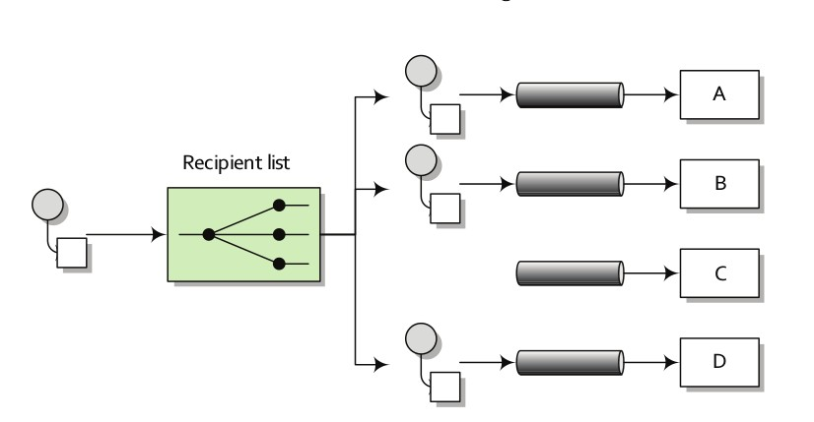
Recipient List
Detects recipients list from message content
Sends messages only to those recipients list

Slide 33
Recipient List
<?xml version="1.0" encoding="UTF-8"?>
<order name="motor" amount="1000" customer="honda"/>
from("jms:queue:xmlOrders")
.bean(RecipientListBean.class);

Slide 34
Recipient List : Bean Binding
@RecipientList
public String[] route(@XPath("/order/@customer") String customer){
if(isPremiumCustomer(customer)){
return new String[]{"jms:queue:accounting", "jms:queue:production"};
}
return new String[]{"jms:queue:accounting"};
}
private boolean isPremiumCustomer(String customer){
return customer.equals("honda");
}

Slide 35
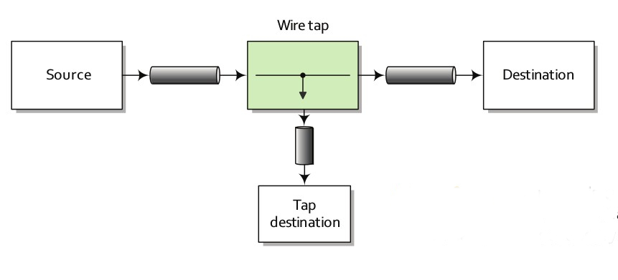
Wire Tap
Some times it is required to inspect message
Fixed recipient list that sends message to a secondary destination
Monitoring, auditing etc

Slide 36
Wire Tap
from("jms:queue:incomingOrders")
.wireTap("jms:orderAudit")
.choice()
.when(header("CamelFileName").endsWith(".xml"))
.to("jms:queue:xmlOrders")
.when(header("CamelFileName").endsWith(".csv"))
.to("jms:queue:csvOrders")
.otherwise()
.to("jms:queue:badOrders");

Slide 37
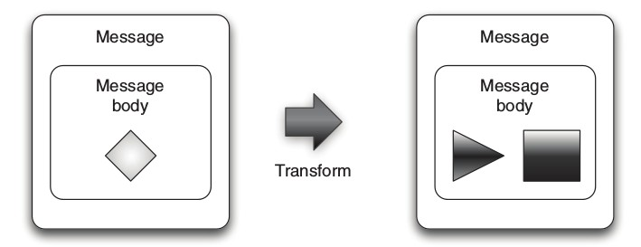
Data Transformation
Different systems uses different protocols
Exposes data in different format
Need mediation and transformation to integrate these systems
Data format transformation (CSV → XML)
Data type transformation (String → TextMessage)

Slide 38
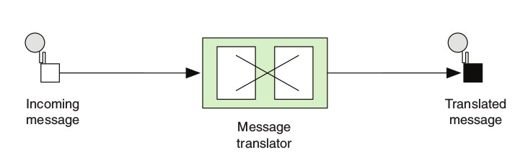
Message Translator EIP
An incoming message goes through a translator
Translates a message from one format to another
Kind of adapter pattern of GOF
Camel implements using processor, beans and transform

Slide 39
Message Translator EIP : Using Bean
Nafi:32:nafi.karim@cefalo.com
from("file:test")
.bean(new PersonToCsvBean())
.to("file://data/persons?fileName=report.csv");
public String map(String customPerson) {
String[] personDetails = customPerson.split(":");
String name = personDetails[0];
String age = personDetails[1];
String email = personDetails[2];
StringBuilder personCsv = new StringBuilder();
personCsv.append(name);
personCsv.append(",").append(age);
personCsv.append(",").append(email);
return personCsv.toString();
}

Slide 40
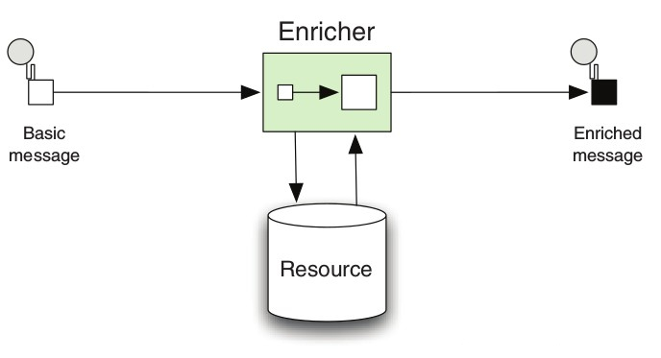
Content Enricher EIP
Enrich message with data obtained from another source
Merges data received from another source with the existing one

Slide 41
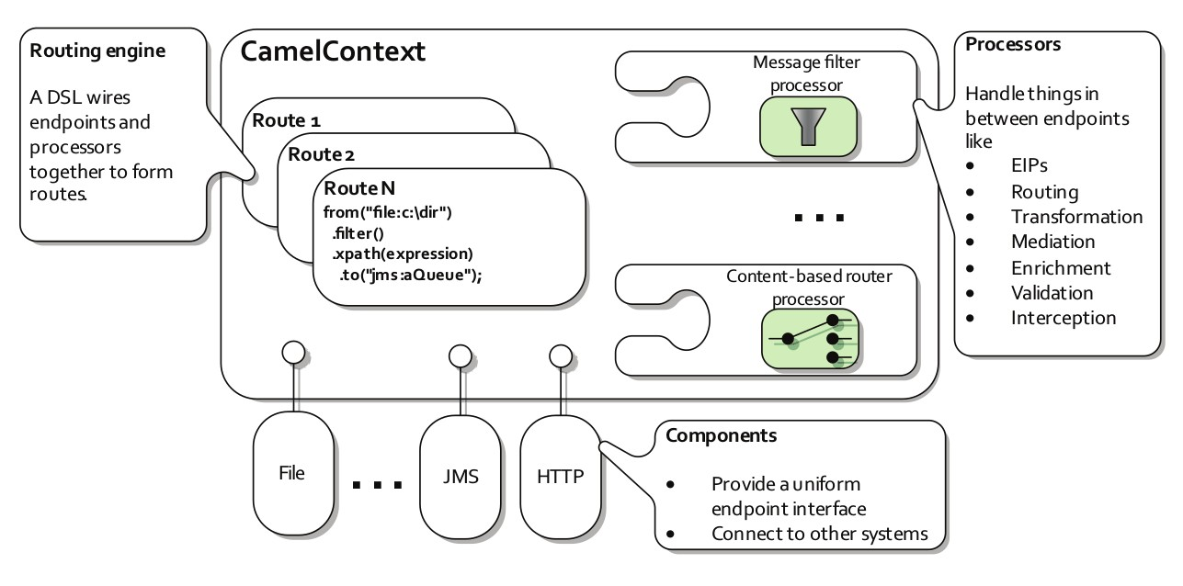
Camel Context

Slide 42
Reference
http://camel.apache.org/
http://camel.apache.org/enterprise-integration-patterns.html
http://www.enterpriseintegrationpatterns.com/patterns/messaging/toc.html
https://www.manning.com/books/camel-in-action-second-edition
https://www.youtube.com/watch?v=jgh6uNcQSiQ
https://www.youtube.com/watch?v=91UiQgazt3g
https://www.youtube.com/watch?v=VK5jK5w011Q
https://dzone.com/articles/qa-with-claus-ibsen-on-apache-camel
https://dzone.com/articles/open-source-integration-apache
https://stackoverflow.com/questions/8845186/what-exactly-is-apache-camel

