Slide 1

Frito Lay
Attrition Analysis
By
Shijo Joseph

Slide 2
Agenda
Objectives:
Provide Analysis and Findings of the data
Discuss models for Attrition and Salary
Understand next steps and recommendations for reducing attrition at Frito Lay.

Slide 3
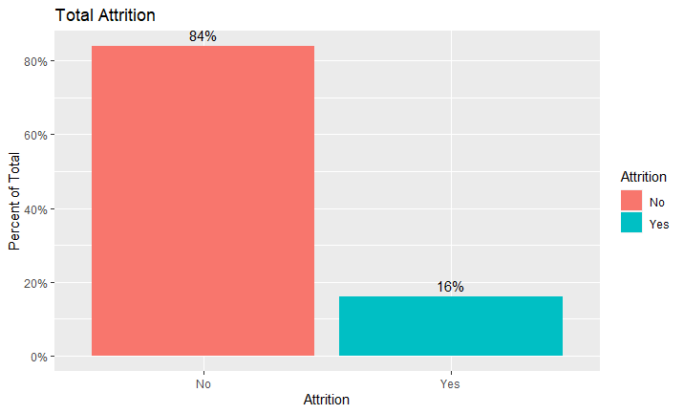

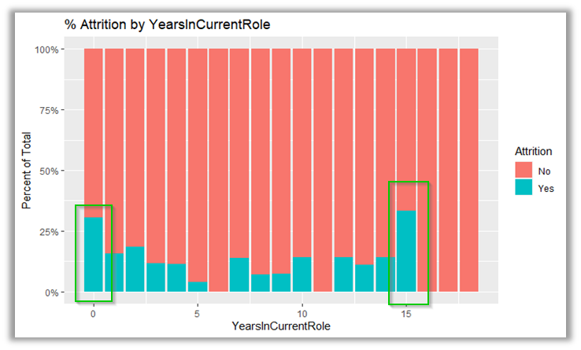
Exploratory Data Analysis
Findings on Attrition
Total Attrition in File
Years in Current Role
New to Position

Slide 4
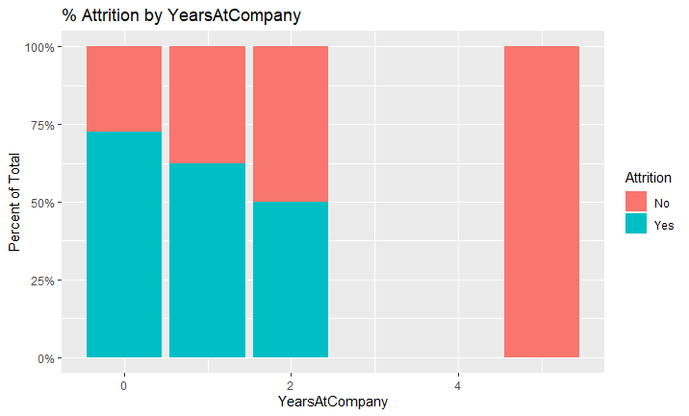
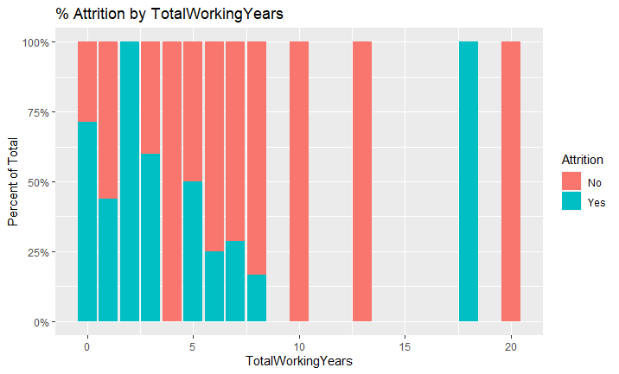
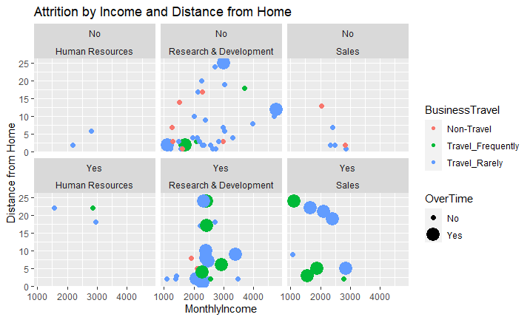
Attrition Variables for New Employees
Variable sets:
New to Positions
Entry Level Jobs
Age
Under 30
Years at the company
Total Working Years
Business Travel
Departments
Overtime

Slide 5
Prediction Models for Attrition and Salary
Factors used for Attrition Classification Model
Monthly Income
Years in Current Role
Job Level
Age
Years at the Company
Distance from Home
Total Working Years
Number of Companies Worked for
Overtime
Department
Business Travel
A NaïveBayes model
Accuracy – 83%
Sensitivity (True Positive) – 87%
Specificity (True Negative) – 65%
A Linear Regression model
MonthlyIncome = -1798.38 + 3714.12*JobLevel + 55.66*TotalWorkingYears
R² – 90.88%
Adjusted R²– 90.86%
RMSE - $1390
Factors used for Predictive Salary Model
Job Level – Corr: .952
Total Working Years – Corr: .779

Slide 6
Next Steps
Issues
Solutions
Frequent travel for new employees causes attrition
Reduce the amount of travel or add comp for the employees who travel more
Travel
Overtime for new employees causes attrition
Reduce the amount of overtime for the new employees. Figure out why they are being overworked. Add compensation for overtime hours.
Over Time
New Employees with little or no experience in the current position causes attrition
When interviewing new applicants to positions, make sure applicant has a few years of experience before hiring.
Job Experience

Slide 7


