Slide 1
ECE 2201 Circuit Analysis I
Lecture Set #8
Thévenin’s Theorem
Version 12
Dr. Dave Shattuck
Associate Professor, ECE Dept.

Slide 2
Thévenin’s Theorem

Slide 3
Overview Thévenin’s Theorem
In this part, we will cover the following topics:
Thévenin’s Theorem
Finding Thévenin’s equivalents
Example of finding a Thévenin’s equivalent
Notes:
You can click on the links to jump to the subject that you want to learn about now.

Slide 4
Textbook Coverage
This material is introduced in different ways in different textbooks. Approximately this same material is covered in your textbook in the following sections:
Electric Circuits 8th Ed. by Nilsson and Riedel: Section 4.10
Notes:
You should also read these sections in your text. This material is intended to complement your textbook coverage, not replace it.

Slide 5
Thévenin’s Theorem Defined
Thévenin’s Theorem is another equivalent circuit. Thévenin’s Theorem can be stated as follows:
Any circuit made up of resistors and sources, viewed from two terminals of that circuit, is equivalent to a voltage source in series with a resistance.
The voltage source is equal to the open-circuit voltage for the two-terminal circuit, and the resistance is equal to the equivalent resistance of the circuit.

Slide 6
Notation
Any circuit made up of resistors and sources, viewed from two terminals of that circuit, is equivalent to a voltage source in series with a resistance.
The voltage source is equal to the open-circuit voltage for the two-terminal circuit, and the resistance is equal to the equivalent resistance of the circuit.
We have used the symbol “~” to indicate equivalence here. Some textbooks use a double-sided arrow (⇔ or ↔), or even a single-sided arrow (⇒ or →), to indicate this same thing.

Slide 7
Note 1
Any circuit made up of resistors and sources, viewed from two terminals of that circuit, is equivalent to a voltage source in series with a resistance.
The voltage source is equal to the open-circuit voltage for the two-terminal circuit, and the resistance is equal to the equivalent resistance of the circuit.
We have introduced a term called the open-circuit voltage. This is the voltage for the circuit that we are finding the equivalent of, with nothing connected to the circuit. Connecting nothing means an open circuit. This voltage is shown here.

Slide 8
Note 2
Any circuit made up of resistors and sources, viewed from two terminals of that circuit, is equivalent to a voltage source in series with a resistance.
The voltage source is equal to the open-circuit voltage for the two-terminal circuit, and the resistance is equal to the equivalent resistance of the circuit.
We have introduced a term called the equivalent resistance. This is the resistance for the circuit that we are finding the equivalent of, with the independent sources set equal to zero. Any dependent sources are left in place.

Slide 9
Note 3
Any circuit made up of resistors and sources, viewed from two terminals of that circuit, is equivalent to a voltage source in series with a resistance.
The voltage source is equal to the open-circuit voltage for the two-terminal circuit, and the resistance is equal to the equivalent resistance of the circuit.
The polarities of the source with respect to the terminals is important. If the reference polarity for the open-circuit voltage is as given here (voltage drop from A to B), then the reference polarity for the voltage source must be as given here (voltage drop from A to B).

Slide 10
Note 4
Any circuit made up of resistors and sources, viewed from two terminals of that circuit, is equivalent to a voltage source in series with a resistance.
The voltage source is equal to the open-circuit voltage for the two-terminal circuit, and the resistance is equal to the equivalent resistance of the circuit.
As with all equivalent circuits, these two are equivalent only with respect to the things connected to the equivalent circuits.

Slide 11
Note 5
Any circuit made up of resistors and sources, viewed from two terminals of that circuit, is equivalent to a voltage source in series with a resistance.
The voltage source is equal to the open-circuit voltage for the two-terminal circuit, and the resistance is equal to the equivalent resistance of the circuit.
When we have dependent sources in the circuit shown here, it will make some calculations more difficult, but does not change the validity of the theorem.

Slide 12
Short-Circuit Current – 1
Any circuit made up of resistors and sources, viewed from two terminals of that circuit, is equivalent to a voltage source in series with a resistance.
The voltage source is equal to the open-circuit voltage for the two-terminal circuit, and the resistance is equal to the equivalent resistance of the circuit.
A useful concept is the concept of short-circuit current. This is the current that flows through a wire, or short circuit, connected to the terminals of the circuit. This current is shown here as i_{SC}.

Slide 13
Short-Circuit Current – 2
Any circuit made up of resistors and sources, viewed from two terminals of that circuit, is equivalent to a voltage source in series with a resistance.
The voltage source is equal to the open-circuit voltage for the two-terminal circuit, and the resistance is equal to the equivalent resistance of the circuit.
When we look at the circuit on the right, we can see that the short-circuit current is equal to v_{TH}/R_{TH}, which is also v_{OC}/R_{EQ}. Thus, we obtain the important expression for i_{SC}, shown here.

Slide 14
Extra note
Go back to Overview slide.
We have shown that for the Thévenin equivalent, the open-circuit voltage is equal to the short-circuit current times the equivalent resistance. This is fundamental and important. However, it is not Ohm’s Law.
This equation is not really Ohm’s Law. It looks like Ohm’s Law, and has the same form. However, it should be noted that Ohm’s Law relates voltage and current for a resistor. This relates the values of voltages, currents and resistances in two different connections to an equivalent circuit. However, if you wish to remember this by relating it to Ohm’s Law, that is fine.
Remember that
v_{OC} = v_{TH},
and
R_{EQ} = R_{TH}.

Slide 15
Finding the Thévenin Equivalent
We have shown that for the Thévenin equivalent, the open-circuit voltage is equal to the short-circuit current times the equivalent resistance. In general we can find the Thévenin equivalent of a circuit by finding any two of the following three things:
the open circuit voltage, v_{OC},
the short-circuit current, i_{SC}, and
the equivalent resistance, R_{EQ}.
Once we find any two, we can find the third by using this equation.
Remember that
v_{OC} = v_{TH},
and
R_{EQ} = R_{TH}.

Slide 16
Finding the Thévenin Equivalent – Note 1
We can find the Thévenin equivalent of a circuit by finding any two of the following three things:
the open circuit voltage, v_{OC} = v_{TH},
the short-circuit current, i_{SC}, and
the equivalent resistance, R_{EQ} = R_{TH}.
One more time, the reference polarities of our voltages and currents matter. If we pick v_{OC} at A with respect to B, then we need to pick i_{SC} going from A to B. If not, we need to change the sign in this equation.

Slide 17
Finding the Thévenin Equivalent – Note 2
We can find the Thévenin equivalent of a circuit by finding any two of the following three things:
the open circuit voltage, v_{OC} = v_{TH},
the short-circuit current, i_{SC}, and
the equivalent resistance, R_{EQ} = R_{TH}.
As an example, if we pick v_{OC} and i_{SC} with the reference polarities given here, we need to change the sign in the equation as shown.
This is a consequence of the sign in Ohm’s Law. For a further explanation, see the next slide.

Slide 18
Finding the Thévenin Equivalent – Note 3
We can find the Thévenin equivalent of a circuit by finding any two of the following three things:
the open circuit voltage, v_{OC} = v_{TH},
the short-circuit current, i_{SC}, and
the equivalent resistance, R_{EQ} = R_{TH}.
As an example, if we pick v_{OC} and i_{SC} with the reference polarities given here, we need to change the sign in the equation as shown. This is a consequence of Ohm’s Law, which for resistor R_{EQ} requires a minus sign, since the voltage and current are in the active sign convention.

Slide 19
Finding the Thévenin Equivalent – Note 4
We can find the Thévenin equivalent of a circuit by finding any two of the following three things:
the open circuit voltage, v_{OC} = v_{TH},
the short-circuit current, i_{SC}, and
the equivalent resistance, R_{EQ} = R_{TH}.
Be very careful here! We have labeled the voltage across the resistance R_{EQ} as v_{OC}. This is true only for this special case. This v_{OC} is not the voltage at A with respect to B in this circuit. In this circuit, that voltage is zero due to the short. Due to the short, the voltage across R_{EQ} is v_{OC}.

Slide 20
Notes
Go back to Overview slide.
We can find the Thévenin equivalent of any circuit made up of voltage sources, current sources, and resistors. The sources can be any combination of dependent and independent sources.
We can find the values of the Thévenin equivalent by finding the open-circuit voltage and short-circuit current. The reference polarities of these quantities are important.
To find the equivalent resistance, we need to set the independent sources equal to zero. However, the dependent sources will remain. This requires some care. We will discuss finding the equivalent resistance with dependent sources in the fourth part of this module.
As with all equivalent circuits, the Thévenin equivalent is equivalent only with respect to the things connected to it.

Slide 21
Example Problem
We wish to find the Thévenin equivalent of the circuit below, as seen from terminals A and B.
Note that there is an unstated assumption here; we assume that we will later connect something to these two terminals. Having found the Thévenin equivalent, we will be able to solve that circuit more easily by using that equivalent. Note also that we solved this same circuit in the last part of this module; we can compare our answer here to what we got then.

Slide 22
Example Problem – Step 1
We wish to find the open-circuit voltage v_{OC} with the polarity defined in the circuit given below. We have also defined the node voltage v_{C}, which we will use to find v_{OC}.
In general, remember, we need to find two out of three of the quantities v_{OC}, i_{SC}, and R_{EQ}. In this problem we will find two, and then find the third just as a check. In general, finding the third quantity is not required.

Slide 23
Example Problem – Step 2
We wish to find the node voltage v_{C}, which we will use to find v_{OC}. Writing KCL at the node encircled with a dashed red line, we have

Slide 24
Example Problem – Step 3
Substituting in values, we have

Slide 25
Example Problem – Step 4
Then, using VDR, we can find
Note that when we solved this problem before, we got this same voltage.

Slide 26
Example Problem – Step 5
Next, we will find the equivalent resistance, R_{EQ}. The first step in this solution is to set the independent sources equal to zero. We then have the circuit below.
Note that the voltage source becomes a short circuit, and the current source becomes an open circuit. These represent zero-valued sources.

Slide 27
Example Problem – Step 6
To find the equivalent resistance, R_{EQ}, we simply combine resistances in parallel and in series. The resistance between terminals A and B, which we are calling R_{EQ}, is found be recognizing that R₁ and R₃ are in parallel. That parallel combination is in series with R₂. That series combination is in parallel with R₄. We have

Slide 28
Example Problem – Step 7 (Solution)
To complete this problem, we would typically redraw the circuit, showing the complete Thévenin’s equivalent, along with terminals A and B. This has been done here. This shows the proper polarity for the voltage source.

Slide 29
Example Problem – Step 8 (Check)
Let’s check this solution, by finding the short-circuit current in the original circuit, and compare it to the short-circuit current in the Thévenin’s equivalent. We will start with the Thévenin’s equivalent shown here. We have

Slide 30
Example Problem – Step 9 (Check)
Let’s find the short-circuit current in the original circuit. We have
Note that resistor R₄ is neglected, since it has no voltage across it, and therefore no current through it.

Slide 31
Example Problem – Step 10 (Check)
With this result, we can find the short-circuit current in the original circuit.
This is the same result that we found using the Thévenin’s equivalent earlier.

Slide 32
Example Problem – Step 11 (Check)
Go back to Overview slide.
This is important. This shows that we could indeed have found any two of three of the quantities: open-circuit voltage, short-circuit current, and equivalent resistance.

Slide 33
What is the deal here? Is this worth all this trouble?
This is a good question. The deal here is that Thévenin’s Theorem is a very big deal. It is difficult to convey the full power of it at this stage in your education. However, you may be able to imagine that it is very useful to be able to take a very complicated circuit, and replace it with a pretty simple circuit. In many cases, it is very definitely worth all this trouble.
There is one example you may have seen in electronics laboratories. There, the signal generator outputs are typically labeled 50[Ω]. This means that the Thévenin’s equivalent resistance, for the complicated circuit inside the generator, is 50[Ω], as viewed from the output terminals. Knowing this makes using the generator easier. We view the generator as just an adjustable voltage source in series with a 50[Ω] resistor.
Go back to Overview slide.

Slide 34
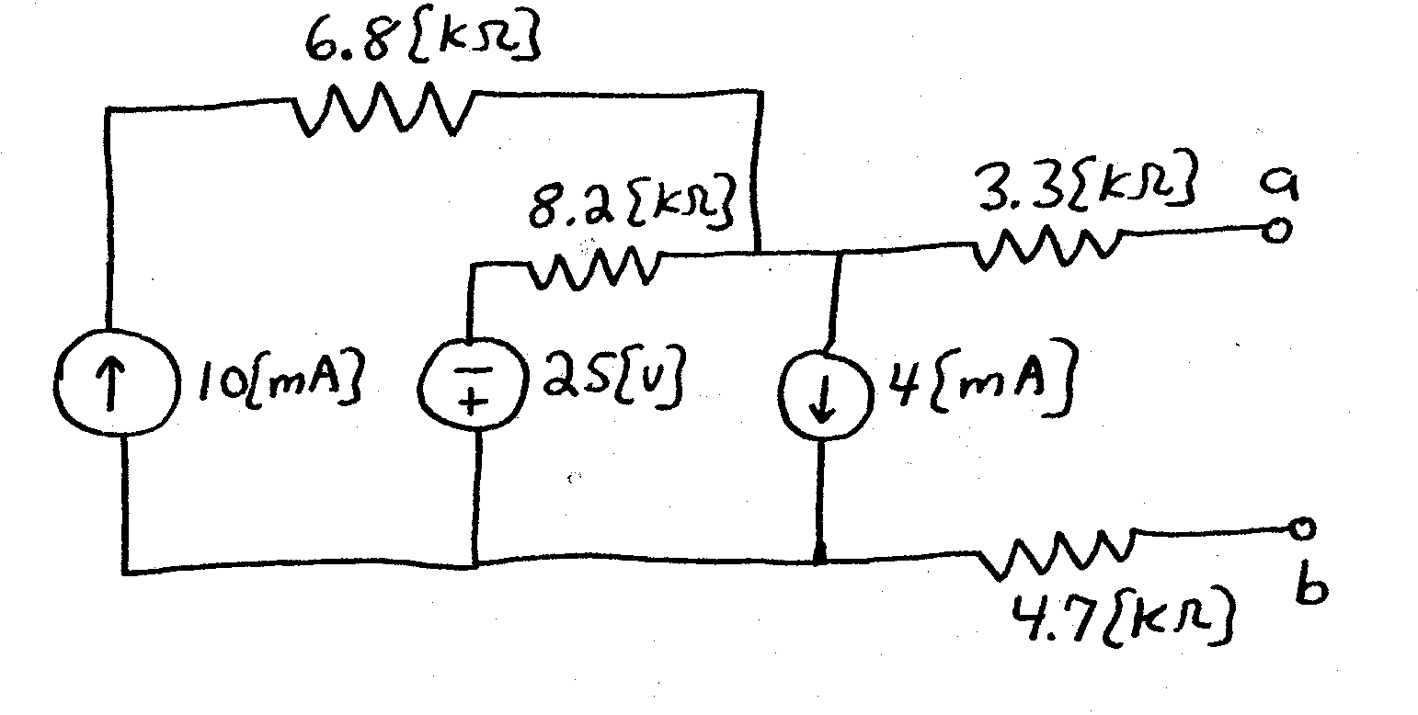
Sample Problem #1
Find the Thévenin equivalent of the circuit shown, with respect to terminals a and b. Draw the equivalent, labeling terminals a and b.
Soln: v_{TH} = 24.2[V], R_{TH} = 16.2[kΩ]

