Slide 1



Why Do Programmers Do What They Do?
A Theory of Influences on Security Practices
Lavanya Sajwan
Supervisors: James Noble, Craig Anslow

Slide 2
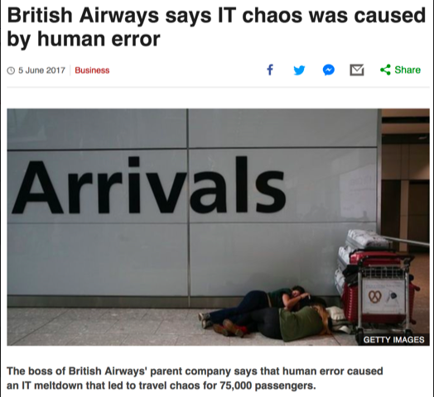
Motivation
http://www.bbc.com/news/business-40159202

Slide 3

The Problem
Lack of Qualitiative Research
Programmers Blamed
Lack of Understanding
Developers are not the enemy
https://ieeexplore.ieee.org/stamp/stamp.jsp?tp=&arnumber=7676144

Slide 4


What is Security?
CONFIDENTIALITY
INTEGRITY
AVAILABILITY
COMPUTER SECURITY STALLINGS 2018

Slide 5
Research Questions
What security challenges do software developers face?
What security training do software developers have?
How do software developers adopt secure software practices?

Slide 6
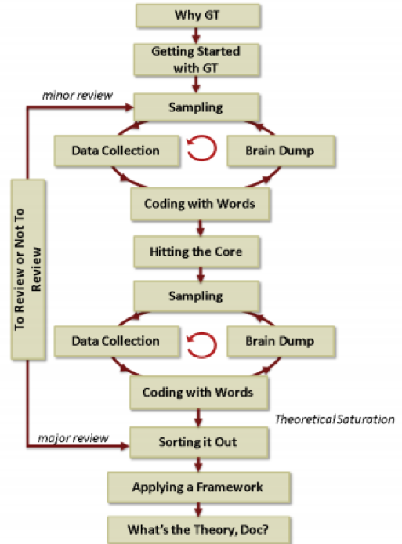


Methodology
Grounded Theory
The Grounded Theory Pattern (Hoda Noble, & Marshall, 2011) Used with Permission [1]

Slide 7

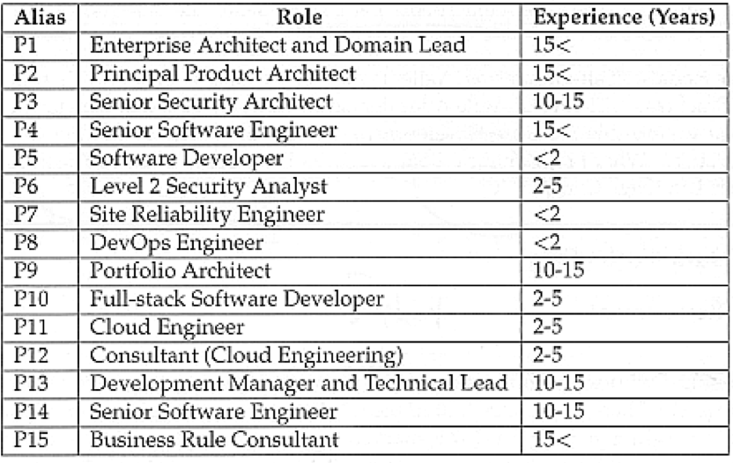


Participants

Slide 8
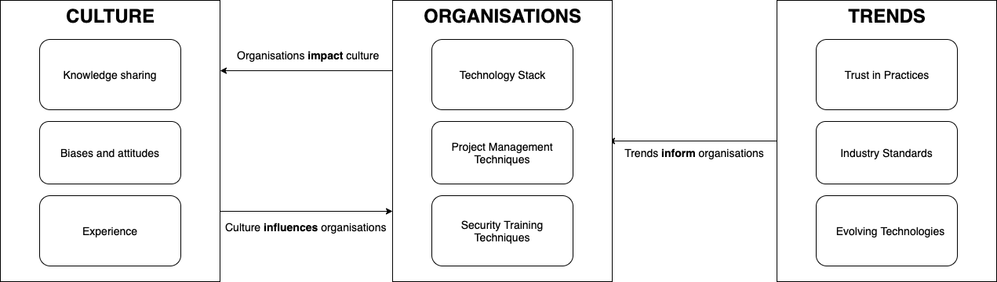
The Emergent Theory The Theory of Influences on Security Practices

Slide 9

The Emergent Theory

Slide 10

The Emergent Theory

Slide 11
The Emergent Theory

Slide 12

FIT
WORK
01
02
"Fit refers to the emergence of conceptual codes and categories from the data rather than the use of preconceived codes or categories from extant theory"
"Work refers to the ability of the grounded theory to explain and interpret behaviour in a substantive area and to predict future behaviour."
RELEVANCE
MODIFIABILITY
"Relevance refers to the theory’s focus on a core concern or process that emerges in a substantive area. Its conceptual grounding in the data indicates the significance and relevance of this core concern or process thereby ensuring its relevance."
03
"Modifiability refers to the theory’s ability to be continually modified as new data emerge to produce new categories, properties or dimensions of the theory. This living quality of grounded theory ensures its continuing relevance and value to the social world from which it has emerged."
04

Slide 13


Limitations and Future Work
Gender imbalance
NDA's
Narrowing scope

Slide 14
Implications for Practice
Active Technical Training
Corporate Hackathons
Explicitly defined project management methodologies

Slide 15
Security is growing space and practices need to adapt in order to continue to support programmers
Lavanya Sajwan
sajwanlava@myvuw.ac.nz
Supervisors: James Noble, Craig Anslow

Slide 16


Thank You!
Questions?
Lavanya Sajwan
sajwanlava@myvuw.ac.nz
Supervisors:
James Noble, Craig Anslow

