Slide 1
NYC congestion pricing: where transit should improve next
October 2026
Notes:
Purpose of this briefing: show what congestion pricing has changed, where outer-borough transit still falls short, and ask for a decision on a phased pilot.

Slide 2
Four questions this briefing answers
01
What has congestion pricing changed so far?
Traffic into the zone, and who travels to Manhattan
Slides 4–5
02
Where does transit still fall short, and why?
Candidate areas, door-to-door trips and missing bus data
Slides 6–8
03
What should be built, and where?
A fix for each area and a model test on Union Turnpike
Slides 9–10
04
In what order, and what is decided today?
Three-phase roadmap, decisions and next 90 days
Slides 11–12
Appendix: highway speeds after tolling (slide 13)
Notes:
Agenda. Each section answers one question; the tracker at the top of every slide shows where we are.

Slide 3
Congestion pricing is working; the next step is a phased transit pilot, starting in Eastern Queens
SITUATION
Congestion pricing is working. About 67,000 fewer vehicles a day (−11%) entered the zone in the first six months, and highway speeds across the city barely changed (median −0.37 mph).
COMPLICATION
Many outer-borough residents still lack a good alternative to driving. Modelled transit trips to Manhattan take 56–71 minutes, 13–22 of them walking and waiting, and key feeder buses are slow, unreliable or not measured at all.
RESOLUTION
Use toll-funded capital money where demand and a measured barrier overlap. Start in Eastern Queens, where a model test saves 6–12.5 minutes a trip; follow with the East Bronx and Southeast Queens once their delays are measured.
Sources: MTA six-month tolling report (2025); NYC DOT speed data; Census LODES 2023, ACS 2018–2022; OpenTripPlanner journey model. Note: [$__M] = cost to be confirmed.
Open interactive exhibit ↗
Notes:
Read this slide as the whole argument. Situation: pricing reduced traffic without causing citywide gridlock. Complication: outer-borough transit trips are long, mostly because of walking, waiting and transfers, and two key feeder buses have never been measured. Resolution: target capital funding where demand and a measured barrier overlap; start in Eastern Queens because it is the most ready to build.

Slide 4
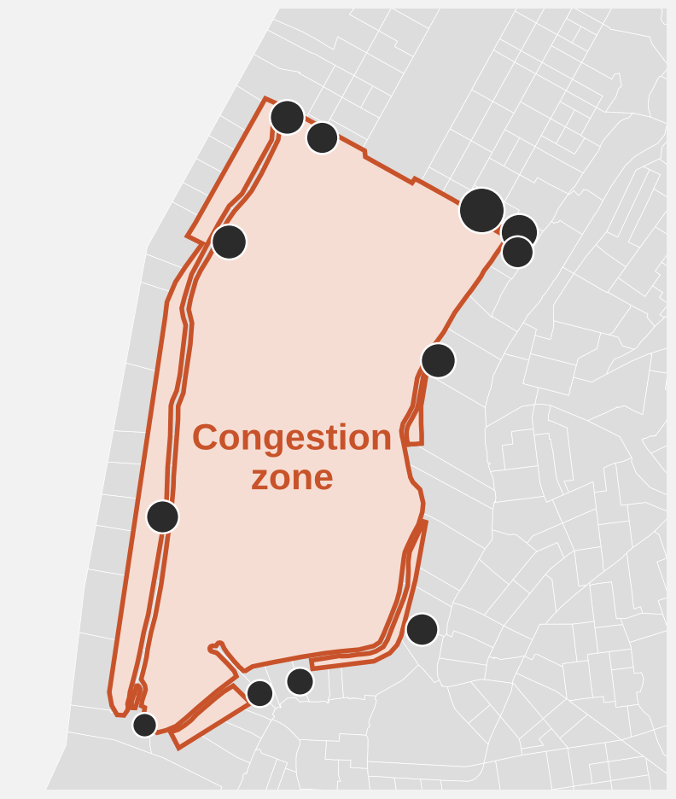
Congestion pricing cut daily vehicle entries into the zone by about 11% in its first six months
Vehicles entering Manhattan south of 60th Street. Official before/after estimate and 2025 weekday counts by crossing.
Daily vehicle entries (official estimate)
Where vehicles enter: average weekday entries by crossing, 2025
−67,000 a day (−11%)
Busiest crossings
East 60th St
79.5k
FDR Drive
53.0k
Lincoln Tunnel
46.8k
Queens Midtown Tunnel
46.5k
West Side Highway
45.9k
Holland Tunnel
41.4k
Top two crossings carry 26% of entries
Circle size = weekday entries
Sources: MTA six-month tolling report; NY Open Data t6yz-b64h (5 Jan–30 Jun 2025). Note: crossing counts (511,829 a weekday) use a different method and do not add up to the official totals.
Open interactive exhibit ↗
Notes:
The official comparison is rounded: about 600,000 entries a day before tolling and 533,000 after, a fall of about 67,000 or 11 percent. The map shows the official zone and the 12 crossings, sized by 2025 weekday entries. Crossing counts come from a separate detection dataset and should not be subtracted from the official numbers.

Slide 5
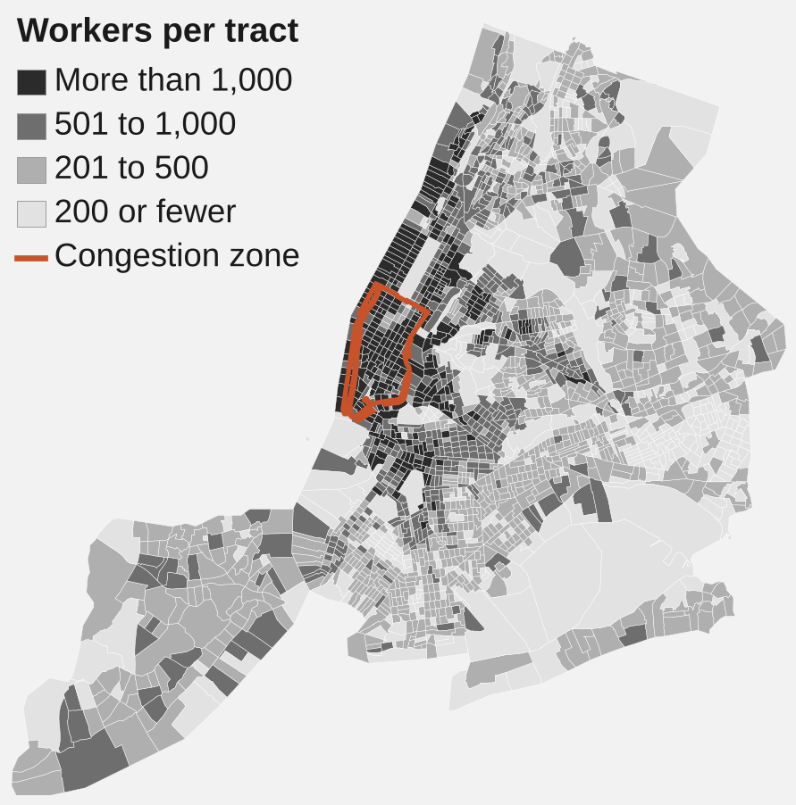
Brooklyn and Queens hold most Manhattan jobs, but the Bronx makes the most car trips into Manhattan
Where zone workers live
Jobs in Manhattan: Brooklyn + Queens hold 51%
Car trips into Manhattan: Bronx ≈2.8× Queens
Sources: Census LEHD LODES 2023 (payroll jobs; Manhattan residents hold a further 532k); NYC DOT Citywide Mobility Survey 2024. Note: survey trips go to all of Manhattan, not only the zone.
Open interactive exhibit ↗
Notes:
The map shows where the 1.24 million NYC residents who work in the zone live; the darkest tracts send more than 1,000 workers each. Jobs show where workers live; they do not show who drives. Car-driver trips per day: Bronx 102,489 (25.6 percent mode share), Brooklyn 42,408, Queens 36,439, Staten Island 8,901.

Slide 6
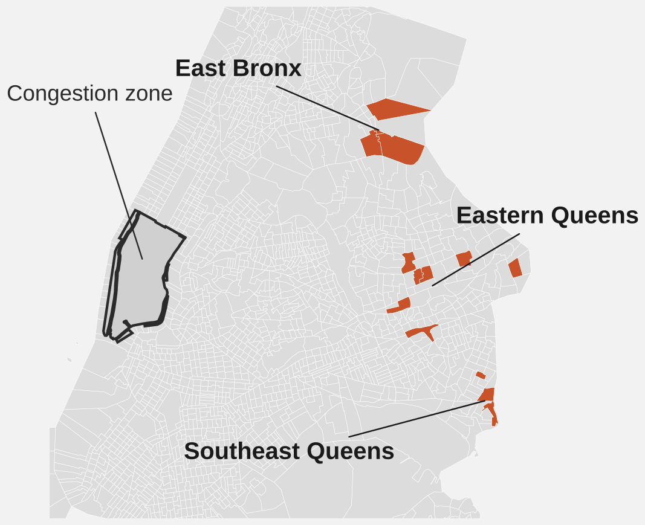
Three areas combine car use, Manhattan jobs and slow transit; Eastern Queens has the most jobs, the East Bronx the most driving
Area | Jobs in the zone | Drive alone | Transit trip and main barrier
Eastern Queens Union Tpke / Fresh Meadows | 2,649 (28%) | 30–60% (avg. ~42%) | 55.6 min; long walks to the bus
East Bronx Throggs Neck / Pelham Bay | 1,454 (29%) | 50–81% (avg. ~57%) | 71.2 min; 16-min feeder bus
Southeast Queens Rosedale / Laurelton | 651 (27%) | 50–60% (avg. ~53%) | 61.9 min; outdoor transfer and 2nd fare
Strongest case on demand
Eastern Queens: 2,649 zone jobs, almost twice the East Bronx.
Strongest case on car use
East Bronx: 57% drive alone, but its bus delay is not yet measured.
Sources: Census LODES 2023; ACS 2018–2022; OpenTripPlanner journeys M01, M02, M07. Note: jobs show where workers live, not who drives in; drive-alone rates cover all commutes.
Open interactive exhibit ↗
Notes:
Census tracts used. Eastern Queens (7): 36081137700, 36081126700, 36081134701, 36081134702, 36081141700, 36081044400, 36081157902. East Bronx (4): 36005013000, 36005013200, 36005011800, 36005016000. Southeast Queens (3): 36081062000, 36081063800, 36081065600. Cunningham Park (36081134700, a 2010 tract) split into 36081134701 (395 jobs) and 36081134702 (376 jobs) in 2020. Job shares are of 9,457, 4,998 and 2,387 resident workers. Rosedale fares: LIRR $5 to $7 plus $2.90 subway.

Slide 7
Transit trips take about an hour, and walking and waiting take 13–22 minutes of each one
Where the time goes (minutes)
Fresh Meadows → Midtown East
55.6 min
Walk and wait: 20.2 min
17.7 min is walking. The Q30 ride is only 6.9 min, so bus lanes alone won’t fix it.
Rosedale → Lower Manhattan
61.9 min
Walk and wait: 22.4 min
LIRR is fast (27 min), but the Nostrand Ave transfer adds an outdoor walk and a second fare.
Throggs Neck → Grand Central
71.2 min
Walk and wait: 12.7 min
The Bx8 bus takes 16 min on Crosby Ave; its real speed is not yet measured.
Source: OpenTripPlanner v2 with MTA fall 2026 schedules (OTP_VERIFIED_10_OD_ITINERARIES.csv, trips M01, M02, M07). Note: driving times not shown because they are not calibrated.
Open interactive exhibit ↗
Notes:
Train and subway legs are fast; the time is lost getting to the stop, waiting and changing. Walking is 31.8 percent of the Fresh Meadows trip. At Rosedale the LIRR covers 14 miles in 27 minutes, then an 8.5-minute outdoor walk between the Nostrand Ave stations and a second fare ($5 to $7 LIRR plus $2.90 subway).

Slide 8
The two feeder buses that matter most, the Q30 and Bx8, have never been measured
MTA bus data, weekday mornings, August 2026. What we know about nearby Queens routes, and what is missing.
Queens routes we can measure: average morning speed (mph)
Not measured yet
Q30
Fresh Meadows feeder to the F train
Speed: unknown · On time: unknown
Bx8
Throggs Neck feeder to the 6 train
Speed: unknown · On time: unknown
Q46 is the Union Turnpike feeder in our model test, and the fastest of these routes.
Q58 arrives on time 66% of the time, below MTA’s 70% target.
What to do: collect speed and on-time data on both routes before committing capital money to bus lanes.
Sources: NY Open Data kufs-yh3x (MTA bus segment speeds, Aug 2026, Mon–Fri 7–9 a.m.); MTA bus wait assessment (scheduled gap + 3 min). Note: Q30 and Bx8 are not among the 29 routes in the dataset.
Open interactive exhibit ↗
Notes:
Why this matters: the Fresh Meadows and Throggs Neck recommendations both depend on how these two buses actually perform. Elsewhere in the city, slow feeders fall well below target: B46 Utica at 57 percent on time and 7.4 mph, B41 Flatbush at 58 percent, B57 Maspeth at 6.4 mph. Measuring the Q30 and Bx8 is cheap and removes the biggest evidence gap.

Slide 9
Each area needs a different fix; the two Eastern Queens projects are ready to start first
One main barrier and one main fix per place. Evidence for each is in the speaker notes.
Place | Main barrier | What to build
Fresh Meadows Eastern Queens | Long walks to the bus | Safer, shorter walks to Q30 stops; better shelters
Union Turnpike Eastern Queens | Slow feeder bus and transfer | Q46 bus lanes and signal priority; sheltered transfer at Kew Gardens
Throggs Neck East Bronx | 16-minute feeder bus | Measure Bx8 delays, then a bus lane on Crosby Ave
Rosedale Southeast Queens | Outdoor transfer and a 2nd fare | Covered LIRR–A train link at Nostrand Ave; cheaper transfer fare
Sources: Census LODES 2023 and ACS 2018–2022; OpenTripPlanner journeys M01, M02, M07; Stage 5 scenario model. Note: [$__M] = cost estimate to be confirmed with MTA and NYC DOT.
Open interactive exhibit ↗
Notes:
Evidence per place. Fresh Meadows: 17.7 of 55.6 minutes is walking; the Q30 ride is only 6.9 minutes. Fix covers Utopia Parkway and 188th Street between 73rd Avenue and Union Turnpike, plus Q30 shelters with live clocks and timing buses to meet the F at 169th Street. Union Turnpike: the model test saves 6.2 to 12.5 minutes; also tap-to-pay readers at the 5 busiest stops. Throggs Neck: 59 percent drive alone; Bx8 not measured; fix on Crosby Avenue approaching Buhre Avenue, plus a sheltered transfer there. Rosedale: an 8.5-minute outdoor walk between the Nostrand Avenue stations and a second fare; also clear signs, lighting and lifts.

Slide 10
On Union Turnpike, faster buses and easier transfers would save 6–12.5 minutes a trip in a model test
Six origins along Union Turnpike to Midtown East. A what-if model, not a ridership forecast.
Door-to-door trip time (minutes)
8.7 min
average time saved per trip (13.5%)
Where the saving comes from
Faster buses (+30% speed): 3.2–9.5 min
Easier transfer: 3.0 min on every trip
Read with care
Trips still take 46–70 min. Covers the Q46 only, not Fresh Meadows walking.
Source: Stage 5 scenario model (stage5_od_scenario_results.csv); OpenTripPlanner baselines. Note: assumes the Q46 runs 30% faster and transfers take 3 min less.
Open interactive exhibit ↗
Notes:
Savings range from 6.2 minutes (Hillcrest, 11.9 percent) to 12.5 minutes (Glen Oaks, 15.2 percent), average 8.7 minutes or 13.5 percent. This is an illustrative engineering model, not an observed benefit. Emissions savings depend on real car trips diverted and must be measured, not assumed.

Slide 11
Three decisions today would let work start within 90 days
Decisions requested from this meeting, and the first actions that follow.
DECISIONS REQUESTED
NEXT 90 DAYS
01
Approve Phase 1 in Eastern Queens
Q46 bus priority, Fresh Meadows walk access and the Kew Gardens transfer. Budget [$__M].
Action
Start speed and on-time tracking on the Bx8 and Q30
Design Q46 bus lanes and signal priority on Union Tpke
Audit walking routes to Q30 stops in Fresh Meadows
Baseline counts: ridership, car entries, control road
Confirm capital eligibility and cost estimates
02
Fund delay measurement on the Bx8 and Q30
Speed and on-time data before any construction in the Bronx.
03
Agree how success is judged
Five measures and a control road (Hillside Ave), reported to the MTA Board.
Notes:
Close on the ask. The first decision unlocks the Eastern Queens pilot. The second removes the biggest evidence gap before any money is spent in the Bronx. The third fixes the yardstick in advance so results can be judged fairly.

Slide 12
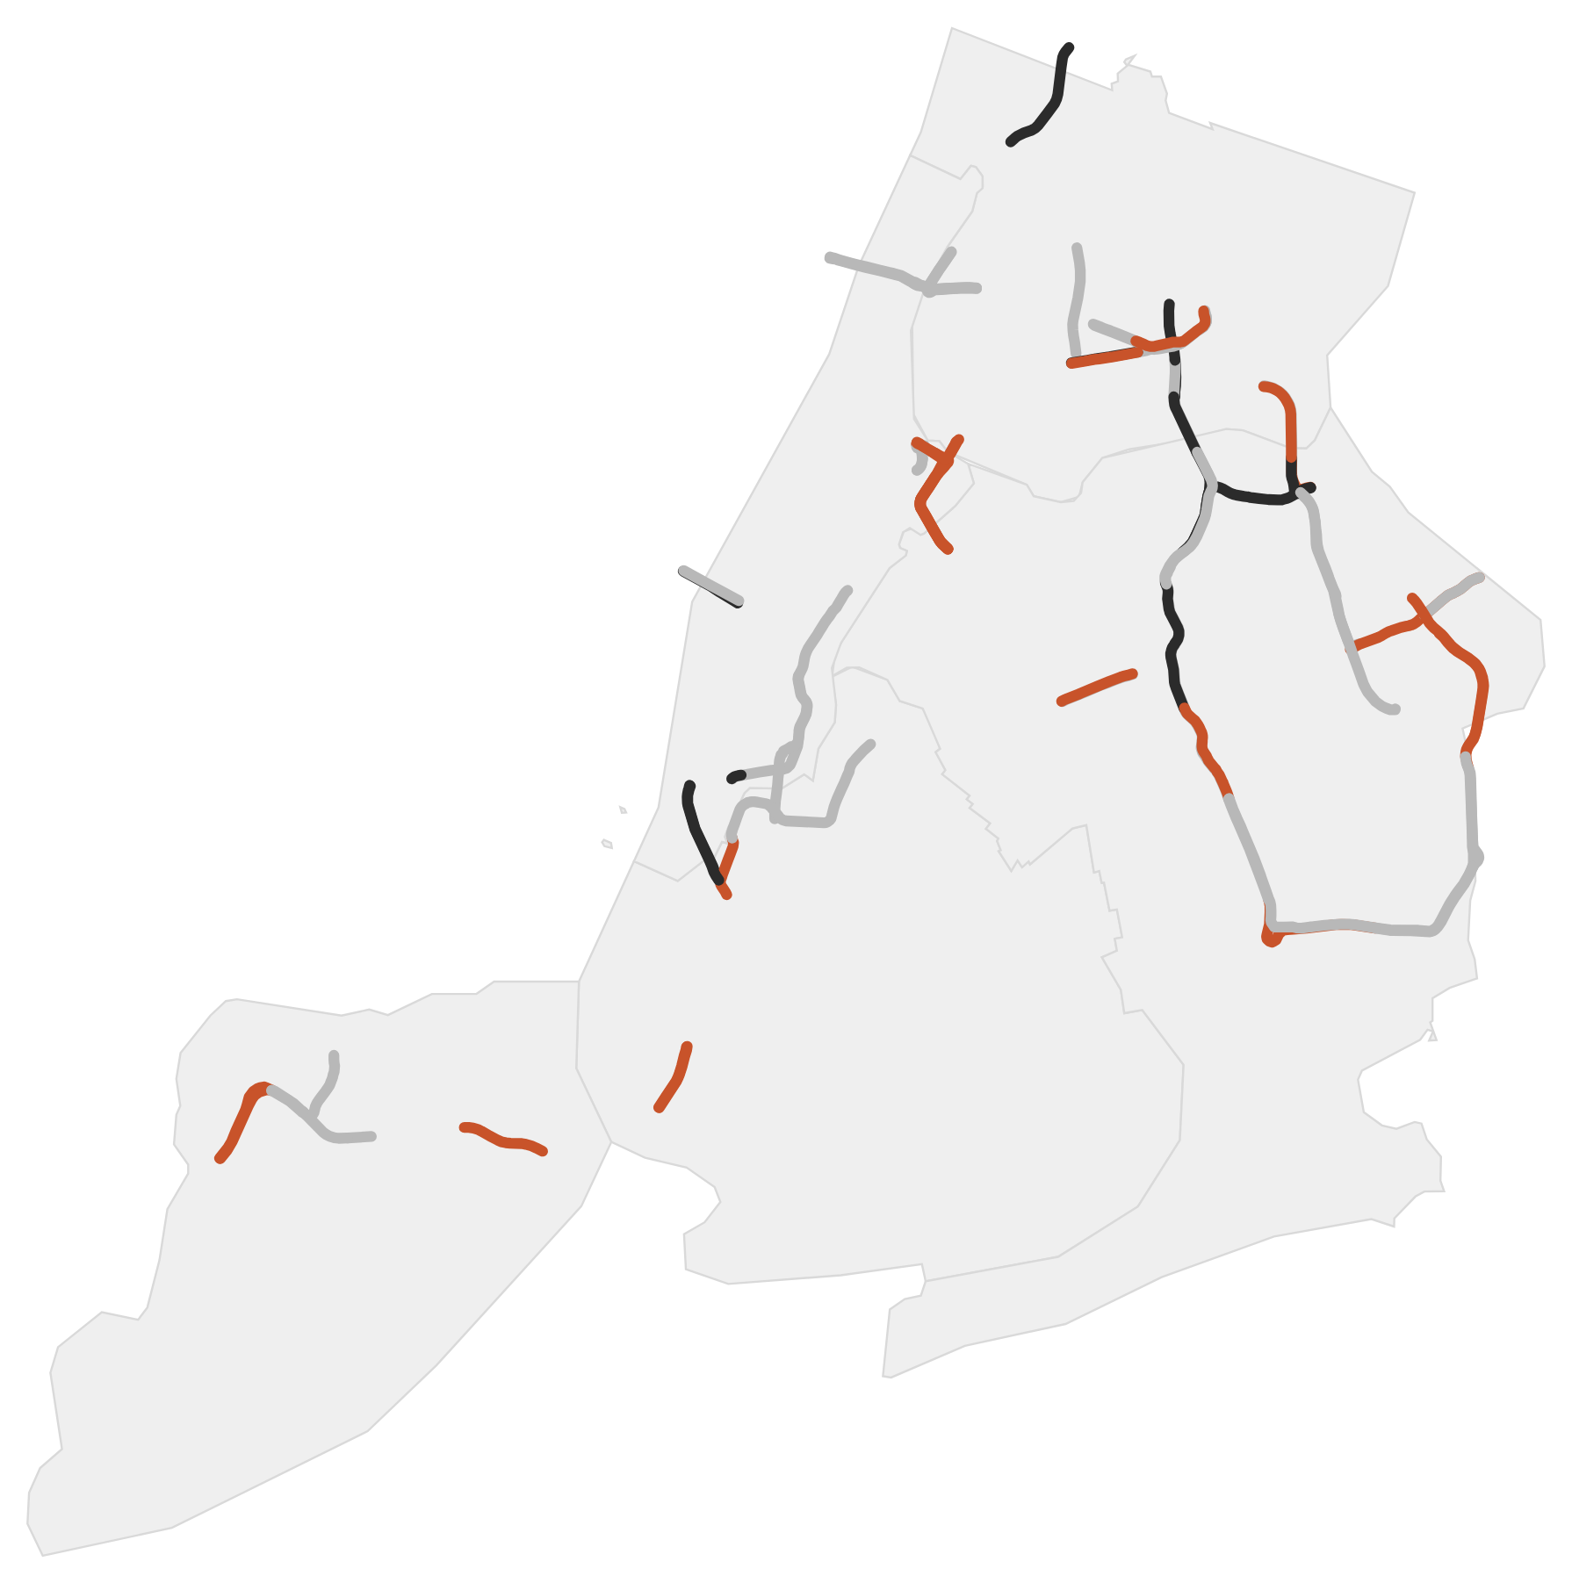
Highway speeds barely changed overall; the biggest slowdown came during roadwork
80 links with good data (of 122 monitored), weekday mornings 7–10 a.m., March–June 2024 vs 2025.
Faster by more than 2 mph
13 links
Little change (within 2 mph)
45 links
Slower by more than 2 mph
22 links
−0.37 mph median change across the 80 links
BQE southbound: 42.2 → 21.5 mph (−49%) during deck repairs and lane closures. Not proven to be drivers avoiding the toll.
No citywide gridlock, and no fix for local bottlenecks.
Source: NYC DOT traffic speed data (Socrata i4gi-tjb9), 86 weekdays per year; links kept only with at least 65 good days in both years.
Open interactive exhibit ↗
Notes:
Median change minus 0.37 mph (minus 1.0 percent); mean minus 0.88 mph. BQE link 4616229 southbound fell from 42.23 to 21.53 mph during state deck repairs. Data check: 8.4 million readings carried only two status codes, and valid readings had no zero speeds.

