Slide 1
SSE19_CD_PROTO

Slide 2


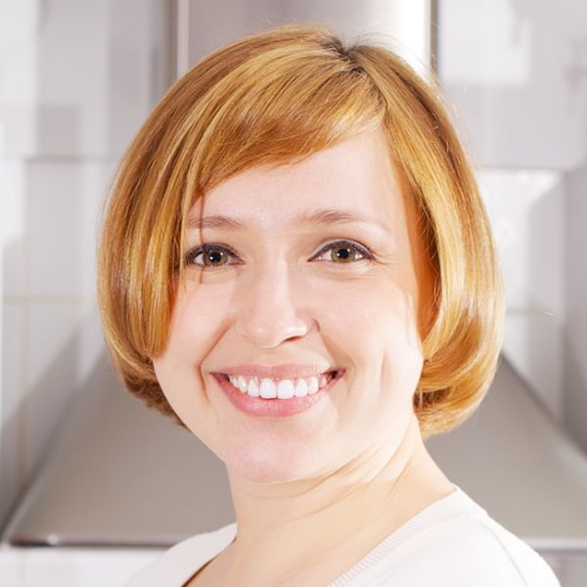
menu
Today
Today
Work Balancing
mitz.holmes@gmail.com
Today
Work Log
Document Log
Life Log
Help
Settings

Slide 3

Today
Today
Today
Today
Files
07:22 – 08:10 48 min
project : sse19
SSE19_CD_PROP.pptx …
2019/09/13 Fri
07:22 -08:10 48 min
Close
2019/09/13 Fri
07:22 -08:10 48 min
Powerpoint 30 min
Project : SSE19
08:25 – 09:32 1: 07 min
project : sse19
SSE19_CD_PROP.pptx …
Focus 26.2%
(Flow 10min, Zone 3min)
Focus 26.2%
(Flow 10min, Zone 3min)
SSE19_CD_PROP.pptx
09:45 – 10:12 27 min
project : sse19
SSE19_CD_PROP.pptx …
Operating : 10 min
Browsing : 14 min
No-Operationg : 6 min
Powerpoint 62% 30 min
Powerpoint 62% 30 min
10:25 – 11:55 1: 30 min
project : sse19
SSE19_CD_PROTO.pptx …
Excel 20% 9 min
Excel 20% 9 min
G:\workplace\sse19\_project_doc\SSE19_CD_PROP.pptx
Edge 10% 5 min
Edge 10% 5 min
12:50 – 13:15 25 min
project : sse19
SSE19_CD_PROTO.pptx …
Outlook 8% 4 min
Outlook 8% 4 min
13:30 – 13:59 29 min
project : sse19
SSE19_SPP_WBS.xlsx …
Operating
Operating
Browsing
No-Operating
Browsing
No-Operating
集中度
15%以下
25%以下
25%以上
35%以上

Slide 4
Today
Today
Today
Today
07:22 – 08:10 48 min
project : sse19
SSE19_CD_PROP.pptx …
2019/09/13 Fri
07:22 -08:10 48 min
Close
2019/09/13 Fri
08:25 -09:32 1:07 min
Close
08:25 – 09:32 1: 07 min
project : sse19
SSE19_CD_PROP.pptx …
Focus 26.2%
(Flow 10min, Zone 3min)
Focus 11.9%
(Flow 6min, Zone 2min)
09:45 – 10:12 27 min
project : sse19
SSE19_CD_PROP.pptx …
Powerpoint 62% 30 min
10:25 – 11:55 1: 30 min
project : sse19
SSE19_CD_PROTO.pptx …
Excel 20% 9 min
Edge 10% 5 min
12:50 – 13:15 25 min
project : sse19
SSE19_CD_PROTO.pptx …
Outlook 8% 4 min
13:30 – 13:59 29 min
project : sse19
SSE19_SPP_WBS.xlsx …
Operating
Operating
Browsing
No-Operating
Browsing
No-Operating
集中度
15%以下
25%以下
25%以上
35%以上

Slide 5
Work Log
Today
Work Log
Work Log
Work Balancing
Weekly
Monthly
Close
Weekly
Monthly
Close
Daily
2019/09/09 Mon 9:12 min
project : sse19
Operating 2:12 Browsing 3:23
No-Operating 2:30 Other : 1:07
Close
2019/09/09 Mon 9:12 min
project : sse19
Operating 2:12 Browsing 3:23
No-Operating 2:30 Other : 1:07
mitz.holmes@gmail.com
2019/09/10 Tue
07:22 -18:33 10:25 min
Today
2019/09/10 Tue 10:25 min
project : sse19
Operating 3:23 Browsing 4:16
No-Operating 0:21 Other : 2:15
2019/09/10 Tue 10:25 min
project : sse19
Operating 3:23 Browsing 4:16
No-Operating 0:21 Other : 2:15
Work Log
Focus 25.2%
(Flow 10min, Zone 3min)
Document Log
Life Log
Help
Settings

Slide 6
Documents Log
Today
Document Log
Document Log
Work Balancing
Weekly
Monthly
Close
Weekly
Monthly
Close
File
project : sse19
SSE19_CD_PROP.pptx
Total : 4:45 min
Close
project : sse19
SSE19_CD_PROP.pptx
Total : 4:45 min
mitz.holmes@gmail.com
SSE19_CD_PROP.ppt
Total : 4:45 min
Operating 1:30 min
Browsing 2:22 min
No-Operation 53 min
Today
project : sse19
SSE19_RD_CD.xlsx
Total : 2:23 min
project : sse19
SSE19_RD_CD.xlsx
Total : 2:23 min
Work Log
Document Log
19/09/10 Tue 08:23 -09:45 1:22 min
Ope 35min Bro 22min No-Ope 25min
Life Log
19/09/10 Tue 11:23 -12:01 0:38 min
Ope 22min Bro 12min No-Ope 4min
Help
Settings

Slide 7





Life Log
Today
Life Log
Life Log
Work Balancing
Today
Weekly
Close
Today
Weekly
Close
2019/09/12
2019/09/12
mitz.holmes@gmail.com
Night
Night
September 2019
Today
22:55 Sleep
07:17
06:12
22:55 Sleep
07:17
06:12
Mo
Tu
We
Th
Fr
Sa
Su
Work Log
1
2
3
4
5
Morning
Morning
Document Log
6
7
8
9
10
11
12
07:13 Transportation
00:42 min
07:55
07:13 Transportation
00:42 min
07:55
Life Log
13
14
15
16
17
18
10
20
21
22
23
24
25
26
Help
07:56 Transportation
00:23
08:19
27
28
29
30
31
07:56 Transportation
00:23
08:19
Settings
08:20 Walk
00:12
08:33
08:20 Walk
00:12
08:33

