Slide 1
The Sakai Framework
Sakai
TPP Tool
Sakai
TPP Tool
Sakai
TPP Tool
Sakai
Service
Sakai
Service
Sakai
Service
Sakai
Service

Slide 2
External
Aggregator
Client
The Sakai Framework
Internal
Aggregator
The Abstract Sakai Environment
Aggregator
Presentation
Support
The Sakai Tool Environment
Presentation
Sakai Tool
Presentation
Tools
Sakai
Tool Code
Application
Services
Services
Framework
Services
System
System

Slide 3
uPortal via
WSRP
The Sakai Framework
HTML Based
Aggregator
Sakai JSF
Widget Set
The Sakai Tool Environment
GUI layout
(JSF/JSP)
Schedule
Tool (Java)
Schedule
API (Java)
OSID Agent
API
System

Slide 4
Sakai
iframe
Portals via
iframe
Sakai
Non iframe
Portals via
WSRP
uPortal via
JSR-168
The Sakai Framework
Servlet/HTML
Renderer
WSRP
Renderer
JSR-168
Renderer
Sakai JSF
Widget Set
The Sakai Tool Environment
Java Server
Faces in JSP
Java Tool Logic
Java Beans
Sakai Application
Services
Sakai and/or OKI
APIs

Slide 5
Sakai
Stand-Alone
uPortal via
iframe
JVM
The Sakai Framework
HTTML Based
Aggregator
Sakai JSF
Widget Set
Sakai Request
Filter
Non-Sakai Web Application
The Sakai Tool Environment
Java Server
Faces in JSP
Presentation
Java Tool Logic
Java Beans
Sakai Commponents
Java Tool Logic
Sakai Application
Services
Application
Services
Sakai/OKI
APIs

Slide 6
Sakai Request Filter
Web Application Container (Tomcat)
Group
Provider
Group
Provider
Presentation
Presentation
Java Tool Logic
Java Tool Logic
Application
Services
Application
Services
Group
Provider
Group
Provider
AUTHN
Provider
AUTHZ
Provider
Group
Provider
AUTHN
Provider
AUTHZ
Provider
Group
Provider
Sakai Components
Storage
Storage
Stand Alone Operation
Operating Within Sakai

Slide 7
Sakai
Stand-Alone
uPortal via
iframe
The Sakai Framework
HTML Based
Aggregator
Sakai Velocity
Support Layer
Sakai JSF
Widget Set
The Sakai Legacy Environment
The Sakai Tool Environment
Velocity
Templates
Java Server
Faces in JSP
Sakai Legacy
Tools
Java Tool Logic
Java Beans
Sakai Legacy
Services
OKI OSID
Legacy Covers
Sakai Application
Services
Sakai
Framework APIs
Hibernate
OKI OSIDs

Slide 8
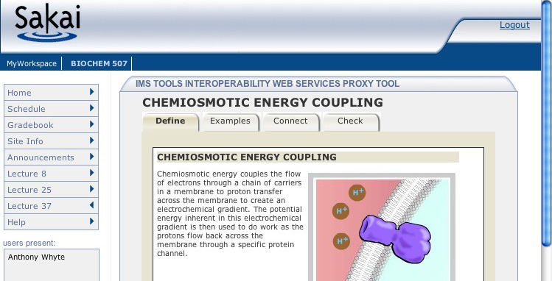
1
6
JVM
Samigo, ConceptTutor, Etc
Sakai
7
Application
Code
Sakai Web
Services
Outcome
Sakai APIs
4
Session
And Services
Bootstrap
5
3
Sakai
IMS Proxy
Launch
2

Slide 9
The Sakai Framework
Presentation
Support
The Sakai Tool Environment
Sakai Tool
Presentation
Sakai
Tool Code
Application
Services

Slide 10
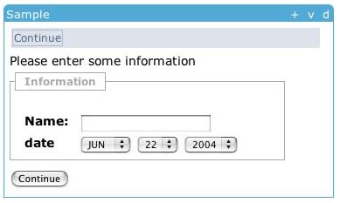
<sakai:view_container title="#{msgs.sample_title}">
<sakai:tool_bar> <sakai:tool_bar_item/> </sakai:tool_bar>
<sakai:instruction_message
value="#{msgs.sample_one_instructions}" />
<sakai:group_box
title="#{msgs.sample_one_groupbox}">
<h:inputText
value="#{MyTool.userName}" />
<sakai:date_input
value="#{MyTool.date}" />
<sakai:button_bar> <sakai:button_bar_item action="#{MyTool.processActionDoIt} value="#{msgs.sample_one_cmd_go}" />
</sakai:button_bar>

Slide 11
<h:inputText
value="#{MyTool.userName}" />
MyTool.userName() {
}
<sakai:date_input
value="#{MyTool.date}" />
MyTool.date() {
}
<sakai:button_bar> <sakai:button_bar_item action="#{MyTool.processActionDoIt} value="#{msgs.sample_one_cmd_go}" />
</sakai:button_bar>
MyTool.processActionDoIt() {
}

Slide 12
Sakai Velocity
Support
Sakai JSF
Support
Sakai Velocity
Tools
Sakai JSF
Tools
Sakai Servlet
Tools
Sakai
Application
Services
Sakai
Framework
Services
Enterprise Data
Sakai
Common
Services
User
Provider
Role
Provider
Course
Provider
Sakai Kernel and RequestFilter
Notes:
Green is application domain and blue is framework domain.

Slide 13
Sakai
Sakai
HSQL
Database
MySql
Database
Developer Environment
Small Production
Environment

Slide 14
Application
Server
Database
Server
Sakai
MySql
Database
Medium Sized Production
Environment

Slide 15
Sakai
Large Production
Environment
IP Sprayer
Sakai
Database
Server
Oracle
Database
Sakai
Application
Server Cluster
Sakai

Slide 16
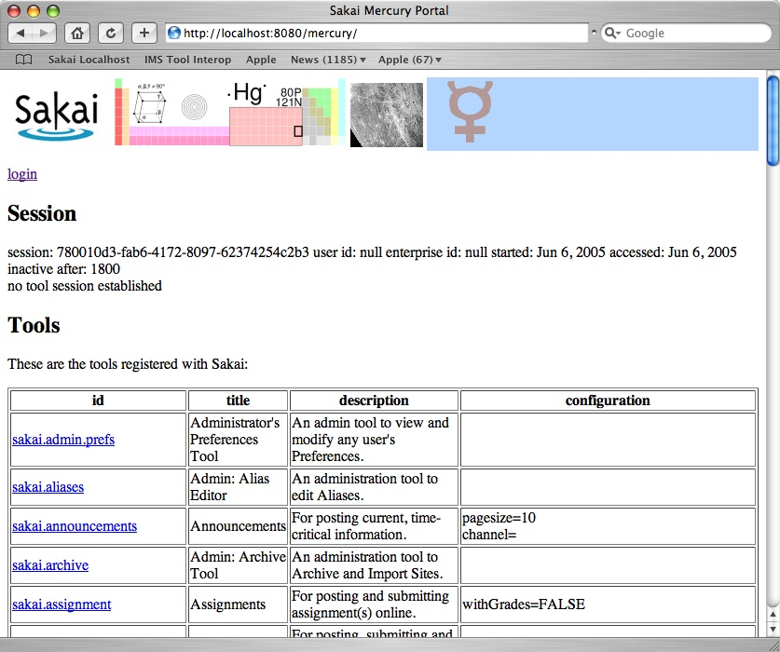
Mercury

Slide 17
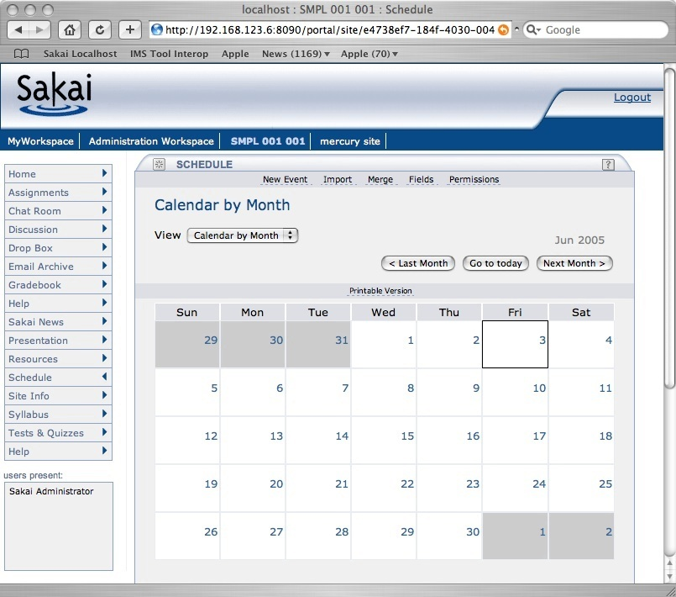
Login
Branding
Site
Selection
Tool
Selection
Tool Area
Presence

Slide 18
http://sakai.edu/portal/gallery
http://sakai.edu/portal/page/<id>
http://sakai.edu/portal/tool/<id>
http://sakai.edu/portal/site/<id>

Slide 19
Web Services
Web Services
Client
Available in Sakai 2.0
Jakarta Axis
Samples Only
WS End Point
Sakai Kernel
Sakai APIs
Notes:
This was very simple because of the Sakai 2.0 kernel

Slide 20
Tools
OSID APIs
Sakai OBAs
Sakai APIs
Sakai OSID
Implementations
Sakai API Implementations
Plugins
OSID APIs
Local OSID
Implementations
Enterprise
Information

Slide 21
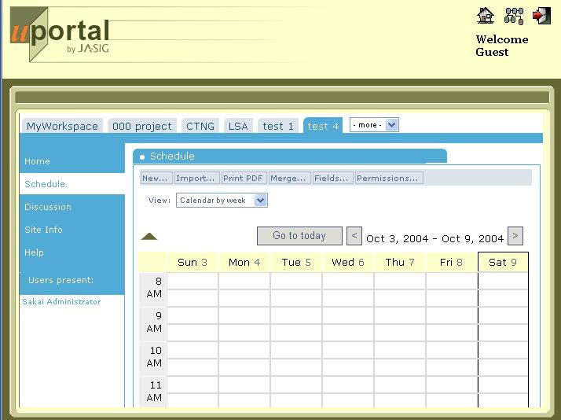
uPortal
branding
and login
iframe
Channel
Sakai
Content

Slide 22
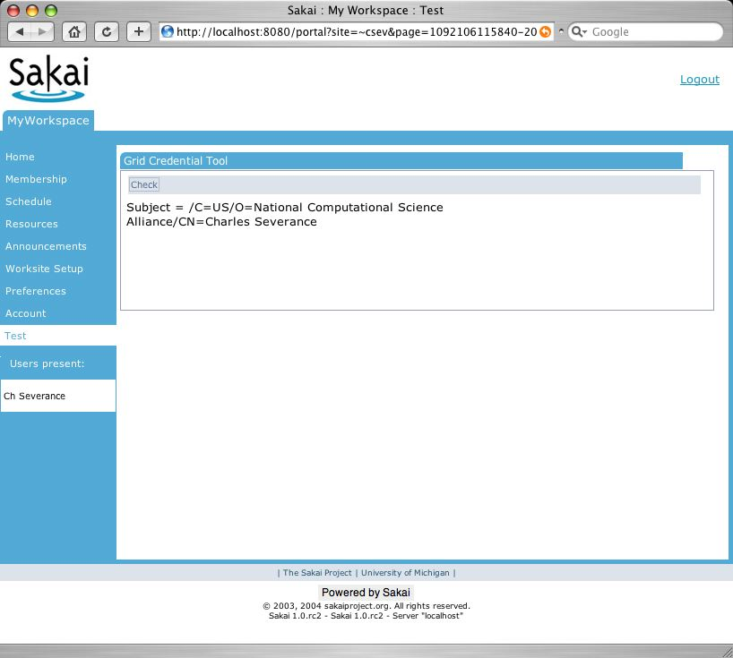
Direct viewing
In a browser
iframe and
Single-sign-on
WSRP in portal
Portal
Portal
HTTP
HTTP
WSRP
Sakai
site servlet
app servlet
WSRP4J servlet
JSF
JSF
JSF
Vel
TPP
Tool
TPP
Tool
TPP
Tool
Legacy
Tool

Slide 23
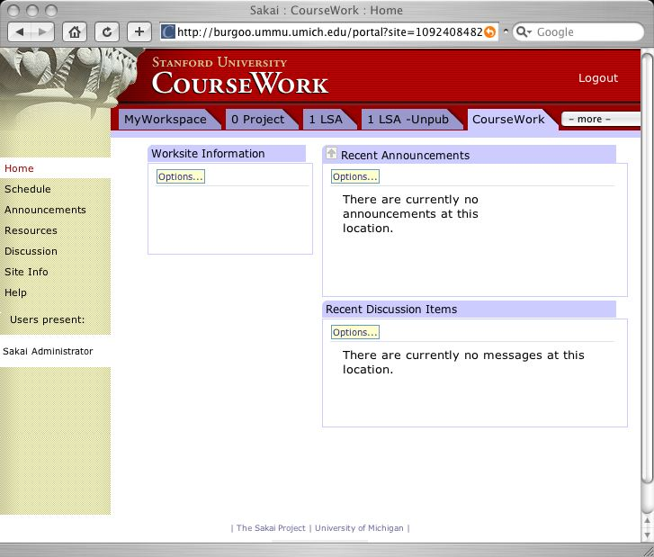
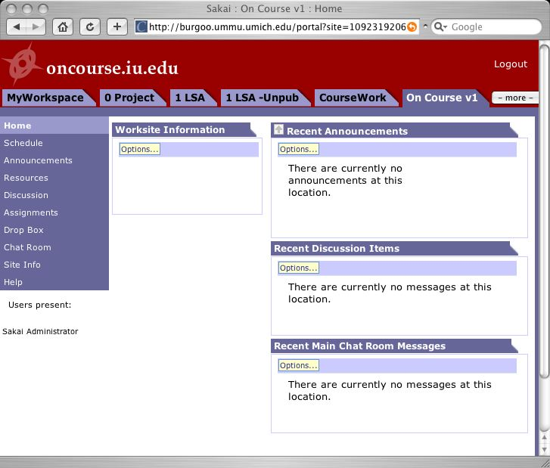
Portal
Non-Sakai
Tool
Non-Sakai
Non-Java Tools
tool
tool
WSRP
WSRP
WSRP
WSRP
HTTP
HTTP
HTTP
Sakai
Sakai
Sakai
tool
tool
tool
tool
tool
tool

Slide 24
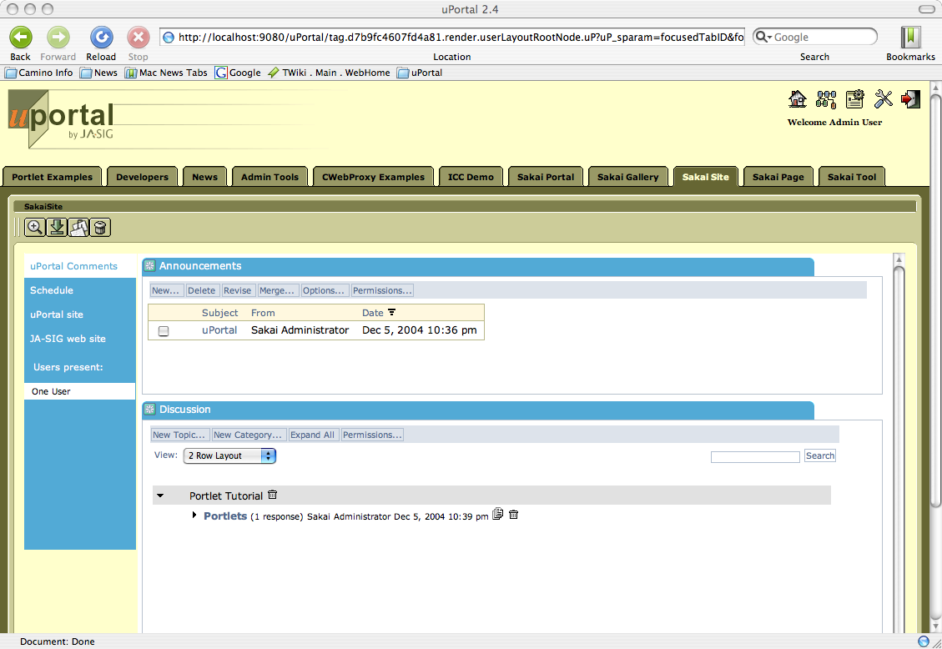
Site

Slide 25
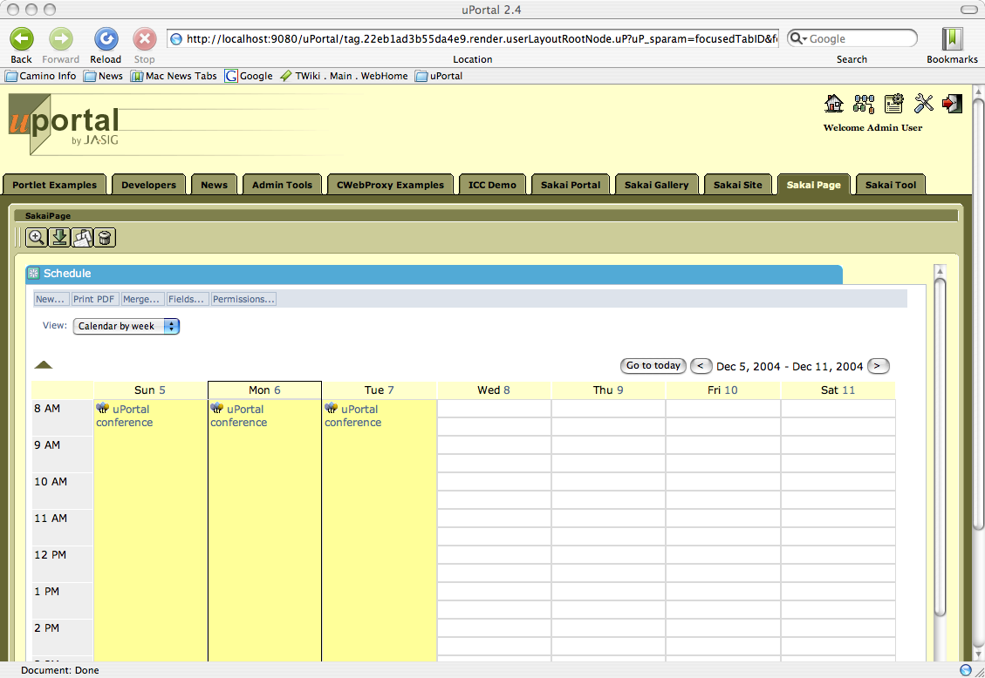
Page

