Slide 1


FLOWER RECOGNITION USING CONVOLUTIONAL NEURAL NETWORKS
SAKAM RANI

Slide 2
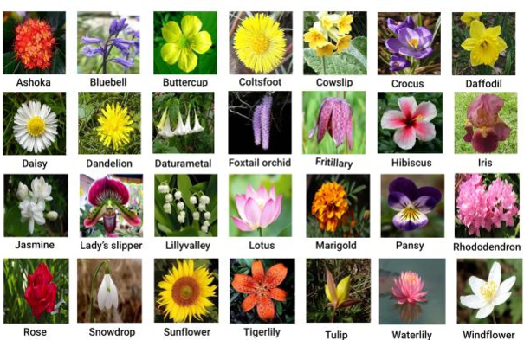
Under the guidance of: Sai Satish sir CEO of Indian servers company

Slide 3
Contents
INTRODUCTION
DATASET
METHODOLOGY
PROJECT OVERVIEW
RESULT

Slide 4
INTRODUCTION
Flower recognition is to recognize a particular flower using techniques.
It uses the edge and colour characterstics of the flower image to classify image.
Flowers are the most attractive and distinguishing feature of a plant. Therefore flower recognition can help to know more about the plant. The two main common features of flowers are their color and shape. Those features can be used to train the model such that it can later identify an unknown flower.
Flower recognition is a very tedious task because of their existence in wide varieties of color and shape

Slide 5
CONT.....
In these present scenario ,It is impossible to identify any particular flower or flower species in any way other than to seek information based on the personal knowledge and expert experience or previous knowledge.
Here to recognize the particular flower we have techniqes such as image processing using convolution neural network .

Slide 6
DATASET
The dataset which we have used for our project is that flowers recognition dataset which was downloaded from kaggle.
Here is the reference link:
https://www.kaggle.com/code/rajmehra03/flowerrecognition-cnn-keras.
This we have placed a directory path from Kaggle.
In this dataset it contains 5 types of flowers data set such as
Daisy
Dandelion
Sunflower
Rose
Tulip

Slide 7
METHODOLOGY
CNN is a neural network that has one or more convolutional layers.
It is mainly used for image processing,classification,segmentation and for other auto correlated data.
It is used in analysing documents, understanding climate, advertising and facial recognition.
CNN is a deep learning neural network designed for processing structured arrays of data such as images.

Slide 8
CONT.....
Step 1: Image acquisition: This step involves collecting images that can be used to train the model so that later when it comes across an unknown image, it can identify the flower based on the knowledge acquired during the training phase.
Step 2: Image Preprocessing: Here the images collected in the previous step were resized and augmented to increase the efficiency of the model. During augmentation, the size of the dataset would be increased by performing operations such as rotation, shear etc. Then the image will be split into 80% training and 20% testing sets.

Slide 9
CONT.....
Step 3: Training Phase: This is the step where the actual training of the model takes place. In this phase the model extracts features such as color and shape of the flower used for training. Each of the training images will be passed through a stack of layers which includes convolutional layer, Relu layer, pooling layer and fully connected layer.
Step 4: Validation phase: Once the model completes its training from the training set it tries to improve itself by tuning its weight values. The loss function used is categorical cross entropy and the optimizer used is stochastic gradient descent.

Slide 10
CONT.....
Step 5: Output prediction: In this phase ,the model is ready to take an unknown image of a flower and predict its name from the knowledge it gained during training and validation phases. Once the recognition is done by the model, the model predicted flower is then its displayed predicted label with the green colour Otherwise it predicts wrong then its displays label with red colour.

Slide 11
CONT.....
CNN models are trained by initially feeding a set of flower images along with their labels.
These images are then passed through a stack of layers including convolutional, ReLU, pooling and fully connected layers.
These images are taken as batches. In the proposed system, a batch size was given.

Slide 12
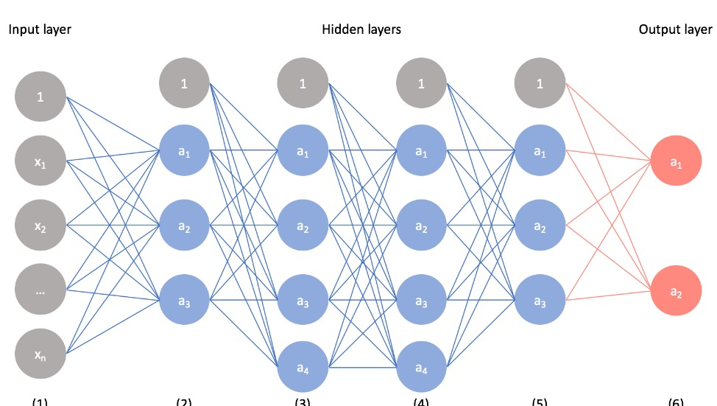

Slide 13
PROJECT OVERVIEW
In our dataset contains 4242 flowers images which contains 5 types of classes with the approx pixels 320×240.
Here we split the dataset into training data(80%) and testing data (20%).
We use four hidden layers to built CNN. In the model we used conv2D,maxpooling,filters,kernel_size,padding to built a model.
We use 80 epochs to train the neural network with all the training data.
The accuracy of this model is 88%.

Slide 14
RESULT
The model is finally ready after model is predicts the flowers.
If the predicted value is true then its displayed predicted label with the green colour.
Otherwise it displays label with red colour.

Slide 15
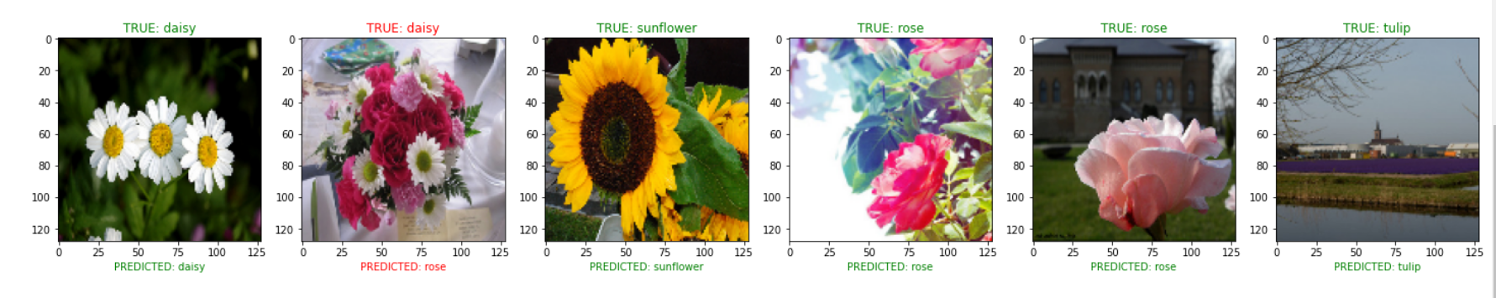
Finally our model predicted like this following image.

Slide 16
THANK YOU

