Slide 1

The fourth birthday party

Slide 2
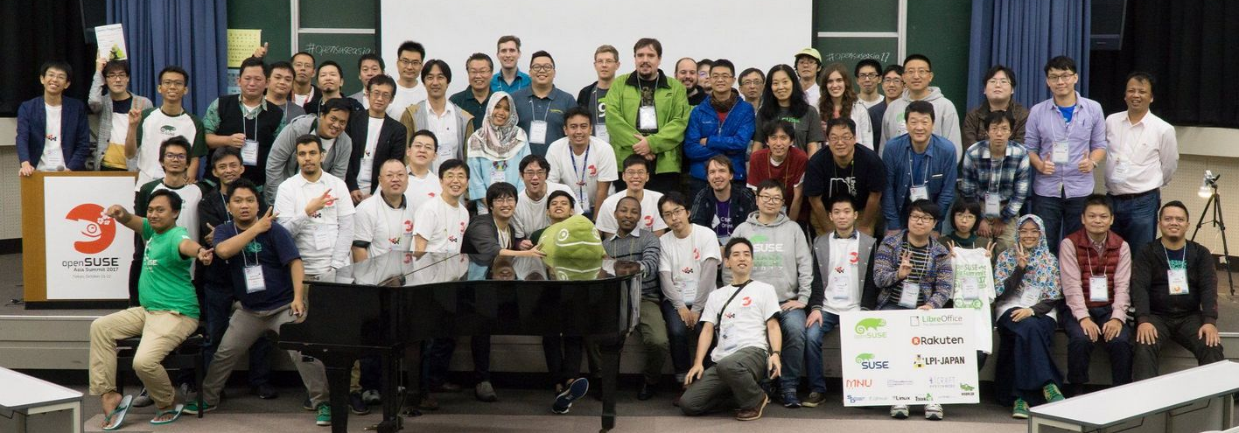
openSUSE.Asia Summit 2017
About 150 attendees, 70 proposals
A chance for young contributors to become speakers
and collaborate internationally

Slide 3






















Logo design competition 2017

Slide 4
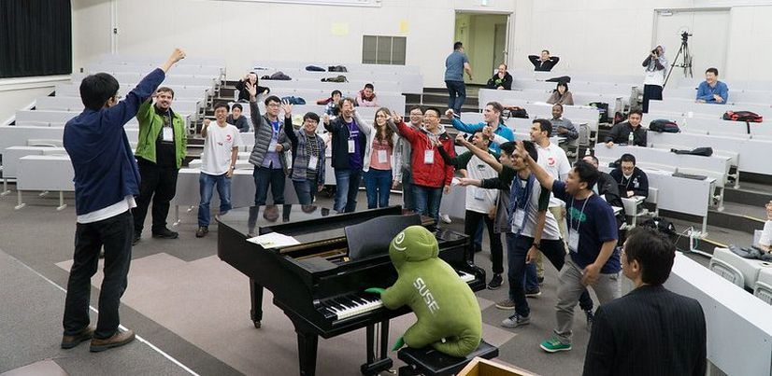
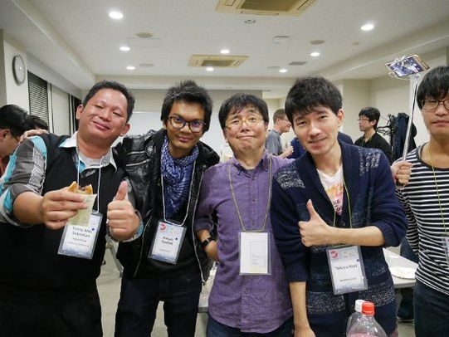
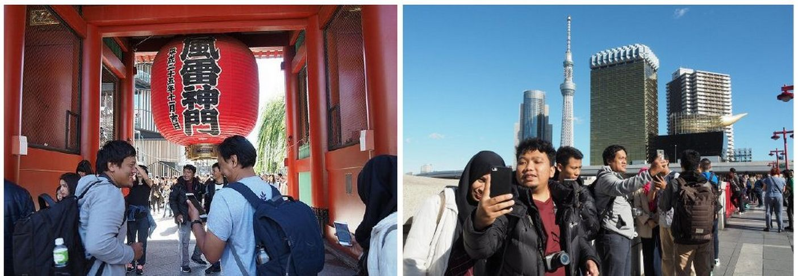
Enjoyed conference in Japan
Photo by Edwin

Slide 5
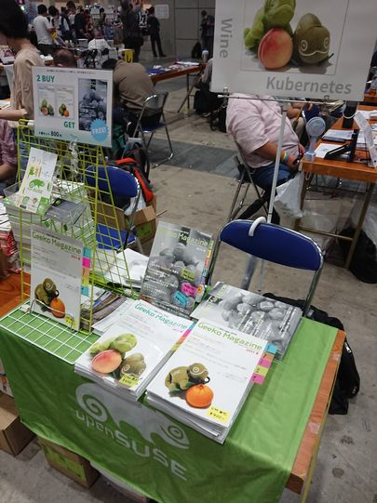


Current situation in Japan
Still many new COVID-19 patients
Some FLOSS events are getting back to offline
Comiket is back and we resumed Geeko Magazine

