Slide 1
TOXIDISP
Atmospheric Toxic Gas
Dispersion Predictor
Project-Based Assignment | Process Safety
Group members: [Name 1] • [Name 2] • [Name 3] • [Name 4]
[Department / Institute] • [Faculty name]
Academic simulation – not for live emergency response

Slide 2
The problem: where does a toxic cloud travel?
A release creates a concentration field that changes with location, release type and atmospheric conditions.
Accidental release
Project objective
A process vessel, pipeline or storage system may release a hazardous gas continuously or as a sudden finite mass.
Build software that predicts concentration at a chosen point and maps the region where a user-selected concentration threshold is exceeded.
INPUTS
MODEL
OUTPUTS
Release mass/rate
Wind • Stability
Release height
Plume / puff
Eddy diffusivity
Pasquill–Gifford
C(x,y,z,t)
Contour map
Threshold zone
Deliverable: an interactive Python application with point calculations, contour plots and downloadable data.

Slide 3
Two release modes: plume and puff
The model must match whether the source releases continuously or releases a fixed mass instantaneously.
CONTINUOUS PLUME
INSTANTANEOUS PUFF
Constant release rate Q (kg/s)
Fixed released mass M (kg)
Example: continuous pipeline leak
Example: sudden vessel rupture

Slide 4
The model library follows Lectures 19–21
Ten idealised cases are organised by physical assumptions and release type.
Cases 1–4 | Isotropic K
Cases 5–8 | Kx, Ky, Kz
Cases 9–10 | P–G Gaussian
Steady or transient point releases with no wind or a constant wind; one eddy diffusivity K in all directions.
Anisotropic puff/plume solutions, ground-level sources and an elevated source with ground reflection.
Puff for instantaneous release; plume for continuous release. Use empirical dispersion coefficients σy and σz.
Pasquill–Gifford atmospheric stability classes
What the Gaussian coefficients mean
A
Extremely unstable
B
Moderately unstable
C
Slightly unstable
σy describes crosswind spread. σz describes vertical spread. Their values depend on downwind distance and stability class.
D
Neutral
E
Slightly stable
F
Moderately stable
The supplied P–G coefficient tables are used for rural conditions.

Slide 5
Software workflow and outputs
The application keeps the user interface separate from the mathematical model functions.
USER INPUTS
MODEL ENGINE
CONCENTRATION
IMPACT CHECK
VISUALISE
Chemical / MW
Q or M
Wind / stability / height
Cases 1–8
P–G puff
P–G plume
C(x, y, z, t)
kg/m³ → ppmv
Point calculation
Compare with
user-entered
threshold
Contour map
Affected area
CSV export
Technology
User-visible outputs
Python • Streamlit • NumPy • SciPy • Matplotlib • Pandas
Point concentration • ppmv • threshold flag • contour • grid-based affected area • CSV
All models return concentration in kg/m³ internally so that the user sees consistent units.

Slide 6
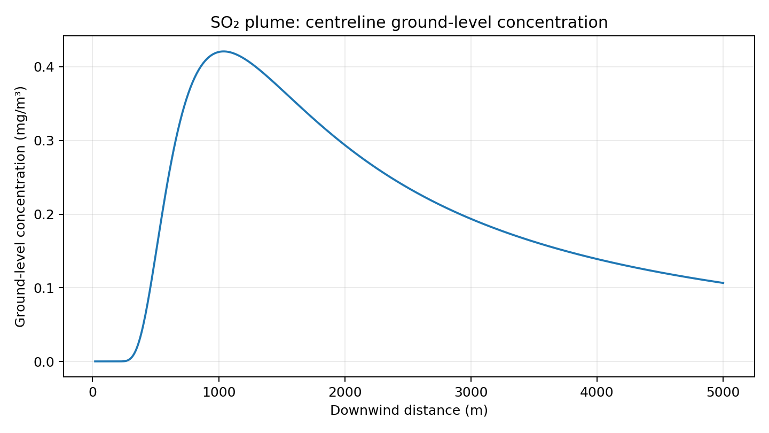
Validation 1: continuous SO₂ release
Lecture 21, Example 1 – elevated continuous release under rural, neutral (class D) conditions.
Inputs
Q = 80 g/s
H = 60 m
u = 6 m/s
x = 500 m
y = 0 and 50 m
Stability = D
Program vs lecture
Centreline at 500 m
1.448 × 10⁻⁴ g/m³
Lecture: 1.45 × 10⁻⁴ g/m³
50 m crosswind
6.374 × 10⁻⁵ g/m³
Lecture: 6.37 × 10⁻⁵ g/m³
The lecture estimates a maximum ground-level concentration of about 4.18 × 10⁻⁴ g/m³ near 1200 m.

Slide 7
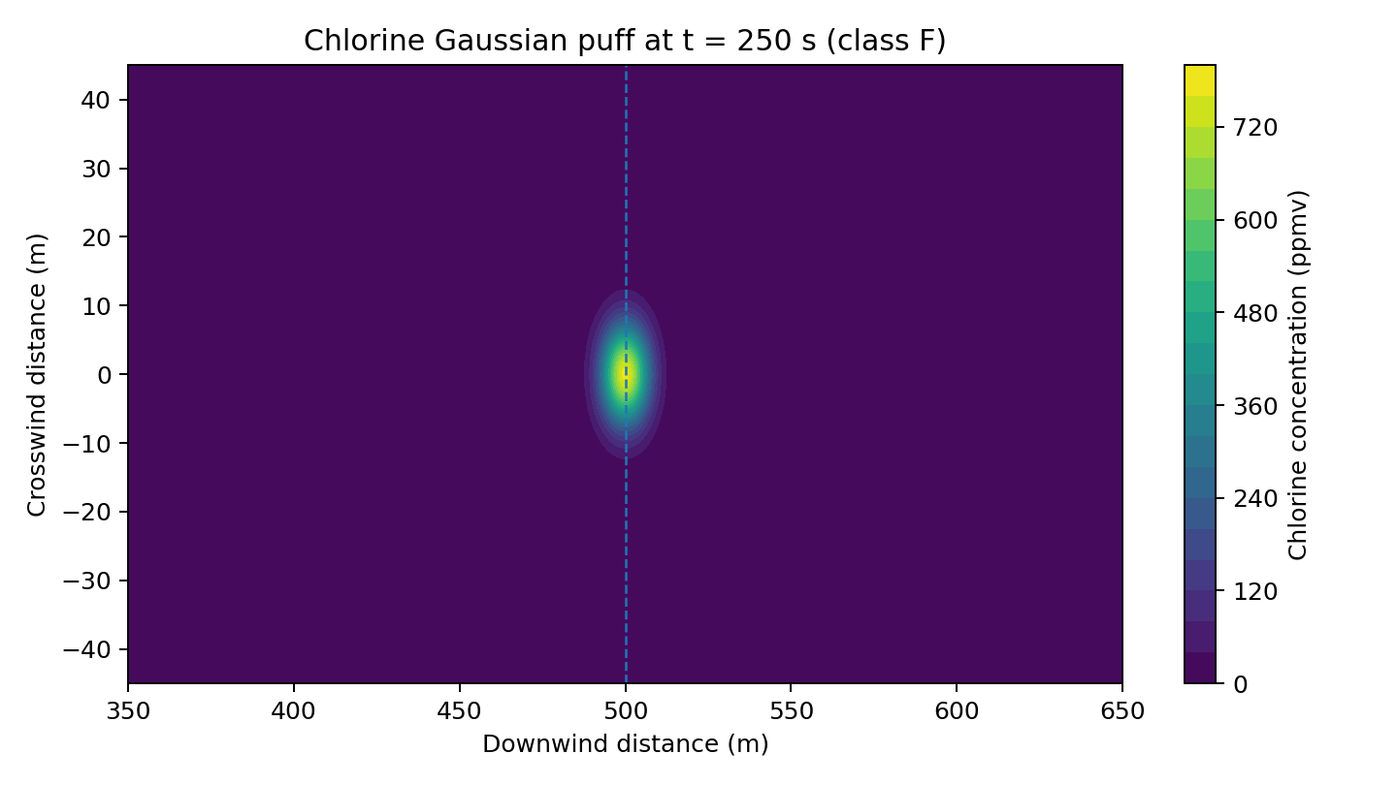
Validation 2: instantaneous chlorine release
Lecture 21, Example 2 – ground-level puff and the time required to reach a residential area.
Inputs
M = 1.0 kg
u = 2 m/s
Distance = 500 m
Stability = F
ERPG-1 example = 1 ppm
Arrival time
t = x/u = 500/2
= 250 s = 4.17 min
Model centre estimate
≈ 776 ppmv using unrounded coefficients. The lecture rounds σx = σy to 5.0 m and σz to 2.2 m and reports ≈ 798 ppm.
Puff centre at x = ut = 500 m when t = 250 s.

Slide 8
Conclusion, limitations and next steps
A useful educational demonstration – with assumptions that must be made explicit.
What the project delivers
Important limitations
• Ten lecture dispersion cases
• Concentration at a selected point
• Ground-level concentration contours
• User-defined threshold comparison
• Estimated threshold-exceedance area
• Neutrally buoyant Gaussian assumption
• Rural P–G correlations
• No dense-gas slumping / CFD
• No complex buildings or changing wind
• Not for live emergency response
Future scope
Changing wind direction
Urban / terrain effects
Dense-gas model
GIS-based mapping
Verified toxicity database
ToxiDisp connects chemical-process safety theory with mathematical modelling and Python-based visualisation.
References: supplied Lecture 19, Lecture 20 and Lecture 21 dispersion-model slides.

