Slide 1
A-LEVEL ECONOMICS - THE DIAGRAM BANK
26 DIAGRAMS | WHAT EARNS THE MARK
AQA 7136 + Edexcel 9EC0
One diagram per slide: project it, walk the checklist, name the mistake.
Sakari Laajoki

Slide 2
THE FIVE HABITS THAT EARN THE DIAGRAM MARKS
1. Title it - name the actual market or economy in the question.
2. Label both axes in full - Price level and Real GDP, not P and Q, in macro.
3. Label every curve at its end - an unlabelled line earns nothing.
4. Dash every equilibrium to BOTH axes - the examiner marks what reaches the axes.
5. Arrow every shift - old and new curve both named.
A-Level Economics | The Diagram Bank

Slide 3
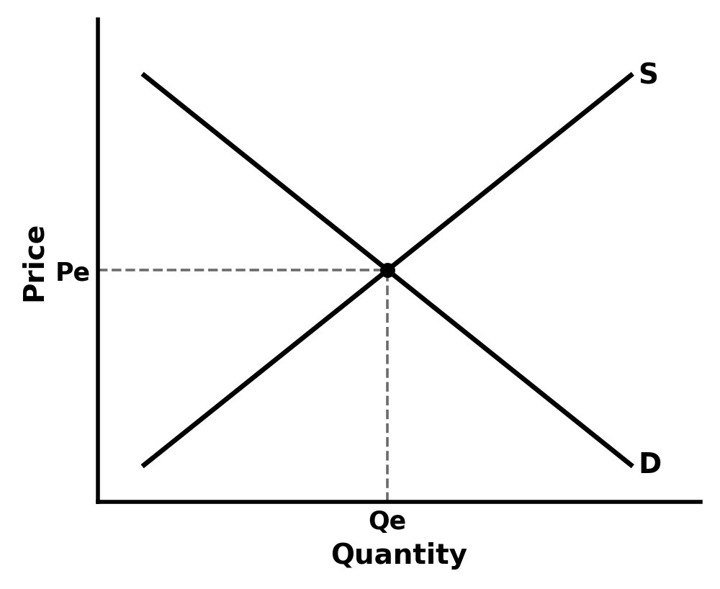
1 - DEMAND AND SUPPLY EQUILIBRIUM
AQA 7136 4.1.3 Edexcel 9EC0 Theme 1 (1.2)
WHAT EARNS THE MARK
• Axes labelled in full: Price on the vertical, Quantity on the horizontal.
• Both curves labelled at their ends: D and S.
• Equilibrium marked with dashed lines to BOTH axes, labelled Pe and Qe.
• The diagram has a title naming the actual market in the question - 'The market for coffee', not 'a market'.
THE MISTAKE: Leaving the equilibrium floating. Without the dashed projection lines the examiner cannot see Pe or Qe on the axes - two seconds of dashed line is the difference between a drawn diagram and a marked one.

Slide 4
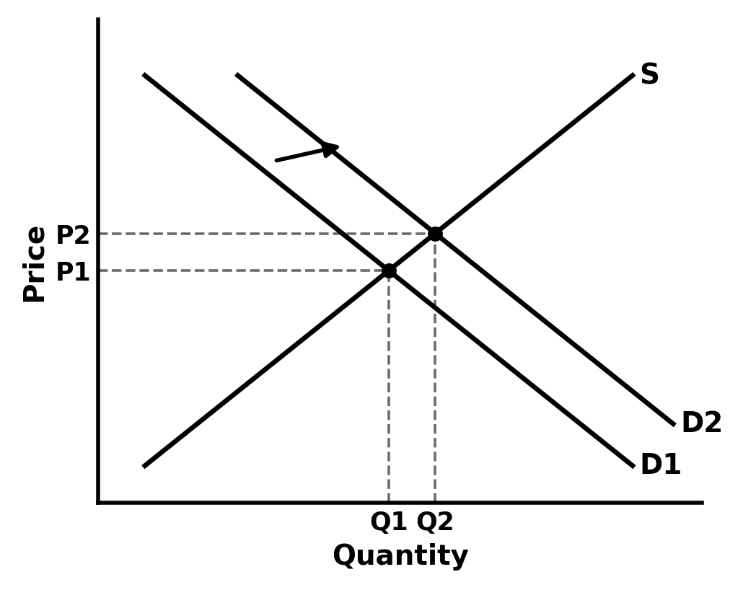
2 - A SHIFT IN DEMAND
AQA 7136 4.1.3 Edexcel 9EC0 Theme 1 (1.2)
WHAT EARNS THE MARK
• An arrow showing the direction of the shift.
• Both curves labelled D1 and D2 - never two unlabelled lines.
• Both equilibria marked and dashed to the axes.
• P1 to P2 and Q1 to Q2 shown on the axes, so the effect can be read off.
THE MISTAKE: Shifting the curve for a price change. A change in the good's own price moves you ALONG the demand curve; only non-price factors - income, tastes, the price of substitutes and complements - SHIFT it.

Slide 5
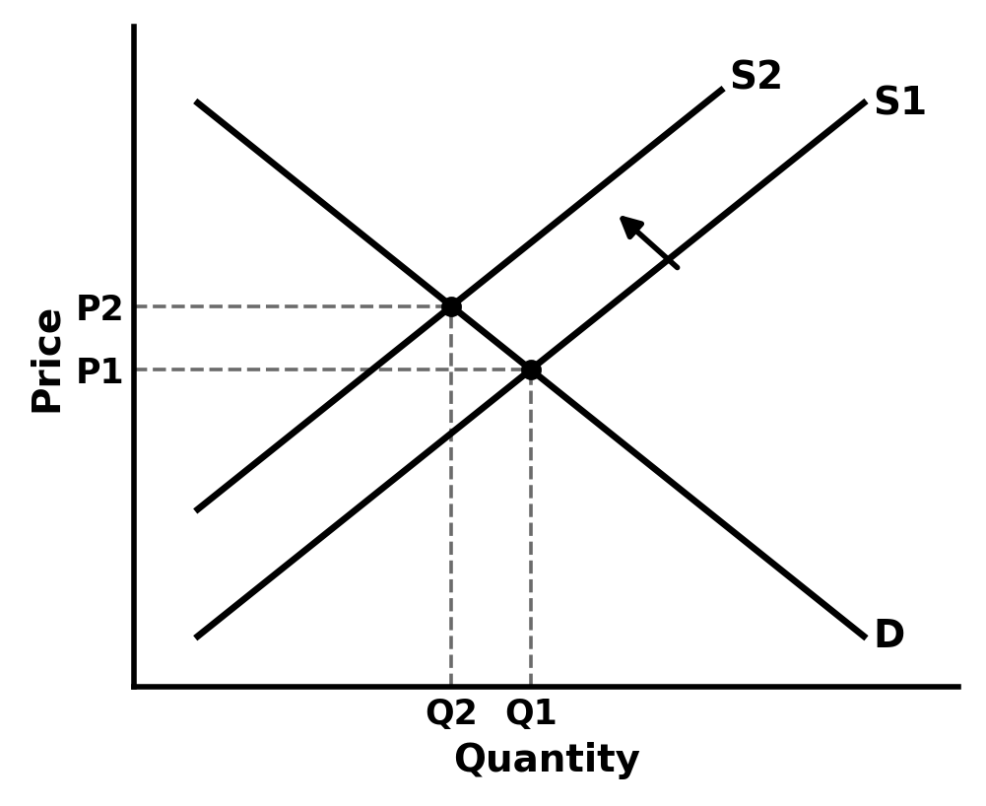
3 - A SHIFT IN SUPPLY
AQA 7136 4.1.3 Edexcel 9EC0 Theme 1 (1.2)
WHAT EARNS THE MARK
• Arrow on the shift, direction matching the story (costs up = supply left).
• S1 and S2 labelled.
• Both equilibria dashed to both axes.
• The result stated from the diagram: price rises, quantity falls.
THE MISTAKE: An arrowless pair of parallel lines. If S1 and S2 are not labelled and arrowed, the examiner cannot tell whether supply rose or fell - and neither can the student writing the analysis under it.

Slide 6
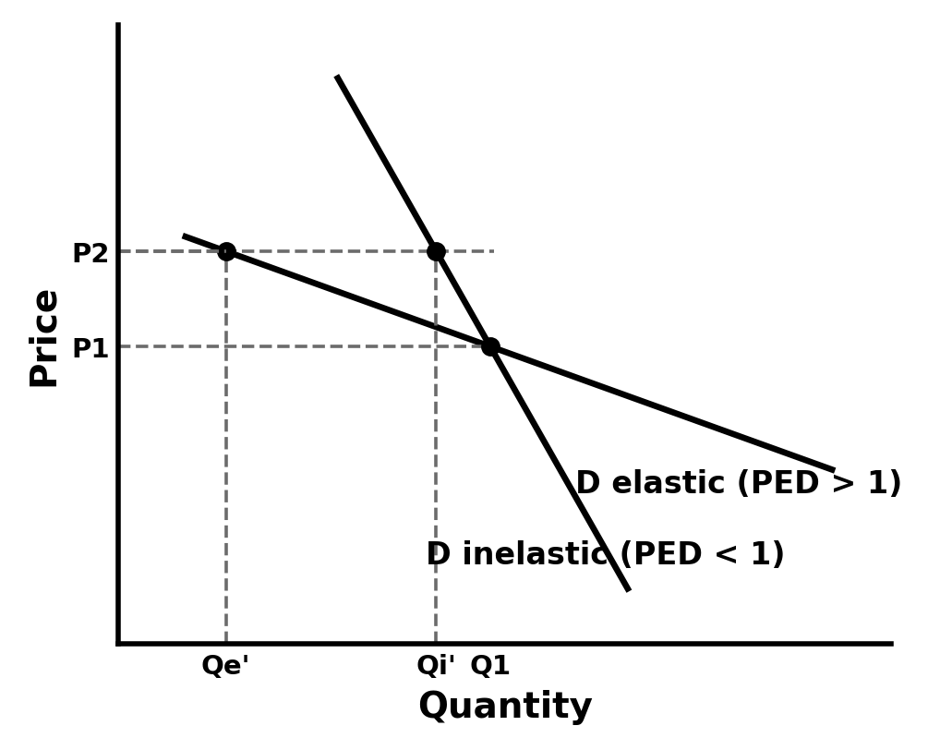
4 - PED: ELASTIC VS INELASTIC DEMAND
AQA 7136 4.1.3 Edexcel 9EC0 Theme 1 (1.2)
WHAT EARNS THE MARK
• Both demand curves drawn through the SAME point, so the comparison is fair.
• The same price change marked on both curves.
• The quantity responses compared on the horizontal axis - large for elastic, small for inelastic.
• PED values stated: elastic means PED greater than 1 (ignoring the sign), inelastic less than 1.
THE MISTAKE: Writing that the slope IS the elasticity. A straight-line demand curve has a different PED at every point along it - steep versus flat only works as a comparison of two curves at the same point and scale. Saying this earns evaluation credit; confusing it loses marks.

Slide 7
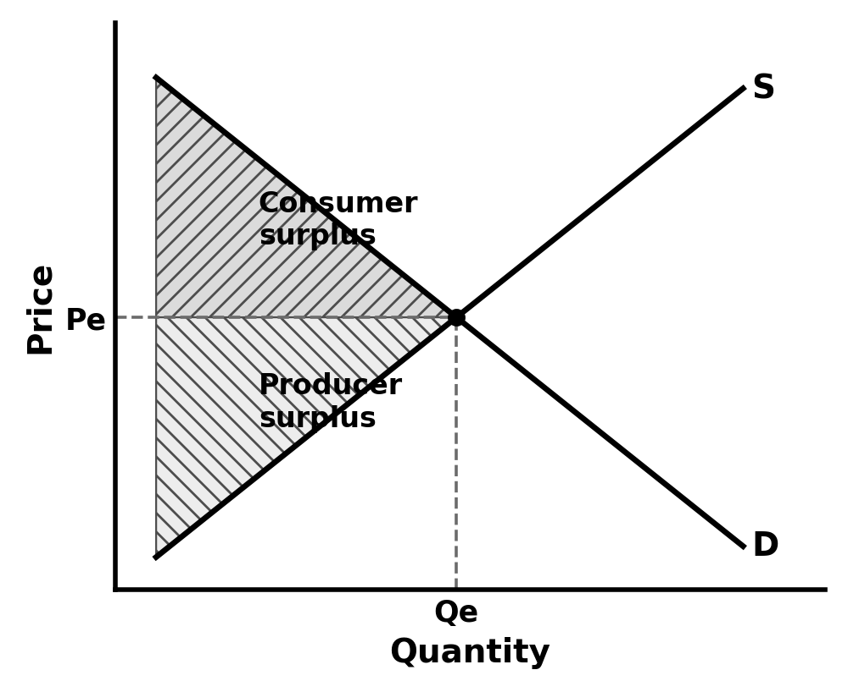
5 - CONSUMER AND PRODUCER SURPLUS
AQA 7136 4.1.3 Edexcel 9EC0 Theme 1 (1.2)
WHAT EARNS THE MARK
• Consumer surplus: the triangle BELOW demand and ABOVE the price paid.
• Producer surplus: the triangle ABOVE supply and BELOW the price received.
• Both areas shaded and labelled - not just pointed at.
• Equilibrium dashed to both axes.
THE MISTAKE: Shading past the equilibrium quantity. Surplus only exists on units actually traded - nothing to the right of Qe is anyone's surplus.

Slide 8
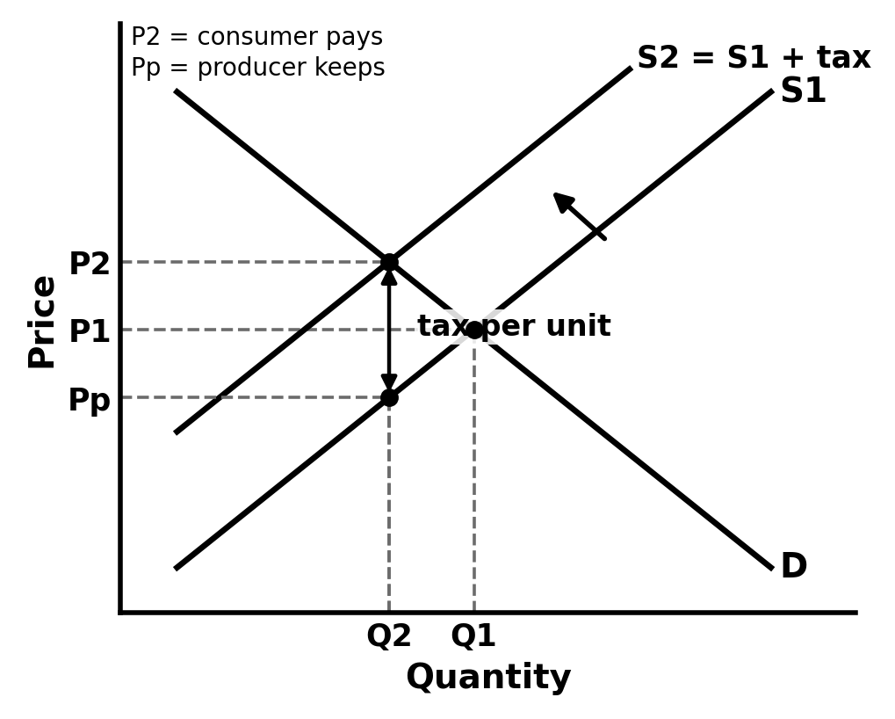
6 - AN INDIRECT TAX (SPECIFIC)
AQA 7136 4.1.8 Edexcel 9EC0 Theme 1 (1.2)
WHAT EARNS THE MARK
• A specific (per-unit) tax shifts supply up in PARALLEL; the vertical gap between S1 and S2 equals the tax per unit.
• The new market price rises by LESS than the tax.
• Three prices marked: what the consumer now pays, the old price, and what the producer keeps after tax.
• The consumer and producer shares of the tax identified on the price axis.
THE MISTAKE: Showing the price rising by the full amount of the tax. That only happens when demand is perfectly inelastic - with a normal downward-sloping demand curve the burden is shared between consumer and producer.

Slide 9
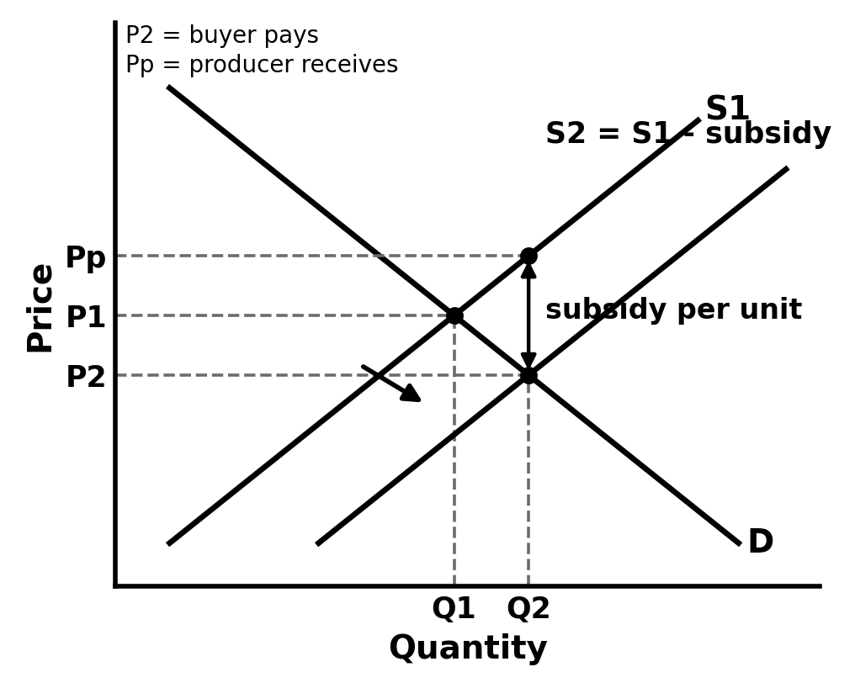
7 - A SUBSIDY
AQA 7136 4.1.8 Edexcel 9EC0 Theme 1 (1.2)
WHAT EARNS THE MARK
• Supply shifts down/right; the vertical gap between S1 and S2 equals the subsidy per unit.
• The market price falls and quantity rises.
• The price the producer receives (market price plus subsidy) marked separately from the price the buyer pays.
• Arrow and labels on the shift.
THE MISTAKE: Shifting demand. The subsidy is paid to producers - it lowers their cost of supplying each unit, so it is the supply curve that moves.

Slide 10
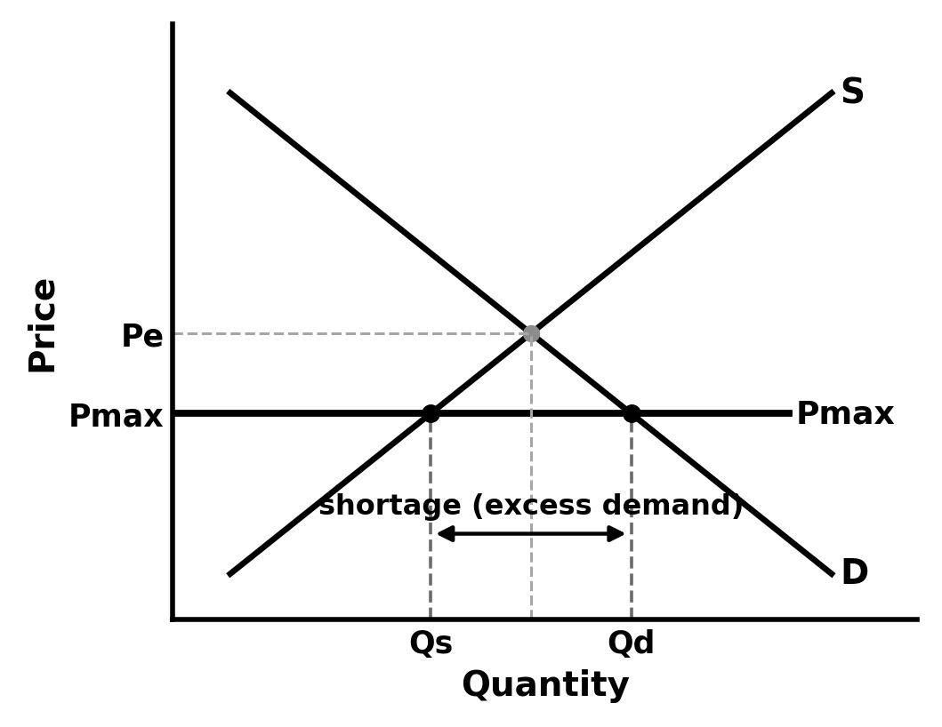
8 - A MAXIMUM PRICE
AQA 7136 4.1.8 Edexcel 9EC0 Theme 1 (1.4)
WHAT EARNS THE MARK
• The price ceiling drawn as a horizontal line BELOW the equilibrium.
• Labelled Pmax.
• Qd and Qs at Pmax both dropped to the quantity axis.
• The shortage (excess demand) bracketed and labelled between them.
THE MISTAKE: Drawing the ceiling above the equilibrium. A maximum price set above the market price changes nothing - and 'explain why this maximum price would have no effect' is exactly how examiners test it.

Slide 11
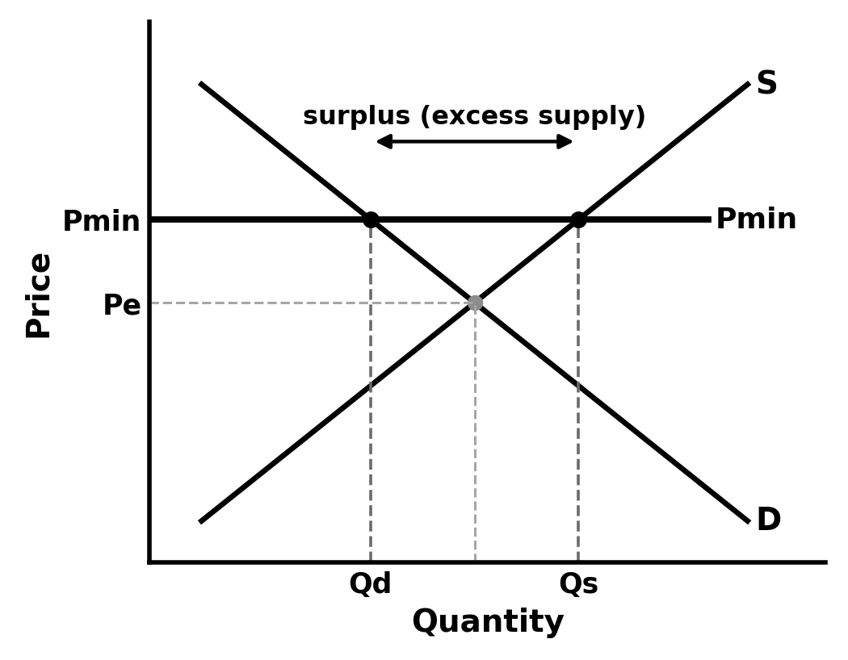
9 - A MINIMUM PRICE
AQA 7136 4.1.8 Edexcel 9EC0 Theme 1 (1.4)
WHAT EARNS THE MARK
• The price floor drawn ABOVE the equilibrium, labelled Pmin.
• Qd and Qs at Pmin dropped to the axis.
• The surplus (excess supply) bracketed and labelled.
• If the context is alcohol minimum unit pricing or a wage floor, the axes renamed to match the market.
THE MISTAKE: Drawing the floor below equilibrium, where it has no effect. The same logic transfers to the minimum wage diagram - but there the axes must change to wage rate and quantity of labour.

Slide 12
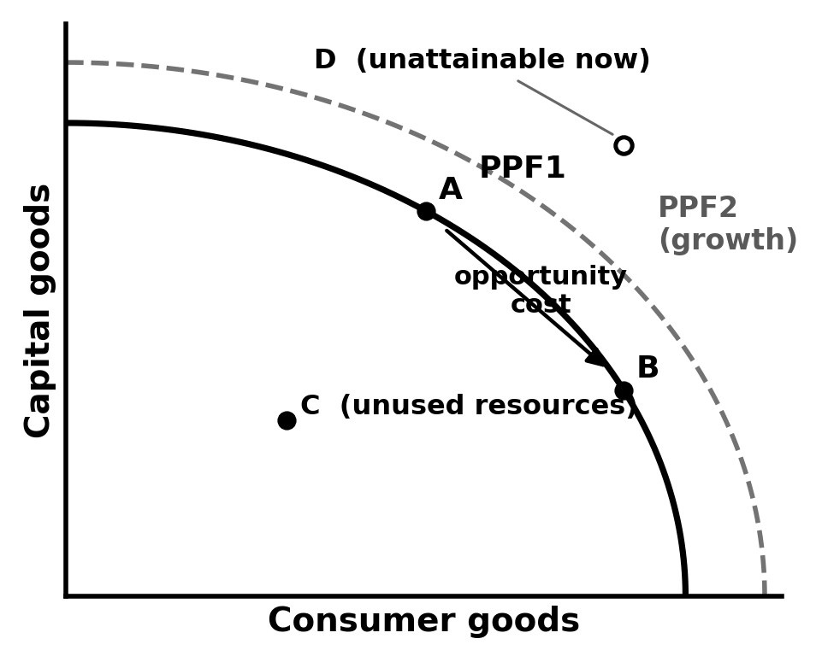
10 - THE PRODUCTION POSSIBILITY FRONTIER
AQA 7136 4.1.1 Edexcel 9EC0 Theme 1 (1.1)
WHAT EARNS THE MARK
• The axes are TWO GOODS (here capital goods and consumer goods) - there is no price on a PPF.
• The curve bows outward (concave to the origin) - moving along it, opportunity cost rises.
• Points labelled: on the frontier productively efficient, inside it unused resources, outside it currently unattainable.
• An outward shift labelled as economic growth in productive capacity.
THE MISTAKE: Putting price or quantity on the axes. The PPF is a real-output diagram - the moment an axis says 'Price', the diagram is answering a different question.

Slide 13
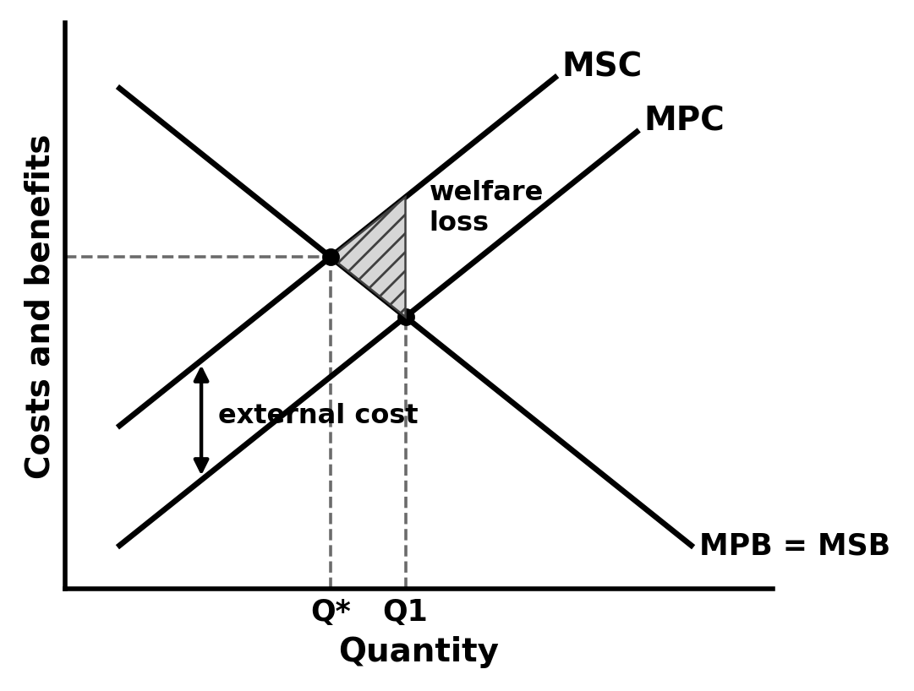
11 - NEGATIVE PRODUCTION EXTERNALITY
AQA 7136 4.1.8 Edexcel 9EC0 Theme 1 (1.3)
WHAT EARNS THE MARK
• Vertical axis labelled 'Costs and benefits', not 'Price'.
• MSC drawn above MPC; the vertical gap labelled as the external cost.
• Market output Q1 where MPC = MPB; social optimum Q* where MSC = MSB.
• The welfare loss triangle sits between Q* and Q1, with its point (apex) ON the social optimum.
THE MISTAKE: The welfare loss triangle drawn the wrong way round. Its apex sits at the social optimum and it opens out towards Q1 - it measures the damage from the units society should not have produced.

Slide 14
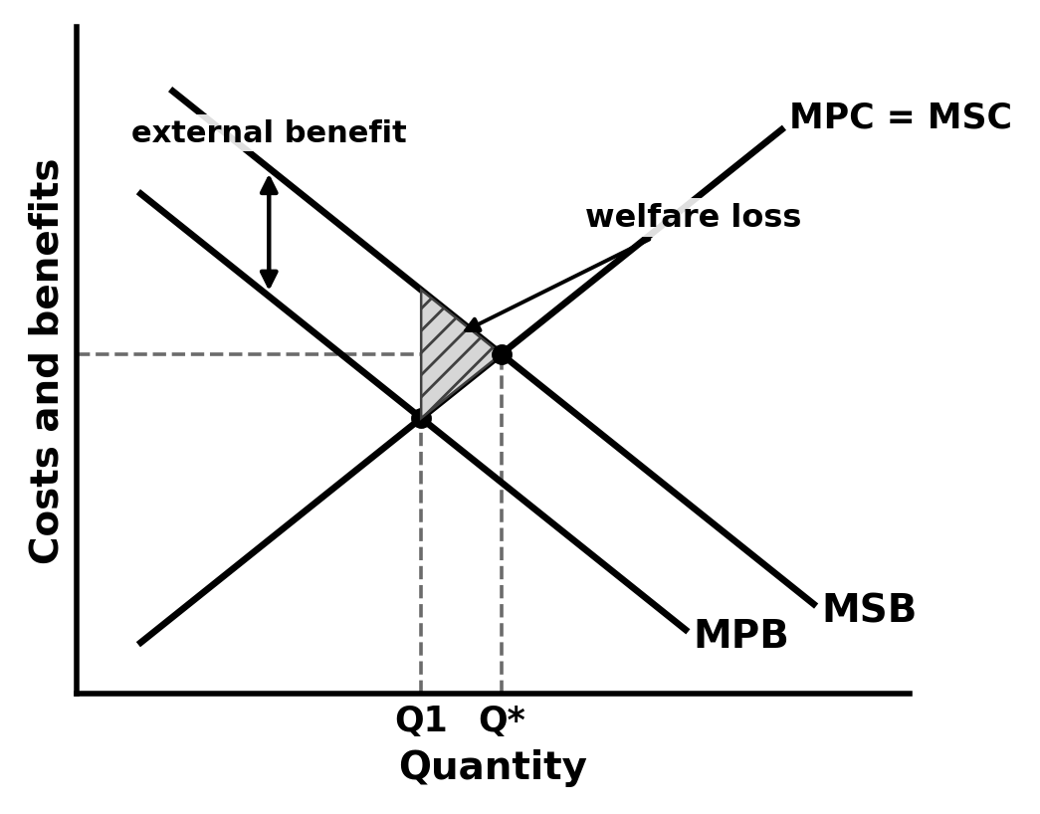
12 - POSITIVE CONSUMPTION EXTERNALITY
AQA 7136 4.1.8 Edexcel 9EC0 Theme 1 (1.3)
WHAT EARNS THE MARK
• MSB drawn above MPB; the vertical gap labelled as the external benefit.
• Market output Q1 where MPB = MPC; social optimum Q* where MSB = MSC - the market UNDER-consumes.
• Welfare loss triangle between Q1 and Q*, apex on the social optimum.
• Context named: vaccination, education, dental check-ups.
THE MISTAKE: Shifting supply. Vaccination and education problems live on the benefit side of the diagram - it is the benefit curves (MPB vs MSB) that are apart, not the cost curves.

Slide 15
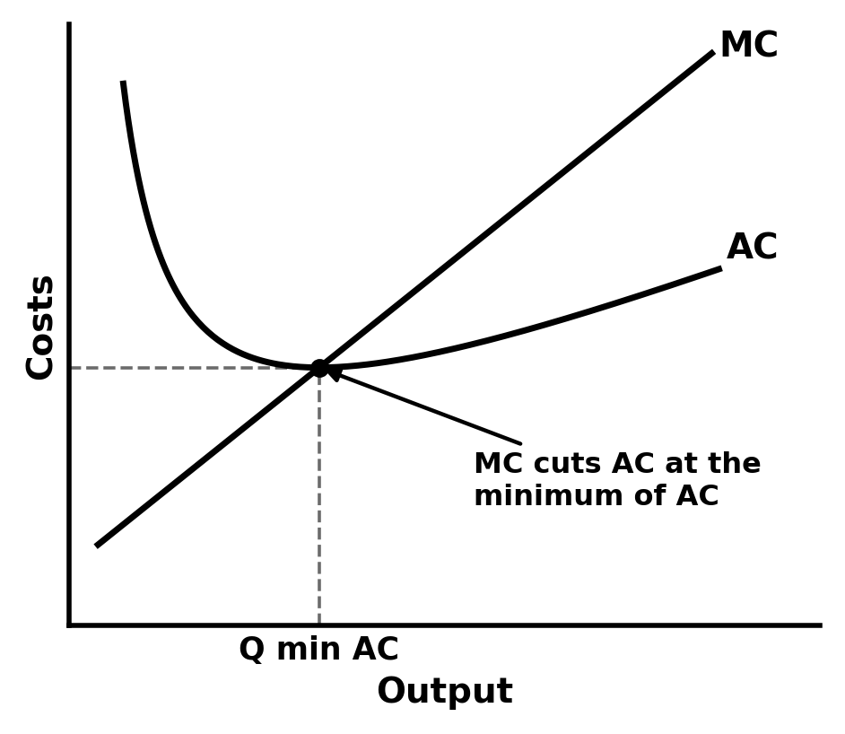
13 - AVERAGE AND MARGINAL COST
AQA 7136 4.1.4 Edexcel 9EC0 Theme 3 (3.3)
WHAT EARNS THE MARK
• AC drawn as a U-shape against output.
• MC cuts AC at the EXACT minimum point of AC, from below.
• Both curves labelled; horizontal axis labelled Output.
• The minimum point of AC marked - it is the productively efficient output.
THE MISTAKE: MC crossing AC somewhere other than its minimum. While the marginal is below the average, the average must still be falling; once above, it pulls the average up - so the crossing point IS the minimum. Examiners look for exactly this.

Slide 16
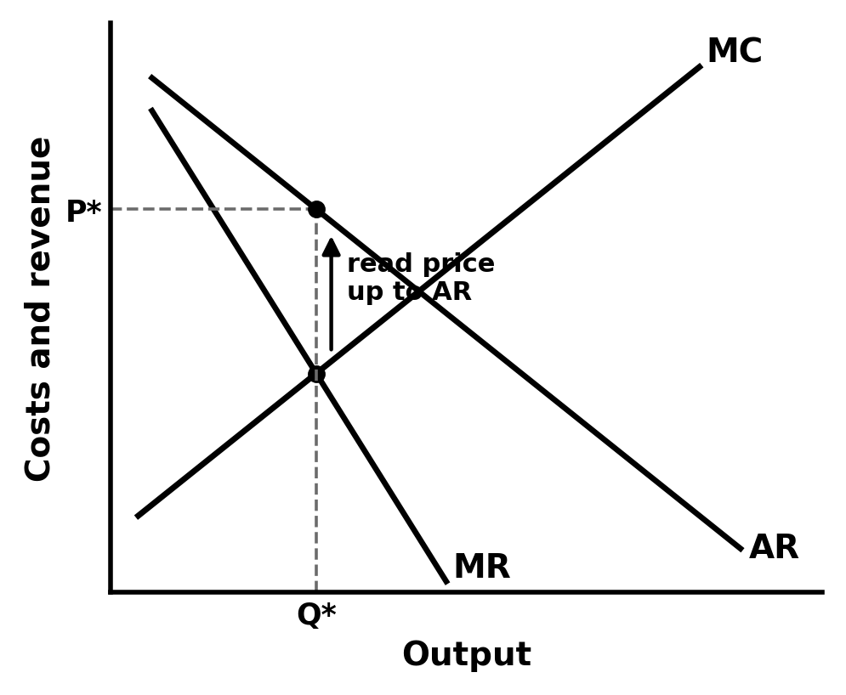
14 - PROFIT MAXIMISATION: MC = MR
AQA 7136 4.1.5 Edexcel 9EC0 Theme 3 (3.2/3.3)
WHAT EARNS THE MARK
• Output chosen where MC = MR, dropped to the axis as Q*.
• Price found by reading UP from Q* to AR, then across - labelled P*.
• For a straight-line AR, MR drawn with twice the slope, hitting the axis at half the quantity.
• All five labels present: AR, MR, MC, Q*, P*.
THE MISTAKE: Reading the price off MR. MR tells the firm where to produce; AR (the demand curve) tells it what price that output sells for. Price comes off AR, always.

Slide 17
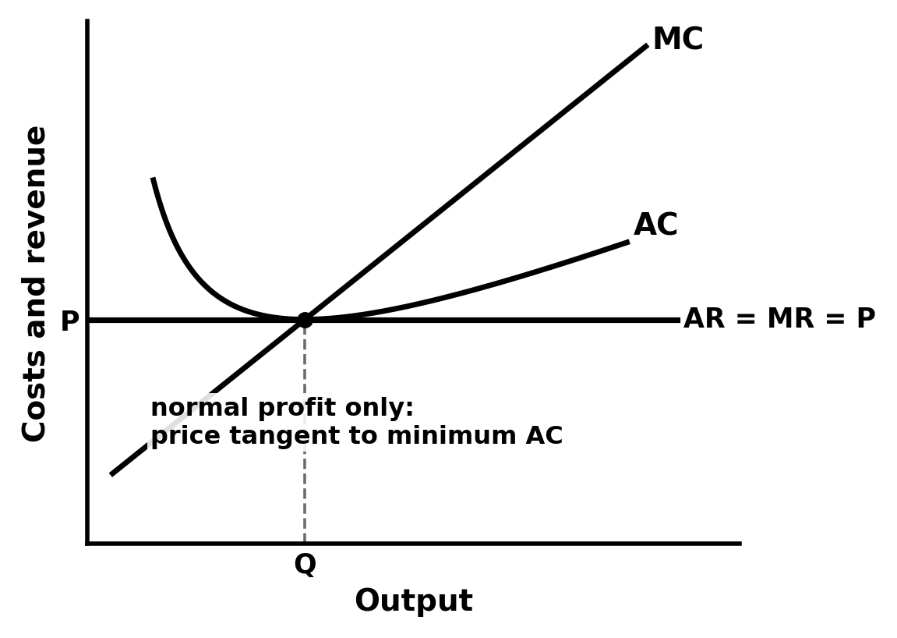
15 - PERFECT COMPETITION IN THE LONG RUN
AQA 7136 4.1.5 Edexcel 9EC0 Theme 3 (3.4)
WHAT EARNS THE MARK
• The firm's demand is horizontal: AR = MR = the market price.
• In the long run the price line is TANGENT to the minimum of AC - normal profit only.
• MC passes through the same point.
• The story stated: supernormal profit attracts entry, which pushes price down to this tangency.
THE MISTAKE: Leaving supernormal profit in a long-run diagram. Free entry competes it away - if the horizontal price line sits above minimum AC, the diagram is a short-run diagram wearing the wrong title.

Slide 18
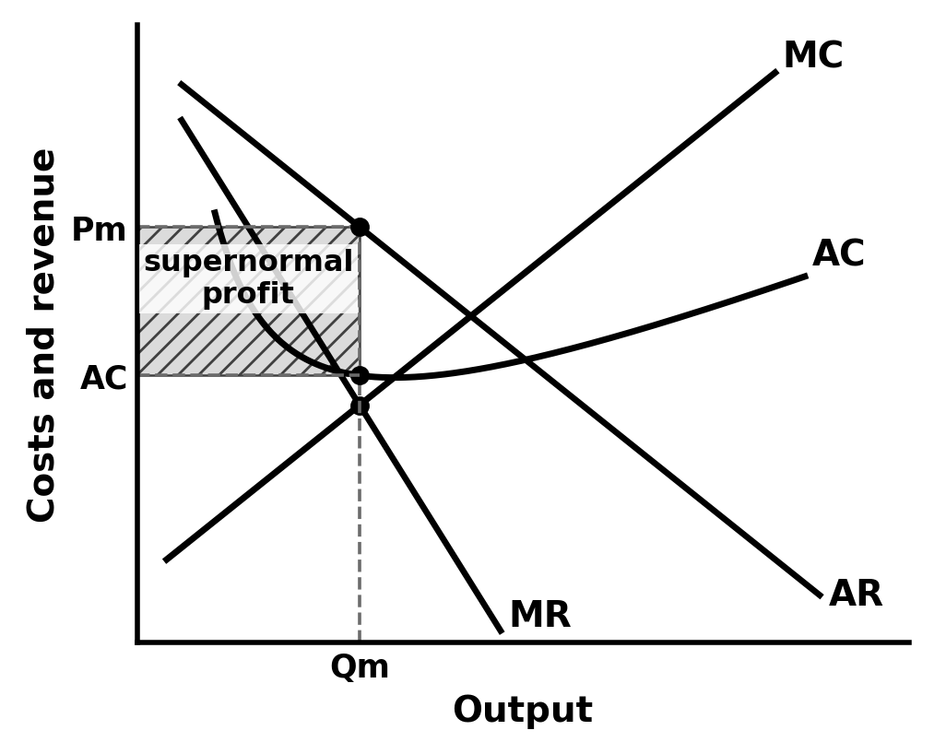
16 - MONOPOLY
AQA 7136 4.1.5 Edexcel 9EC0 Theme 3 (3.4)
WHAT EARNS THE MARK
• Output Qm where MC = MR; price Pm read up to AR.
• MR below AR with twice the slope.
• The supernormal profit rectangle: between Pm and AC at Qm, across the output sold - shaded and labelled.
• AC drawn so the rectangle is measurable (AC at Qm below Pm).
THE MISTAKE: Drawing the profit rectangle down to MC instead of AC. Profit per unit is AR minus AVERAGE cost - the rectangle's floor is the AC curve at Qm, nothing else.

Slide 19
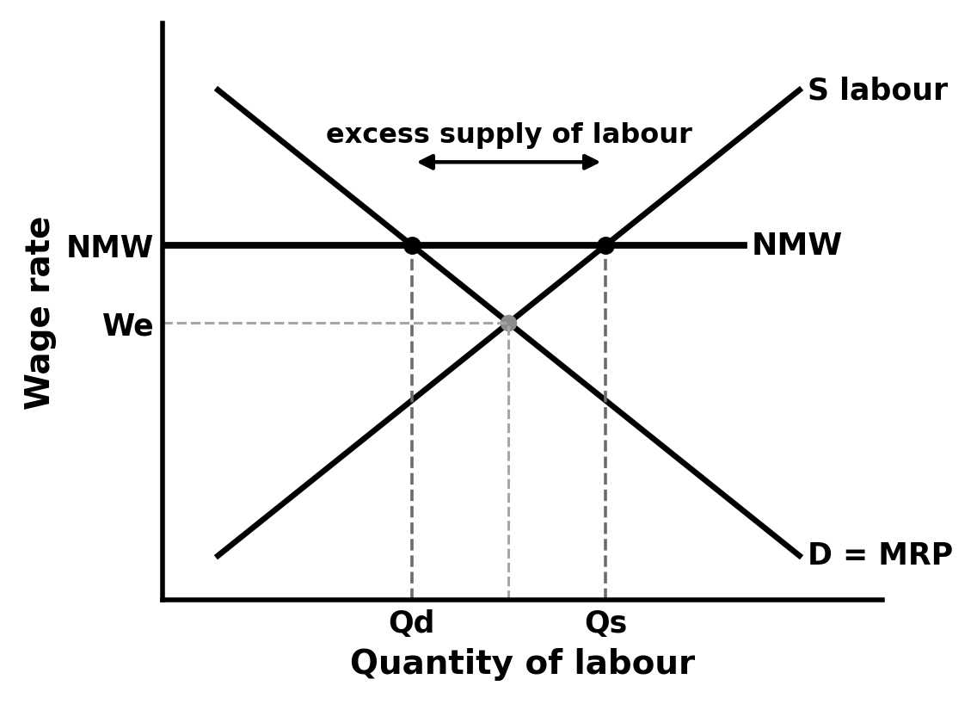
17 - THE LABOUR MARKET AND A MINIMUM WAGE
AQA 7136 4.1.6 Edexcel 9EC0 Theme 3 (3.5)
WHAT EARNS THE MARK
• Axes relabelled: Wage rate on the vertical, Quantity of labour on the horizontal.
• Demand for labour labelled MRP, sloping down; supply of labour sloping up.
• The minimum wage drawn ABOVE the equilibrium wage.
• The excess supply of labour bracketed between Qd and Qs.
THE MISTAKE: Recycling product-market labels. P, Q, D and S on a labour diagram loses the application marks - the axes ARE the marks here: wage rate, quantity of labour, MRP.

Slide 20
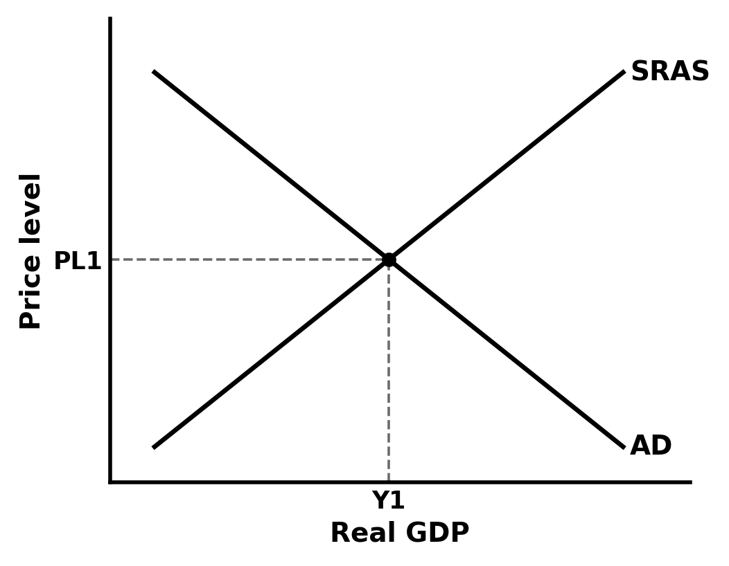
18 - AD/AS EQUILIBRIUM
AQA 7136 4.2.2 Edexcel 9EC0 Theme 2 (2.3/2.4)
WHAT EARNS THE MARK
• Vertical axis 'Price level', horizontal axis 'Real GDP' (or real national output).
• AD sloping down, SRAS sloping up, both labelled.
• Equilibrium dashed to both axes and labelled PL1 and Y1.
• No micro labels anywhere.
THE MISTAKE: Micro labels on a macro diagram. 'Price' and 'Quantity' instead of 'Price level' and 'Real GDP' loses the diagram marks before the analysis has even started - it is the single most common AD/AS error.

Slide 21
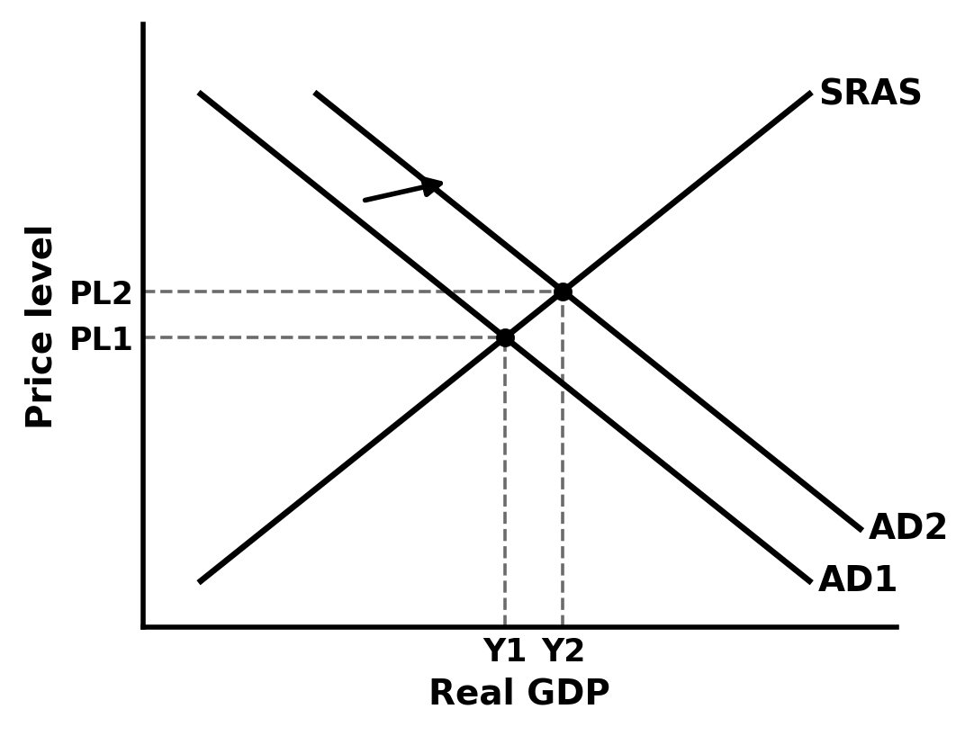
19 - A SHIFT IN AD
AQA 7136 4.2.2 Edexcel 9EC0 Theme 2 (2.2)
WHAT EARNS THE MARK
• AD1 and AD2 labelled, with an arrow.
• Both equilibria dashed: PL1 to PL2, Y1 to Y2.
• The driver of the shift named in the analysis (a component of AD: C, I, G or X-M).
• Macro axis labels kept.
THE MISTAKE: Shifting AD because the price level changed. A change in the price level is a movement ALONG AD - the same along-versus-shift discipline as micro, and examiners test it the same way.

Slide 22
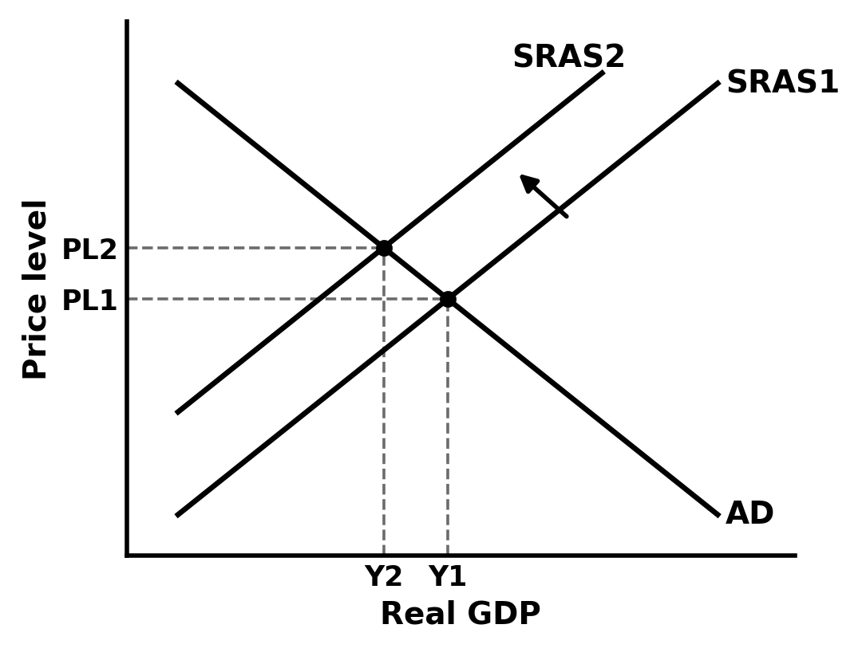
20 - A SHIFT IN SRAS
AQA 7136 4.2.2 Edexcel 9EC0 Theme 2 (2.3)
WHAT EARNS THE MARK
• SRAS shifts left for a rise in business costs (energy, wages, imported materials).
• Result read off: price level UP and real GDP DOWN together.
• Both curves labelled, arrow on the shift, both equilibria dashed.
• That combination named in analysis: it is the stagflation pair.
THE MISTAKE: Moving AD in the same diagram 'because everything changed'. One shock, one curve - then analyse the new equilibrium. Two curves moving at once makes the diagram unreadable and unmarkable.

Slide 23
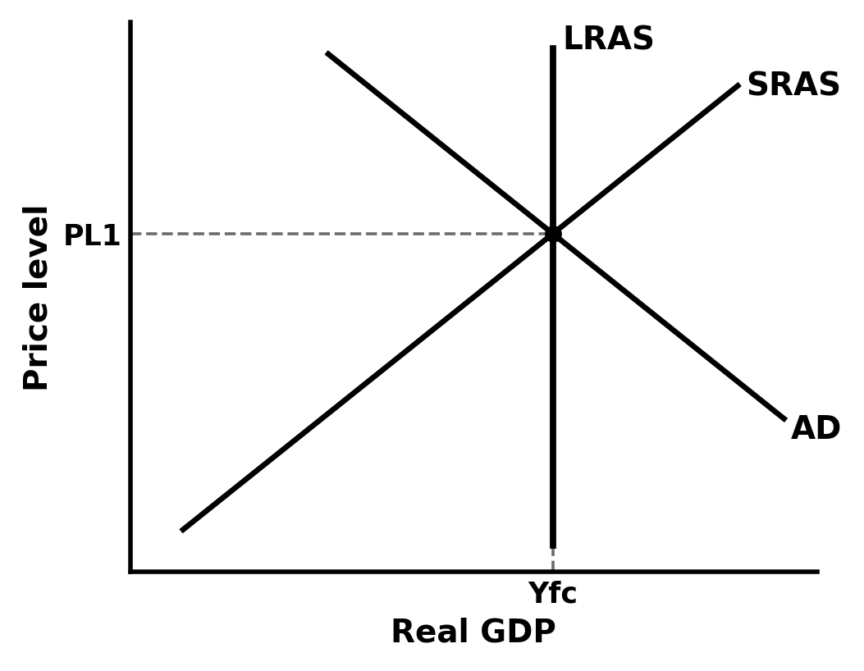
21 - LONG-RUN EQUILIBRIUM: CLASSICAL LRAS
AQA 7136 4.2.2 Edexcel 9EC0 Theme 2 (2.3)
WHAT EARNS THE MARK
• LRAS drawn VERTICAL at full-employment output, labelled Yfc.
• AD and SRAS crossing on the LRAS line in long-run equilibrium.
• Yfc dropped to the axis.
• The meaning stated: in the classical model, potential output does not depend on the price level.
THE MISTAKE: A sloping LRAS. The whole point of the classical long run is that output is fixed by resources and productivity, not the price level - if the line leans, the model is gone.

Slide 24
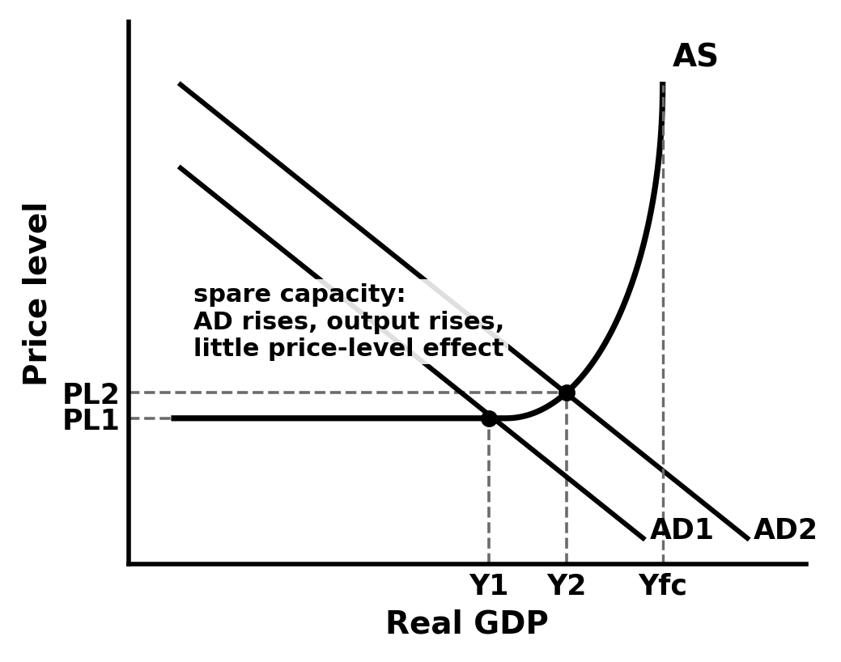
22 - KEYNESIAN AS AND SPARE CAPACITY
AQA 7136 4.2.2 Edexcel 9EC0 Theme 2 (2.3)
WHAT EARNS THE MARK
• The Keynesian AS: flat at low output, curving upward, vertical at Yfc.
• AD crossing on the FLAT section = spare capacity.
• A rise in AD there raises real GDP with little effect on the price level - shown, not just said.
• Yfc labelled where the curve turns vertical.
THE MISTAKE: Equilibrium drawn beyond Yfc. Output cannot sit past the vertical section - and if AD crosses on the vertical part, a rise in AD is pure price level, which is a different answer.

Slide 25
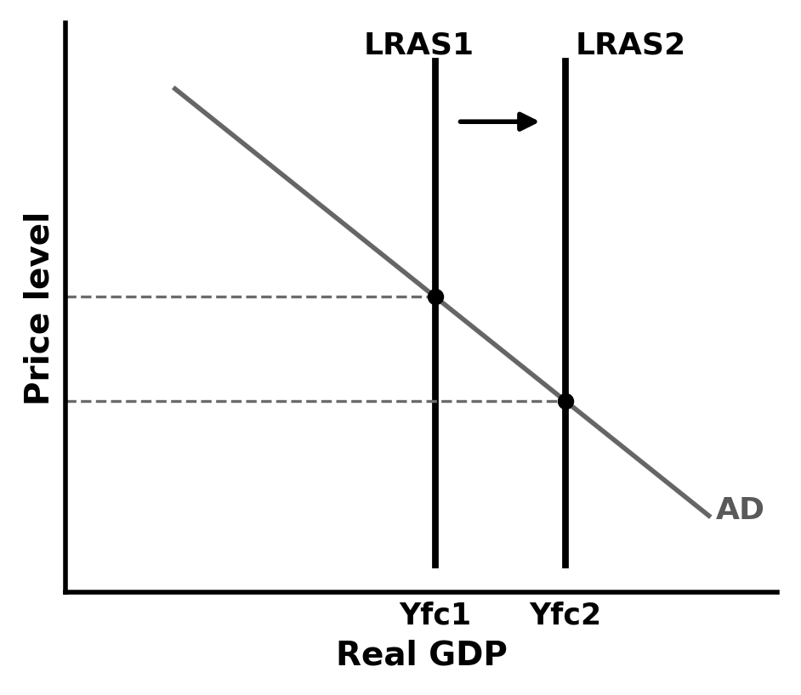
23 - ECONOMIC GROWTH: LRAS SHIFTS RIGHT
AQA 7136 4.2.3 Edexcel 9EC0 Theme 2 (2.5)
WHAT EARNS THE MARK
• LRAS1 to LRAS2 with an arrow; new full-employment output Yfc2 on the axis.
• AD kept on the diagram for context.
• The causes named as supply-side: productivity, capital stock, labour force, technology.
• The pair made: this diagram and the outward PPF shift tell the same story.
THE MISTAKE: Showing long-run growth as only an AD shift. Demand can close a gap in the short run; sustained growth needs the economy's capacity itself - the LRAS - to move.

Slide 26
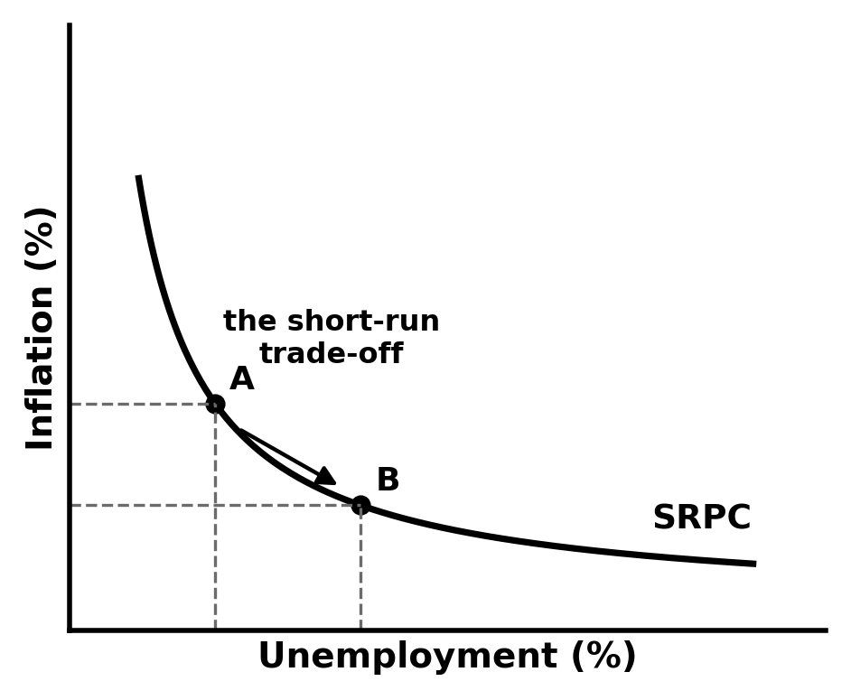
24 - THE SHORT-RUN PHILLIPS CURVE
AQA 7136 4.2.3 Edexcel 9EC0 Theme 2 (2.6)
WHAT EARNS THE MARK
• Vertical axis inflation (%), horizontal axis unemployment (%).
• The curve slopes down and is convex - flatter at high unemployment.
• The trade-off shown as a move along the curve (A to B), not a shift.
• Evaluation flagged: the trade-off is a short-run relationship; it broke down in the 1970s and can shift.
THE MISTAKE: Swapping the axes, or drawing it straight. Inflation is vertical, unemployment horizontal, and the curve bends - a straight line misses why small falls in unemployment get ever more expensive in inflation.

Slide 27
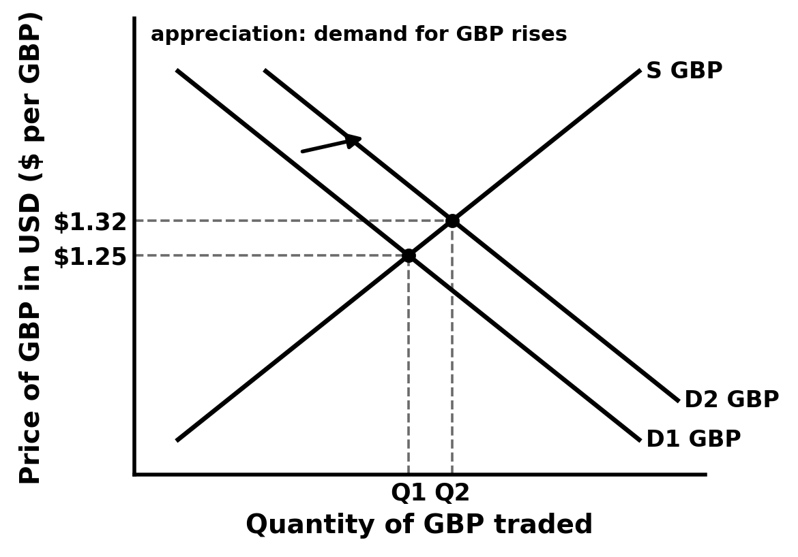
25 - THE EXCHANGE RATE: THE MARKET FOR POUNDS
AQA 7136 4.2.6 Edexcel 9EC0 Theme 4 (4.1)
WHAT EARNS THE MARK
• Vertical axis is the exchange rate IN FULL: 'Price of GBP in USD ($ per GBP)'.
• Horizontal axis: quantity of pounds traded.
• Demand for pounds (exports, inward investment) down; supply of pounds (imports, outward investment) up.
• An appreciation shown by D for pounds shifting right, with the new rate labelled.
THE MISTAKE: A vertical axis that just says 'price of currency'. The exchange rate is a price in terms of ANOTHER currency - if the axis does not say dollars per pound (or equivalent), the diagram never states what appreciated.

Slide 28
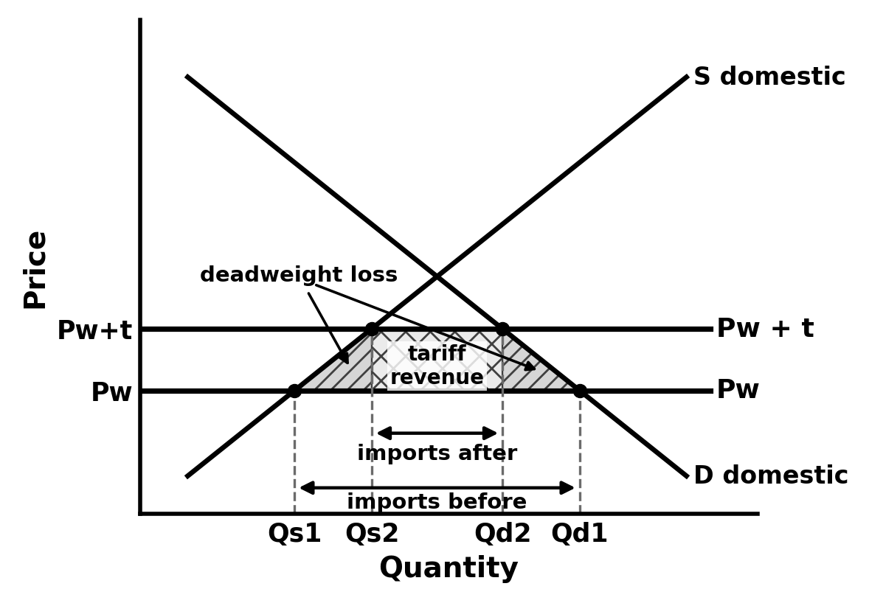
26 - A TARIFF
AQA 7136 4.2.6 Edexcel 9EC0 Theme 4 (4.1)
WHAT EARNS THE MARK
• World supply drawn HORIZONTAL (small-country assumption) below the domestic equilibrium.
• The tariff lifts the world price line by t - still below the domestic equilibrium.
• Imports marked before and after: they shrink from both ends as domestic supply expands and demand contracts.
• Government revenue = t times post-tariff imports (the rectangle); the two triangles either side are the deadweight welfare losses.
THE MISTAKE: Lifting the world price above the domestic equilibrium. Do that and imports vanish entirely - the question stops making sense. Keep Pw plus tariff below the no-trade price and every area stays readable.

Slide 29
DRAW IT, DASH IT, LABEL IT
If this bank saved you planning time, a star rating helps other teachers find it.
Author: Sakari Laajoki - TBS Education Ltd Oy (company number 3614159-3)
(c) 2026 Sakari Laajoki

