Slide 1




MVC Filters
Eyal Vardi
CEO E4D Solutions LTD Microsoft MVP Visual C# blog: www.eVardi.com

Slide 2
Agenda
What is Filters?
Built-in Filters
Filter Interfaces
Custom Filters
Filter Providers

Slide 3
ASP.NET MVC Filters
Filters are custom classes that provide both a declarative and programmatic means to add pre-action and post-action behavior to controller action methods.
[HandleError]
[Authorize]
public class CourseController : Controller {
[OutputCache]
[RequireHttps] public ActionResult Net( string name ) { ViewBag.Course = BL.GetCourse(name); return View(); }
}

Slide 4
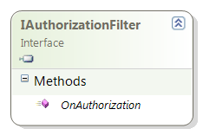
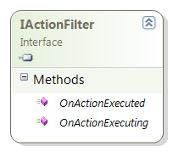
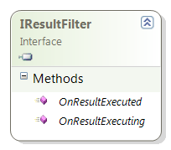
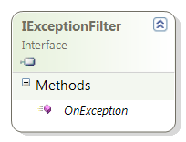
Filter Interfaces
Action Method
Action Result
1
2
3
4

Slide 5
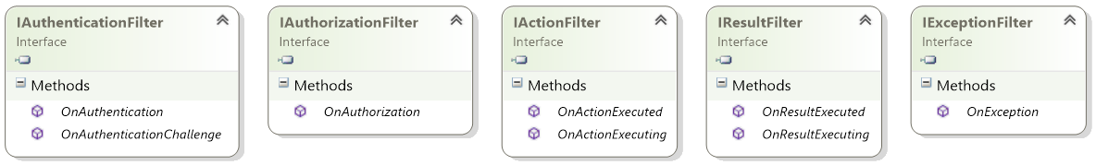

Slide 6
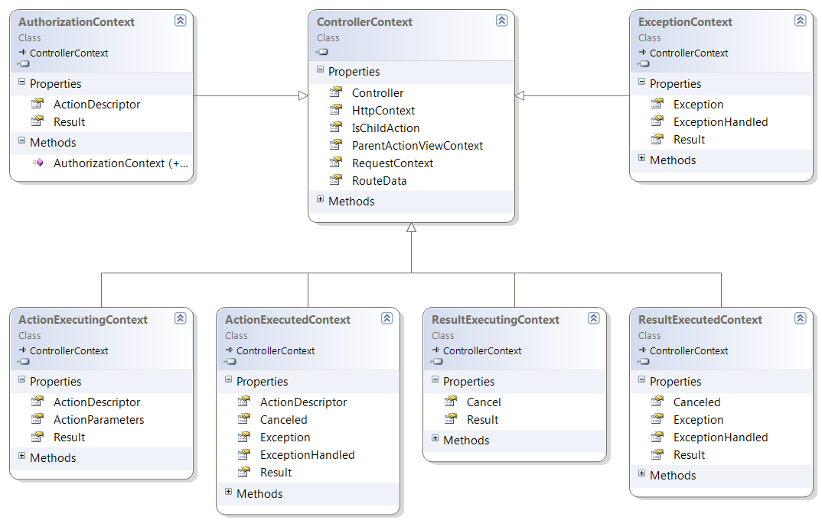
Controller Context
1
6
2
3
4
5

Slide 7
Filter Order
Filters run in the following order:
Authorization filters
Action filters
Response filters
Exception filters

Slide 8
Controller & Filters
The Controller class implements each of the filter interfaces.
You can implement any of the filters for a specific controller by overriding the controller's On<Filter> method.
OnAuthorization
OnActionExecuting
OnActionExecuted
OnResultExecuting
OnResultExecuted
OnException

Slide 9
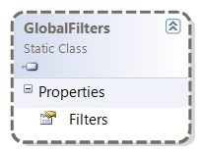
“Install” Filters
You can “Install” a filter in the following ways:
Attribute on Actions or Controllers
Add to Global Filters

Slide 10
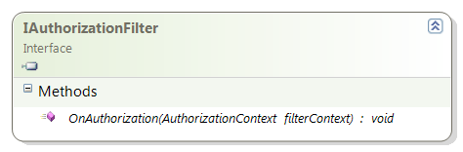
IAuthorizationFilter
Make security decisions about whether to execute an action method.
AuthorizeAttribute
RequireHttpsAttribute

Slide 11
Authorize Attribute Sample
Authorization won’t be granted unless both conditions are met, Users & Roles.
[Authorize(Users=“Eyal, Oz”, Roles=“Admin”)]
public class CourseController : Controller {
public ActionResult Net( string name ) { ViewBag.Course = BL.GetCourse(name); return View(); }
}

Slide 12
Custom Authorization Policy
public class MyAuthorizationAttribute : AuthorizeAttribute
{
protected override bool AuthorizeCore(HttpContextBase httpContext)
{
return httpContext.Request.IsLocal ||
AuthorizeCore(httpContext);
}
}

Slide 13
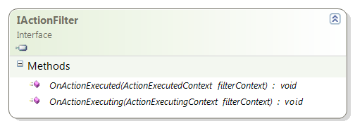
IActionFilter Interface
OnActionExecuting
Runs before the action method.
OnActionExecuted
Runs after the action method

Slide 14
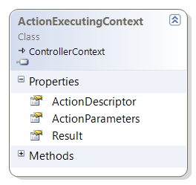
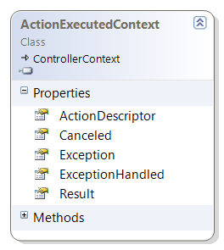
IActionFilter Context’s

Slide 15
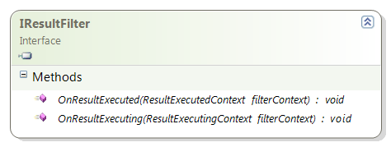
IResultFilter Interface
OnResultExecuting
Runs before the ActionResult object is executed.
OnResultExecuted
Runs after the result.
Can perform additional processing of the result.
The OutputCacheAttribute is one example of a result filter.

Slide 16
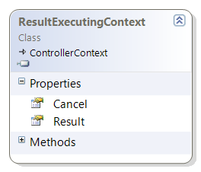
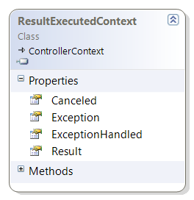
IResultFilter Context’s

Slide 17
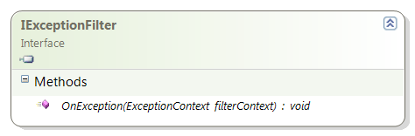
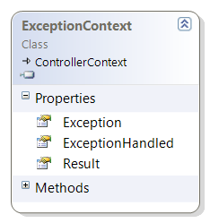
IExceptionFilter
Execute if there is an unhandled exception thrown during the execution of the ASP.NET MVC pipeline.
Can be used for logging or displaying an error page.
HandleErrorAttribute is one example of an exception filter.

Slide 18
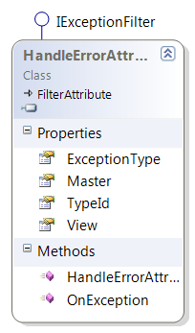
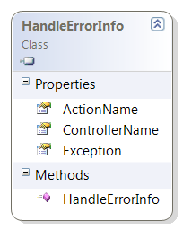
Handle Error Attribute
You can specify an exception and the names of a view and layout.
Works only when custom errors are enabled in the Web.config file
<customErrors mode="On" /> inside the <system.web>
The view get HandleErrorInfo

Slide 19
Custom Exception Filter
public class MyExceptionAttribute: FilterAttribute, IExceptionFilter {
public void OnException(ExceptionContext filterContext)
{
if (!filterContext.ExceptionHandled &&
filterContext.Exception is NullReferenceException)
{
filterContext.Result =
new RedirectResult("/MyError.html");
filterContext.ExceptionHandled = true;
}
}
}

Slide 20

Filters

Slide 21
First
Global
Controller
Action
Last
Filter I
Filter I
Filter I
Filter I
Filter I
Filter II
Filter II
Filter II
Filter II
Filter II
Action Method
Action Result
Authorization
Action
Result
Exception
Filter I
Filter I
Filter I
Filter I
Filter I
Filter II
Filter I
Filter II
Filter I
Filter II
Filter I
Filter I
Filter I
Filter I
Filter I
Filter II
Filter I
Filter II
Filter II
Filter I
Filter I
Filter I
Filter I
Filter II
Filter I
Filter I
Filter I
Filter I
Filter I
Filter II
Filter I
Filter II
Filter I
Filter II
Filter I
Filter I
Filter I
Filter I
Filter I
Filter I

Slide 22
Custom Filter
You can create a filter in the following ways:
Override one or more of the controller's On<Filter> methods.
Create an attribute class that derives from ActionFilterAttribute or FilterAttribute.
Register a filter with the filter provider (the FilterProviders class).
Register a global filter using the GlobalFilterCollection class.

Slide 23
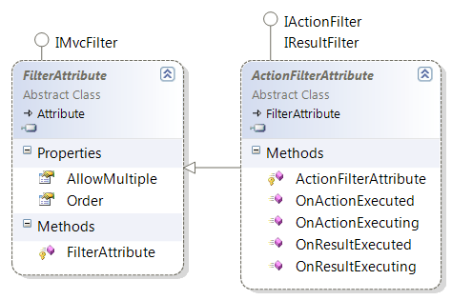
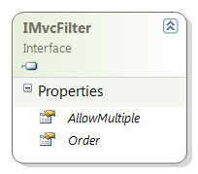
Custom Attribute Filters

Slide 24
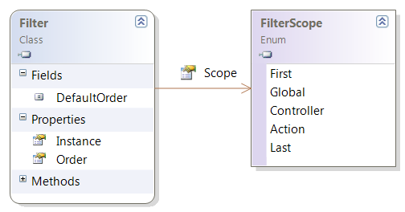
Custom Global Filters

Slide 25
Filter Providers
By default, ASP.NET MVC registers the following filter providers:
Filters for global filters.
FilterAttributeFilterProvider for filter attributes.
ControllerInstanceFilterProvider for controller instances.

Slide 26
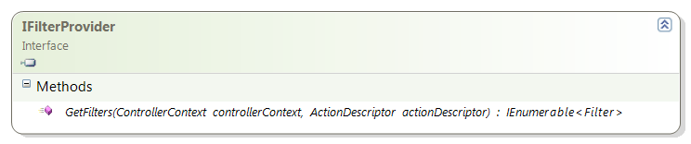
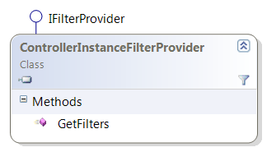
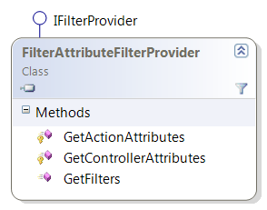
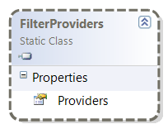
The Filter Provider Interface
The GetFilters method returns all of the IFilterProvider instances in the service locator.

