Slide 1




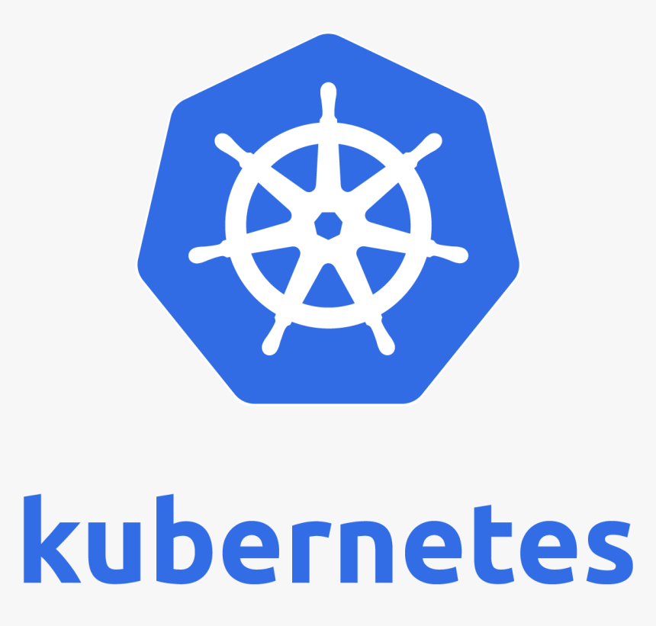
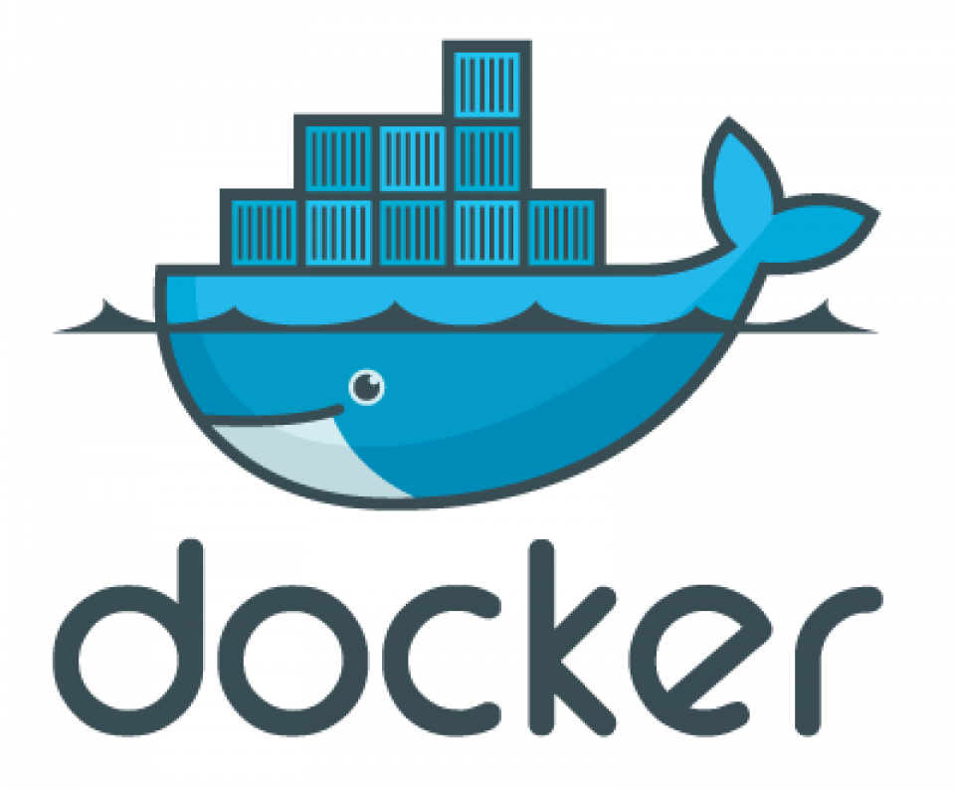


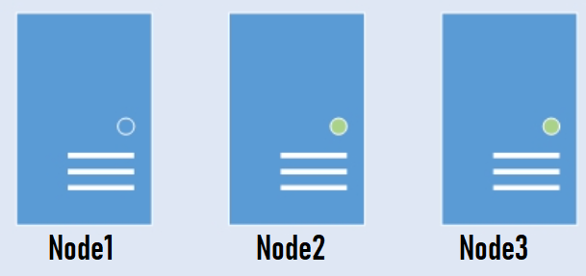
4.Push to artifactory
5.Pull Image
1.commit
2.Build
3.Docker Image
6.Deploy to multiple Servers

Slide 2
