Slide 1

WIPRO NGA Program – 25SUB4530_CP_JAVA
Capstone Project Presentation – 9th Feb & 10th Feb 2026
Project Title – Banking Account Management System
Presented by – S M Siddharth & Sakcham Singh
Team No – 17
www.rpsconsulting.in

Slide 2

Banking Management System
Introduction :
Efficiently managing bank accounts and financial records is a core requirement for modern banking. Manual record-keeping is slow and prone to errors.
The Banking Account Management System is a streamlined digital solution that allows administrators to create customer profiles, manage accounts, and handle daily transactions with precision.
The application features a clean Angular dashboard, providing instant access to account details and automated balance calculations for improved accuracy.
2024 - RPS Consulting all rights reserved

Slide 3
Banking Management System
Problem Statement :
In the Banking domain, organizations face several challenges, such as:
-- Inaccurate manual entry of customer account details.
-- Significant delays in retrieving customer transaction history.
-- Lack of real-time balance updates after deposits or withdrawals.
-- Absence of a centralized platform to monitor all customer accounts simultaneously.
-- Difficulty in maintaining data integrity across large datasets.
--A robust, automated system is essential to ensure reliability and speed in banking services.
2024 - RPS Consulting all rights reserved

Slide 4
Banking Management System
Objective :
→Primary Objectives
-- Develop a secure web portal for managing customer banking data.
-- Implement real-time transaction processing for Deposits and Withdrawals.
-- Provide a centralized dashboard for quick account lookups and status monitoring
→Secondary Objectives
-- Ensure high availability and reliability using Azure Cloud hosting.
-- Maintain detailed transaction logs for auditing and history tracking.
-- Build a responsive UI that works across different screen sizes.
2024 - RPS Consulting all rights reserved

Slide 5
Banking Management System
Key Features :
The system provides the following features:
--Customers can register using a simple form
--System checks and validates entered details
--Users can deposit or withdraw money instantly
--Each transaction is recorded automatically
--Transaction history is shown with date and reference ID
--Account balance updates immediately after each transaction
--Users can search and filter customer accounts easily
-- System shows success or error messages for every action
2024 - RPS Consulting all rights reserved

Slide 6
Banking Management System
System Architecture :
The application follows a 3-tier architecture:
#Presentation Layer
--Angular frontend
--User interface
--Displays policies data
#Application Layer
--Spring Boot backend
--REST APIs
#Data Layer
--MySQL database
--Stores Policies and categories
Flow :
User → Angular UI → Spring Boot API → Database → Spring Boot → Angular UI → User
2024 - RPS Consulting all rights reserved

Slide 7
Banking Management System
Technology Stack :
#Frontend
--Angular framework
--HTML, CSS
--Angular services for API calls
#Backend
--Spring Boot
--Spring Data JPA
--REST API architecture
--Maven build tool
#Database
--MySQL
#DevOps
--Docker for containerization
--Azure App Service for hosting
2024 - RPS Consulting all rights reserved

Slide 8
Banking Management System
Function Module :
1. Customer Management Module:
--Customer Registration & Profile Management
--View and Update Customer Details
2. Transaction Management Module:
-- Deposit & Withdrawal Processing
-- Balance Validation
-- Transaction Metadata
3. Account Assignment Module:
--Link Accounts to Customers
--Maintain Ownership Records
4. Transaction Tracking Module:
--Track Policy Status(Active, Pending, Expired)
--Monitor Account Lifecycle
5. Statement & History Management Module:
-- Generate Transaction History
-- Account Summaries
6. Audit & Log Management Module:
-- History Tracking
-- Status History
2024 - RPS Consulting all rights reserved

Slide 9
Banking Management System
User Interface:
The Angular frontend provides:
--Dashboard page
--Account Creation & Management Pages
--Transaction Interface
--Transaction History View
--Account status tracking (Active / Pending /Expired)
--Account Summary Section
--Real-time Balance Section
The UI updates in real time when accounts are created or transactions (deposits/withdrawals) are processed.
Application Workflow:
User opens application:
Admin manages customer and bank account details.
Data is sent to backend API
Backend validates and stores data
Account balance or transaction status is updated instantly.
Dashboard updates
Admin views details and status
This ensures smooth and efficient Banking Account Management.
2024 - RPS Consulting all rights reserved

Slide 10
Banking Management System
DevOps & Deployment :
→Docker:
--Containerizes backend
--Ensures consistent environment
→Azure:
--Hosts backend APIs
--Supports scalability
→Benefits:
--Easy deployment
--Cloud hosting
--High availability
2024 - RPS Consulting all rights reserved

Slide 11
Banking Management System
Advantages & Limitations :
Advantages :
--Easy to use
--Saves time
--Reduces paperwork
--Data is stored safely
--Status updates are fast
--Centralized data storage
--Accessible from anywhere
Limitations :
--Depends on server availability
--Manual data entry required
--Performance depends on the network
These limitations can be improved in future versions.
2024 - RPS Consulting all rights reserved

Slide 12
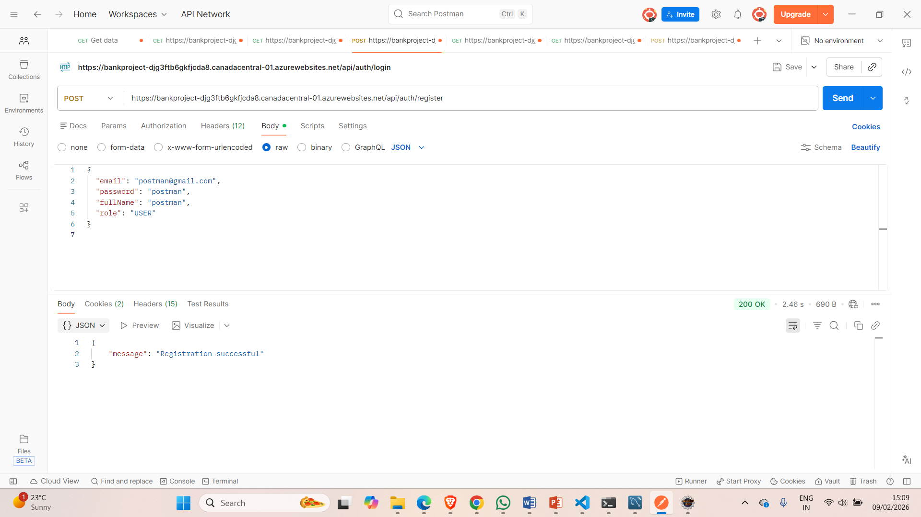
Postman

Slide 13
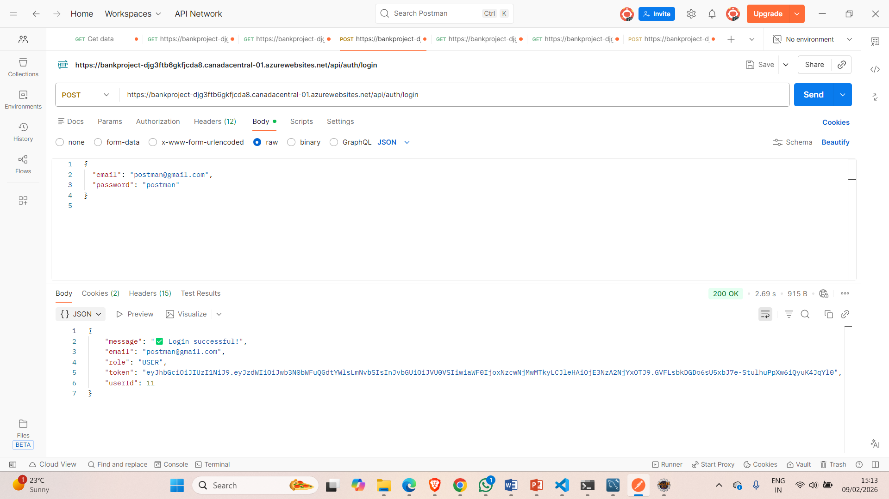

Slide 14
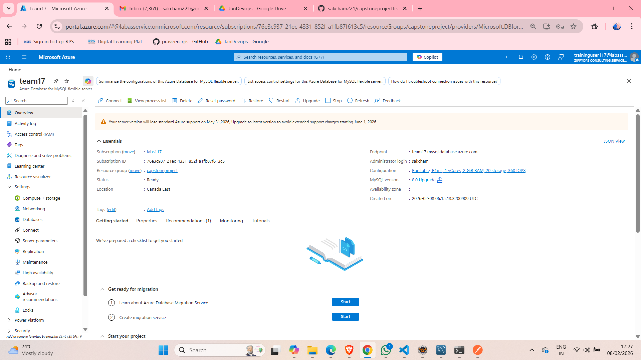
Azure database connection

Slide 15
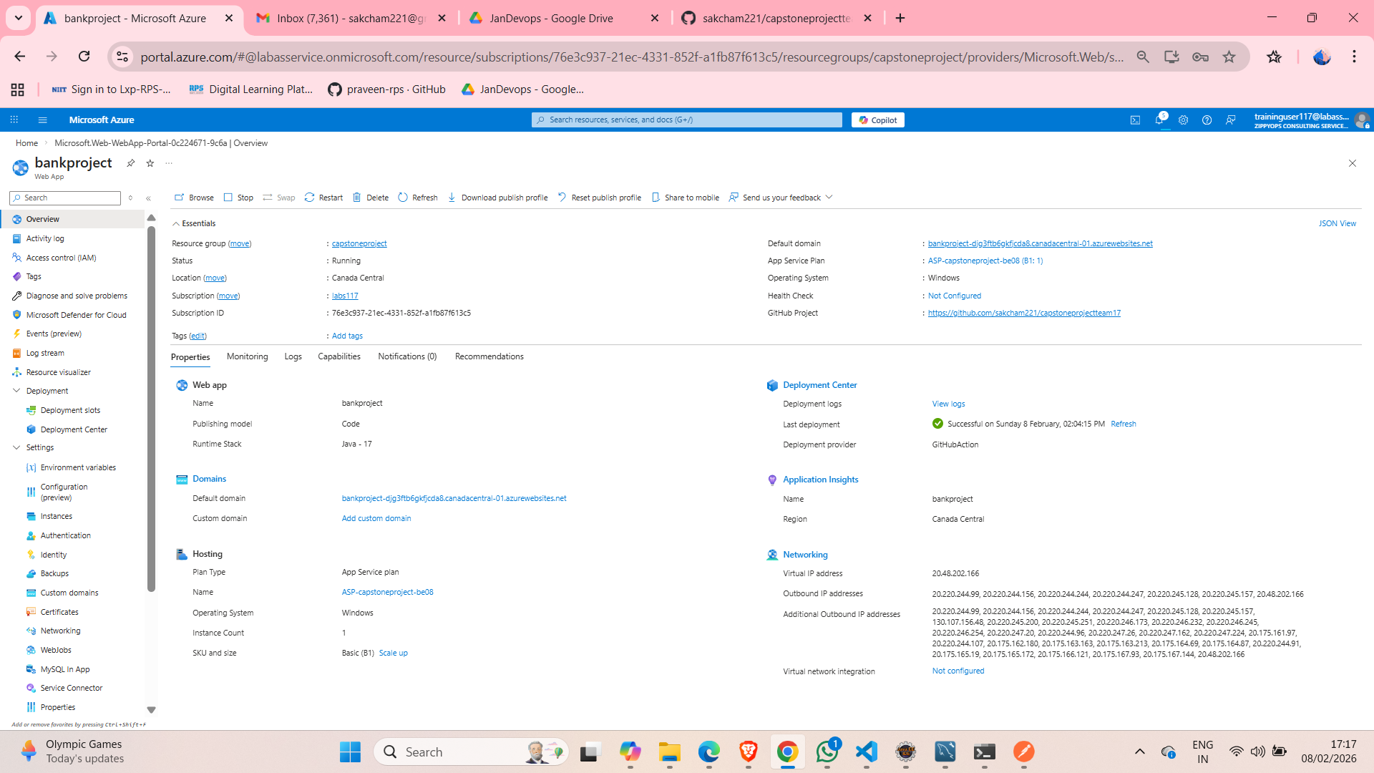
Azure backend connection

Slide 16
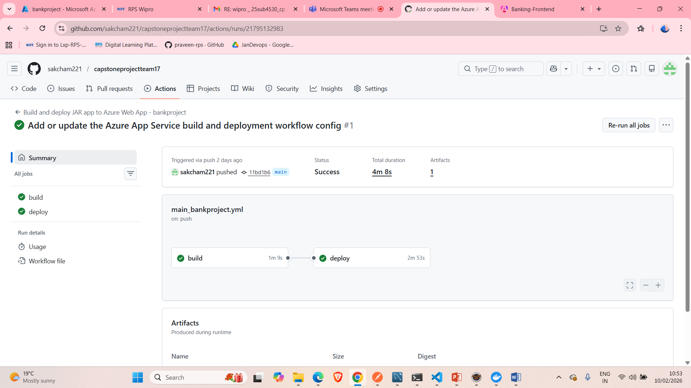
In GitHub Actions successfully build and deploy the backend

Slide 17
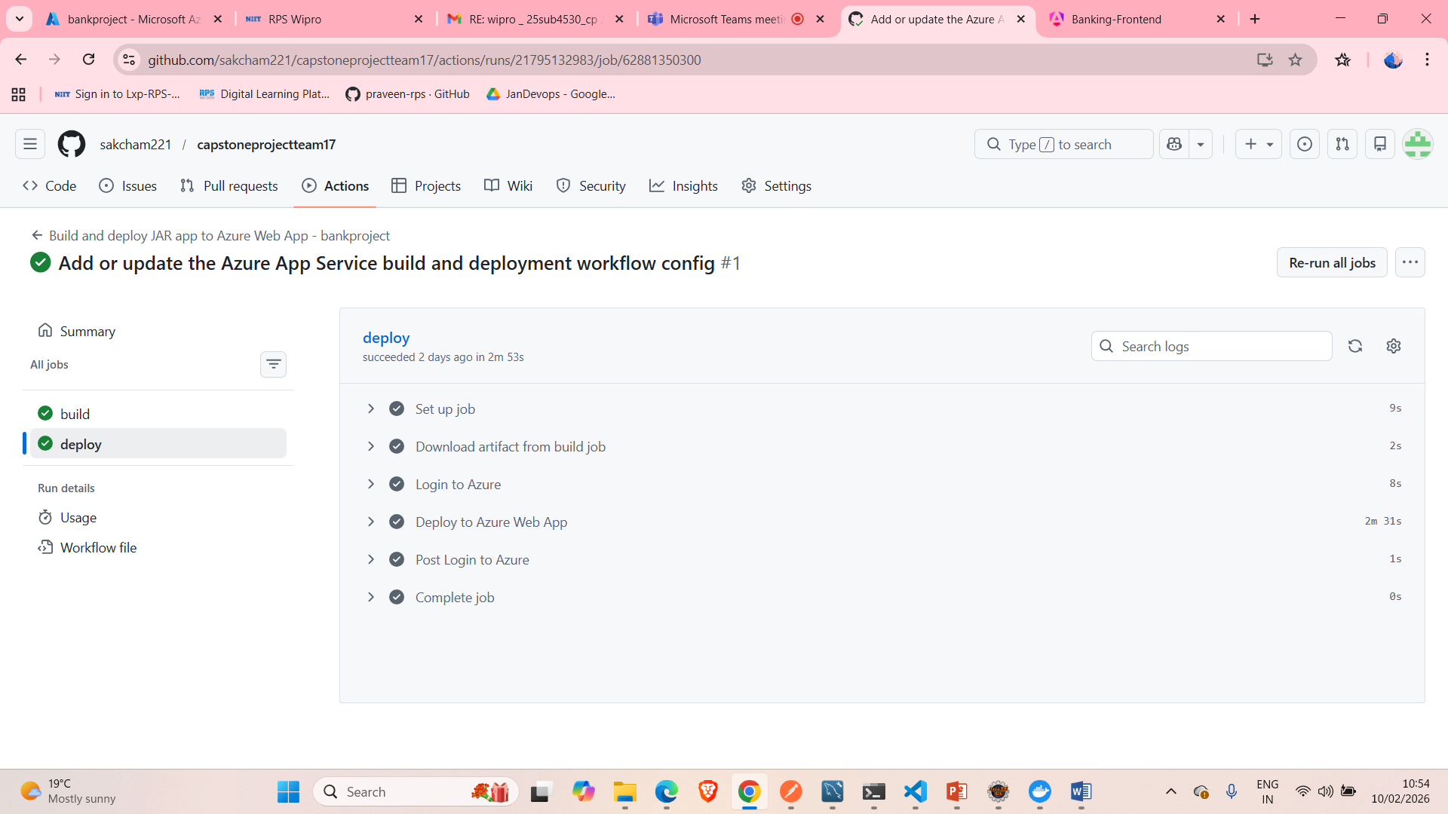
Inside view of Deploy in GitHub Actions

Slide 18
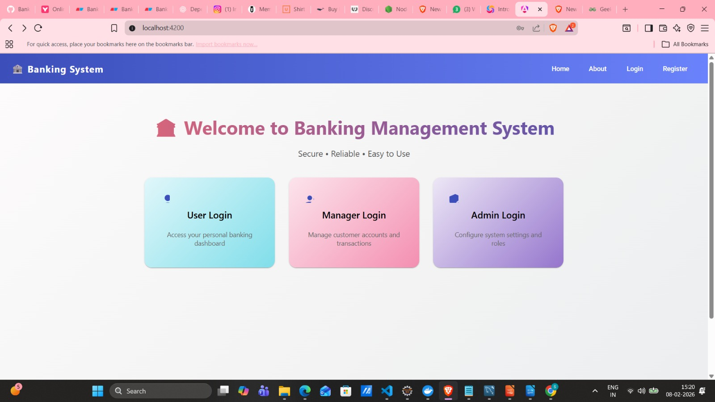
HOME PAGE OUTPUT:

Slide 19
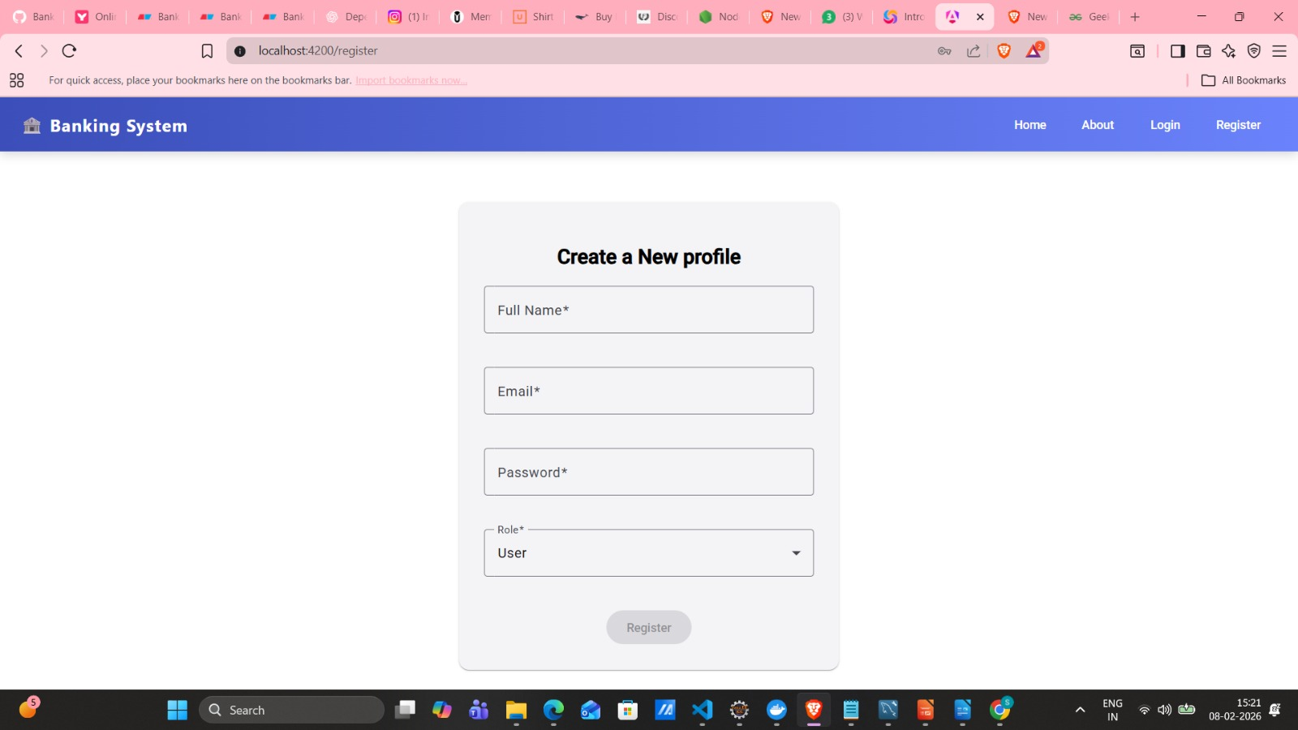
USER REGISTRATION PAGE:

Slide 20
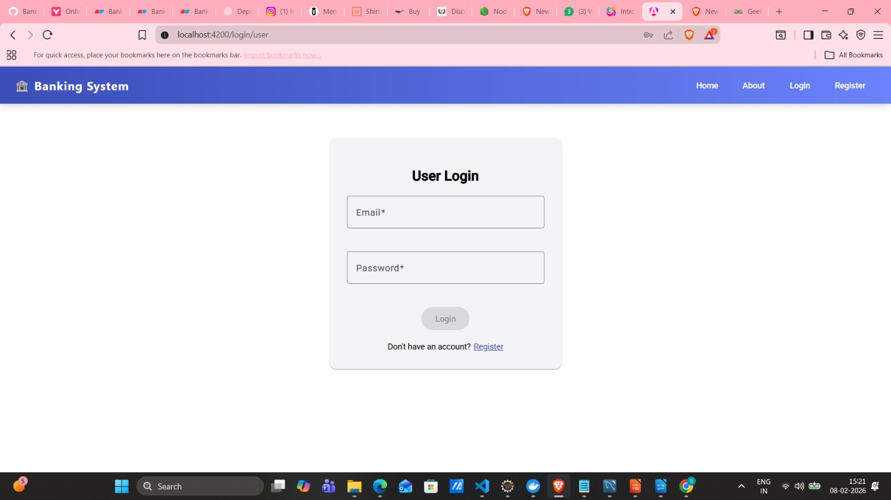
USER LOGIN PAGE:

Slide 21
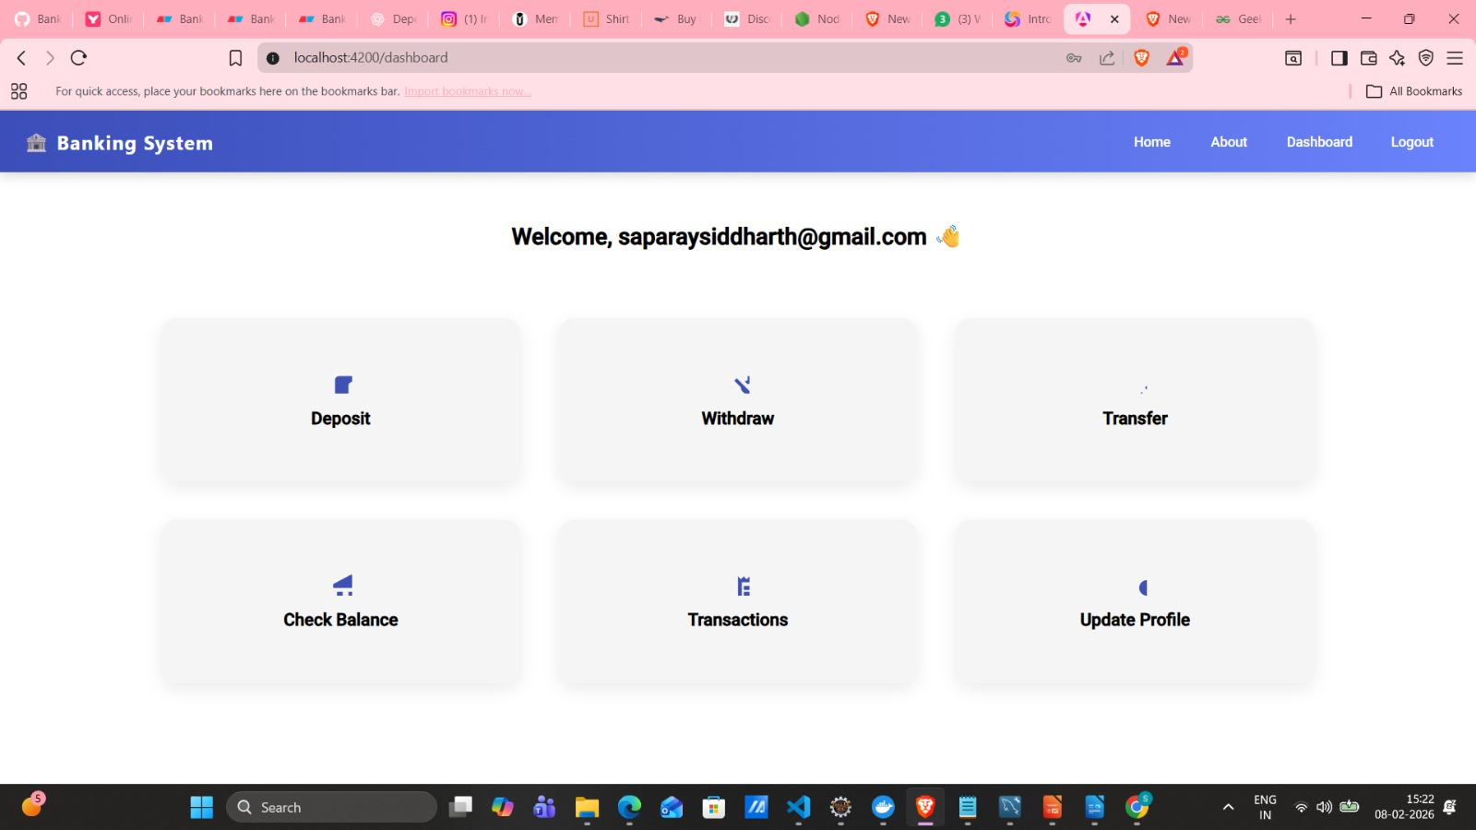
USER DASHBOARD:

Slide 22
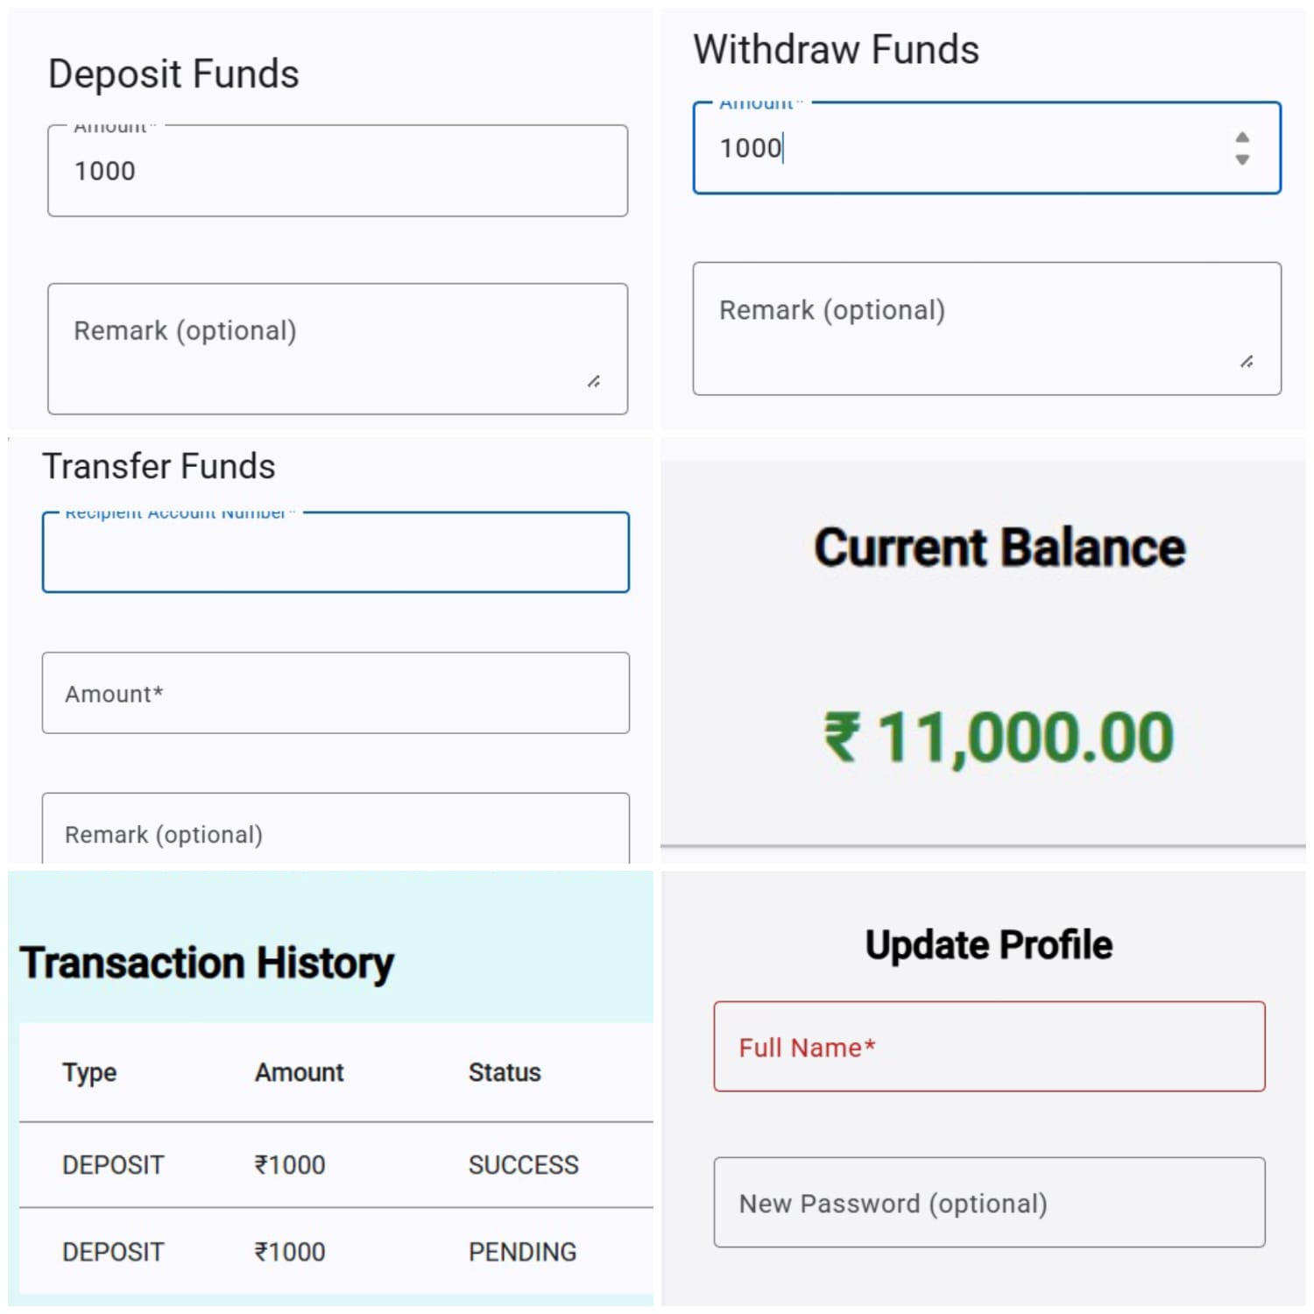
USER MODULES:

Slide 23
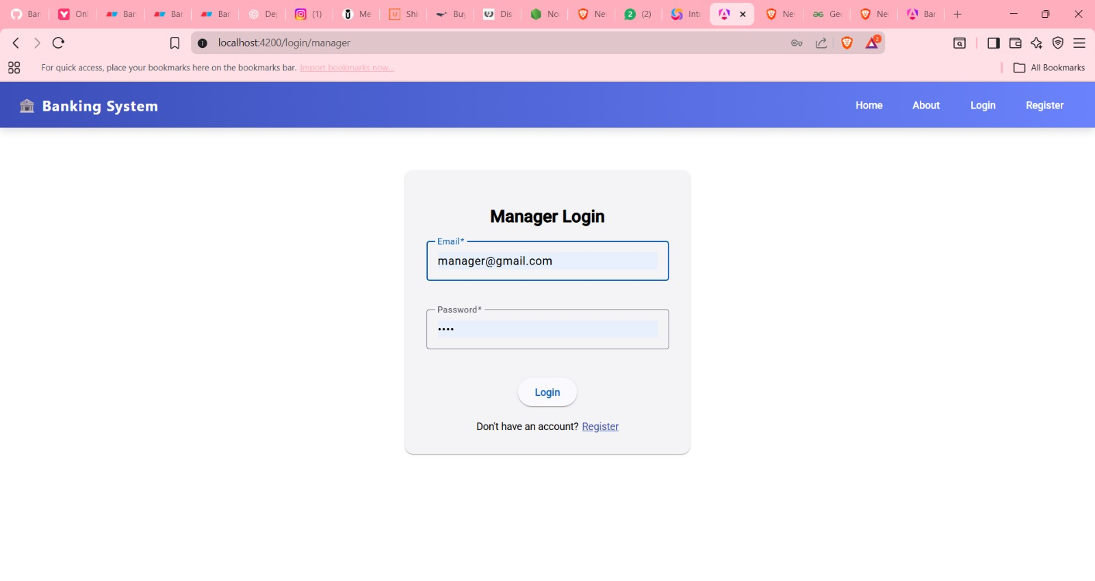
MANAGER LOGIN PAGE:

Slide 24
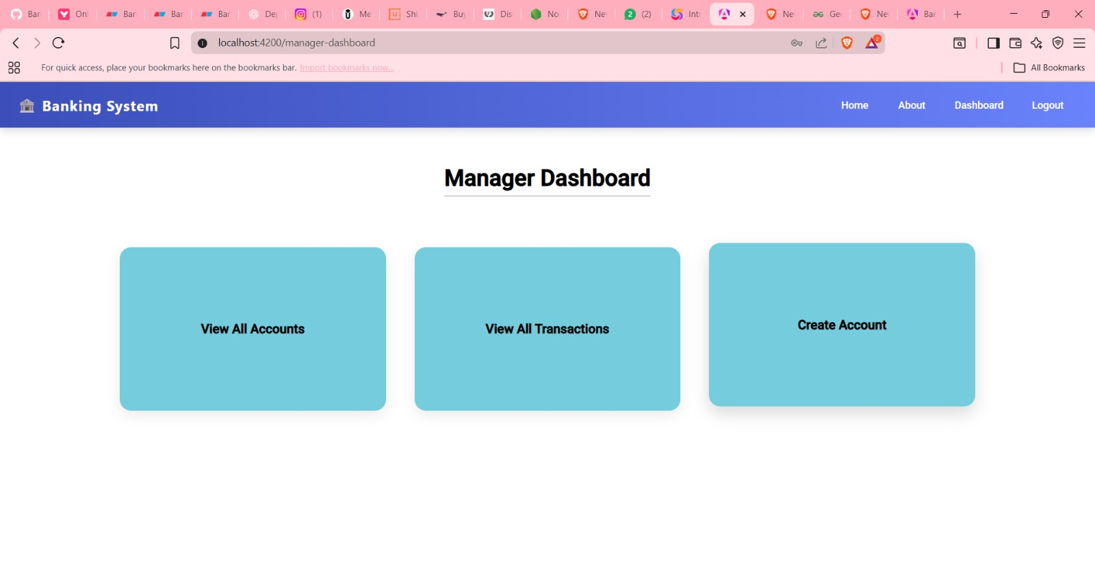
MANAGER DASHBOARD:

Slide 25
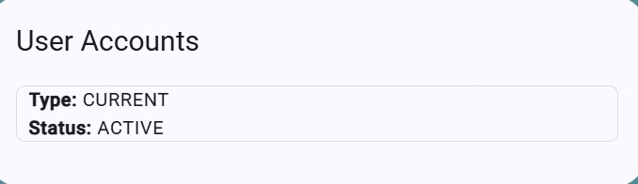
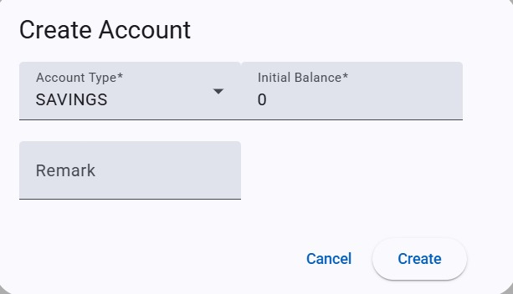
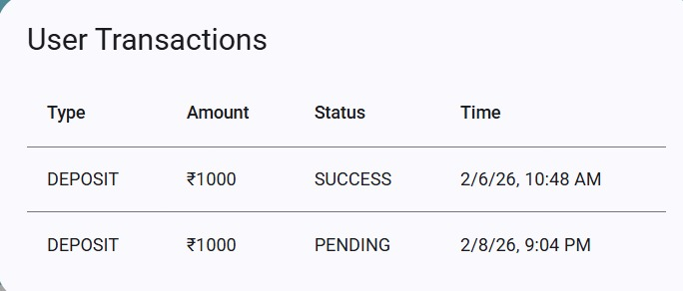
MANAGER MODULES:

Slide 26

ADMIN LOGIN PAGE:

Slide 27
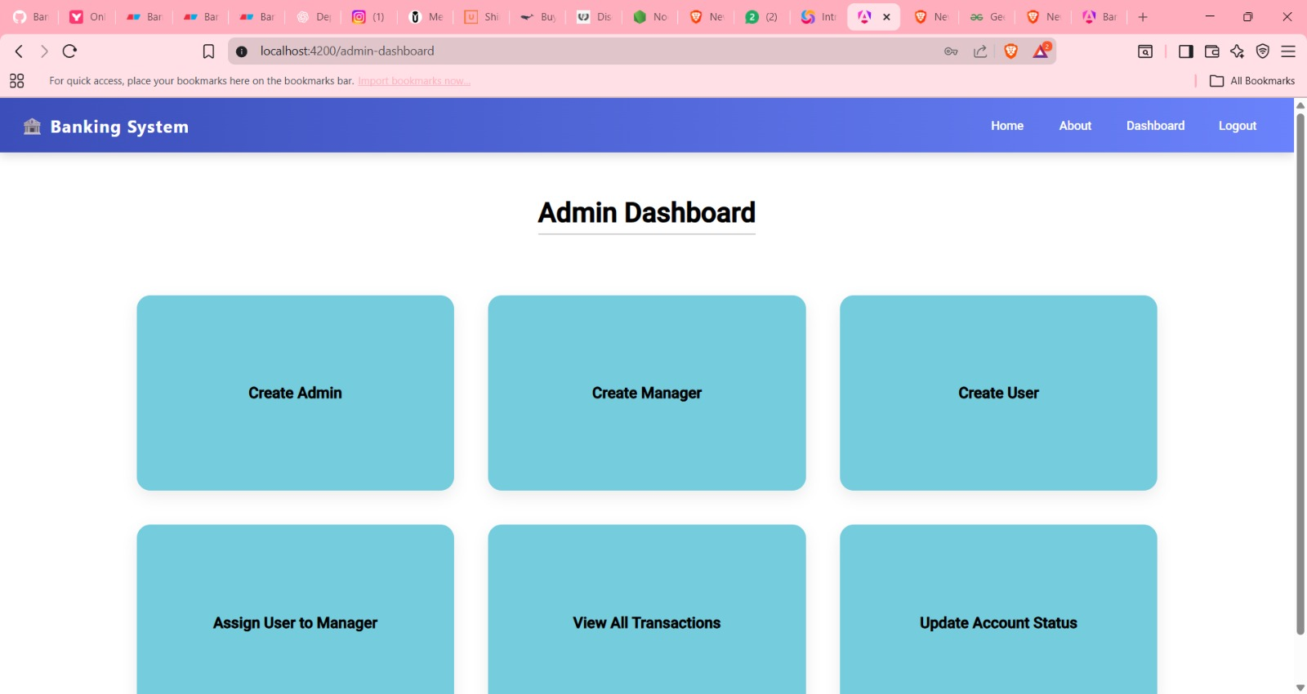
ADMIN DASHBOARD:

Slide 28
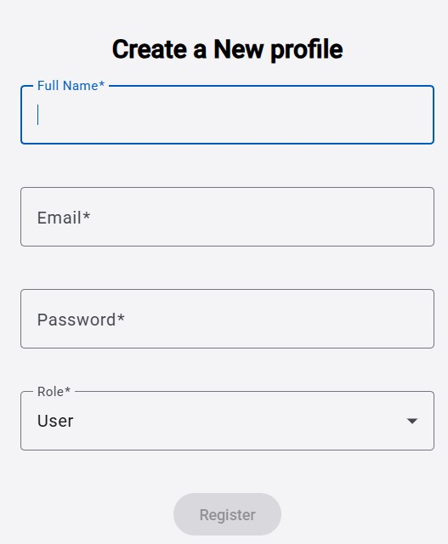
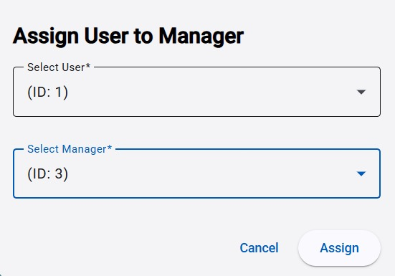
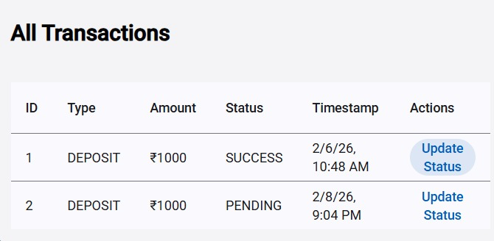
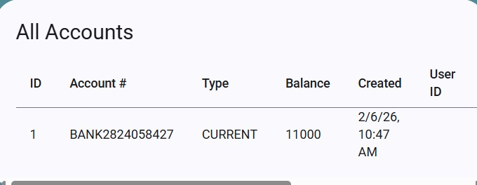
ADMIN MODULES:

Slide 29
Banking Management System
Conclusion:
This Banking Account Management System is our full-stack web application that helps administrators track and manage customer bank accounts effectively.
It provides:
--Centralized Account Management
--Real-time Transaction Processing (Deposit/Withdrawal)
--Detailed Transaction History and Reports
--Secure Cloud Deployment on Azure
At last, our Capstone project demonstrates practical implementation of modern web technologies including Angular, Spring Boot, and PostgreSQL to solve real-world banking challenges.
2024 - RPS Consulting all rights reserved

Slide 30


