Slide 1
row health
Marketing Insights & Recommendations
Campaign Performance
Data Team

Slide 2
Table of Contents
Project Overview
North Star Metrics
Insights Deep-Dive
Recommendations and Next Steps
Appendix
row health
2

Slide 3
Overview
3

Slide 4
Context
The goal of this project is to investigate the
performance of marketing campaigns at row
health in order to surface recommendations on Marketing budget allocation for 2026 campaigns.
The budget is allocated to drive two primary
objectives: 1) to raise awareness of Row Health’s brand across the country and 2) to increase the number of customer signups.
row health
4

Slide 5
North Star Metrics
In order to evaluate campaign performance, we focused on the following key metrics:
Compared to industry benchmarks, Row Health has low signup rate and low CPC, but higher than average CTR.
Increase Awareness
Increase Signups
Signup Rate
Click Through Rate
The percent of people who see a campaign and subsequently sign up for a Row Health Plan.
In Q1 of 2026, the average signup rate was 0.33% across 16.29k total signups.
The percent of people who see a campaign and click on the associated link
In Q1 of 2026, the average click through rate was 12.59% across 8.4M impressions.
Cost per Signup
The average dollars spent in order to acquire a signup from each campaign.
In Q1 of 2026, the average
cost per signup was $2.2, ranging from $1.3 to $124.05 per campaign.
row health
5

Slide 6
Insights Deep-Dive
6

Slide 7
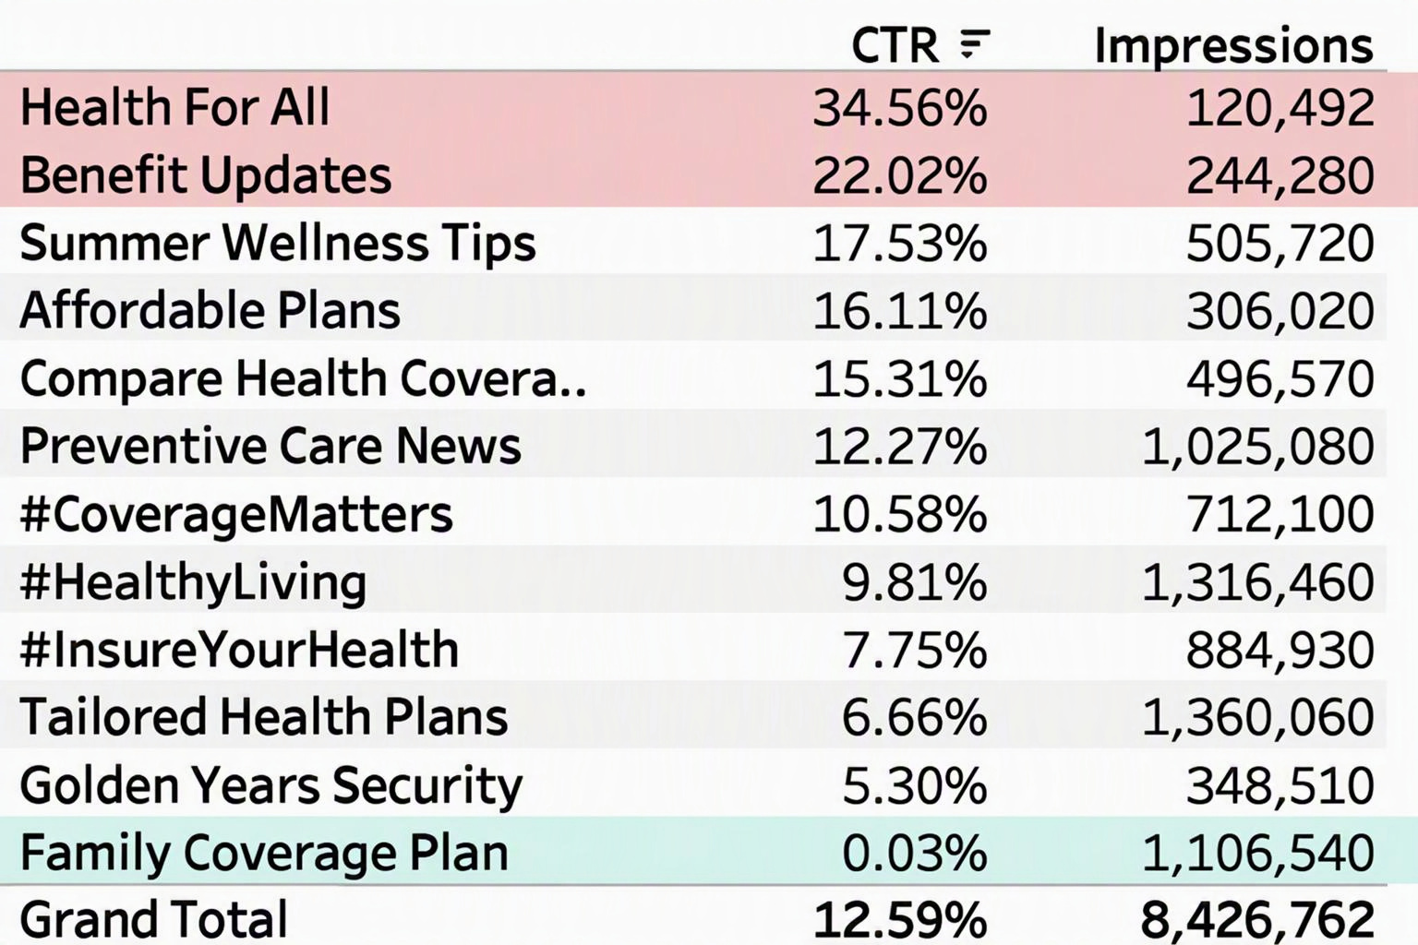
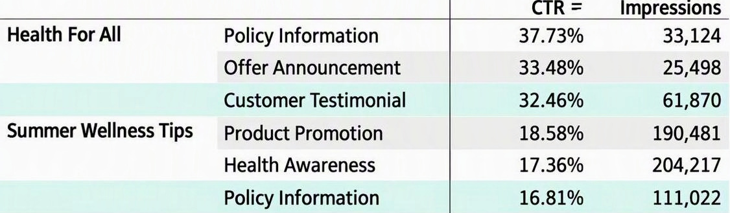
Health for All campaigns outperformed on CTR
compared to campaigns with more impressions.
Across categories, Health for All and Benefit Updates performed nearly 2-3x better than the average CTR at 34.56% and 22.02%, respectively.
Within the two categories with high CTR,
Customer Testimonial-based campaign and Policy Information had relatively low CTR (32.46% and 16.81% respectively).
Family coverage Plan data showed high impressions but few clicks (0.03%) – this needs to be investigated and could be due to missing data or issues with campaign tagging.
7

Slide 8
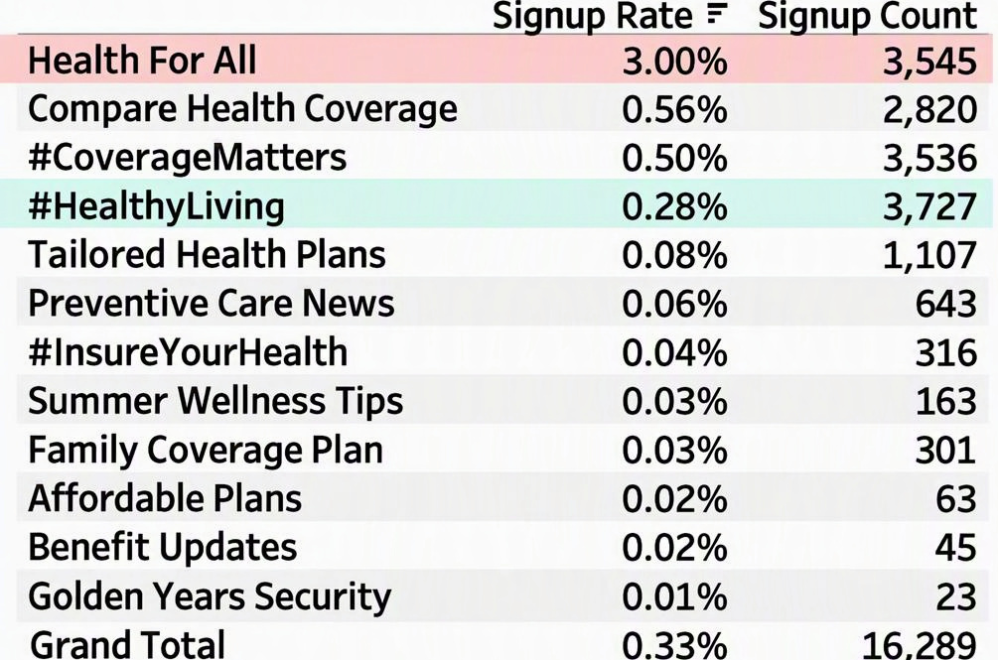
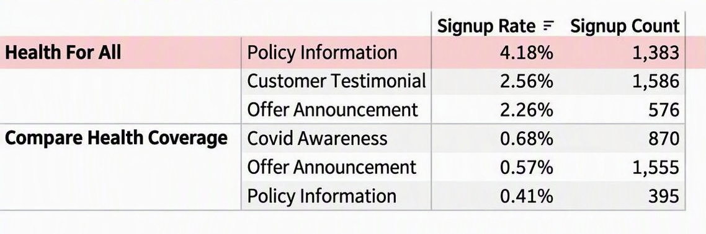
Signup rate was also by far the highest among
Health For All campaigns.
Across campaign categories, Health for All campaigns had the best-performing signup rate (3.0%) and the second-highest number of signups (3.5k).
This high signup rate is due to the Policy Information campaign type, which had by far the highest signup rate across all campaign types (4.18%).
Interestingly, the most expensive campaign,
which had the highest number of signups.
#HealthLiving – had a comparably low
Signup rate at 0.28%
*highest spend was $4.6k, across other spend of $1.12k-$46k.
8

Slide 9
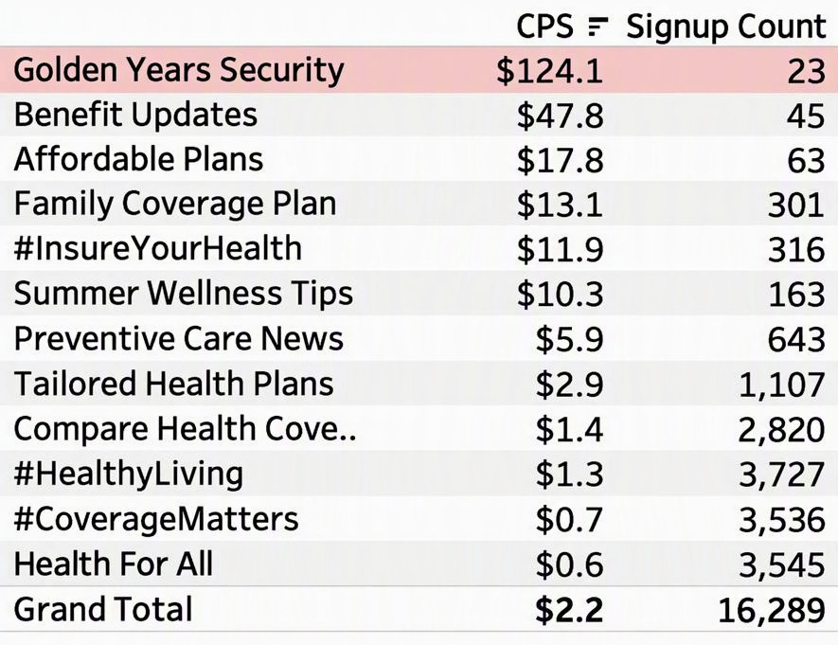
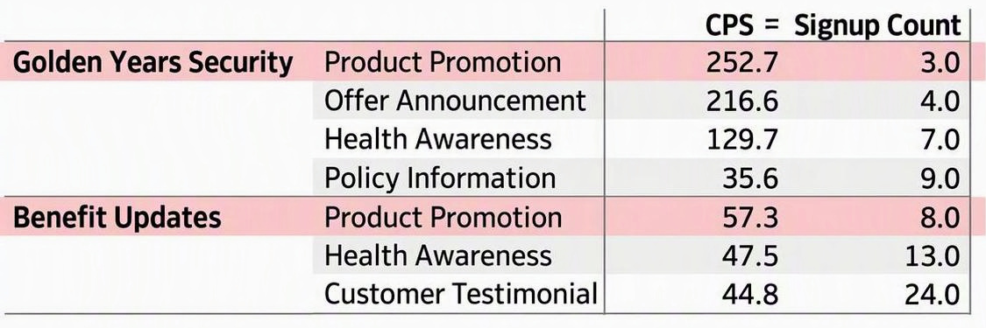
Cost per signup was high for Golden Years Security,
Which also performed poorly in terms of cost and volume.
Across campaign categories, Golden Years security had by far the highest cost per
Signups ($124.1), as well as the lowest number of signups (23), compared to an average of $2.2.
Within the two campaign categories with
highest cost per signup, Product Promotion
drove the high costs per signup.
9

Slide 10
Recommendations and
Next steps
10

Slide 11
Key Recommendations
Recommendations focus on two strategies: removing ineffective campaign categories and reallocating budget towards categories with better performance across north star metrics.
Increase Signups and Awareness
Health for All: Reallocate budget from Golden years Security, which had high cost per acquisition, to Health for All campaigns. The second category outperforms across all key metrics, yet we have invested a relatively low amount ($20K) on them.
Health awareness: Within Health for All campaigns, focus on Policy Information-type campaigns, and less on Offer Announcement-type campaigns, which had low signup rate and CTR.
Golden Years Campaigns: Investigate the cause of high cost per signup for these campaign categories, which had high CACs compared to an average signup cost of $2.2. Consider removing these campaigns altogether after exploring the root cause.
#HealthLiving: Decrease investment in this campaign category, which has the highest spend ($4.6k) but
Mediocre signup rates compared to Health for All campaigns.
row health
11

Slide 12
Caveats and Next Steps
For improved analysis and future steps, consider the following:
Include campaign start and end dates to understand campaign performance over time
Investigate few clicks for Family Coverage Plan category.
Include customer-specific dimensions (plan, state) to further tailor campaign recommendations based on client demographics.
Explore relationship between campaign and customer claims to identify and target ideal patient types.
Regroup with marketing team to explore the potential impact of recommendations
Explore Tableau dashboard for more insights and recommendations tailored to campaign categories and types
Improved
Date quality &
availability
Include other
dimensions
Revisit
Marketing
Budget with
team
row health
12

Slide 13
Thank you!
13

Slide 14
Appendix
14

Slide 15
Technical Process
Dataset Stats:
12 unique campaigns were analyzed across 6 different campaign types
Data ranges from January 1, 2026 to March 31, 2026
Data points involved:
Campaigns: campaign category, campaign type, clicks, cost, impressions (43 total records)
The technical process included:
Loading data into Tableau from Excel
Build a self-service dashboard for visualization in Tableau
Use calculated functions to calculate CTR, CPC, and signup rate
Use filters to alternate views based on plan, state, and campaign type
Minimal data cleaning was needed for this dataset, but could involve checking for nulls and nonsensical
values, aligning data types, and augmenting missing data
row health
15

Slide 16
Supplementary Data – CAC (Coverage Campaigns)
Covid Awareness | Tailored Health Plans | 4.1
 | Compare Health Coverage | 1.4
 | #CoverageMatters | 0.5
Customer Testimonial | Benefit Updates | 44.8
 | Family Coverage Plan | 14.8
 | Preventive Care News | 6.8
 | #HealthyLiving | 1.3
 | #CoverageMatters | 0.7
 | Health For All | 0.6
Health Awareness | Golden Years Security | 129.7
 | Benefit Updates | 47.5
 | Affordable Plans | 18.9
 | Summer Wellness Tips | 11.5
 | #InsureYourHealth | 9.4
 | Family Coverage Plan | 9.2
 | Preventive Care News | 5.8
 | Tailored Health Plans | 2.8
 | #HealthyLiving | 1.8
 | #CoverageMatters | 0.9
Offer Announcement | Golden Years Security | 216.6
 | Family Coverage Plan | 8.3
 | Tailored Health Plans | 3.0
 | Compare Health Coverage | 1.3
 | #HealthyLiving | 0.9
 | Health For All | 0.6
Policy Information | Family Coverage Plan | 94.9
 | Golden Years Security | 35.6
 | Affordable Plans | 17.0
 | #InsureYourHealth | 13.0
 | Summer Wellness Tips | 8.5
 | Preventive Care News | 5.5
 | Tailored Health Plans | 2.1
 | Compare Health Coverage | 1.8
 | #HealthyLiving | 1.2
 | Health For All | 0.5
Product Promotion | Golden Years Security | 252.7
 | Benefit Updates | 57.3
 | #InsureYourHealth | 14.9
16

Slide 17
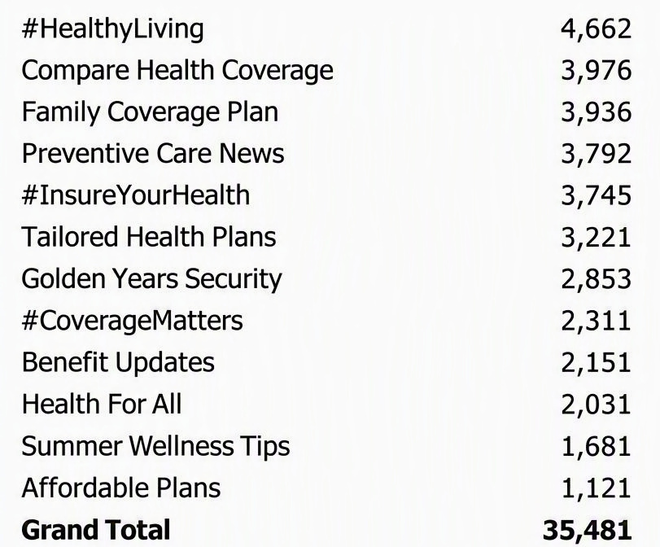
Supplementary Data – Spend by Category
Campaign Category Spend (Q1 2026)
17

