Slide 1
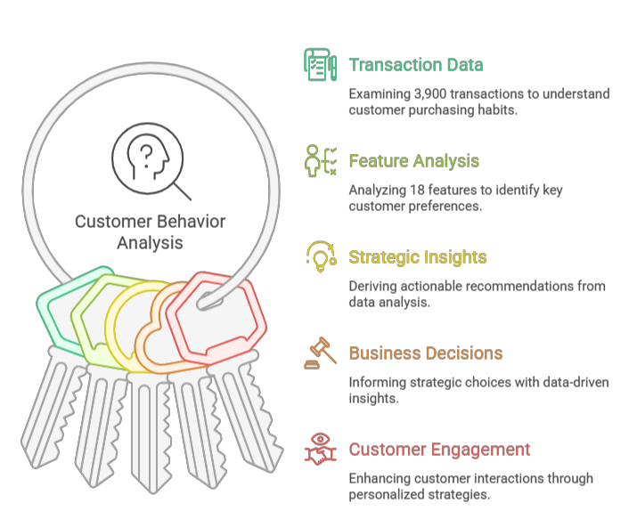
Customer Behavior Analysis

Slide 2
Three Insights That Matter
Subscription Gap
High-Spending Discount Users
Age-Based Revenue Concentration
73% non-subscribers — $500K+ up-sell opportunity
Discount users still spending above average — margin risk
Revenue concentrated in specific age groups — targeting gap

Slide 3

Methodology: Clean → Analyze → Visualize
Python Data Cleaning
SQL Analysis
Power BI Dashboard
3,900 rows · 18 features · 37 missing review ratings imputed by category median
Source: Transactional dataset, n=3,900, 18 features. Missing review ratings (37 values) imputed by category median.

Slide 4
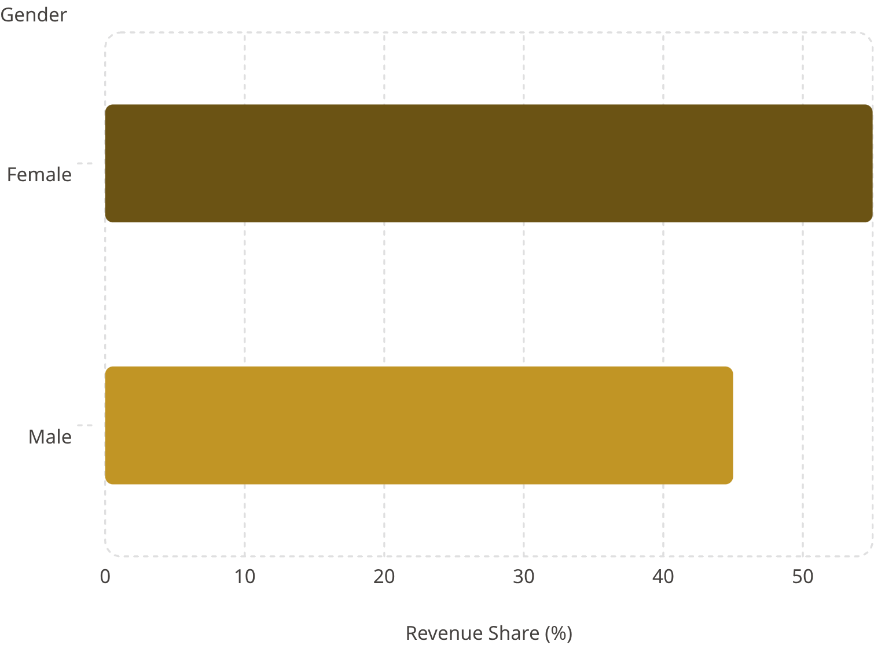
Spending Patterns at a Glance
Key Metrics
High-spending discount users identified — above-average spenders using
discounts, signaling margin risk.
$59.76
3,900
Avg. purchase amount
Total transactions
Source: SQL analysis. Average purchase amount = total revenue / number of transactions.

Slide 5
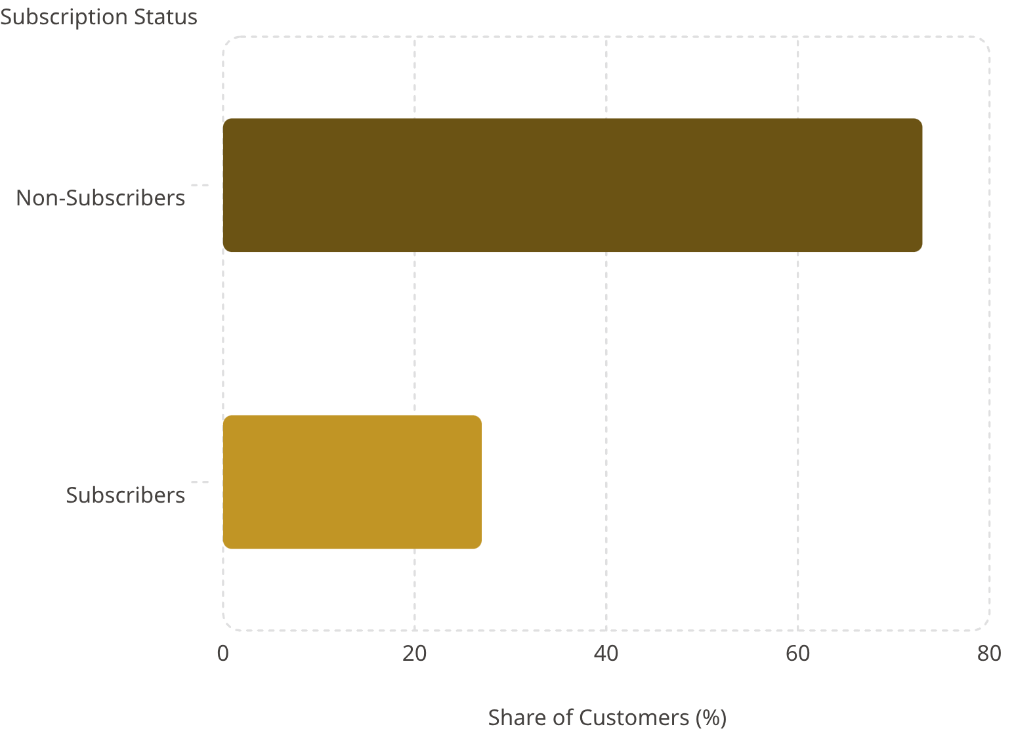
73% of Customers Are Not Subscribers
27% Subscribers
Higher avg. spend per transaction
73% Non-Subscribers
$500K+ up-sell potential
Repeat Buyers (5+ purchases)
More likely to subscribe — prime conversion targets
Note: Repeat buyers defined as customers with 5+ purchases. Non-subscribers represent a $500k+ up-sell opportunity.

Slide 6
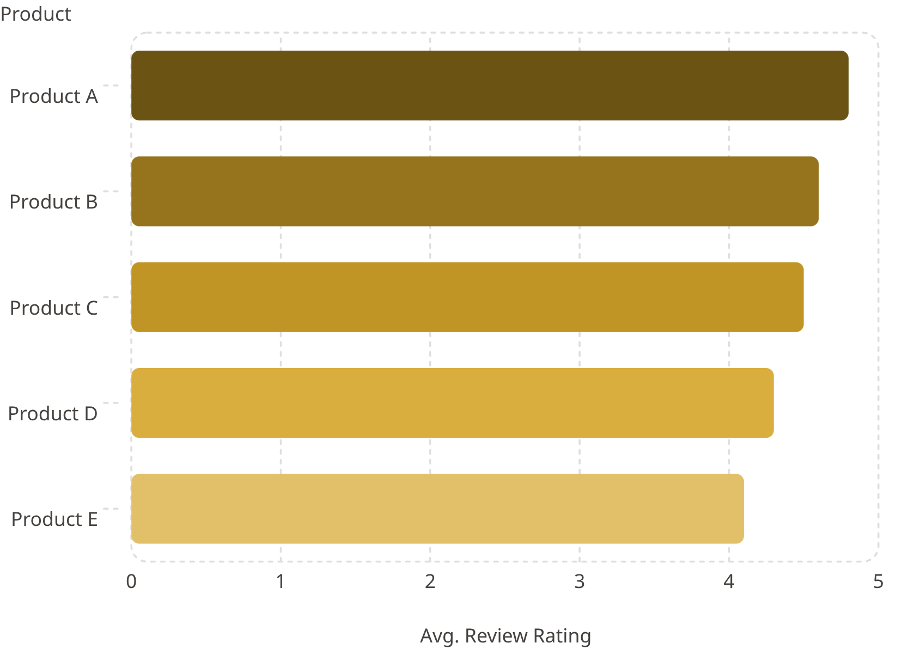
What's Selling — and What Needs Discounts
Key Findings
Top-Rated Products
Avg. rating ≥4.5 — amplify in campaigns
Discount-Dependent Products
5 products with highest % discounted purchases
Top 3 per Category
Bestsellers identified across all categories
Note: Top-rated = average review rating ≥4.5. Discount-dependent = highest % of discounted purchases.

Slide 7
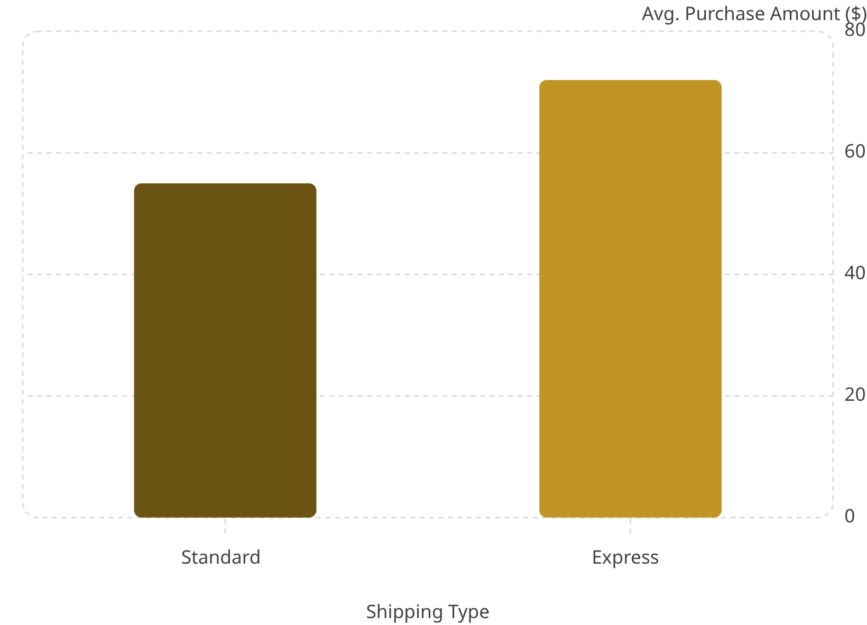
Express Shippers Spend More. Loyal Customers Drive Revenue.
Customer Segments
New
Returning
1 purchase
2–4 purchases
Loyal
5+ purchases
Express shipping users show higher average spend — target for upsell.
Definitions: New (1 purchase), Returning (2–4 purchases), Loyal (5+ purchases). Express shipping users show higher average spend.

Slide 8
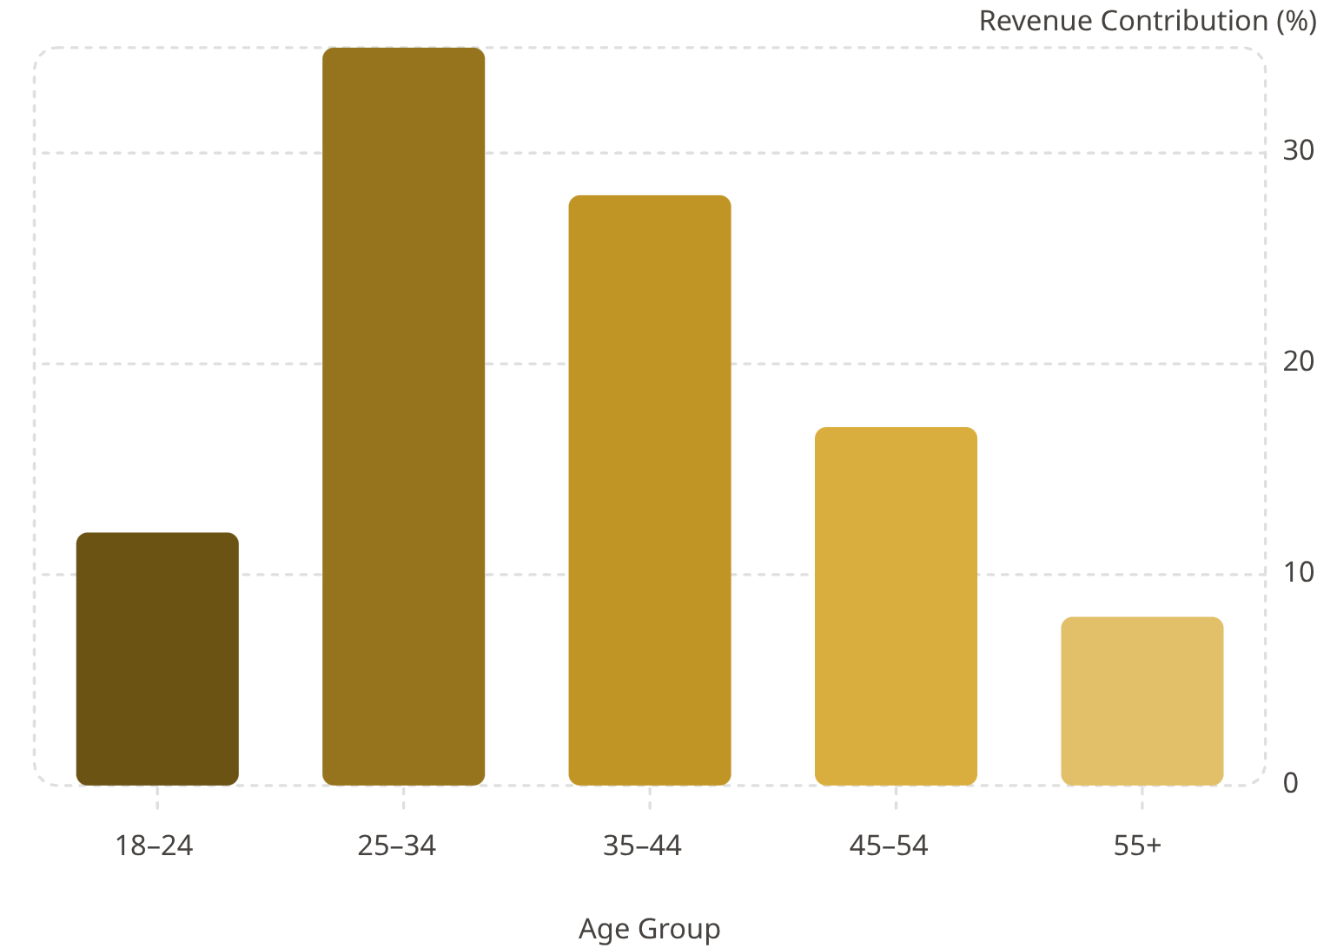
Revenue Concentrates in Key Age Groups
Power BI Dashboard
Interactive executive dashboard built with full drill-down capability across all dimensions
25–34 Age Group
35–44 Age Group
Highest revenue contributor — primary targeting focus
Second-largest segment — underinvested in current campaigns
Source: SQL analysis. Age groups binned from customer ages. Power BI dashboard interactive visual available.

Slide 9
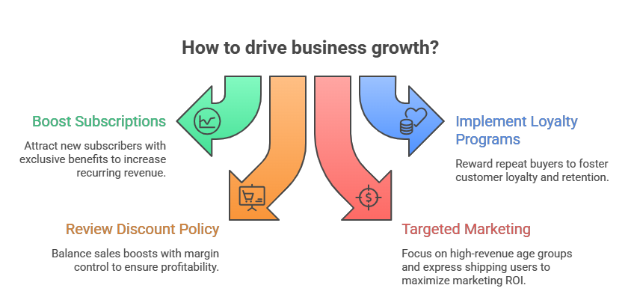
Four Actions to Drive Growth

Slide 10
From Insight to Action
0–3 Months
1
Launch subscription pilot; A/B test incentives for repeat buyers
2
3–6 Months
Deploy loyalty program; refine discount policy; target 25–34 age group
6–12 Months
3
Scale winning tactics; full Power BI roll out; measure LTV uplift

