Slide 1

CL 299 presentation 1
LNP Manufacturing and Process
Simulation
Presented by:
Rhythem Soni 24110296 Aman Bola 24110032 Saket Jonwal 24110311
Supervisor:
Prof. Kaustubh S. Rane Department of Chemical Engineering

Slide 2
MOTIVATION AND BACKGROUND
Rapid success of mRNA vaccines. (Eg: Pfizer-BioNTech and Moderna).
Directly injected mRNA would be rapidly degraded by enzymes in the body before it can reach and enter cells.
LNPs are the industry-standard delivery system for mRNA.
Major challenges: scalability, reproducibility and controllable manufacturing of LNPs.
Commercial manufacturing requires tight control on size and uniformity.

Slide 3
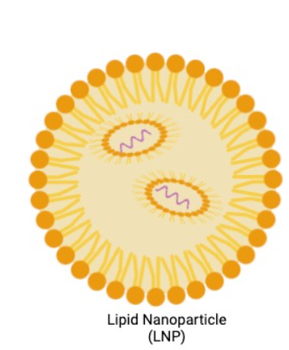
Lipid Nanoparticles (LNPs) ?
Tiny, spherical particles made of lipids.
Small size - (10nm - 100nm).
Widely used in vaccines.
They encapsulate and protect fragile molecules like mRNA to reach and enter in cells efficiently.
Human cell membranes are also made up of lipids so body is already familiar with LNPs.
https://en.wikipedia.org/wiki/Lipid-based_nanoparticle

Slide 4
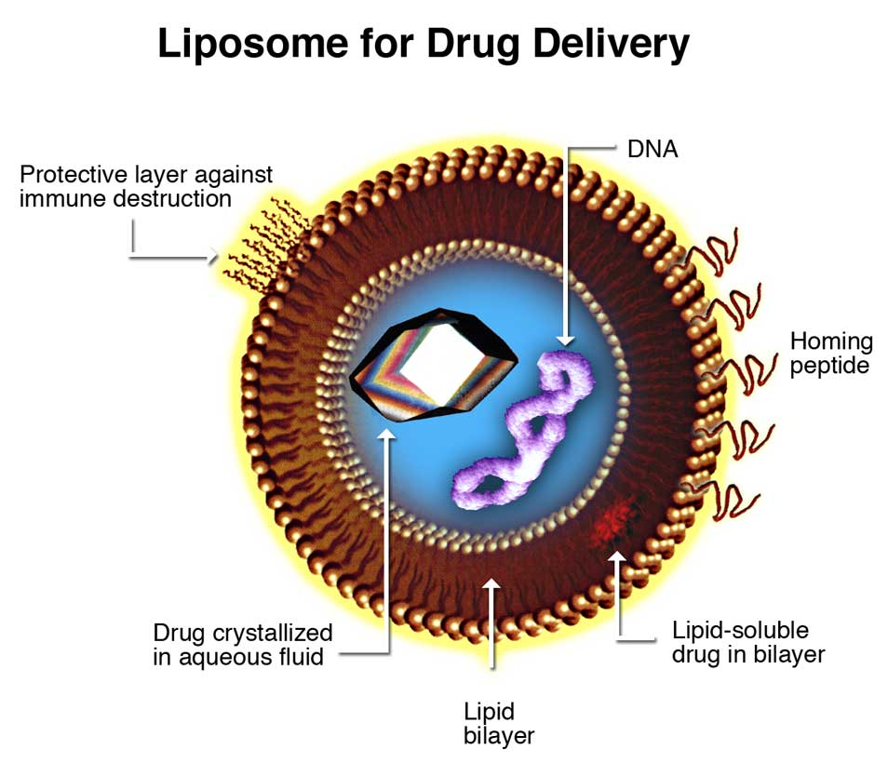
Before LNPs → Liposomes
Liposomes are spherical vesicles composed of one or more phospholipid bilayers enclosing an aqueous core.
Liposomes were the first clinically successful lipid-based nanocarriers.
Widely used for small molecules, proteins, and early nucleic acid delivery.
Why liposomes were originally used for nucleic acids :-
Phospholipid bilayers are biocompatible
Can encapsulate hydrophilic cargo (DNA/RNA) in aqueous core
Protect cargo from enzymatic degradation
https://en.wikipedia.org/wiki/Lipid-based_nanoparticle

Slide 5
Disadvantages of liposomes for mRNA delivery
Low mRNA encapsulation efficiency because liposomes rely on passive loading and lack strong electrostatic interaction with nucleic acids.
Poor endosomal escape, resulting in degradation of mRNA before it reaches the cell.
Limited scalability.
Why the field shifted from Liposomes to LNPs?
Very high mRNA encapsulation efficiency (>90%) due to electrostatic complexation between ionizable lipids and negatively charged mRNA.
Efficient endosomal escape enabled by ionizable lipids that become protonated at low pH and disrupt the endosomal membrane.
Excellent scalability and reproducibility through continuous manufacturing methods (ethanol injection, microfluidics, jet/impingement mixing) with tight control of CQAs.

Slide 6
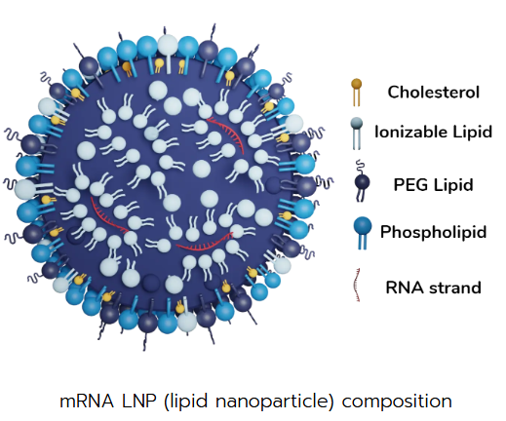
COMPOSITION OF LNPs
Ionizable lipid: binds RNA and enables endosomal escape.
Phospholipid: provides structural stability.
Cholesterol: improve membrane rigidity and integrity.
PEG-lipid: prevents aggregation and improves circulation time.
https://insidetx.com/resources/reviews/lnp-synthesis-overview-of-the-manufacturing-methods/

Slide 7
Role of Ionizable lipids
Ionizable lipids are neutral at physiological pH of blood → Low toxicity
They are positively charged at acidic pH inside cells → RNA release inside cells.

Slide 8
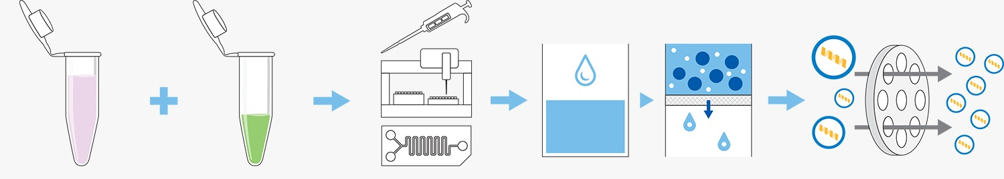
LNP Formulation
Organic phase:
Lipids dissolved in ethanol
(3 parts)
Aqueous phase:
mRNA in buffer
(1 part)
Mixing
Organic and aqueous in 3:1
Dilute, buffer exchange and concentrate
Size extrusion
https://www.wyatt.com/solutions/lnp-formulation.html

Slide 9
LNP FORMULATION
When Aqueous and organic phases are mixed, ethanol concentration suddenly drops.
Rapid dilution of ethanol causes lipid oversaturation → lipids become insoluble.
Lipids spontaneously self-assembled around mRNA.
Process occurs within millisecond.
Hence, LNPs are formed.

Slide 10
IMPORTANCE OF MIXING
Particle size control and uniformity of LNPs are determined by mixing time.
Mainly ensures a homogeneous temperature and mRNA concentration during formulation.
Ensure high mRNA encapsulation efficiency → improve drug loading.
The rate and manner of mixing directly affect self-assembly steps.
Slow or uncontrolled mixing results in broad size distribution (high PDI).
The faster the mixing the smaller the synthesized LNPs.

Slide 11
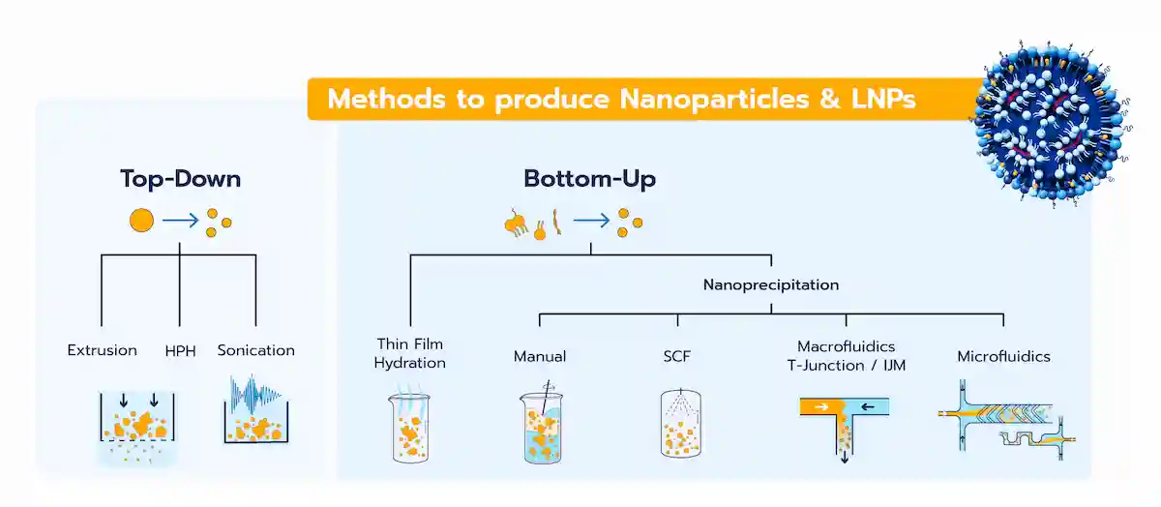
https://insidetx.com/resources/reviews/lnp-synthesis-overview-of-the-manufacturing-methods/

Slide 12
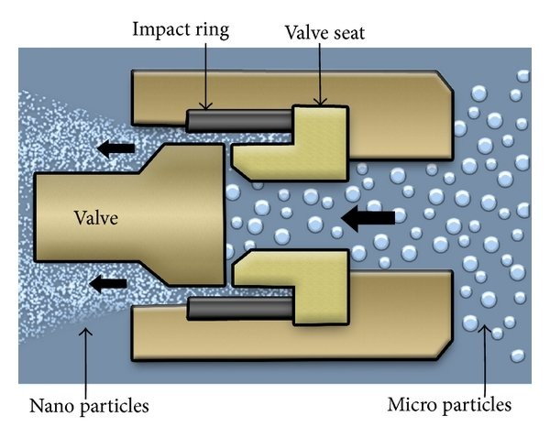
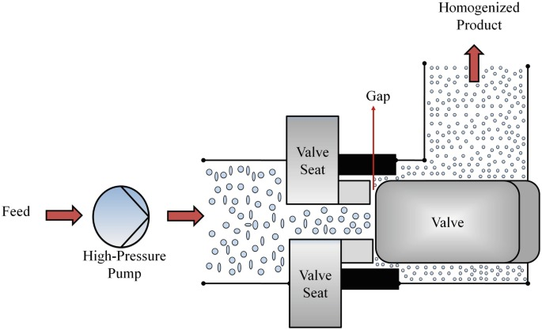
Top-down methods: Also referred to as high-energy methods, these involve applying energy to break larger particles into smaller ones.
Bottom-up methods: These rely on the self-assembly of lipid components to form homogeneous nanoparticle systems.
High-Pressure Homogenization (HPH)
Liquid is forced through a narrow valve at very high pressure, creating intense shear and turbulence for mixing.
Droplet/particle size is reduced to the nanoscale due to shear, cavitation, and impact forces.
Suitable for large-scale, continuous processing, but involves high energy input.
https://www.researchgate.net/figure/Schematic-representation-of-the-high-pressure-homogenization-process-11_fig5_258392503

Slide 13
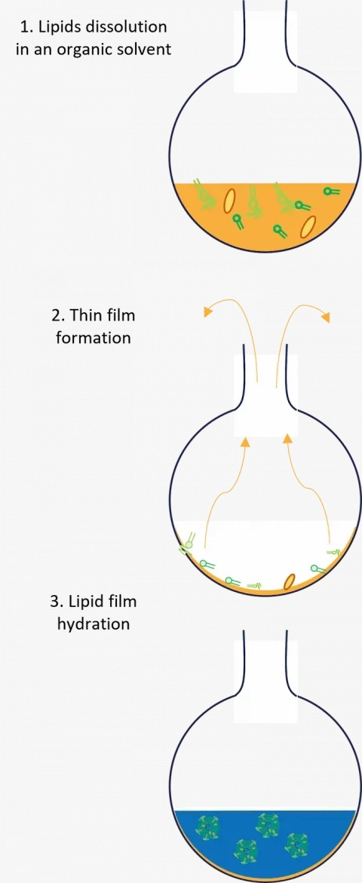
Bottom-up approach
Thin film Hydration
Lipids are first dissolved in an organic solvent and dried to form a thin film on the container wall.
The film is hydrated with an aqueous phase, causing lipids to self-assemble into vesicles/nanoparticles.
It is a simple, widely used laboratory method, but offers limited control over particle size.
https://insidetx.com/resources/reviews/mastering-thin-film-hydration-method-for-liposome-and-lipid-nanoparticle-formulation/

Slide 14
Manual method
Lipid and aqueous phases are mixed manually using pipetting or simple stirring.
The process offers minimal control over mixing intensity and uniformity.
Results in poor reproducibility and broad particle size distribution.
Uses supercritical CO₂ as an antisolvent to mix with lipid solutions and induce nanoparticle formation.
Enables rapid mixing with low residual organic solvent in the final product.
Requires high-pressure, complex equipment, limiting routine use.
Supercritical Fluid Methods (SCFs)

Slide 15
Macrofluidics
Mixing occurs in millimeter-scale channels with controlled flow rates.
Offers better control than batch/manual mixing but less precision than microfluidics.
Suitable for higher throughput and easier scale-up compared to microfluidic systems.
Eg: Impingement Jet Mixing (IJM).
Fluids are mixed in micron-scale channels under precisely controlled flow conditions.
Provides highly uniform and reproducible nanoparticles with narrow size distribution.
Ideal for formulation screening and early-stage development, though scale-up can be challenging.
Eg: NxGen Mixing Technology.
Microfluidics

Slide 16
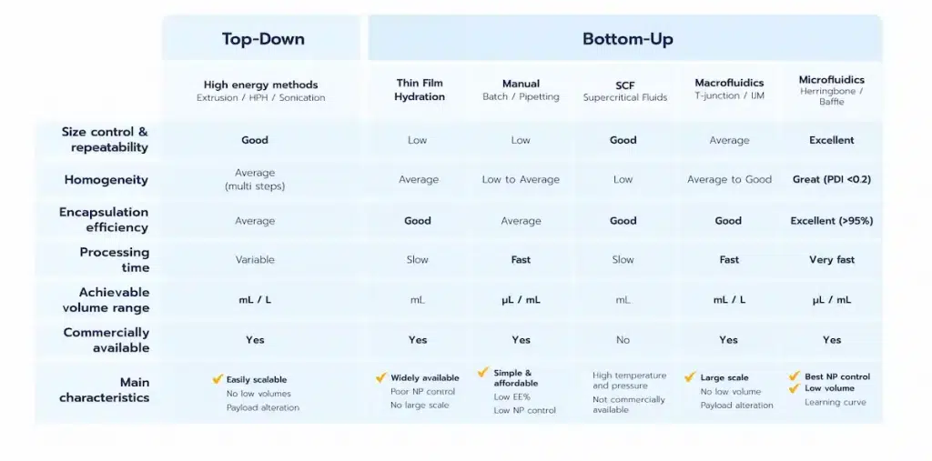

Slide 17
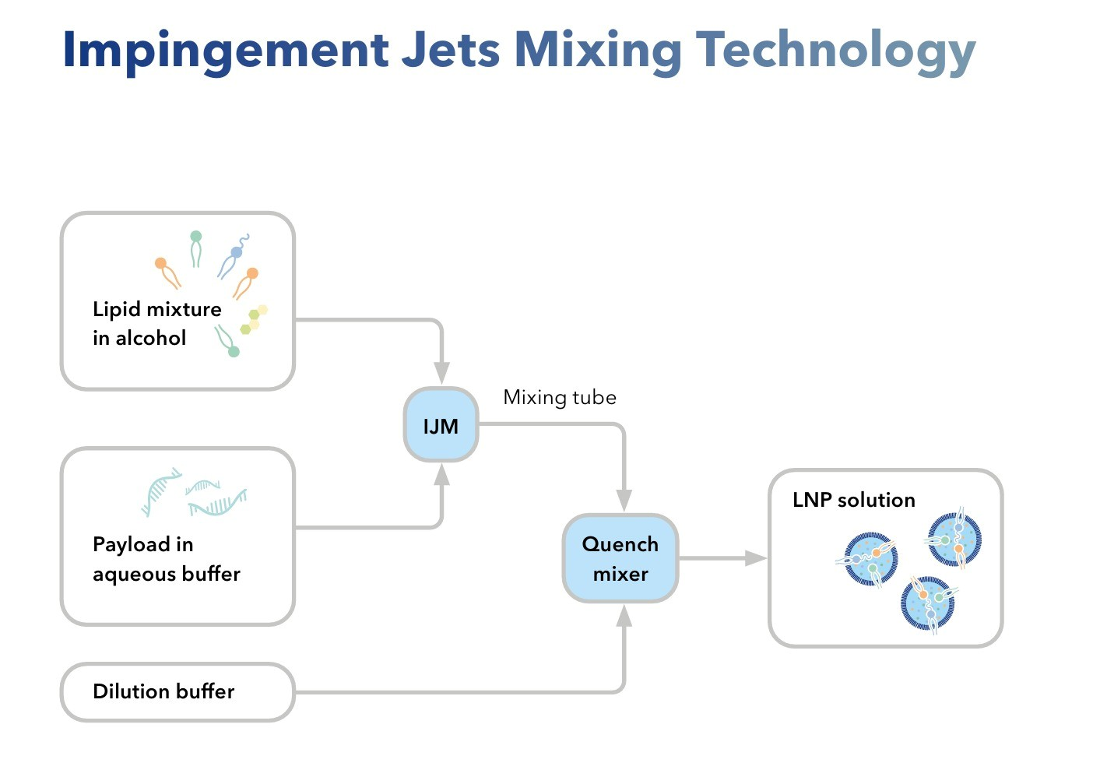
Impingement Jet Mixing (IJM)
Impingement Jet Mixing (IJM) is a rapid, continuous mixing technology used for the industrial production of lipid nanoparticles (LNPs).
Two liquid streams collide head on at high velocity
Collison creates intense turbulence
Mixing occurs in milliseconds under turbulent flow
Lipid self-assembly is triggered by rapid solvent dilution

Slide 18
What happens inside the IJM chamber
The two streams impinge directly at the mixing point
High Reynolds number flow generates strong turbulence
Turbulence eliminates concentration gradients instantly
Ethanol concentration drops rapidly → lipid solubility collapses
Nucleation :- Small lipid clusters form uniformly throughout the volume
Growth arrest :- Fast quenching prevents uncontrolled aggregation

Slide 19
Encapsulation mechanism
Ionizable lipids become positively charged.
Negatively charged mRNA binds electrostatically.
mRNA is trapped inside the forming lipid structure.
Why does IJM gives narrow size distribution?
Uniform nucleation dominates over growth.
No local concentration gradients.
Particle size is fixed within the first milliseconds.

Slide 20
Result
Lipids become supersaturated.
Lipid molecules self-assemble.
mRNA is electrostatically encapsulated during particle formation.
Now LNPs are formed inside IJM and now we need to analyze (using PAT) it and filter it.
Key Concept :-
Mixing time is much shorter than nanoparticle assembly time, leading to uniform and reproducible LNPs.

Slide 21
Process Analytical Technology (PAT)
Framework for real-time monitoring, analysis, and control of pharmaceutical manufacturing processes.
It focuses on identifying and controlling: Critical Quality Attributes (CQAs) Critical Process Parameters (CPPs)
Why PAT is needed?
LNP production is rapid and continuous
Small variations in flow, mixing, or concentration can affect:
Particle size
Encapsulation efficiency
Stability
PAT ensures consistent quality during production, not just end-product testing

Slide 22
Key CQAs monitored
Particle size (< 200 nm).
Polydispersity index (PDI < 0.3).
Zeta potential (≈ ±30 mV).
Encapsulation efficiency (> 80%).
Key CPPs monitored
Flow rate and flow ratio.
Mixing intensity/pressure.
Temperature.
Solvent (ethanol) concentration.
PAT continuously monitors critical quality attributes and process parameters to ensure consistent LNP quality during manufacturing.”

Slide 23
Quenching
Quenching by dilution is the immediate dilution of the freshly formed LNP suspension with an excess aqueous buffer.
First , LNPs are formed.
Now, quench buffer is added which results in sharp drop of ethanol concentration which reduces lipid solubility and mobility.
Finally, particle growth ceases, preventing further fusion or aggregation, thereby locking in the final particle size and PDI.
Quenching by filtration is performed using Tangential Flow Filtration (TFF) or Membrane-based filtration to remove:
Residual solvent (ethanol)
Unencapsulated components
THIS IS THE FINAL STEP OF LNP MANUFACTURING.

Slide 24
NxGen Mixing
NxGen mixing is a controlled rapid-mixing technology.
Based on controlled nanoprecipitation of lipids with nucleic acids.
Mixing is done under high controlled flow conditions.
Precise control over mixing time and flow profiles enables uniform particle formation and low PDI.
Scale-up achieved via parallelization of microfluidic cartridges
Single-use fluid paths reduce cross-contamination risk

Slide 25
RESOURCES
https://insidetx.com/resources/reviews/lnp-synthesis-overview-of-the-manufacturing-methods/
https://en.wikipedia.org/wiki/Lipid-based_nanoparticle
https://drive.google.com/drive/folders/10AyL6bArZ2kjxkyHl5krHhYheAy40hMO?usp=drive_link

Slide 26
THANK YOU!!

