Slide 1

CL 299 presentation 2
LNP Manufacturing and Process
Simulation
Presented by:
Rhythem Soni 24110296 Aman Bola 24110032 Saket Jonwal 24110311
Supervisor:
Prof. Kaustubh S. Rane Department of Chemical Engineering

Slide 2
Quenching
Quenching is the immediate dilution of the freshly formed LNP suspension with an excess aqueous buffer.
First , LNPs are formed.
Now, quench buffer is added which results in sharp drop of ethanol concentration which reduces lipid solubility and mobility.
Finally, particle growth ceases, preventing further fusion or aggregation, thereby locking in the final particle size and PDI.
The quenched stream exits the system, and the LNPs are collected in a sterile container or bag.

Slide 3
Down-Stream Process
Downstream processing includes all steps carried out after product formation to purify, stabilize, ensure safety, and make it suitable for storage.
After LNP formation, the suspension still contains residual ethanol, acidic buffer, free lipids, unencapsulated mRNA, incorrect concentration, and lacks sterility. Thus, while the LNP structure is correct, the surrounding environment and purity are unsuitable for use.
Downstream processing ensures removal of ethanol and impurities, addition of buffer, and dosage adjustment, and a stable, sterile product for storage.
To Achieve this we use Tangential Flow Filtration(TFF), Sterile Filtration ,Fill–Finish.

Slide 4
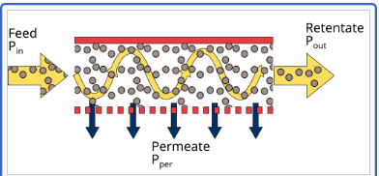
Tangential Flow Filtration (TFF)
TFF simultaneously removes ethanol, enables buffer exchange (pH adjustment), and controls product concentration (Core purification & conditioning step).
LNP suspension flows parallel to a membrane.
Small molecules (ethanol, salts) pass through MWCO memberance in which driving force is TMP.
LNPs are retained and recirculated.
Fresh buffer is continuously added (diafiltration).
Source : https://upload.wikimedia.org/wikipedia/commons/thumb/3/32/Cross-flow.svg/500px-Cross-flow.svg.png

Slide 5
Membrane MWCO
MWCO stands for Molecular Weight Cut-Off. It is the approximate molecular weight of the smallest molecule that the membrane will retain.
MWCO is not an exact pore diameter. It is an operational definition, based on: Shape, Flexibility, Hydration of molecules.
Ethanol, free lipid, M-RNA, salts, Buffer-molecule have approx. (MW :- /1KDa) which can easily pass through MWCO (100–250 KDa).
LNP = MW > 500KDa
Molecules smaller than MWCO → pass through the membrane
Molecules larger than MWCO → are retained

Slide 6
Transmembrane Pressure (TMP)
TMP is the pressure difference across the membrane. It is the driving force pushing small molecule to pass through the membrane.
It Determines permeate flow rate, Controls how fast ethanol and buffer are removed.
If TMP is too low then , Slow filtration and Long processing time.
If TMP is too high then, Membrane fouling and LNP deformation or rupture.
Cross-flow Rate(tangential velocity) is speed at which the LNP suspension flows parallel to the membrane.
Diafiltration volume defines how many times the LNP solution is washed with fresh buffer during TFF, determining how completely small impurities are removed.

Slide 7
Alternatives to TFF
Alternative | When Used | Limitations
Dialysis | Lab Scale only | Very Slow, Not scalable
Centrifugal purifications | Small Batches | Shear, Low scalablity
SEC(Size Exlusions) | Analytical Purifications | Not Industrial
Precipitations | Rare | High LNP loss

Slide 8
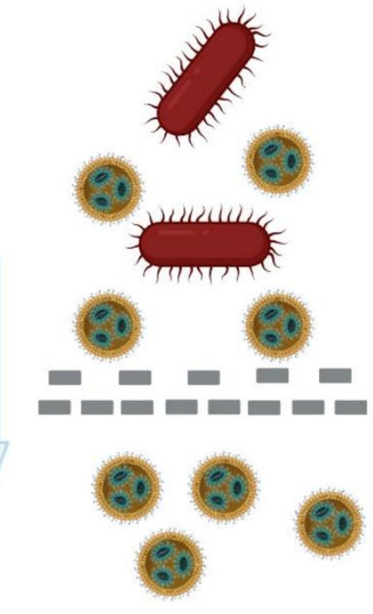
Sterile Filtration
Sterile filtration is a physical separation process used to remove microorganisms from the LNP formulation without using heat or chemicals.
LNPs are injectable products which must be free from bacteria.It removes bacteria using a 0.22 µm filter.
It is done by :-
Low-pressure filtration
Lipid-compatible membranes
Source:https://ars.els-cdn.com/content/image/1-s2.0-S0378517325003576-ga1.jpg

Slide 9
Alternative Method | Why not used in LNP Formation
Heat Sterilization | Destroy M-RNA and melt lipid structure
Gamma irradiation | Cause RNA strands to break
Chemical sterilants | Leaves toxic residues
0.45 µm filtration | Not sufficient to ensure sterility
Sterile filtration is the only practical sterilization method for mRNA-LNPs.

Slide 10
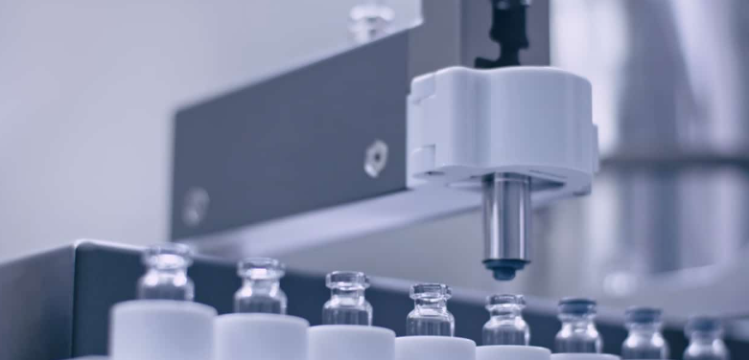
Fill–Finish
It is needed to Accurate dosing and Protection from contamination.
First we do Aseptic method to fill in Vials and Syringes.
Then, Stoppering and sealing and at last Labeling and batch tracking.
Storage
It is stored between –80°C to –20°C.
Must be Stored in RNase Free Environment.
Source:https://www.ubrigene.com/wp-content/uploads/2024/10/Need-Aseptic-Fill-Finish-Support.jpg

Slide 11
mRNA Feed (Aqueous Phase)
Single standed messenger RNA is dissolved in aqueous buffer.
Buffer Concentration ≤ 25 mM.
Typically 0.05 – 1 mg/mL
Chosen based on desired final dose & encapsulation efficiency
pH = 4.0 during mixing

Slide 12
Buffer Systems and Lipid-RNA Relationships
Allowed buffer bases:
Tris, Bis-Tris, Triethanolamine (TEA)
Allowed counter-anions:
Chloride, Acetate, Lactate, Glycolate, etc.
Buffer Concentration ≤ 25 mM
Lipid : RNA (mass ratio):
~9 : 1 to ~20 : 1

Slide 13
Lipid Feed (Organic Phase)
Component | Typical Role
Ionizable lipid | Electrostatic binding to mRNA
Phospholipid | Structural scaffold
Cholesterol | Membrane rigidity & packing
PEG-lipid | Size control & colloidal stability
Total lipid concentration is 10 mM

Slide 14
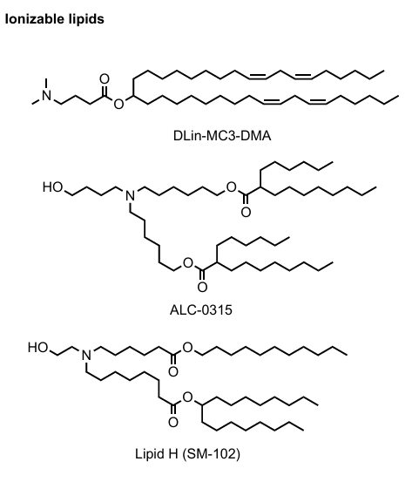
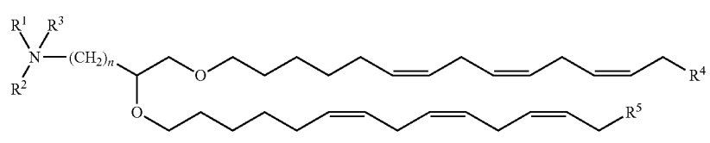
Ionizable Lipids
There are large libraries of ionizable/cationic lipids, including:
Tertiary amine–based ionizable lipids
Biodegradable ionizable lipids
Ester-, amide-, and carbamate-linked lipids
Examples: DLin-MC3-DMA, SM-102, ALC-0315, C12-200
Key property: pKa ≈ 6.2 – 6.8
pH 4 ensures full protonation of ionizable lipid
General structure of cationic lipids

Slide 15
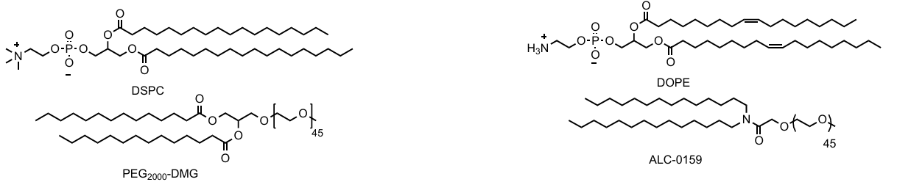
Helper Lipids Examples
DSPC, DPPC, DMPC, ALC-0159, DOPC, DOPE, DOPG, DOPS
Sphingomyelins, Glycolipids
Role:
Structural stability and membrane organization

Slide 16
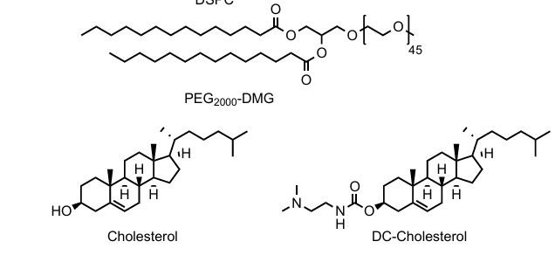
Sterols & Lipopolymers
Sterols:
Cholesterol
Derivatives
Phytosterols
Increase membrane rigidity
Lipopolymers:
PEG-lipids
PEG-phospholipids
Polysarcosine-lipids
Prevent aggregation

Slide 17
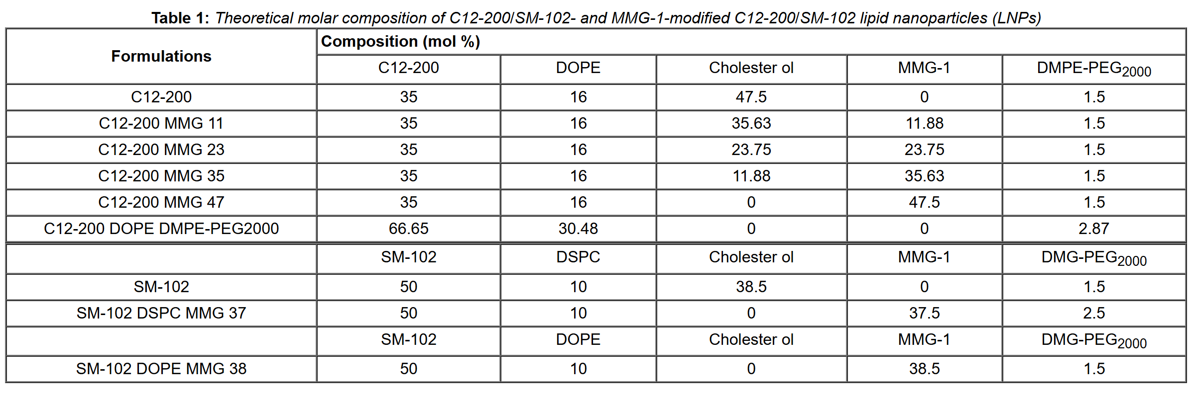
An example of composition from EPO patent. C12-200 LNPs were prepared by microfluidic mixing using the NanoAssemblr® Ignite™ microfluidic mixer system (Precision Nanosystems Inc., Vancouver, Canada), which uses a toroidal micromixer chip.
MMG: monomycoloyl glycerol

Slide 18
Design Space
Component | Allowed Range (mol%) | Preferred Range
Ionizable lipid | 10 – 60 | 30 – 40
Helper lipid | 5 – 30 | 10 – 20
Sterol | 5 – 70 | 10 – 50
Lipopolymer | 0.5 – 50 | 1 – 5
Aqueous : Organic = 1:1 to 3:1, with 3:1 most commonly reported.
Obtaining structurally distinct LNPs often requires drastically changing the chemical composition.

Slide 19
N/P ratio (critical feed parameter)
N/P ratio = (Number of protonatable nitrogens in ionizable lipid) / (Number of phosphate groups in RNA)
Values used: mRNA → N/P = 6
siRNA → N/P = 3
Controls how much lipid is required per RNA
Directly affects:
particle formation
charge balance
encapsulation

Slide 20
Feed Variables Classified (Engineering View)
Fixed / chosen upfront:
Lipid identity
Lipid molar ratio
RNA concentration
Buffer pH
Tunable during operation:
Flow rate
Flow ratio
Mixing intensity
This classification is excellent for simulation justification.

Slide 21
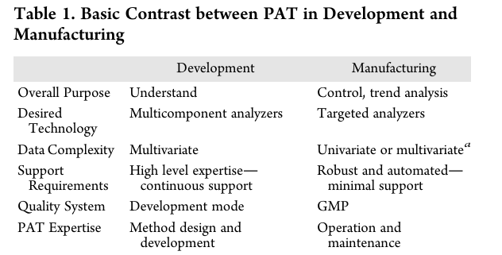
Process Analytical Technology(PAT)
FDA defines PAT as a system to analyse, monitor, and control pharmaceutical manufacturing processes in real time.
It is used for taking measurements directly during the process.
PAT data may measure chemical or physical aspects.

Slide 22
Why Use PAT?
Real-time and frequent measurements.
Improved process understanding.
Better process control and consistency.
Enhanced safety.
Ability to monitor difficult systems.
Improved scale-up and technology transfer.

Slide 23
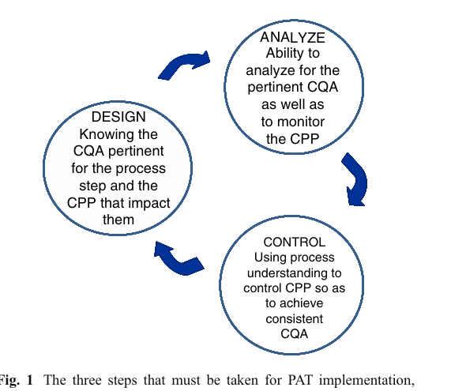
PAT Implementation
PAT integrates process understanding, real-time analysis, and control to ensure product quality.

Slide 24
Role of PAT in LNP Manufacturing
Lipid nanoparticles are highly sensitive to process conditions
Small process variations can significantly affect:
Particle size
Stability
Drug delivery performance
PAT enables real-time monitoring and control during LNP production
It focuses on identifying and controlling: Critical Quality Attributes (CQAs) Critical Process Parameters (CPPs)

Slide 25
Some Analytical techniques used in PAT
Dynamic Light Scattering (DLS) This technique is used to measure particle size and size distribution in real-time.
Zeta Potential Analysis This technique determines the surface charge of LNPs.
X-ray Diffraction (XRD): Analyzes the crystalline or amorphous nature of lipid components within LNPs.
Mass Spectrometry (MS): Provides information on molecular weight and composition of lipids, especially ionizable lipids.
Nuclear Magnetic Resonance (NMR): Provides detailed insights into lipid structure, composition, and molecular interactions in LNP formulations.

Slide 26
High-Performance Liquid Chromatography (HPLC): Quantifies lipid components and encapsulated payload (e.g., mRNA, siRNA).
Differential Scanning Calorimetry (DSC): Used to study the thermal behavior and phase transitions of lipids in LNP formulations.

Slide 27
PAT Tools
Multivariate tools for design, data acquisition, and analysis
Process analyzers
Process control tools
Continuous improvement and knowledge management tools
An appropriate combination of some or all of these tools may be applicable to a single unit operation or to an entire manufacturing process and its quality assurance.

Slide 28
PAT Measurement Level
describe how closely an analytical method is connected to the manufacturing process and how useful it is for real-time control.
Four Analytical levels: Offline: analysis after sample removal At-line: analysis near the manufacturing line In-line: sensor placed directly in the process stream Online: automated sampling and analysis loop
Process relevance and control capability increase from offline to online.

Slide 29
Conclusion
Process Analytical Technology (PAT) helps monitor and control pharmaceutical processes while manufacturing is happening.
Instead of checking quality only at the end, PAT checks quality during the process, which improves reliability.
Different measurement approaches (offline, at-line, inline, and online) allow PAT to be used flexibly in many processes.
In lipid nanoparticle (LNP) manufacturing, PAT is very important because it helps control particle size, which affects product performance.
Overall, PAT supports better process design, consistent quality, and modern manufacturing methods such as continuous processing.

Slide 30
Resources:
https://www.sciencedirect.com/science/article/abs/pii/S0378517325003576
https://pubmed.ncbi.nlm.nih.gov/40139451/
https://www.cytivalifesciences.com/en/us/insights/filtration-of-nucleic-acids-and-lnps-in-mrna-manufacture
https://www.sharpservices.com/expert-content/beyond-lipids-the-science-of-lnp-manufacturing-and-fill-finish/
https://advanced.onlinelibrary.wiley.com/doi/10.1002/adma.202419538
https://www.researchgate.net/publication/361170223_Lipid_nanoparticle_formulations_for_optimal_RNA-based_topical_delivery_to_murine_airways
https://data.epo.org/publication-server/rest/v1.2/patents/EP4442256NWA1/document.html
https://patentimages.storage.googleapis.com/4b/d7/bf/442f9a59aba04c/US11191849.pdf
https://patentimages.storage.googleapis.com/b9/d6/94/1da620d0bbb5a7/US20230414747A1.pdf

Slide 31
https://pubs.acs.org/doi/full/10.1021/acs.accounts.1c00544
https://www.tandfonline.com/doi/full/10.1517/17425247.2012.673278#d1e579
https://www.nature.com/articles/s41578-021-00358-0
https://www.tandfonline.com/doi/full/10.2147/IJN.S123062#d1e182
https://link.springer.com/article/10.1007/s00216-010-3781-x#Sec8
https://pubs.rsc.org/en/content/articlehtml/2010/ay/c0ay00257g
https://pubs.acs.org/doi/full/10.1021/op400358b

Slide 32
THANK YOU!!!

