Slide 1

CL 299 presentation 3
LNP Manufacturing and Process
Simulation
Presented by:
Rhythem Soni 24110296 Aman Bola 24110032 Saket Jonwal 24110311
Supervisor:
Prof. Kaustubh S. Rane Department of Chemical Engineering

Slide 2
PROCESS FLOW CHART –LAB SCALE
We made the flow chart using draw.io software.
In this flow chart we have covered mixing, TFF, ultra filtration, quenching, sterile filtration and cold storage.
For aqueous phase we have used 25mM citrate buffer with target pH~4.
For both the aqueous and organic phases, the temperature is between 20 – 25°C.
we are using macrofluidic mixing as it is easier to operate at lab scale.

Slide 3
Alternatives of M101(macrofluidic mixture)
1. Microfluidic mixing. -Hydrodynamic focusing -Controlled laminar diffusion mixing * Precise FRR and TFR control * Low PDI (<0.2) * High reproducibility * Suitable for 0.5–50 mL batches Best for research optimization Precise size control | 2.Static T-Mixer (Syringe Pump-Based) * Two syringe pumps * T-junction connector * Controlled FRR (e.g., 3:1) * Total flow 2–12 mL/min Low cost Easy to assemble Slightly higher size variability | 3.Rapid Injection / Vortex Mixing * Inject lipid ethanol into stirring mRNA buffer * Magnetic stirrer or vortex Simple setup No pump required Less size control Higher PDI possible

Slide 4
Alternatives for UF101 (Ethanol Removal & Buffer Exchange)
1. Amicon Ultra Centrifugal Filters (Most Common) * 100–300 kDa MWCO * Spin at 3,000–5,000 g * Volume: 1–50 mL * Used for: Ethanol removal Buffer exchange Concentration Fast Widely used in labs Simple operation | 2.Dialysis Tubing System * 100–300 kDa membrane * Buffer bath under stirring * 4–12 hour exchange Very low cost No pump required Slow process Less control over TMP | 3.Stirred Cell Ultrafiltration (Pressure-Driven) * Nitrogen pressure system * Controlled membrane filtration * Better scalability than centrifuge filters More professional setup Better process control Suitable for 50–200 mL

Slide 5
Alternatives for F101 (Sterile Filtration)
0.22 µm Syringe Filter (Standard Lab Method) * PES / PVDF membrane * Manual sterile filtration * Used inside biosafety cabinet Most common method Easy and affordable Suitable for small batches | 2.Vacuum Filtration Assembly * 0.22 µm membrane * Vacuum pump * For 50–200 mL batches Faster for larger volumes Controlled sterile handling | 3.Sterile Single-Use Assembly (Advanced Lab Setup) * Pre-sterilized tubing * Inline 0.22 µm filter * Closed transfer system Mimics GMP process Reduces contamination risk Suitable for translational research

Slide 6
Catalogue Code
We have used python as our coding language using the Google Colab for writing and executing code.
We took reference of some patents and extracted the data from these patents using AI tools.
We extracted information about various components of LNPs (particularly ionizable lipids, helper lipids, PEG-lipids and sterols).
In data we have list of various compounds for each components of LNPs and their molecular weights.
There are many compounds for which we have a range of molecular weight because they have number of units (n) which varies across mixture.
Also, we have distribution of various categories.

Slide 7
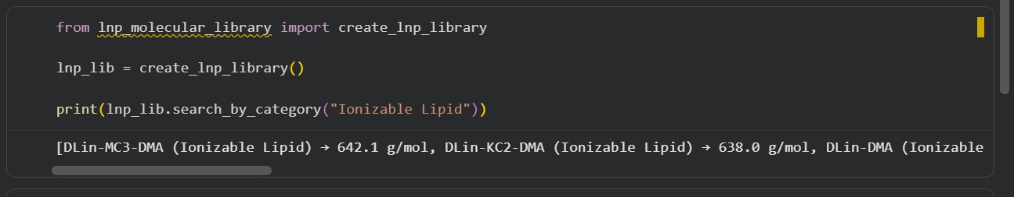
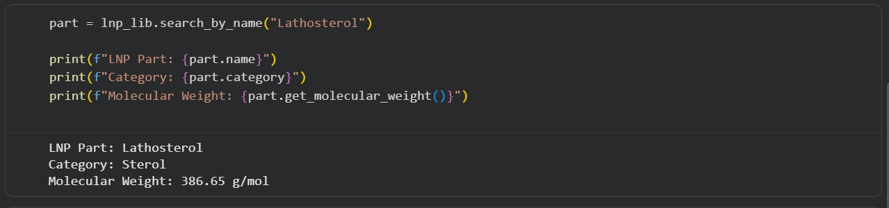

Slide 8
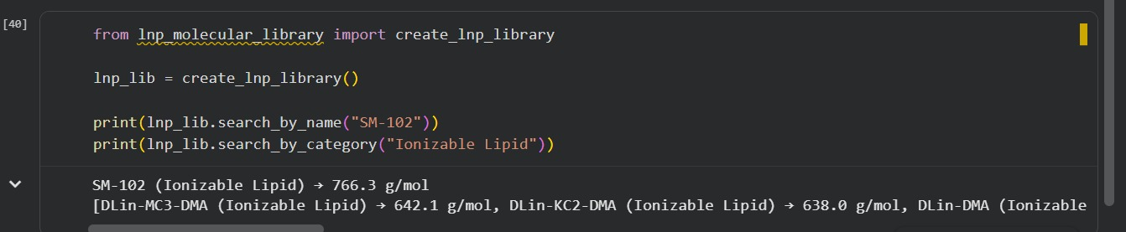

Slide 9
PAT Measurement Level
describe how closely an analytical method is connected to the manufacturing process and how useful it is for real-time control.
Four Analytical levels: Offline: analysis after sample removal. At-line: analysis near the manufacturing line. Online: automated sampling and analysis loop. In-line: sensor placed directly in the process stream. Process relevance and control capability increase from offline to Inline.

Slide 10
Offline Analysis
A sample is removed from process.
Transported to a separate laboratory.
Then analysed and results are obtained.
Perform by manual sampling that can cause some sampling errors.
Not real time monitoring.
High accuracy and advance analysis.
Offline measurement is the traditional approach where quality is checked after sampling instead of during processing.

Slide 11
At-line Analysis
A sample is removed from the process.
Analysed using equipment located near the production line.
Faster analysis compared to offline laboratory testing.
Performed by manual sampling and sampling errors may still occur.
Not fully real-time monitoring but provides quicker feedback.
Allows rapid process monitoring and adjustment.
At-line measurement is an intermediate approach where analysis is done close to the process, providing faster results than offline analysis but still requiring sample removal.

Slide 12
Online Analysis
Sample is automatically taken from the process using a bypass system.
Analytical equipment is connected directly to the production line.
Sample may be conditioned before analysis (e.g., dilution or temperature control).
Provides near real-time monitoring.
Reduces manual sampling errors.
Allows continuous process monitoring and faster feedback.
The disadvantages of online analysis are the higher capital costs that arise from the automation and the requirements for robustness of the analytical equipment.

Slide 13
In-line Analysis
Measurement is performed directly inside the process.
Analytical sensor is integrated into the production line.
No sample removal is required.
Provides continuous and real-time monitoring.
Enables immediate detection of process changes.
Supports automatic process control and optimization.
Inline measurement is an in-situ approach where analysis occurs directly within the process stream, allowing real-time monitoring and control without manual sampling.

Slide 14
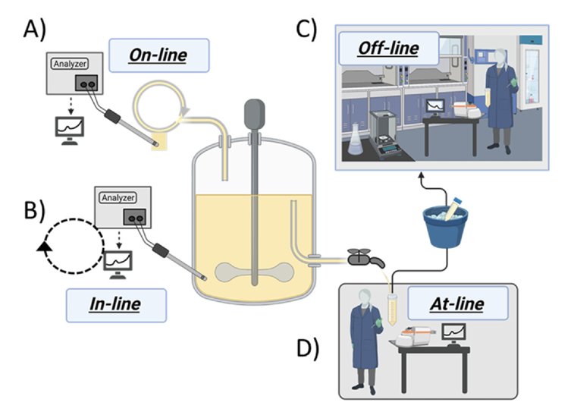
Level | Sample removal | Real-time | Control capability
Offline | Yes | No | Low
At-line | Yes | Limited | Medium
Online | Automated | Near real-time | High
Inline | No | Real-time | Highest

Slide 15
CLASSIFICATION OF TECHNIQUES
Near-infrared spectroscopy (NIR) Measures molecular vibrations. Used for real-time process monitoring as online and inline.
Infrared spectroscopy This technique is used to identify chemical bonds and molecular structures Used for real-time process monitoring as online and inline(major).
Nuclear magnetic resonance (NMR) This technique is used to determine molecular structure and chemical composition using magnetic properties of atomic nuclei. Offline and online.
Raman spectroscopy This technique is used to analyze molecular structure and composition by measuring light scattering from molecules online and inline.

Slide 16
Dynamic light scattering (DLS) This technique is used to measure particle size and size distribution in real-time. Inline.
Fluorescence This technique is used to detect specific molecules and monitor nanoparticle formation or payload distribution offline
Surface plasmon resonance (SPR) Surface plasmon resonance is an optical sensing technique that measures changes in refractive index at a metal surface to detect molecular interaction. Inline.
reflective interference spectroscopy (RIF) measures interference patterns of reflected light to detect changes in surface thickness or refractive index. Inline.

Slide 17
Mass spectrometry (MS) provides information about the molecular weight and composition of lipids online.
Electrochemical sensors measure the chemical properties. Inline.
NIR Turbidity uses Near-Infrared (NIR) light to determine how cloudy or particle-rich a liquid is. Inline.
Capacitance: Inline.
IR Absorption Infrared (IR) absorption occurs when molecules absorb infrared radiation, causing changes in vibrational and rotational energy levels. Online and inline.

Slide 18
(Bio)chemical Analysers used to measure chemical or biological components offline.
Calorimetry measuring heat transfer during physical or chemical processes online.
Confocal Spectroscopy (CICS) used for high-resolution nanoparticle characterization offline.
Consistent cryo-electron microscopy (Cryo-EM) This technique is used to visualize nanoparticle structure and morphology at very high resolution. offline

Slide 19
Small-angle X-ray scattering (SAXS). This technique is used to analyze nanoscale structure and internal organization of particles using X-ray scattering. offline
Computational Fluid Dynamics (CFD) uses mathematical modeling and simulations. Offline.
Zeta potential Analysis This technique determines the surface charge. Inline and at-line.

Slide 20
Optical Microscopy and Electron Microscopy helping to identify any issues like agglomeration or structural defects. Offline.
Differential Scanning Calorimetry (DSC) (Thermal analysis, not real-time). Offline.
X-ray Diffraction (XRD) This technique is used to determine crystal structure and phase composition by analyzing X-ray diffraction patterns. Offline.
High-Performance Liquid Chromatography (HPLC) On-line possible via auto-samplers for drug loading, encapsulation efficiency, or degradation monitoring.
Fourier Transform Infrared Spectroscopy (FTIR) Can be on-line with ATR-FTIR probes, but typically offline unless specialized probe systems are used.

Slide 21
UV spectroscopy used to measure chemical changes and molecular concentration.
Ultrasonic crystallization monitoring (UCM) uses ultrasonic waves to monitor crystallization processes by detecting particle formation and phase changes
Photometric stereo imaging Photometric stereo imaging reconstructs surface shape by analyzing images taken under different lighting angles. At-line and online.
FBRM (Focused Beam Reflectance Measurement) this technique is used to monitor particle size and count in real time
PVM (Particle Vision and Measurement) captures real-time images of particles inside a process to monitor particle shape, size, and behavior. Inline.

Slide 22
Resources
https://docs.google.com/presentation/d/18YQe9UQSGdCi0CvTygbpCGwfLPhk4ogJ/edit?usp=sharing&ouid=114130096820631242211&rtpof=true&sd=true
https://drive.google.com/file/d/1qwG77msmF2oO8doUGwgtkrXdz0KD0xtk/view?usp=sharing
https://drive.google.com/file/d/1qwG77msmF2oO8doUGwgtkrXdz0KD0xtk/view?usp=sharing
Patents & Patent Applications:
D. G. Anderson et al., “Lipid nanoparticles for nucleic acid delivery,” U.S. Patent 9,512,092, Dec. 6, 2016.
M. J. Hope et al., "Lipid nanoparticle formulations," W.O. Patent 2018/081480 A1, May 3, 2018.
S. M. Ansell et al., "Methods of preparing lipid nanoparticles," W.O. Patent 2020/160397 A1, Aug. 6, 2020.
S. G. Hoge et al., "Compositions and methods for delivering messenger RNA," U.S. Patent 11,191,849 B2, Dec. 7, 2021.

Slide 23
D. G. Anderson et al., “Lipid-like compounds and methods of use,” U.S. Patent 9,993,512, Jun. 12, 2018.
H. Dong et al., “Biodegradable lipid nanoparticles for nucleic acid delivery,” U.S. Patent 10,221,127, Mar. 5, 2019.
K. Karikó et al., “Lipid nanoparticle compositions for RNA delivery,” U.S. Patent 10,933,127, Mar. 2, 2021.
K. Karikó et al., “RNA-containing lipid nanoparticles and uses thereof,” U.S. Patent 10,702,600, Jul. 7, 2020.
K. R. Love et al., “Lipid nanoparticles for nucleic acid delivery,” U.S. Patent 10,221,127, Mar. 5, 2019.
M. J. Hope et al., “Cationic lipids for nucleic acid delivery,” U.S. Patent 7,531,490, May 12, 2009.
P. R. Cullis, M. J. Hope, and T. D. Madden, “Lipid nanoparticle formulations for delivery of nucleic acids,” U.S. Patent 8,058,069, Nov. 15, 2011
S. M. Ansell et al., "Methods for preparation of lipid-encapsulated therapeutic agents," U.S. Patent Application 2022/0001029 A1, Jan. 6, 2022.
S. A. Stanton et al., "Lipid nanoparticle compositions and methods of formulating the same," E.P. Patent Application 4 046 629 A1, Aug. 24, 2022.
S. M. Ansell and X. Du, "Lipids and lipid nanoparticle formulations for delivery of nucleic acids," U.S. Patent 11,648,324 B2, May 16, 2023.

Slide 24
P. Samayoa, N. Silver, G. Feinstein, and M. LeBlanc, "Lipid nanoparticle compositions and uses thereof," W.O. Patent 2023/239756 A1, Dec. 14, 2023.
Acuitas Therapeutics, Inc., "Lipid nanoparticle compositions," E.P. Patent Application 4 442 256 A1, 2024.
L. Dagge, K. Harr, M. Paul, and G. Schnedl, “Classification of process analysis: Offline – Atline – Online – Inline,” Cement International, vol. 7, no. 5, pp. 2–8, 2009.
A. de Juan and R. R. de Oliveira, “Hyperspectral image and chemometrics. A step beyond classical spectroscopic PAT tools,” Analytical and Bioanalytical Chemistry, vol. 418, pp. 23–34, 2025, doi: 10.1007/s00216-025-06154-x.
G. Gerzon, Y. Sheng, and M. Kirkitadze, “Process analytical technologies – Advances in bioprocess integration and future perspectives,” Journal of Pharmaceutical and Biomedical Analysis, vol. 207, 114379, 2021, doi: 10.1016/j.jpba.2021.114379.
P. L. Ahl, “Microfluidic and turbulent mixing for mRNA LNP vaccines,” Pharmaceutics, vol. 17, no. 9, Art. no. 1148, 2025, doi: 10.3390/pharmaceutics17091148.

Slide 25
THANK YOU!!!

