Slide 1

CL 299 presentation 7
LNP Manufacturing and Process
Simulation
Presented by:
Rhythem Soni 24110296 Aman Bola 24110032 Saket Jonwal 24110311
Supervisor:
Prof. Kaustubh S. Rane Department of Chemical Engineering

Slide 2
Energy
Syringe Pump :
Flow Rate | Power
1–10 mL/min | ~10 W
10–50 mL/min | ~15–20 W
Peristaltic Pump :
Flow Rate | Power
10–50 mL/min | 20–40 W
50–100 mL/min | 40–80 W
TFF circulation pump :- 80–120 W OverHead Stirrer :- 50–100 W Magnetic stirrer :- 5–15 W Total power :- 695W

Slide 3




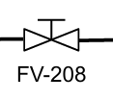



PAT AS P&ID
Some elements that we use in the P&ID.
Level Indicator(LI)
Flow Transmitter
Valve
Temperature transmitter
Low flow valve
Pressure transmitter
Flow controller
Conductivity sensor

Slide 4
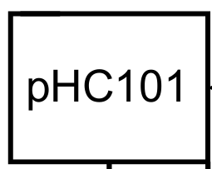
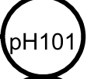


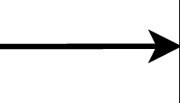

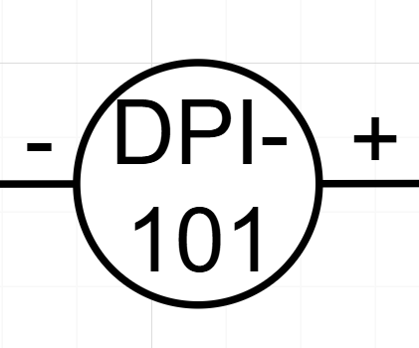
pH Controller
Emergency Shutdown (ESD)
Process line
Differential Pressure Indicator
pH transmitter
Pressure controller
Control loop line

Slide 5
Why there is no Cooling for Mixer?
We have Low flow rate
There is not much increment in temperature at lab scale

Slide 6
Resource
P. R. Cullis and M. J. Hope, “Lipid nanoparticle systems for enabling gene therapies,” Molecular Therapy, 2017
K. A. Whitehead et al., “Formulations and methods for delivery of nucleic acids,” US Patent US20180208676A1, 2018
J. R. Bourne and R. G. K. Friberg, “Mixing apparatus and method,” US6874900B2, Apr. 5, 2005.
J. R. M. Clark et al., “Bioreactor mixing system,” US20110223636A1, Sep. 15, 2011.
D. J. McCarthy, “Agitation system with impeller,” US20100060325A1, Mar. 11, 2010.

Slide 7
THANK YOU!!!

