Slide 1

CL 299 presentation 8
LNP Manufacturing and Process
Simulation
Presented by:
Rhythem Soni 24110296 Aman Bola 24110032 Saket Jonwal 24110311
Supervisor:
Prof. Kaustubh S. Rane Department of Chemical Engineering

Slide 2
PAT

Slide 3
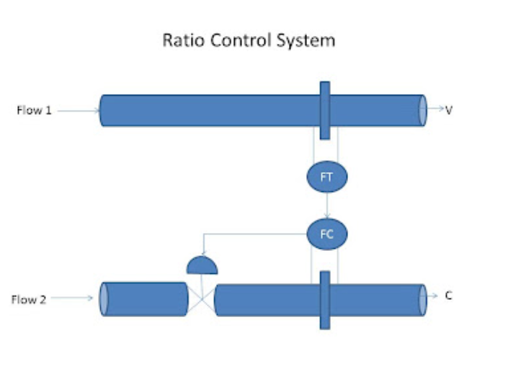
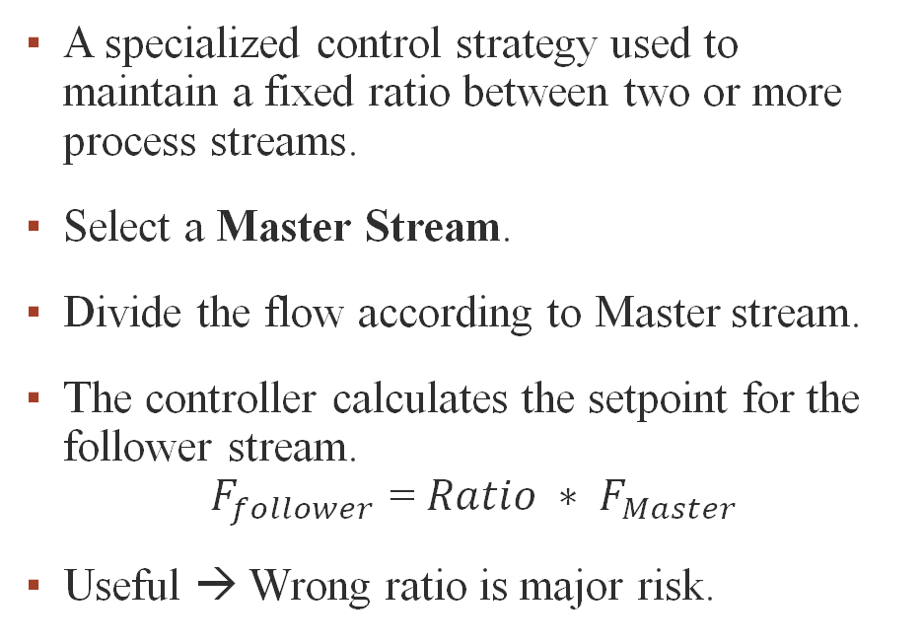
TYPES OF CONTROLLER USED IN P&ID
RATIO CONTROLLER
A specialized control strategy used to maintain a fixed ratio between two or more process streams.
Select a Master Stream.
Divide the flow according to Master stream.
The controller calculates the setpoint for the follower stream. $F_{follower}$ = ${Ratio ∗ F}_{Master}$
Useful → Wrong ratio is major risk.

Slide 4
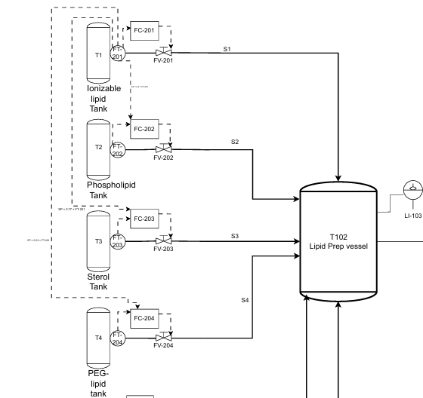
HOW WE USE RATIO CONTROLLER ?
S1 as master stream → Measure.
Measured stream to be adjusted.
Send signals to other controllers.
Then divide the flow. S2 = 0.2 * S1 S3 = 0.77 * S1 S4 = 0.03 * S1

Slide 5
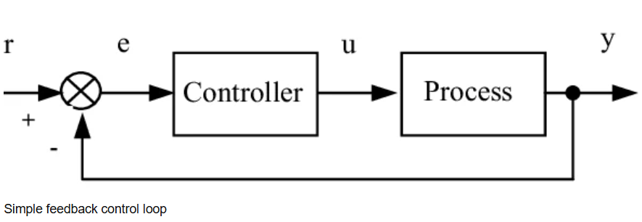
Feedback Controller
Closed-loop control strategy.
output of a process is continuously measured by a sensor, compared to a desired setpoint.
the error is used to automatically adjust the manipulated variable to bring the process back to the setpoint.

Slide 6
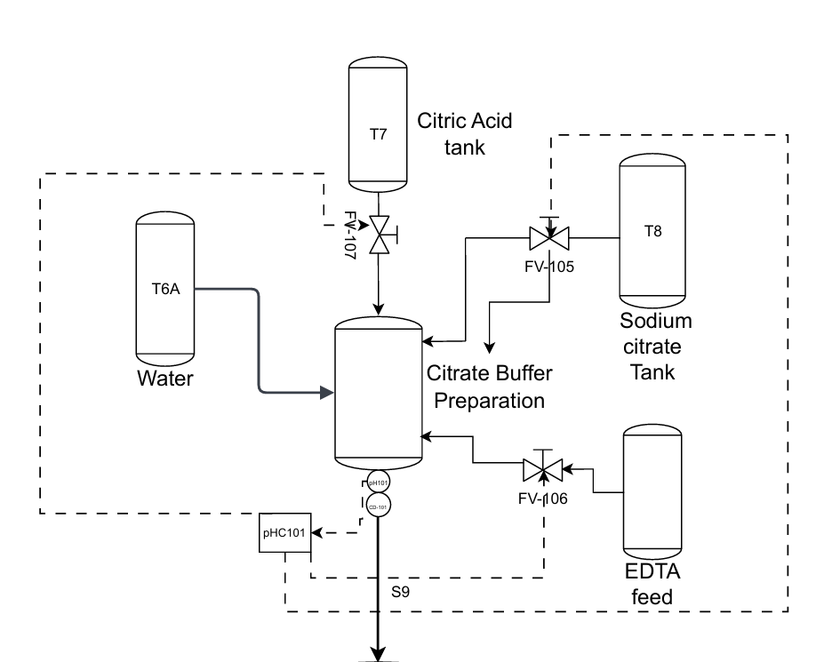
HOW WE USE FEEDBACK CONTROLLER?
pH transmitter continuously measures solution Ph
Controller compares measured pH to setpoint and generates an error signal
Error drives acid or base valve to bring pH back to setpoint

Slide 7
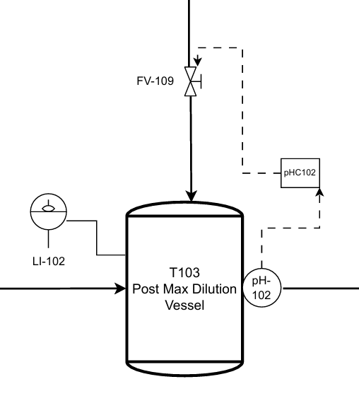
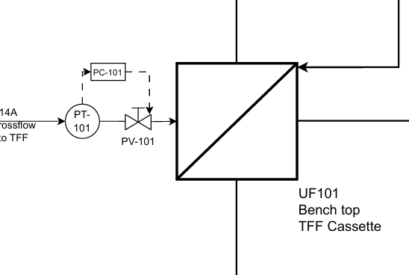

Slide 8
On/Off ( bang-bang) Controller
Close loop control strategy.
The controller output has only two possible states: Fully ON or Fully OFF
A switching action is triggered when the measured variable crosses a preset threshold.
Implemented as part of a Safety Instrumented System (SIS).

Slide 9
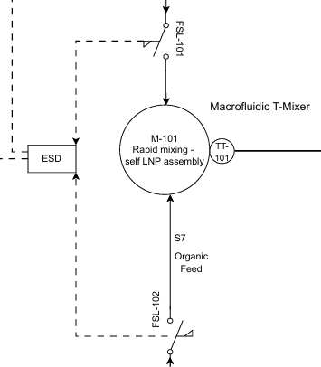
HOW WE USE On/Off CONTROLLER?
FSL-101 or FSL-102 drops below trip setpoint.
ESD activates.
full process shutdown

Slide 10
Resources
G. Dragffy, “The design of a highly reliable safety critical emergency shutdown (ESD) system,” Reliability Engineering & System Safety, 1998.
N. K. Drunasky and B. J. Hackel, "PID controls: the forgotten bioprocess parameters," Discov. Chem. Eng., vol. 2, no. 1, p. 1, Jan. 2022, doi: 10.1007/s43938-022-00008-z.
C. B. Roces et al., "Manufacturing considerations for the development of lipid nanoparticles using microfluidics," Pharmaceutics, vol. 12, no. 11, Nov. 2020, Art. no. 1095, doi: 10.3390/pharmaceutics12111095.
P. Woolf et al., "11.4: Ratio control- What is it? When useful? When not? Common usage," in Chemical Process Dynamics and Controls, Davis, CA, USA: LibreTexts, Jul. 2022. [Online].
S. Singh, R. Ierapetritou, and F. J. Muzzio, “Closed-loop feedback control of a continuous pharmaceutical tablet manufacturing process via wet granulation,” Journal of Pharmaceutical Innovation, vol. 9, no. 2, pp. 137–152, 2014, doi: 10.1007/s12247-014-9170-9.

Slide 11
Su, Q., Moreno, M., Giridhar, A. et al. A Systematic Framework for Process Control Design and Risk Analysis in Continuous Pharmaceutical Solid-Dosage Manufacturing. J Pharm Innov 12, 327–346 (2017). https://doi.org/10.1007/s12247-017-9297-6.
https://aiche.confex.com/aiche/2016/webprogram/Paper471687.html

Slide 12
THANK YOU!!!

