Slide 1
EMBEDDED LAB PRESENTATION
EXPERIMENT NUMBER: 5
ELECTRICITY HARVEST USING SOLAR PLATE
By Group Members:
Pushkar Kumar
Akash Kumar
Manu Kumari
Saket Tiwari
Vikash Kumar

Slide 2
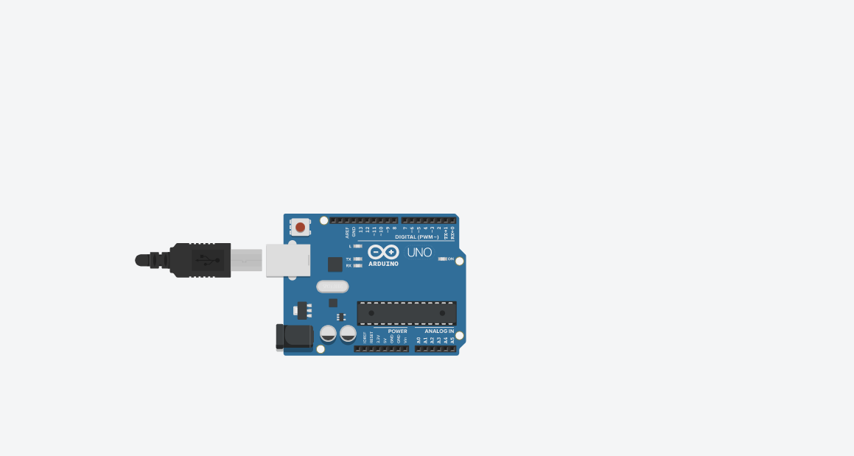
In the Circuit click on the left side, COMPONENT BASIC AND SELECT AURDINO UNO

Slide 3
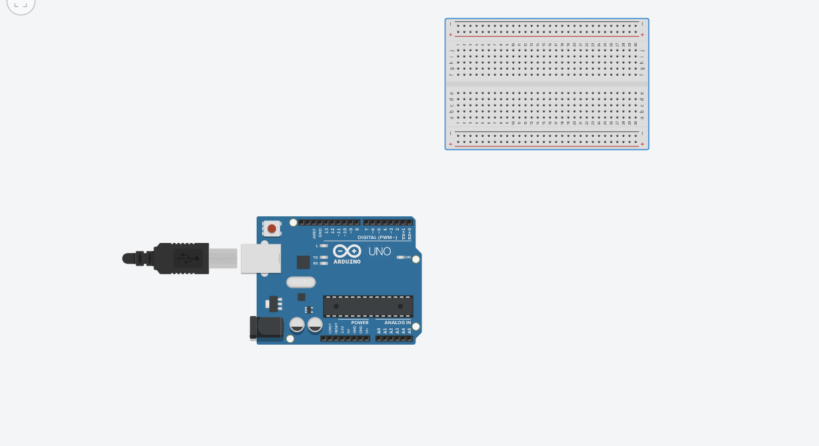
Place two bread-boards

Slide 4
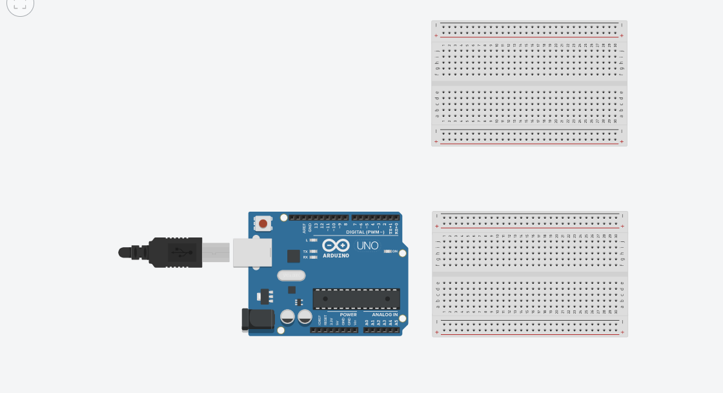
PLACE TWO BREAD-BOARDS

Slide 5
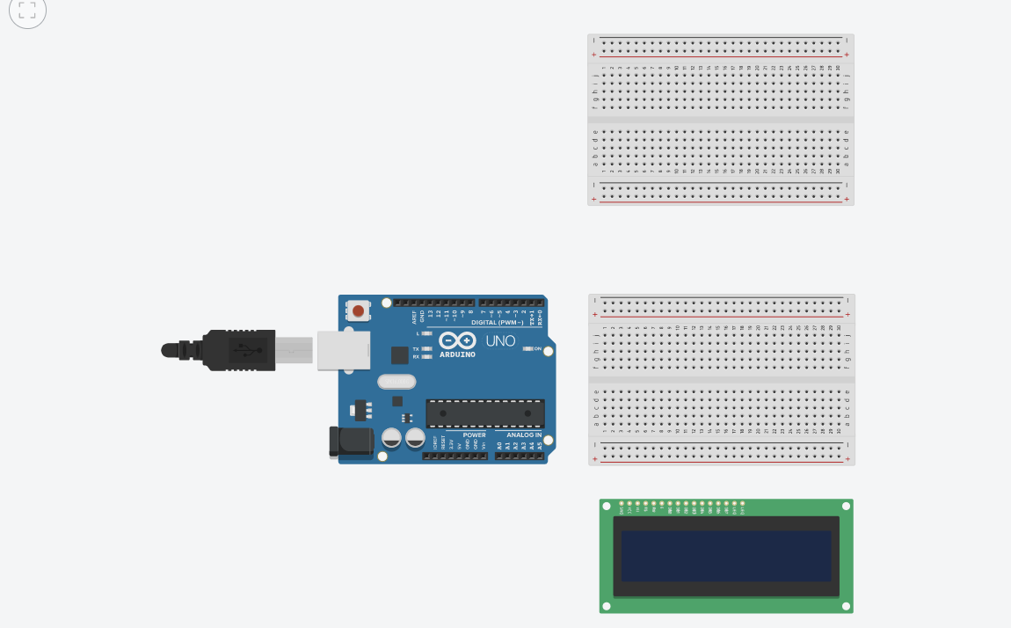
ADD A 16*2 LCD

Slide 6
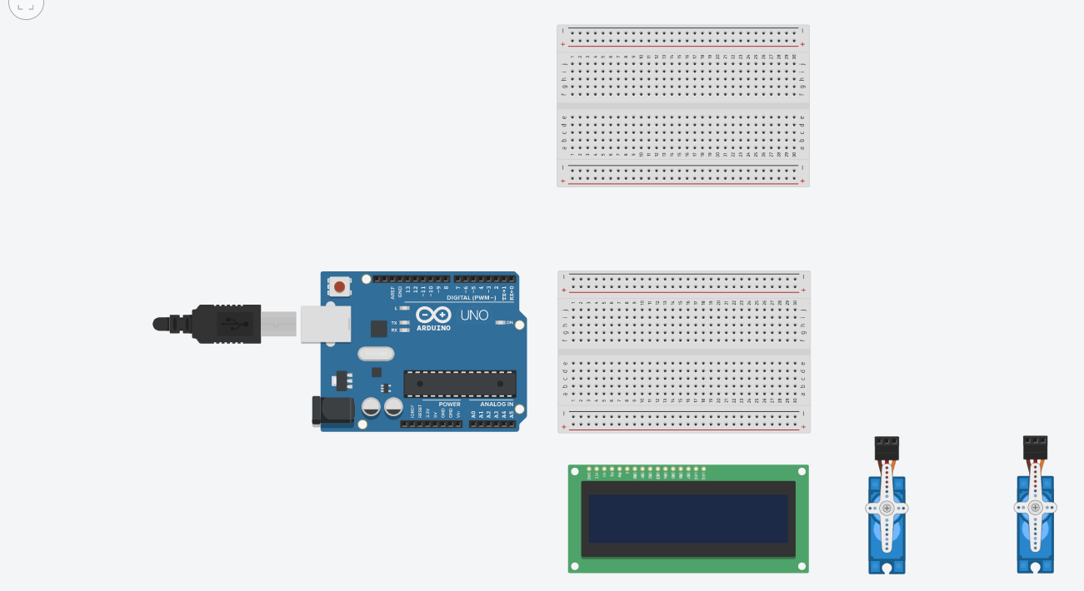
ADD TWO SERVO MOTORS TO ROTATE THE SOLAR PANEL AND MEASURE THE ANGLE

Slide 7
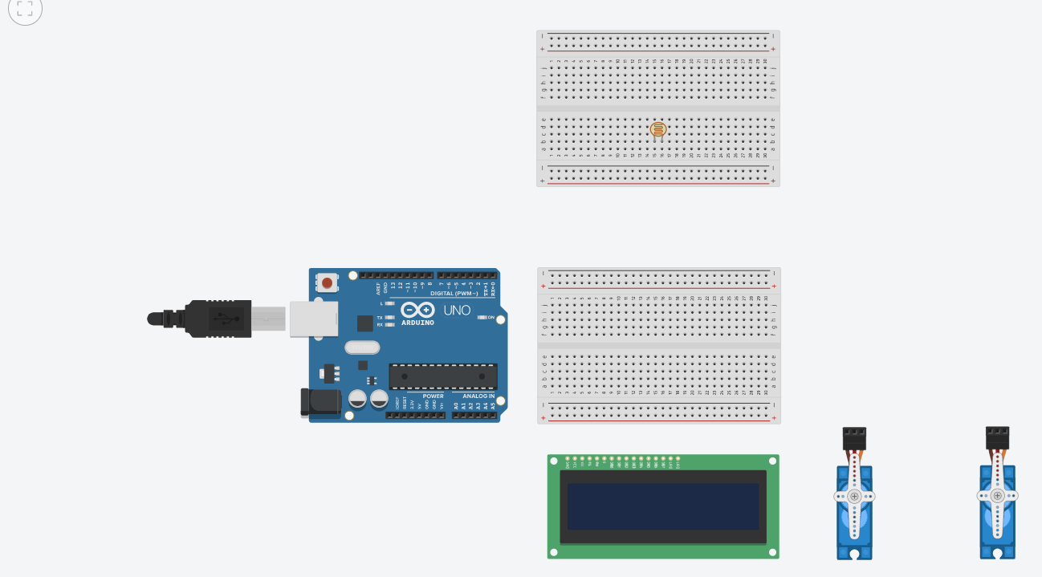
ADDING PHOTO-RESISTORS

Slide 8
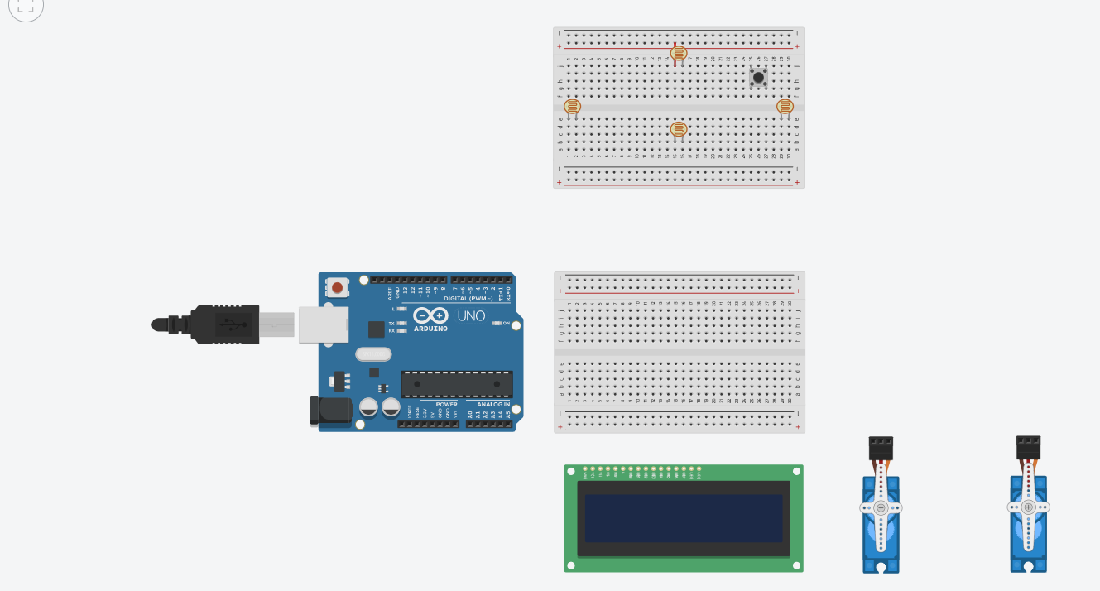
ADDING PHOTO-RESISTORS

Slide 9


Slide 10
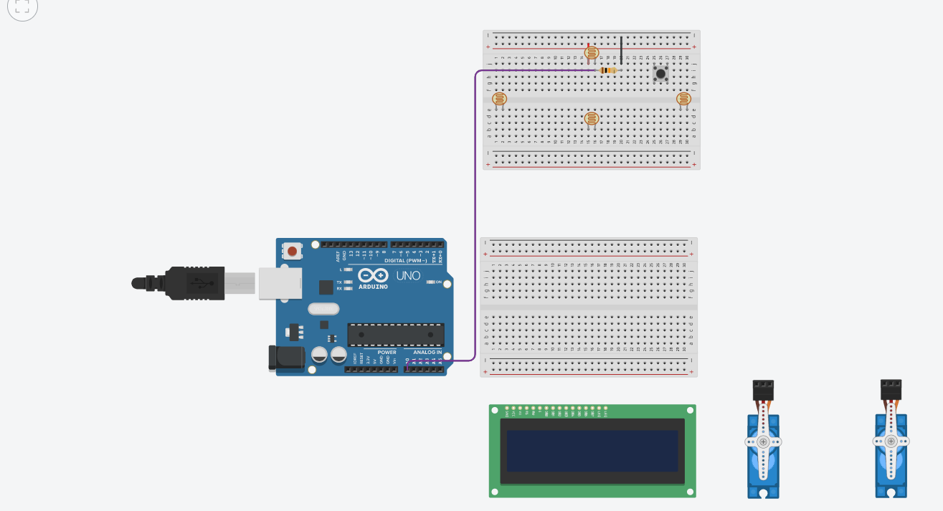

Slide 11


Slide 12
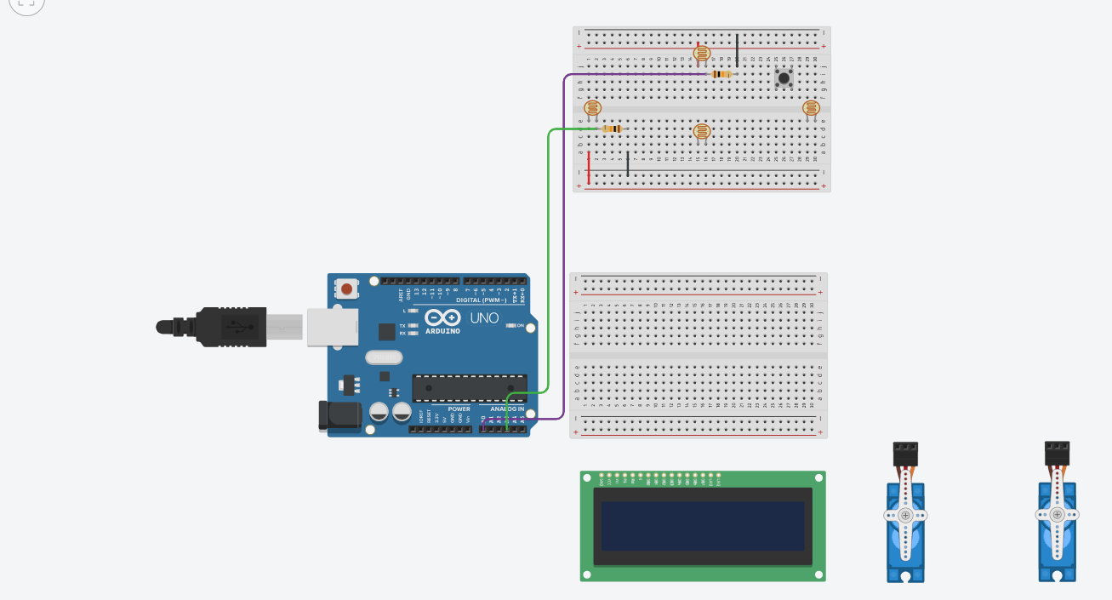

Slide 13


Slide 14


Slide 15
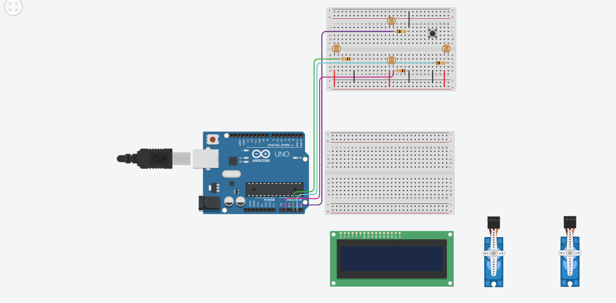

Slide 16
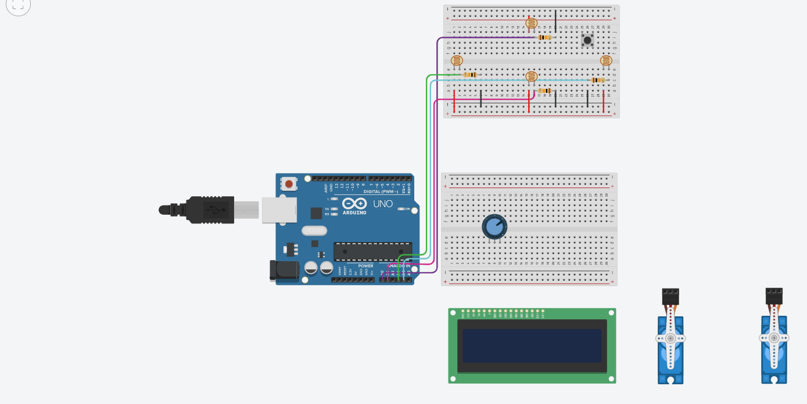

Slide 17
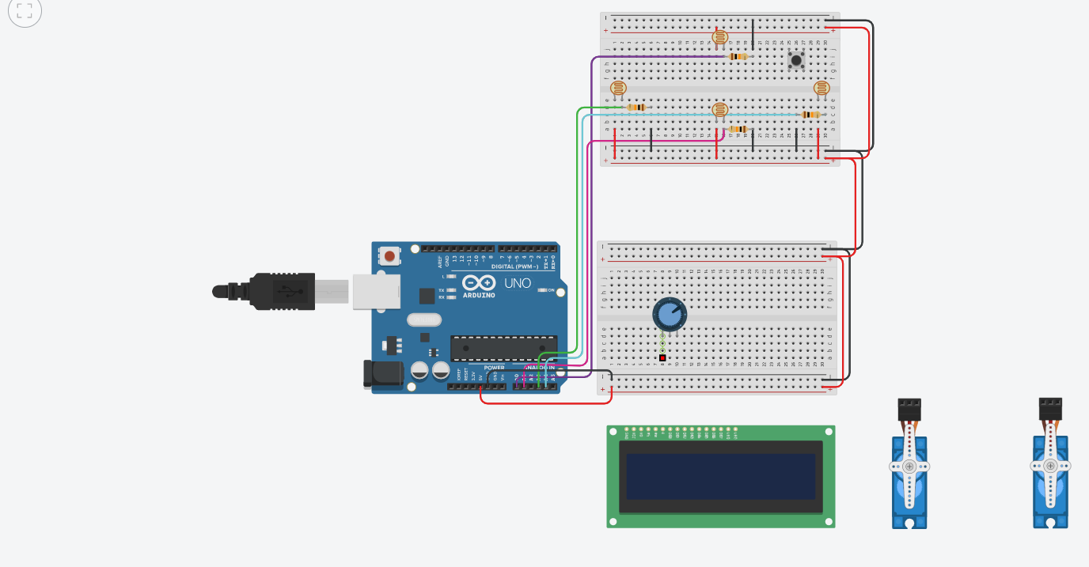

Slide 18
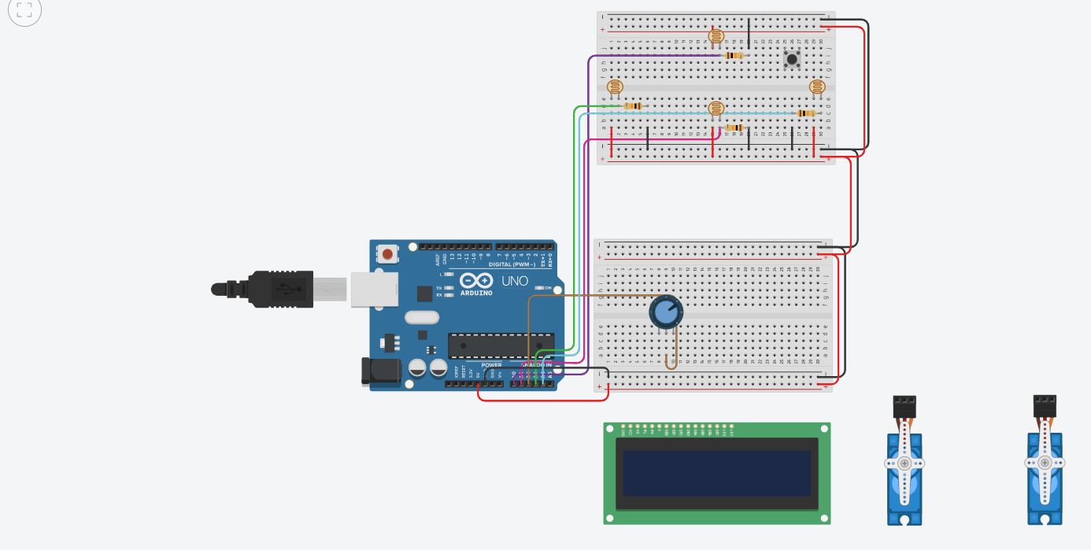

Slide 19
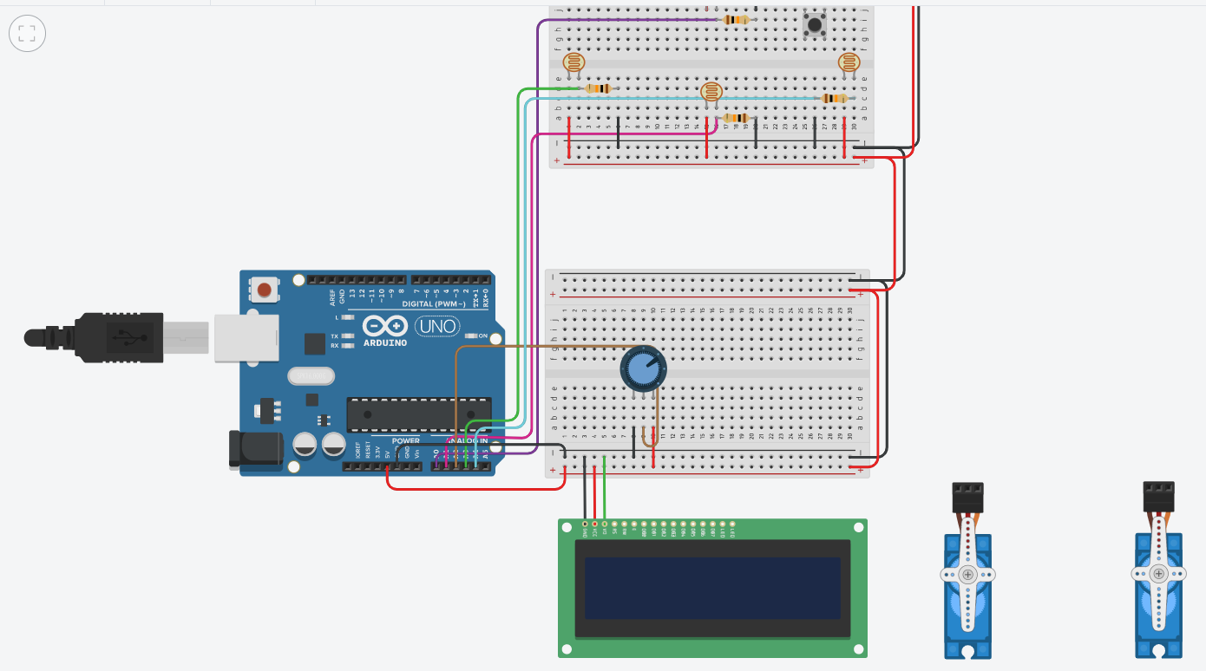

Slide 20
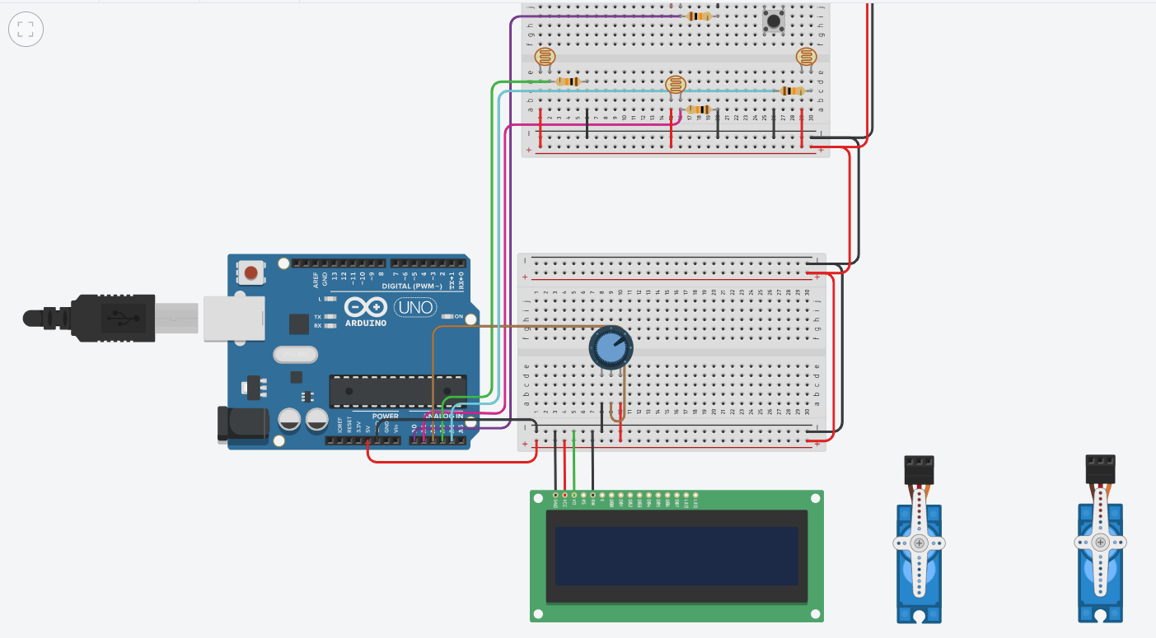

Slide 21
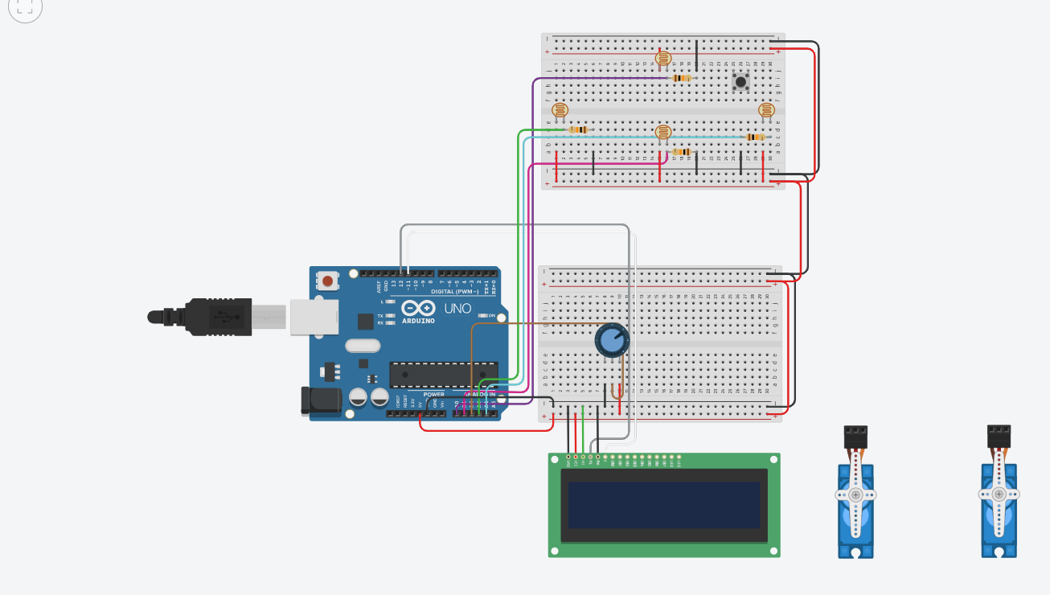

Slide 22
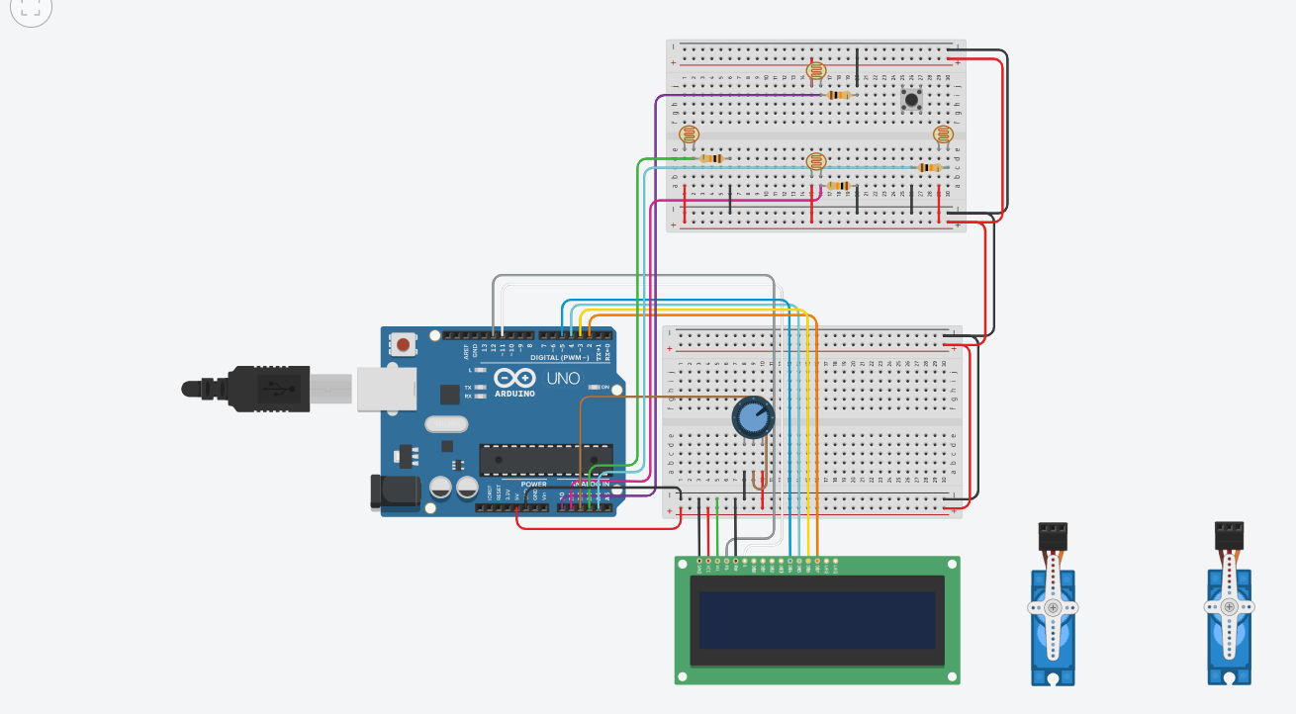

Slide 23
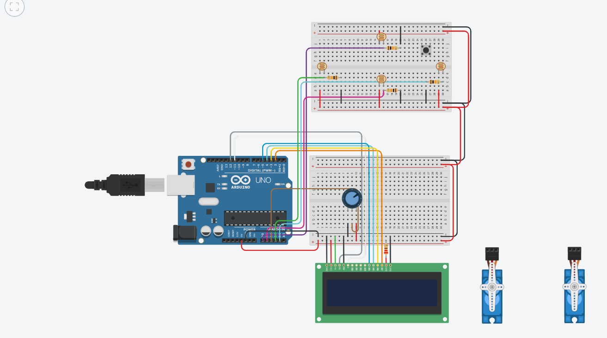

Slide 24
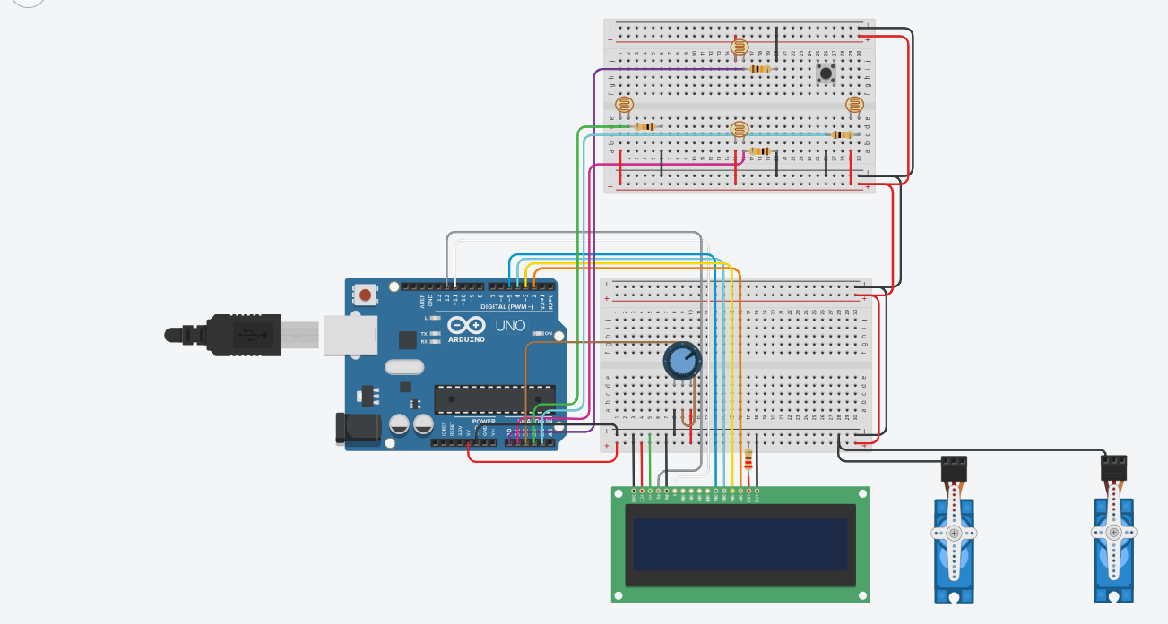

Slide 25


Slide 26


Slide 27
