Slide 1
Data Communication & Networks.
EXPERIMENT 12 - HOME NETWORK SETUP
BY: Group 12
Saket Tiwari (2017UGEC035R) Ankit Kumar (2017UGEC005R)

Slide 2
OBJECTIVE
AIM OF THE EXPERIMENT

Slide 3
OBJECTIVE
AIM OF THE EXPERIMENT
Configuration of a home network topology using Cisco Packet Tracer software.

Slide 4
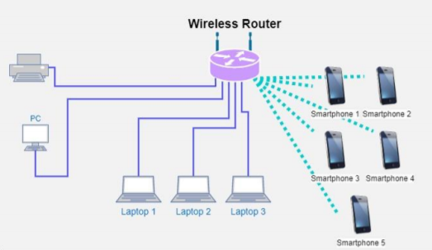
OBJECTIVE
AIM OF THE EXPERIMENT
Configuration of a home network topology using Cisco Packet Tracer software.

Slide 5
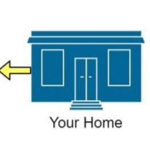
OBJECTIVE
AIM OF THE EXPERIMENT
Configuration of a home network topology using Cisco Packet Tracer software.

Slide 6
THEORY
Today almost every home and small office have a local network and an Internet connection.

Slide 7
THEORY
Today almost every home and small office have a local network and an Internet connection.
The home network or small office network enables multiple devices e.g. PCs, tablets, laptops, smart phones, etc. to connect, and also to connect to the internet.

Slide 8
THEORY
Today almost every home and small office have a local network and an Internet connection.
The home network or small office network enables multiple devices e.g. PCs, tablets, laptops, smart phones, etc. to connect, and also to connect to the internet.
In this experiment we aim to build and setup a home or small office network.

Slide 9
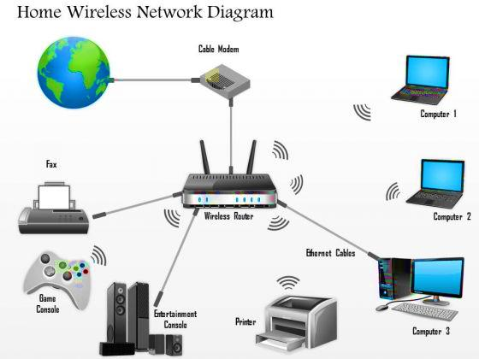

Slide 10
Wired or wireless ???
Wired networks use Ethernet over UTP cable and tend to be faster than wireless networks, which is an important consideration if you are a gamer.

Slide 11
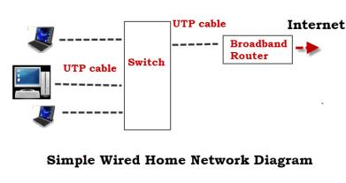
Wired or wireless ???
Wired networks use Ethernet over UTP cable and tend to be faster than wireless networks, which is an important consideration if you are a gamer.

Slide 12
Wired or wireless ???
Wired networks use Ethernet over UTP cable and tend to be faster than wireless networks, which is an important consideration if you are a gamer.
The simple wired home network diagram shows a minimum setup with a switch and broadband router.

Slide 13
Wired
ADVANTAGES

Slide 14
Wired
ADVANTAGES:
Fast typically 100 Mbps to 10 Gbps

Slide 15
Wired
ADVANTAGES:
Fast typically 100 Mbps to 10 Gbps
Secure and reliable.

Slide 16
Wired
Dis-Advantages:

Slide 17
Wired
Dis-Advantages:
Doesn’t work with devices that don’t have an Ethernet port e.g. tablets and smart phones.

Slide 18
Wired
Dis-Advantages:
Doesn’t work with devices that don’t have an Ethernet port e.g. tablets and smart phones.
Not so easy for visitors and mobile devices (laptops) to connect to.

Slide 19
Wired
Dis-Advantages:
Doesn’t work with devices that don’t have an Ethernet port e.g. tablets and smart phones.
Not so easy for visitors and mobile devices (laptops) to connect to.
Not so easy and fast to setup as it requires running cables. However Home plug or powerline adapters can be used instead.

Slide 20
Wired
USES:

Slide 21
Wired
USES:
Used for network backbone i.e. connecting between router, network switches and wireless access points on different levels (floors).

Slide 22
WIRELESS

Slide 23
WIRELESS
Wireless networks use Wi-Fi. and are quick and easy to install, but are generally slower than wired networks.

Slide 24
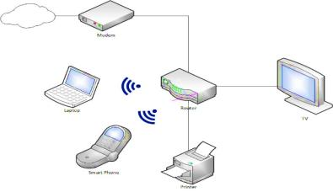
WIRELESS
Wireless networks use Wi-Fi. and are quick and easy to install, but are generally slower than wired networks.

Slide 25
WIRELESS
ADVANTAGES:

Slide 26
WIRELESS
ADVANTAGES:
Easy to setup from an end user perspective.

Slide 27
WIRELESS
ADVANTAGES:
Easy to setup from an end user perspective.
Allows easy access to smart phones, Tablets and mobile devices.

Slide 28
WIRELESS
ADVANTAGES:
Easy to setup from an end user perspective.
Allows easy access to smart phones, Tablets and mobile devices.
No cables to run.

Slide 29
WIRELESS
DIS-ADVANTAGES:
Not as Secure as wired networks without proper configuration. and easy to setup insecurely.

Slide 30
WIRELESS
DIS-ADVANTAGES:
Not as Secure as wired networks without proper configuration. and easy to setup insecurely.
Not so as fast as wired networks.

Slide 31
WIRELESS
DIS-ADVANTAGES:
Not as Secure as wired networks without proper configuration. and easy to setup insecurely.
Not so as fast as wired networks.
Not as reliable as wired networks.

Slide 32
WIRELESS
USES:

Slide 33
WIRELESS
USES:
Connecting peripheral devices like computers, smart phone, tablets etc.

Slide 34
WIRED OR WIRELESS ???
Most home networks will use a mixture of wired and wireless.

Slide 35
Setting up a Home Network
The main components required to build a typical home/small office network are:

Slide 36
Setting up a Home Network
The main components required to build a typical home/small office network are:
Router or Wireless Router - Connects the network to the Internet.

Slide 37
Setting up a Home Network
The main components required to build a typical home/small office network are:
Router or Wireless Router - Connects the network to the Internet.
Ethernet Hub or Switch - Used to Connect Ethernet equipped devices.

Slide 38
Setting up a Home Network
The main components required to build a typical home/small office network are:
Router or Wireless Router - Connects the network to the Internet.
Ethernet Hub or Switch - Used to Connect Ethernet equipped devices.
Copper Straight Wire with RJ45 connectors.

Slide 39
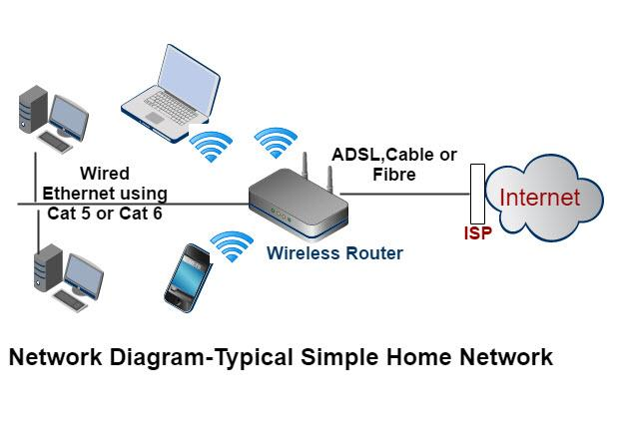
Setting up a Home Network
The home network diagram below shows the structure of a typical small home network:

Slide 40
Home Router Setup
To administer the router, you access it via a web browser, and login using a username and password.

Slide 41
Home Router Setup
To administer the router, you access it via a web browser, and login using a username and password.
Before you allow devices to connect to your home network you should make some basic changes to the default setup parameters of your router.

Slide 42
Home Router Setup
To administer the router, you access it via a web browser, and login using a username and password.
Before you allow devices to connect to your home network you should make some basic changes to the default setup parameters of your router.
The two important one is the SSID used to access the Router and the router admin password as the default username/passwords are well known, and published on the Internet.

Slide 43
Connecting Wi-Fi Devices

Slide 44
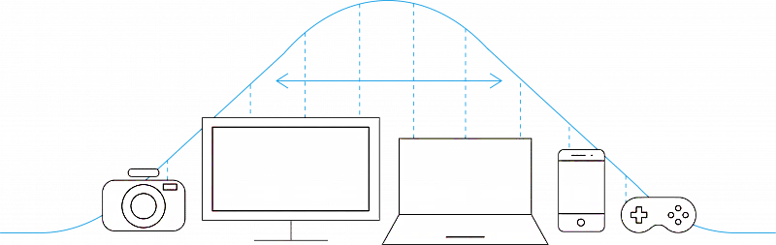
Connecting Wi-Fi Devices
Most wireless access points and wireless routers can theoretically have 255 devices connected at a time. That represents a lot of computers, smartphones, tablets, cameras, and other devices and probably far exceeds the needs of the typical home. Keep in mind that each computer or device that’s added to your network will reduce the bandwidth available to the other devices using the same Internet connection.

Slide 45

Security over Wi-Fi Devices
The standard way of connecting a Wi-fi device to a Wi-fi network is the connect to the network and enter the password when prompted.
However most modern Wi-Fi routers/hubs support a feature called WPS (Wi-fi protected setup). Which usually involves pressing a button on the Wi-Fi router and a corresponding WPS connection button on the Device.

Slide 46
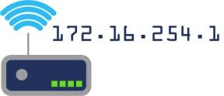
Home Network IP Address
All of your devices will need an IP address. This is provided automatically by a service called DHCP which, by default, is provided by the home router.
IP address provided by the DHCP server are known as dynamic address as they can change. You can also assign addresses manually, and these are known as static addresses.

Slide 47
What we are building?
We are creating a small network which has 3 Laptops, 1 PC, 1 Printer and 5 Smartphones in its network.

Slide 48
What we are building?
We are creating a small network which has 3 Laptops, 1 PC, 1 Printer and 5 Smartphones in its network.
Since, PC, Laptops and Printer can be static at a position, so we can create their connectivity over wired network. One of the advantages of wired network is its speed and reliability.

Slide 49
What we are building?
We are creating a small network which has 3 Laptops, 1 PC, 1 Printer and 5 Smartphones in its network.
Since, PC, Laptops and Printer can be static at a position, so we can create their connectivity over wired network. One of the advantages of wired network is its speed and reliability.
Therefore, PC and Laptops are connected with switch and switch is directly connected to router. Printer can be connected with router directly or with switch indirectly.

Slide 50
What we are building?
We are creating a small network which has 3 Laptops, 1 PC, 1 Printer and 5 Smartphones in its network.
Since, PC, Laptops and Printer can be static at a position, so we can create their connectivity over wired network. One of the advantages of wired network is its speed and reliability.
Therefore, PC and Laptops are connected with switch and switch is directly connected to router. Printer can be connected with router directly or with switch indirectly.
As the smart phones are not static over a place. They keep moving sometimes inside the home and sometimes outside the home. So, we cannot provide its connectivity using wired network.

Slide 51
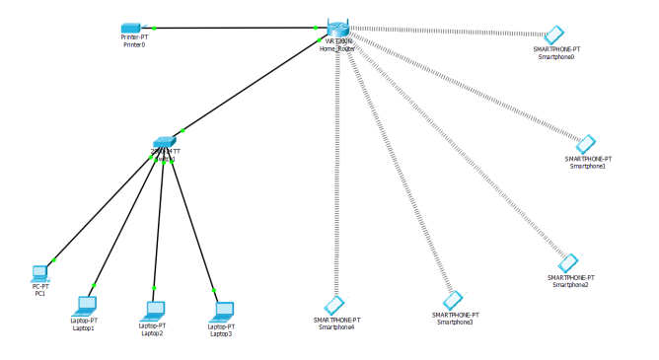
What we are building?
Finally, our network will look like this:

Slide 52
Let’s Build logically !

Slide 54
Let’s Build physically !

Slide 56
Finally we can say!!

Slide 57
Finally we can say!!
By themselves, computers are powerful tools. When they are connected in a network, they become even more powerful because the functions and tools that each computer provides can be shared with other computers. Network is a small group of computers that share information, or they can be very complex, spanning large geographical areas that provide its users with unique capabilities, above and beyond what the individual machines and their software applications can provide.

Slide 58
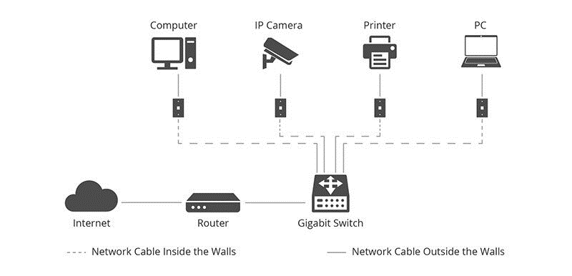
Finally we can say!!
The ultimate goal of any network is to allow multiple devices to communicate.

Slide 59
Answer to some why’s!

Slide 60
Answer to some why’s!
While choosing a suitable device between Hub & Switch, we preferred switch because:

Slide 61
Answer to some why’s!
While choosing a suitable device between Hub & Switch, we preferred switch because:
Switch is more efficient than hub.

Slide 62
Answer to some why’s!
While choosing a suitable device between Hub & Switch, we preferred switch because:
Switch is more efficient than hub.
A switch can join multiple computers within one LAN.

Slide 63
Answer to some why’s!
While choosing a suitable device between Hub & Switch, we preferred switch because:
Switch is more efficient than hub.
A switch can join multiple computers within one LAN.
Switch is smarter than Hub to determine the target of the forwarding data.

Slide 64
Answer to some why’s!
The reason why we chose DHCP (Dynamic HOST Configuration Protocol) for assigning IP Configuration:

Slide 65
Answer to some why’s!
The reason why we chose DHCP (Dynamic HOST Configuration Protocol) for assigning IP Configuration:
There is less chance that two devices will have same IP address.

Slide 66
Answer to some why’s!
The reason why we chose DHCP (Dynamic HOST Configuration Protocol) for assigning IP Configuration:
There is less chance that two devices will have same IP address.
Static IP configuration is time consuming and has a greater chance of error.

Slide 67
Answer to some why’s!
The reason for using Wireless Routers:

Slide 68
Answer to some why’s!
The reason for using Wireless Routers:
It gives greater control over our home network.

Slide 69
Answer to some why’s!
The reason for using Wireless Routers:
It gives greater control over our home network.
Enable guest networks for visitors and set restrictions and cut off internet access as per requirements.

Slide 70
Answer to some why’s!
The reason for using Wireless Routers:
It gives greater control over our home network.
Enable guest networks for visitors and set restrictions and cut off internet access as per requirements.
More intelligent and sophisticated than switch.

Slide 71
Answer to some why’s!
The reason for using Wireless Routers:
It gives greater control over our home network.
Enable guest networks for visitors and set restrictions and cut off internet access as per requirements.
More intelligent and sophisticated than switch.
It can link with both wired and wireless network.

Slide 72
Answer to some why’s!
The reason why we are using WPA2 security:

Slide 73
Answer to some why’s!
The reason why we are using WPA2 security:
Prevention of unauthorized access in our network.

Slide 74
Final discussion

Slide 75
Final discussion
Hence, the establishment of proposed Home Network has been done in the simulated environment.

Slide 76
Final discussion
Hence, the establishment of proposed Home Network has been done in the simulated environment.
The routers, PC, switch and the Smart Phones were configured accordingly.

Slide 77
Final discussion
Hence, the establishment of proposed Home Network has been done in the simulated environment.
The routers, PC, switch and the Smart Phones were configured accordingly.

Slide 78
Final discussion
Hence, the establishment of proposed Home Network has been done in the simulated environment.
The routers, PC, switch and the Smart Phones were configured accordingly.
Packets were sent from one computer to the other and the transmission of such data to their destination was successful in an efficient manner.

Slide 79
Final discussion
Hence, the establishment of proposed Home Network has been done in the simulated environment.
The routers, PC, switch and the Smart Phones were configured accordingly.
Packets were sent from one computer to the other and the transmission of such data to their destination was successful in an efficient manner.
For security facilities to the network various methods are implemented like password protection is also applied on the wireless routers for restricted usage and which can be used only for home network.

Slide 80
Final conclusion

Slide 81
Final conclusion
Hence, we conclude, this proposed idea helps in designing the network topology for a home or small office network, that provides the different functionalities within a single network such as security of the network, wireless area network, mobility, operational efficiencies and a costs effective network for better small-scale business and home networks.

Slide 82
THANK YOU
END

