Slide 1


C++ IDE For Linux
Nidhi Gupta 07020001
Saket Jalan 07020006

Slide 2
Introduction

Slide 3

What is an IDE?
Integrated Development Environment also known as Integrated Design Environment.
All parts required namely – Editor, Compiler, Debugger and Build Automation Tools are present in the same Environment.
Provides Comprehensive facilities for Programmers for faster and bigger software (project) development.

Slide 4
Comparitive Study of Existing IDE's
There are many existing IDE's for C/C++ like anjuta, Eclipse CDT, Turbo C++ explorer, Code::Blocks, Xcode, KDevelop etc.
These IDE's have features like multiple compiler, inbuilt text editor, syntax highlighter, automatic indenter etc.
They use standard GNU compilers for compilation on Linux.
Code::blocks and KDevelop are cross platform with a debugger, GUI builder and they use MingW as their compiler for Windows.

Slide 5
Design Goals
Compile and Execute with Ease of Environment.
Benefits of Normal Source Editor.
Terminal within the Environment.
Facilitate Group Work.
Quick Review of Past codes and important lines.
Cache frequently used lines of code.
Simultaneously work on more than one file.
Differentiate between different tokens of code.
Tools and Instruments.

Slide 6
Design Approach

Slide 7
Incremental Approach: Basic Principles
A series of mini-Waterfalls are performed, where all phases of the Waterfall development model are completed for a small part of the systems, before proceeding to the next incremental, or
Overall requirements are defined before proceeding to evolutionary, mini-Waterfall development of individual increments of the system, or
The initial software concept, requirements analysis, and design of architecture and system core are defined using the Waterfall approach, followed by iterative Prototyping, which culminates in installation of the final prototype (i.e., working system).

Slide 8
Incremental Appraoch: Advantages
Steady Development
Planned approach to Develop IDE
Involvement of user in development of IDE is a very effective approach as they can help in finding bugs and giving useful suggestions as the IDE is being developed for these users
The Incomplete version will lay basis for the complete one and can be useful as in IDE the incomplete versions will also be a working with some features less

Slide 9
Implementation

Slide 10
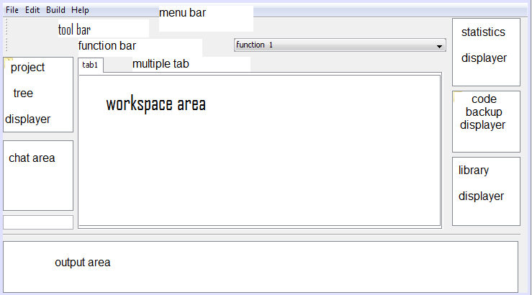
Layout Design

Slide 11
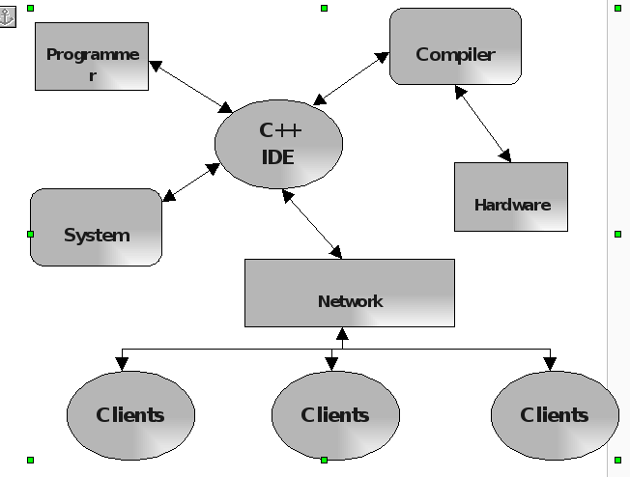
Interface Diagram

Slide 12
Technologies Used
Java
GNU Compilers
Netbeans
Linux
Networking

Slide 13
Features and Scope

Slide 14
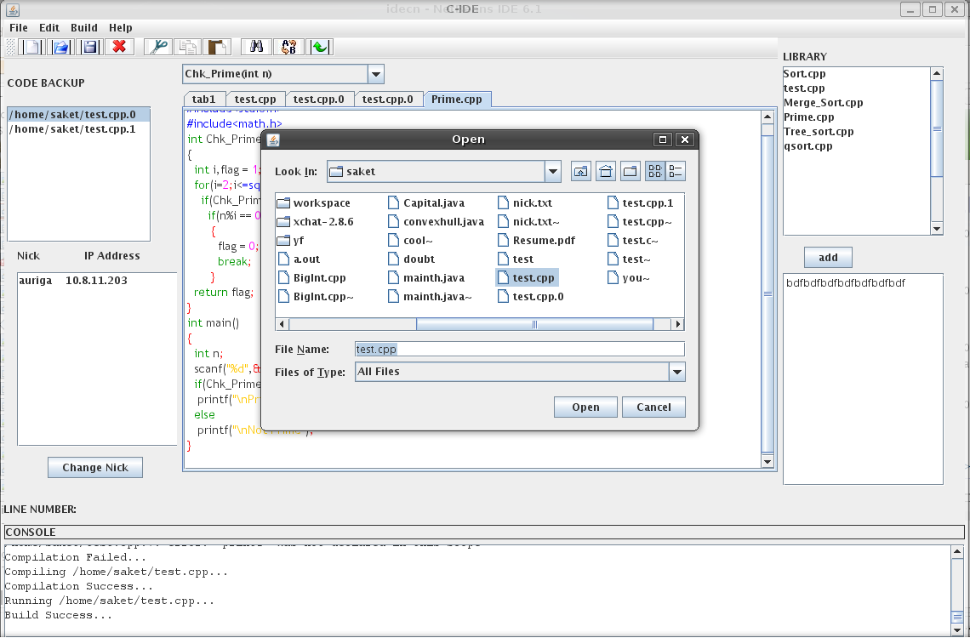
General tools of Text Editor
Source Editor Pane
Showing Open Dialog
Maximized workspace Area
File Operations like Open, Save, SaveAs...
Edit Operations like Cut, Copy, Paste, Undo, Find, FindNext, Replace etc.

Slide 15
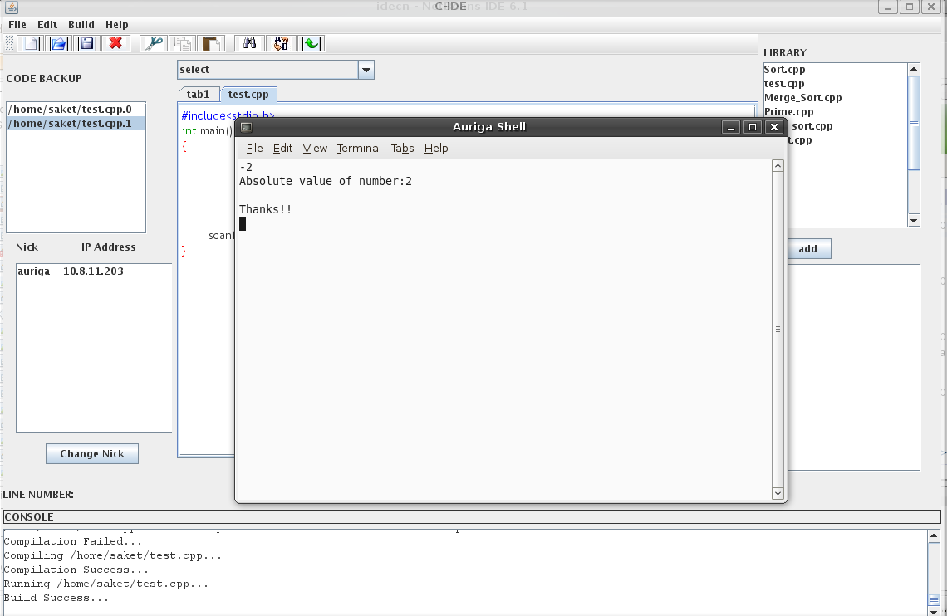
Build Tools: Compile and Run
Execution on Terminal
Console showing Compilation Logs

Slide 16
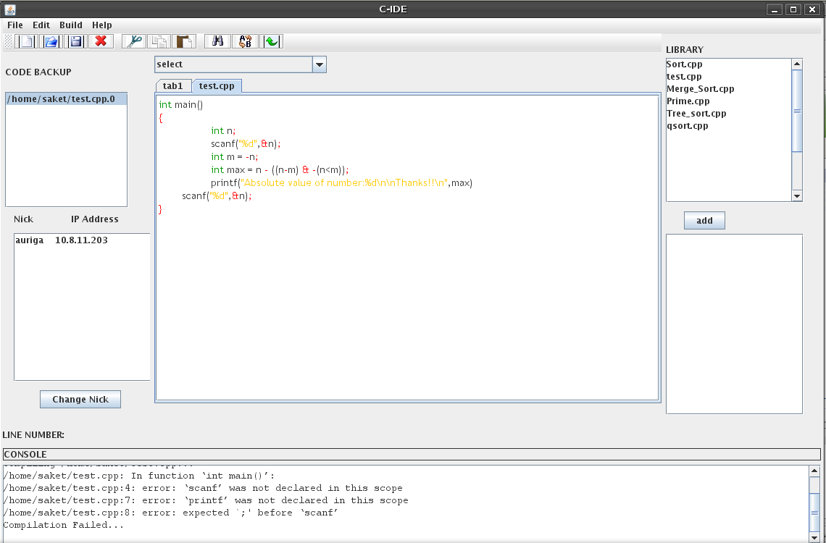
Syntax Highlighting
Different Tokens have Different colours

Slide 17
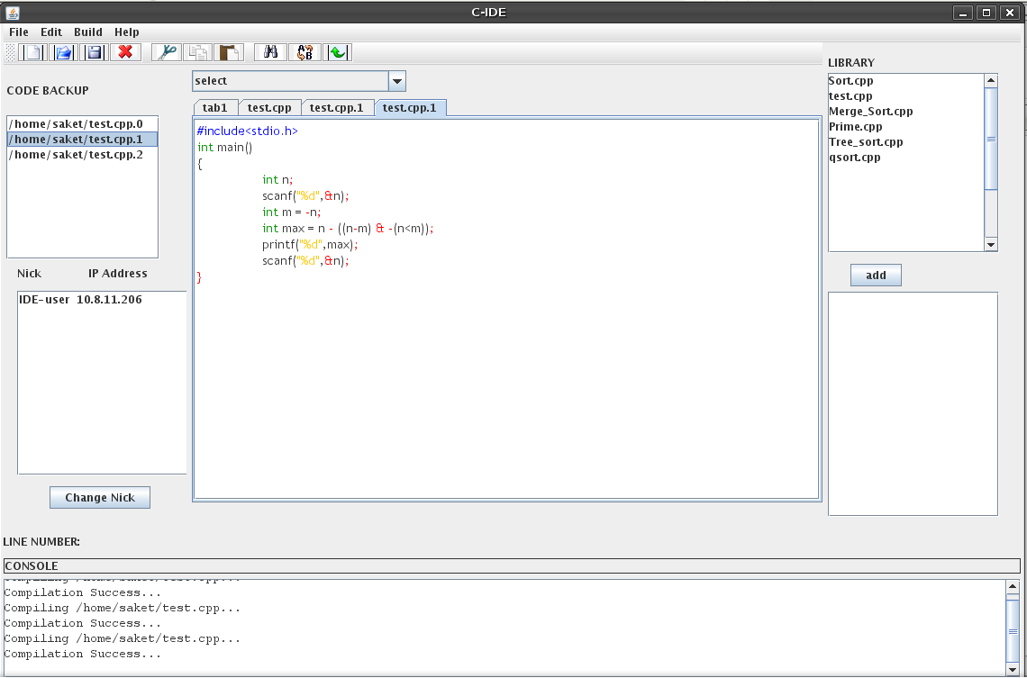
Code Back-up
Selected Code Opens in New Tab
Backed Up Codes

Slide 18
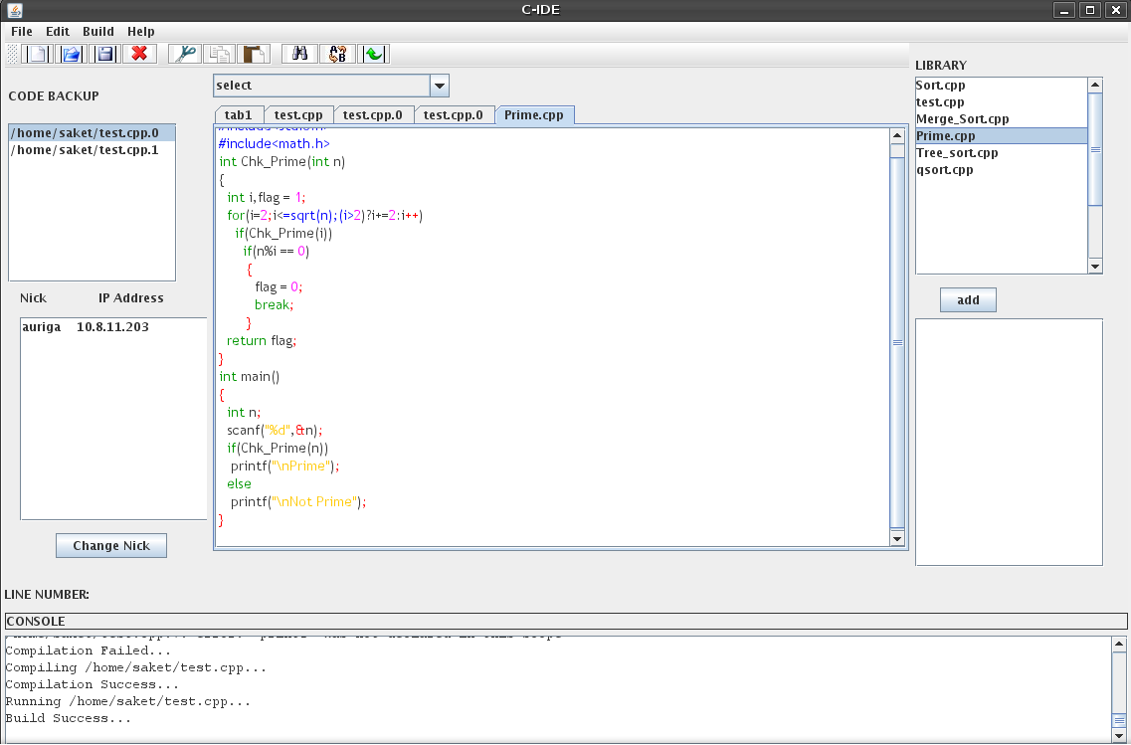
Dynamic Personal Library
Selected Code Opens in New Tab
Dynamic Personal Library

Slide 19
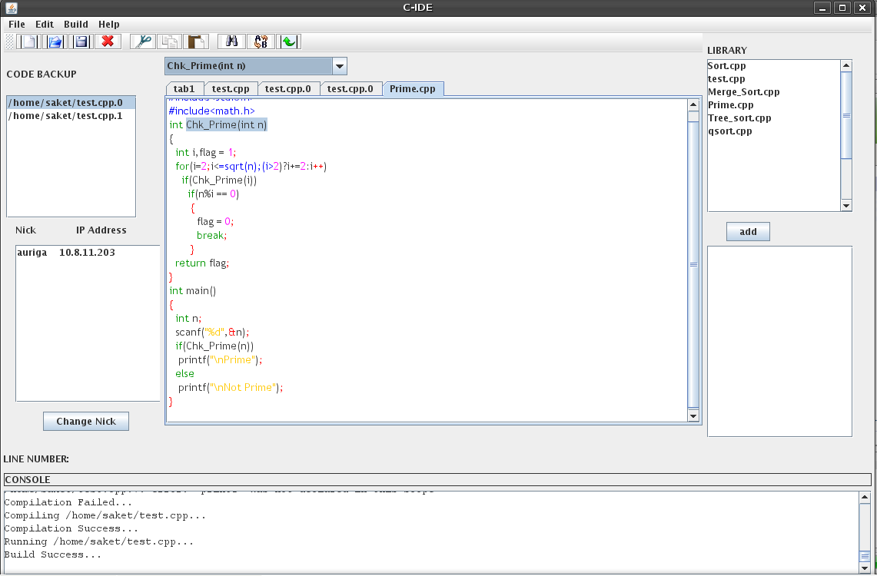
Bookmark Feature and Chat
Selected Bookmark gets Highlighted
Chat Pane

Slide 20
Other Features
Help Menu – Contains Reference
Bracket Matching – Auto match for different symbols occurring in pair
Interactive light weight GUI

Slide 21
Critical Assessment

Slide 22
Comparison With Other IDE's
Debugger Not Present
Has Some New Features
Implemented on Java, is portable for any Linux Platform having JRE and GNU compilers

Slide 23
Future Upgradations
Project handling
Debugger
Direct Access to DPL for users on Network
A low complexity algorithm for Code back-up
Auto Completion of codes for keywords and library functions.
Port to Windows.

Slide 24
Achievements
Software Design and Development
Java
Networking
GUI Development
Object Oriented Programming
Event Driven Programming
Linux (System Calls)‏
Handling Bugs and Coercing modules together

Slide 25
Thanks...

