Slide 1

HACKATHON
facebook India
Dipanshu, Gaurav Kumar,
Saket Jalan, Nidhi Gupta

Slide 2

About
This application lets users share multiple photographs directly from their computer
Images are shared using just a single right click
No need to open browser and select each pic to upload

Slide 3
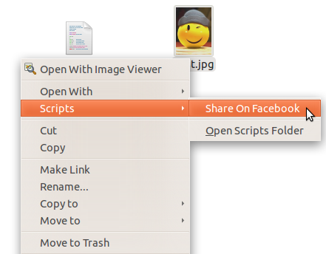
Usage
Select images to be uploaded by clicking on them
Right Click and select Scripts->Share on facebook
Done!

