Slide 1
A PROJECT REPORT ON
REMOTE SHOPPING SYSTEM
(ShopSoft)
PERFORMED BY:
AKSHAY LAHE (51)
SHOUNAK GUJARATHI (30)
SAKET JOSHI (35)
T.E. DIVISION ‘A’

Slide 2
ABSTRACT:
INFORMATION:
This application software is developed to allow the users to shop online.
The application will contain two modules, A shop-end module and A user-end module.
The user-end module will be distributed by the shopkeeper himself.
As per his/her requirement, the user will select all the items he/she wants to order.
Once this is done, a query will be sent to the shop-end module, via the internet.
ADVANTAGES:
Allow users to shop anytime, on your computer
User friendly graphical interface
Selection of items according to their categories
Multiple billing options
Print receipts

Slide 3
SCOPE:
The software can be used by a variety of shopkeepers right from
small soft owners and large malls
Future enhancements include an internet based framework
Developing of android apps

Slide 4
REQUIREMENTS
Windows 7 32-bit or 64-bit platform
Intel core series processor 2.66 GHz or an AMD equivalent (for user module)
Support for crystal reports version 13.04
An active working internet connection
RECOMMENDED:
intel core i5-2430m processor (for user module)
Internet connection speed at least 256 kbps

Slide 5
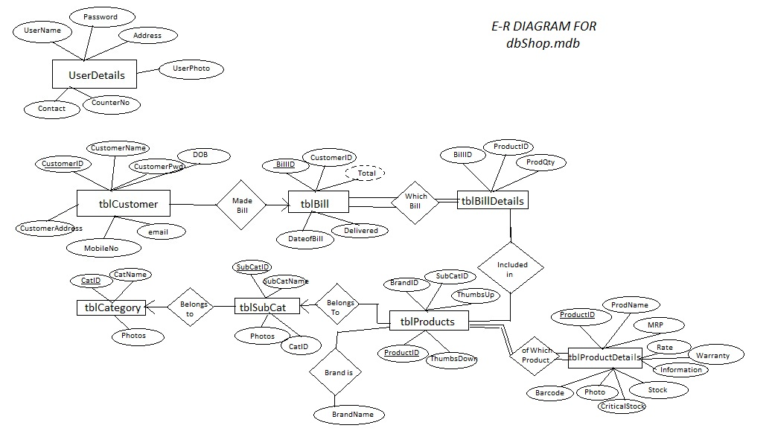
E-R DIAGRAM

Slide 6
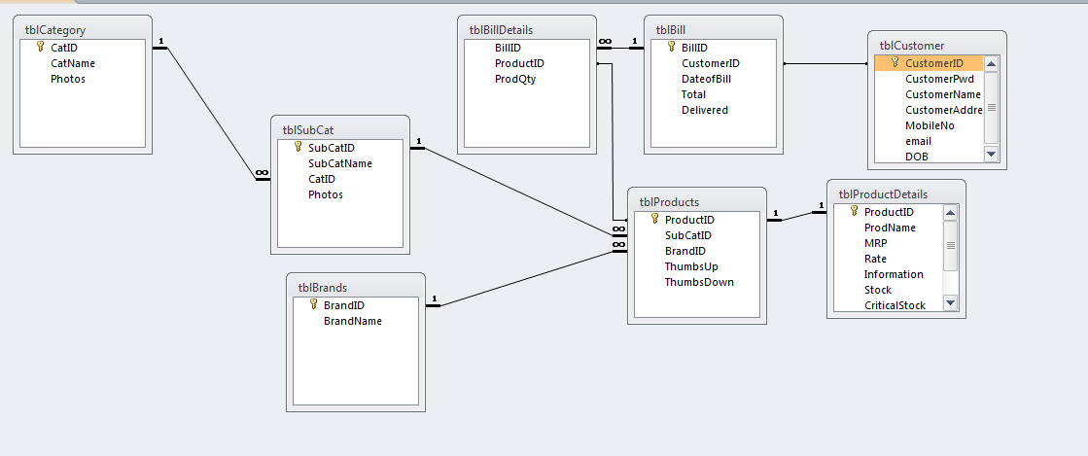
RELATIONAL DATABASE DESIGN

Slide 7
TESTING
The program runs without any exception for all the possible cases
A high speed internet connection is required for quick loading of
the forms in User Module
Maximum capacity of the shopping cart in User Module is 5 items
Cannot print bill reports based on bill dates

Slide 8
CONCLUSION
Thus we have completed the mini project work and tested it for all
the possible cases

