Slide 1
Open the following url and download all the files
2018
https://github.com/saket1402/BootcampR2018

Slide 2

Infographics using
2018
Envision Club

Slide 3
Why Infographics?

Slide 4



Slide 5


Slide 6
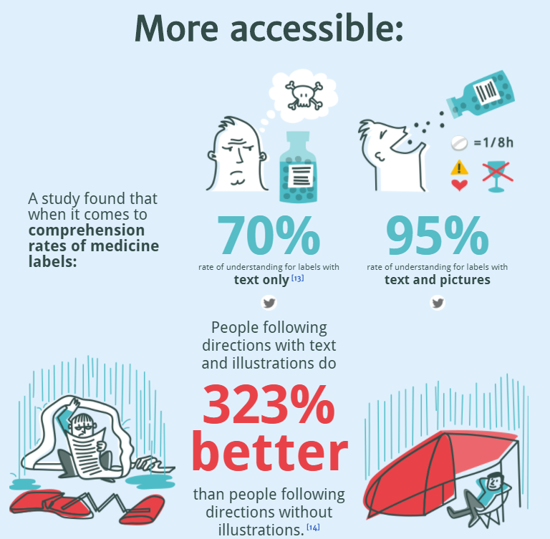

Slide 7


Slide 8
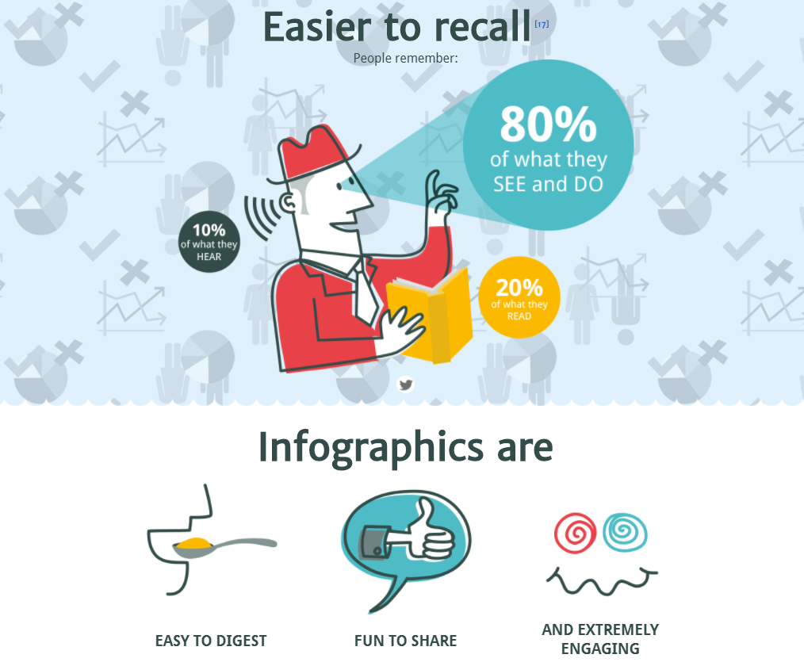

Slide 9
What is Infographics?

Slide 10
You have been seeing Infographics
in the slides before!!

Slide 11
Let us test our brain and Counting skills
Tell what does your brain process first
Number or,
Graphic

Slide 12


Slide 14











Slide 15

Custom Visuals for Infographics
Synoptic Panel by SQL BI With this visualization you can define regions in any picture or images, and map data points to the image in your Power BI report.
Visit: https://synoptic.design/
Load car-data in Power BI. Open below link: https://www.123rf.com/photo_1648382_sw-car--layout-for-presentation--vector.html
Upload image to synoptic designer
Define Areas
Export svg file
Import svg in Synoptic Custom Visual

Slide 16
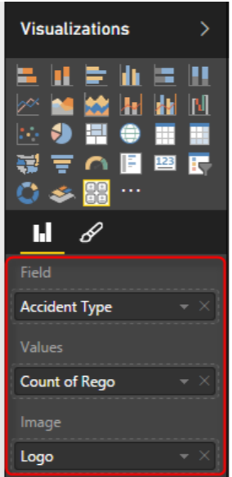
Custom Filters using Chiclet Slicer
Create another spread sheet with accident types and a field called logo which is a URL for an image related to each item.
Change data type to web url
Now in the Chiclet Slicer custom visual I set fields as accident type, and Image as Logo, and count of regno. as Values.

Slide 17
Integrating Shape Maps
Shape Map allows you to add your own Map
Consists of geometry data – points, boundaries, lines etc.
Convert it to TOPO JSON for using it in PowerBI.
Find file source here
Source: http://shpescape.com/
Verify regions in Format -> Shape section with clicking on “View Map Keys”
Cons: You cannot add other layers of map to it (for example if you want to add heatmap, or bubbles to it)

Slide 18
Questions?

