Slide 1


SPEED LIMIT OF VEHICLE INSIDE THE COMPANY/INDUSTRY PREMISES USING RFID AND GETTING SECURITY NOTIFICATIONS THROUGH IOT
IC HACK 2.0
Name of team leader : Saket Kumar Mishra
Name of group member 1 : Tarak Nath Mahato
1st Semester
Master of Technology
Department of Electrical Engineering
National Institute of Technology, Jamshedpur

Slide 2
Introduction
Over speeding vehicle make a lot of nuisance sometimes also leading to loss of lives and other damages.
Also imposing speed restrictions through sign boards have been rendered fruitless wherein the vehicle drivers do not comply with it and resulting catastrophic.
Vehicle Speed Limit Controller project is a great solution to this problem as it not only provides speed limitations, it also implements it through a controlling mechanism.
In future, we can implement our projects in heavy vehicles by reducing the size of an sensor module and its display unit and increasing the range of the RF sensor units to control the vehicle speed beyond the range of its zones like schools and hospitals.

Slide 3
Idea/Approach Details
Prototype model of a vehicle in a company premises.
After RFID punch the vehicle is now under guidance of specific rules of company.
If the driver tries to cross the speed limit, a notification will automatically sent to the authority as well as notify the driver.
If the driver wants to restart the vehicle then he/she need to reduce the vehicle speed.
During exit of the vehicle outside the premises a notification of exit will appear on the display and the vehicle is now out of restrictions.
Using the RFID network, the analysis of traffic, selecting the signal and time allocation for the signals can be done, it can be controlled automatically and zero accident rate can be obtained.
In previous works there is a no option for security notification option we are implementing this in our project.
In future, We are adding an emergency button also for exception cases to increase the vehicle speed only during emergency and same will notified to security officials as well as medical representatives.
We will also record the movement of emergency cases and save it to cloud for future references.

Slide 4
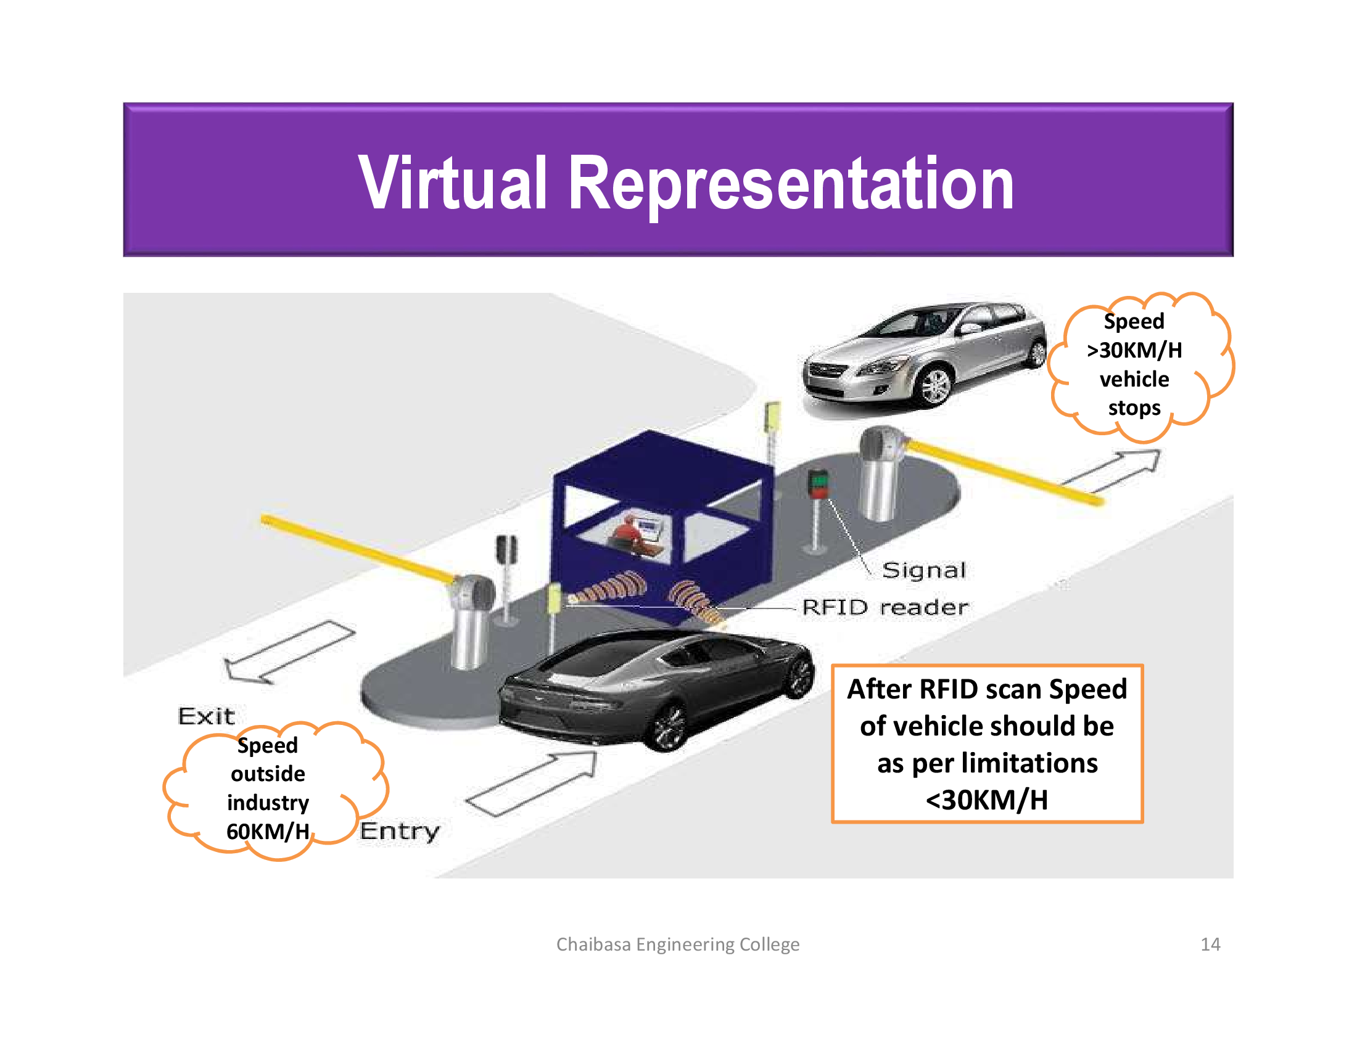

Slide 5
Objective
To decrease accidental rates in sensitive areas of company or industry.
Preventing from over-speeding of vehicles.
No other vehicle speed control technique is implemented in these area till now.
Accidents occurs due to over speed.
Mostly there are no sign boards are used to indicate the specific zones.
No technical alerting system is available.
Our project may also helpful for the peoples to drive safely without their knowledge
Because of using microcontroller the cost of this project is low to implement it in a vehicle

Slide 6
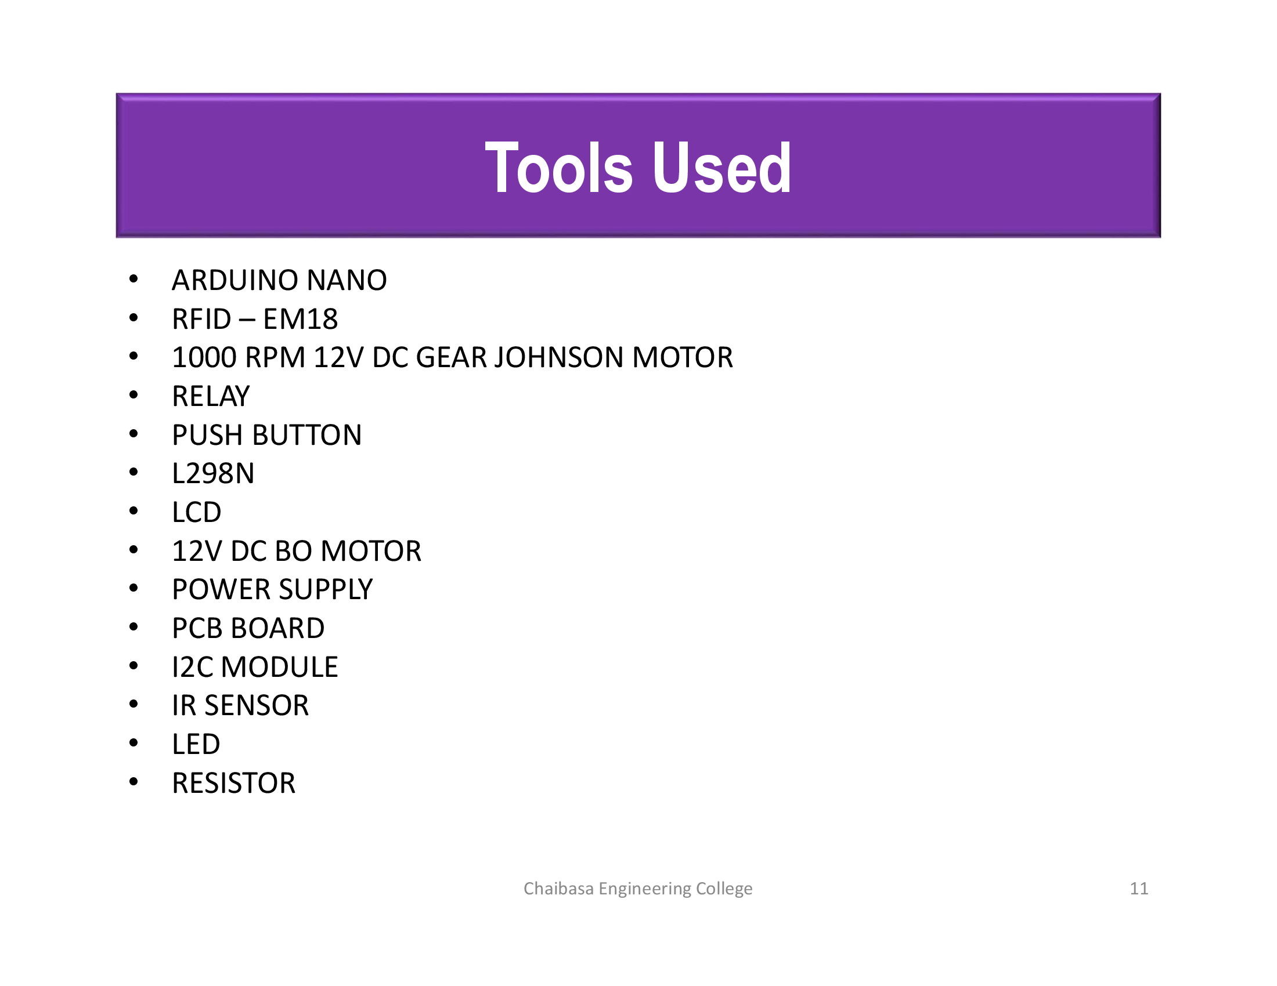

Slide 7
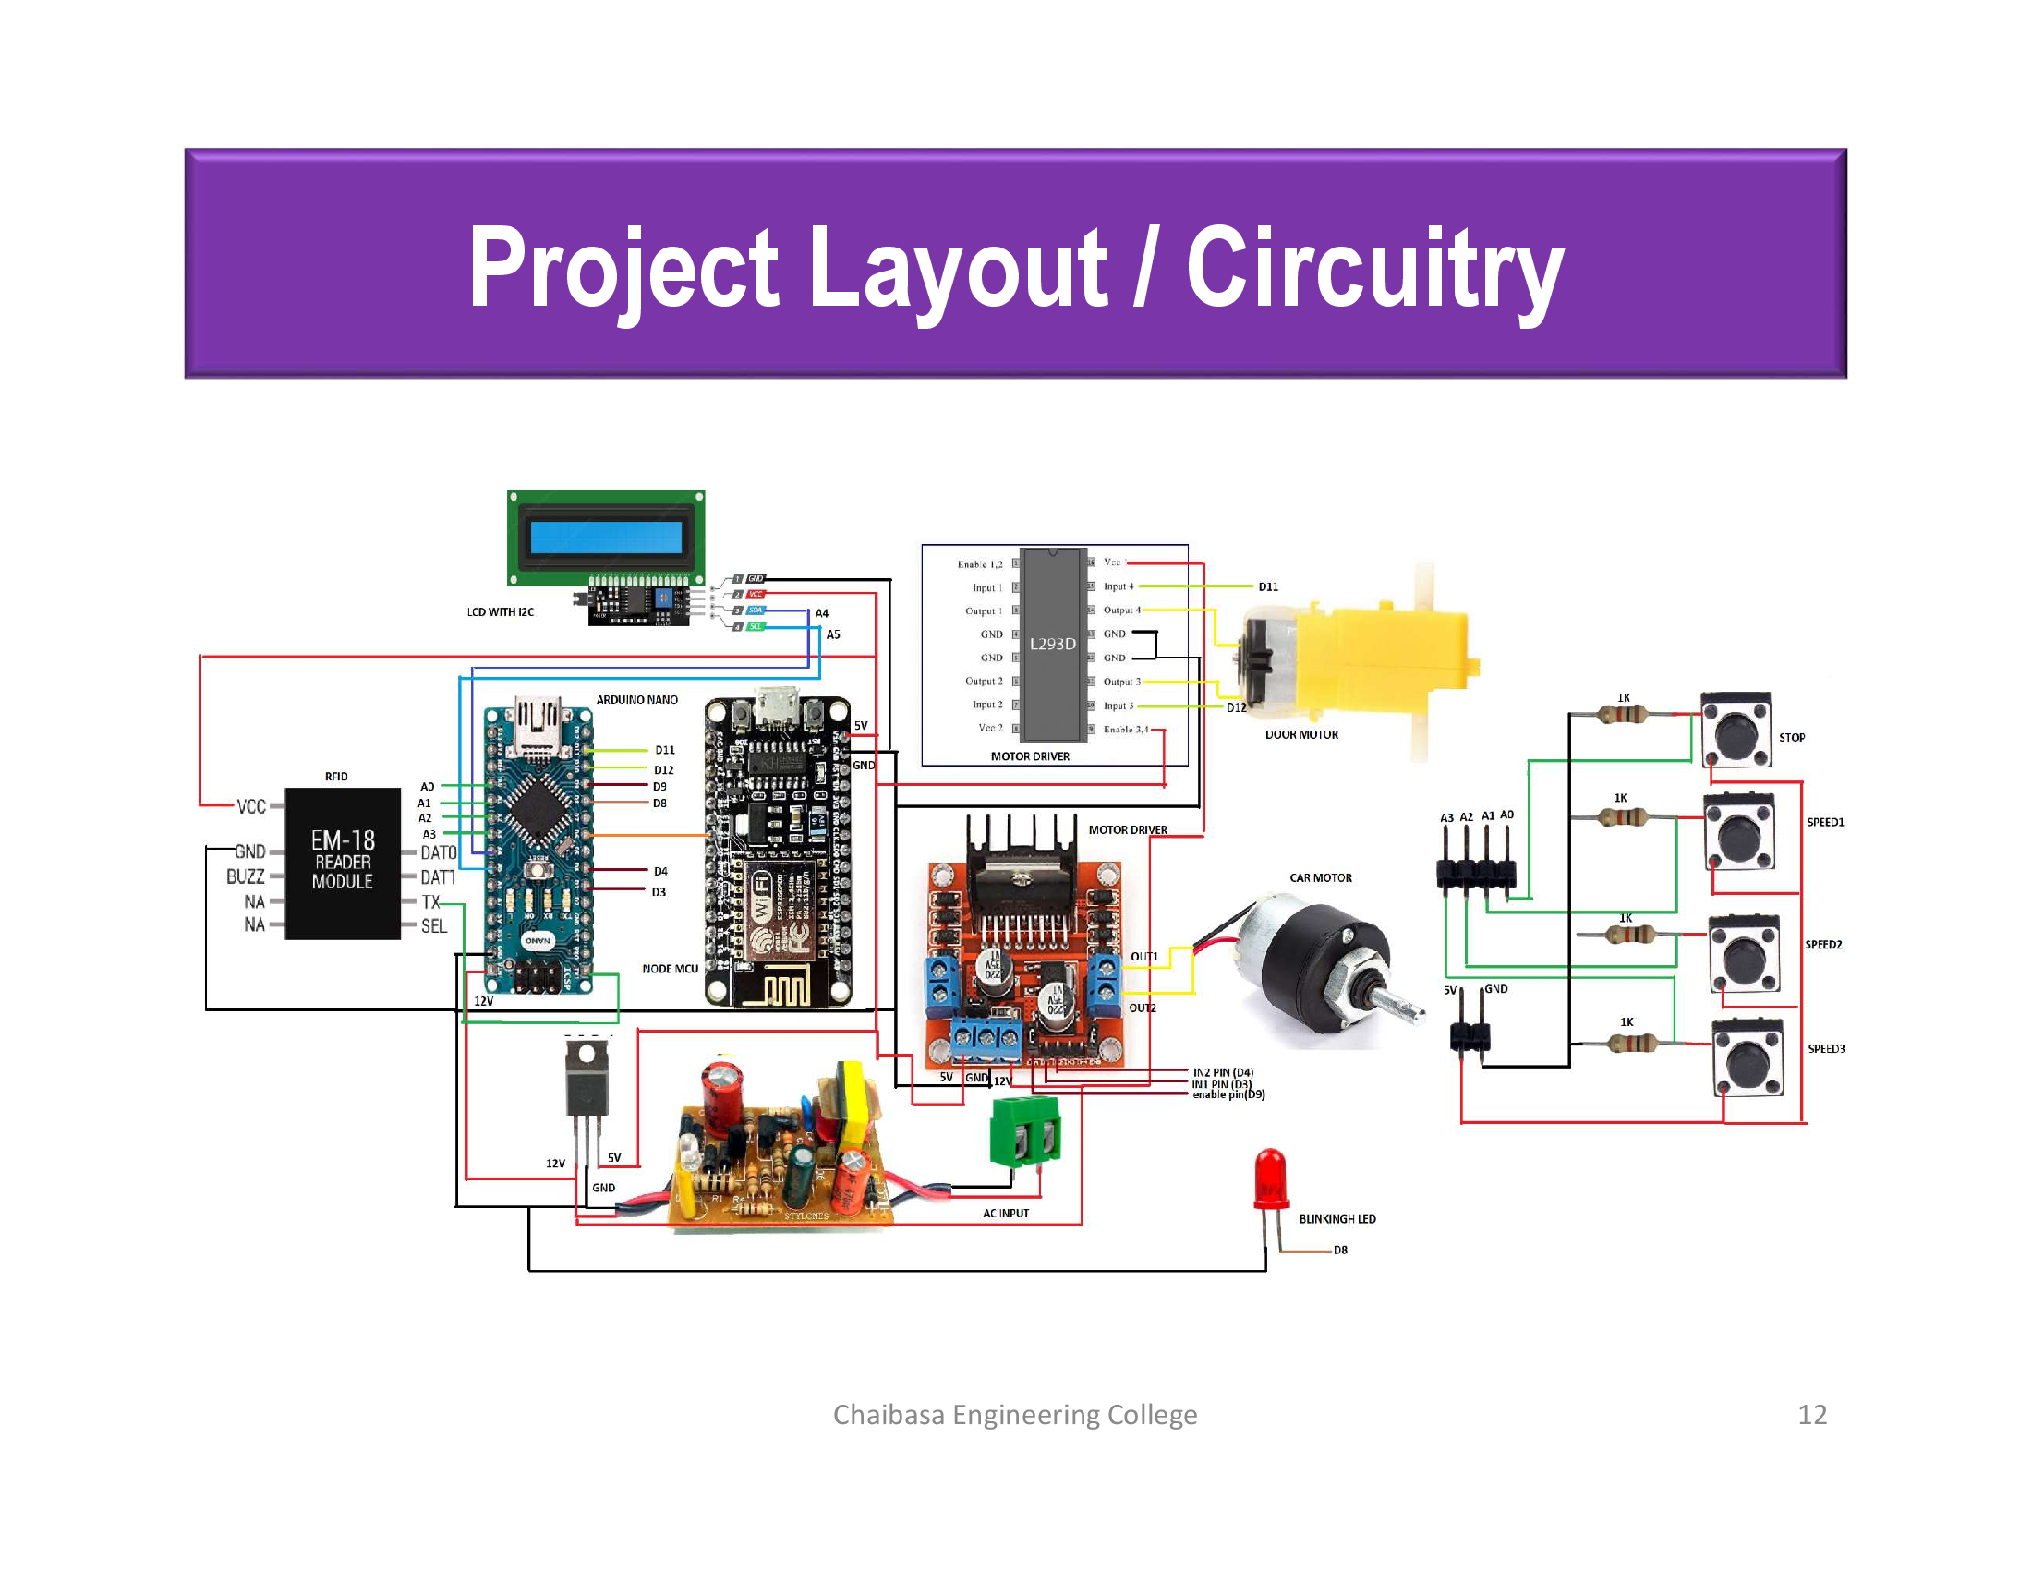

Slide 8
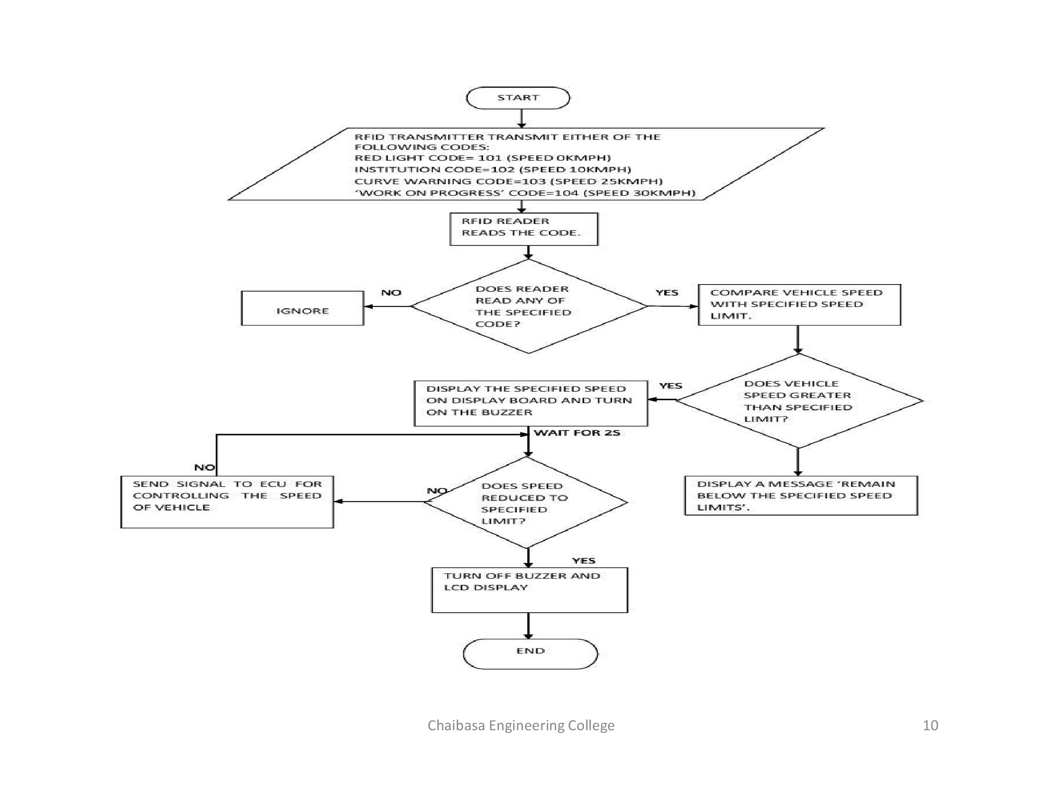

Slide 9
Application
To detect as well as control over-speeding of vehicles in company premises for avoiding loss-time-injury (LTI) of a rider.
To ensuring safety of pedestrians on accident prone areas inside the industry.
This project can be used to avoid the rash driving of riders.

Slide 10
Reference
Gangadhar S.; R N Shetty, An intelligent road traffic control system, IEEE conference publication Kharagpur (2010).
Vehicle Speed Control using R.F. Technology, 5704017, June 2006, SRM institute of Science and Technology.
Design of RF based Speed control system for vehicles, International Journal of Advanced Research in Computer and Communication Engineering Vol. 1, Issue 8, October 2012.
SAFE DRIVE and SAVE LIFE
Switch Safe-T
THANKING YOU

