Slide 1
Adaptive Replacement Cache Algorithm
A novel cache replacement algorithm that outperforms traditional approaches through two-tier architecture and adaptive learning.

Slide 2
The Problem
FIFO Limitation
LRU Limitation
LFU Limitation
Ignores access patterns entirely, treating all items equally regardless of their importance or frequency of use.
Optimizes for recency but fails with frequency-based workloads, evicting frequently-accessed items incorrectly.
Prioritizes frequency but suffers cache pollution: new items with low frequency get unfairly evicted.

Slide 3


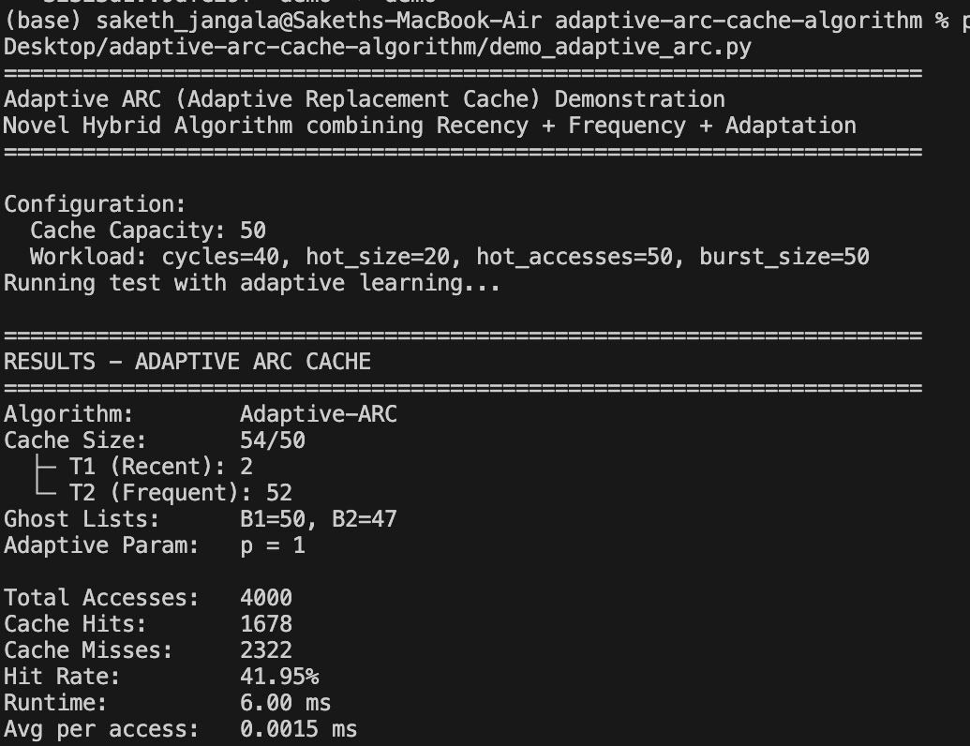

Adaptive-ARC: The Solution
A hybrid approach combining the strengths of LRU and LFU with adaptive learning mechanisms.
Two-Tier Architecture
Adaptive Learning
T1 for recent items, T2 for frequent items—captures both recency and frequency dimensions.
Ghost lists B1 and B2 track eviction patterns, allowing the algorithm to learn and adjust from mistakes.
O(n) Complexity

Slide 4
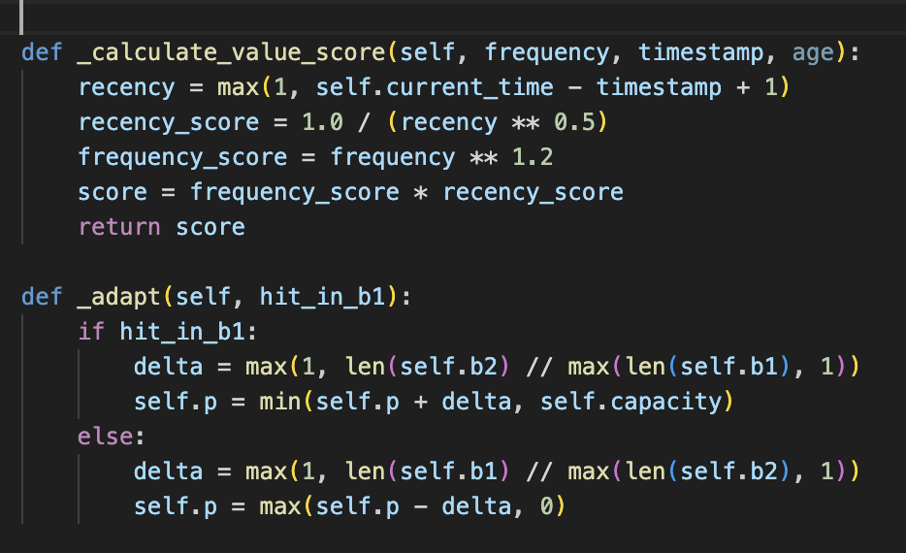
Value-Based Scoring Formula
Intelligent eviction decisions using combined frequency and recency metrics.
score = frequency^1.2 × (1 / recency^0.5)
This formula weighs frequency more heavily (exponent 1.2) while moderating recency's impact (reciprocal with exponent 0.5). Items with high frequency and recent access receive higher scores, avoiding premature eviction of frequently-used data.

Slide 5
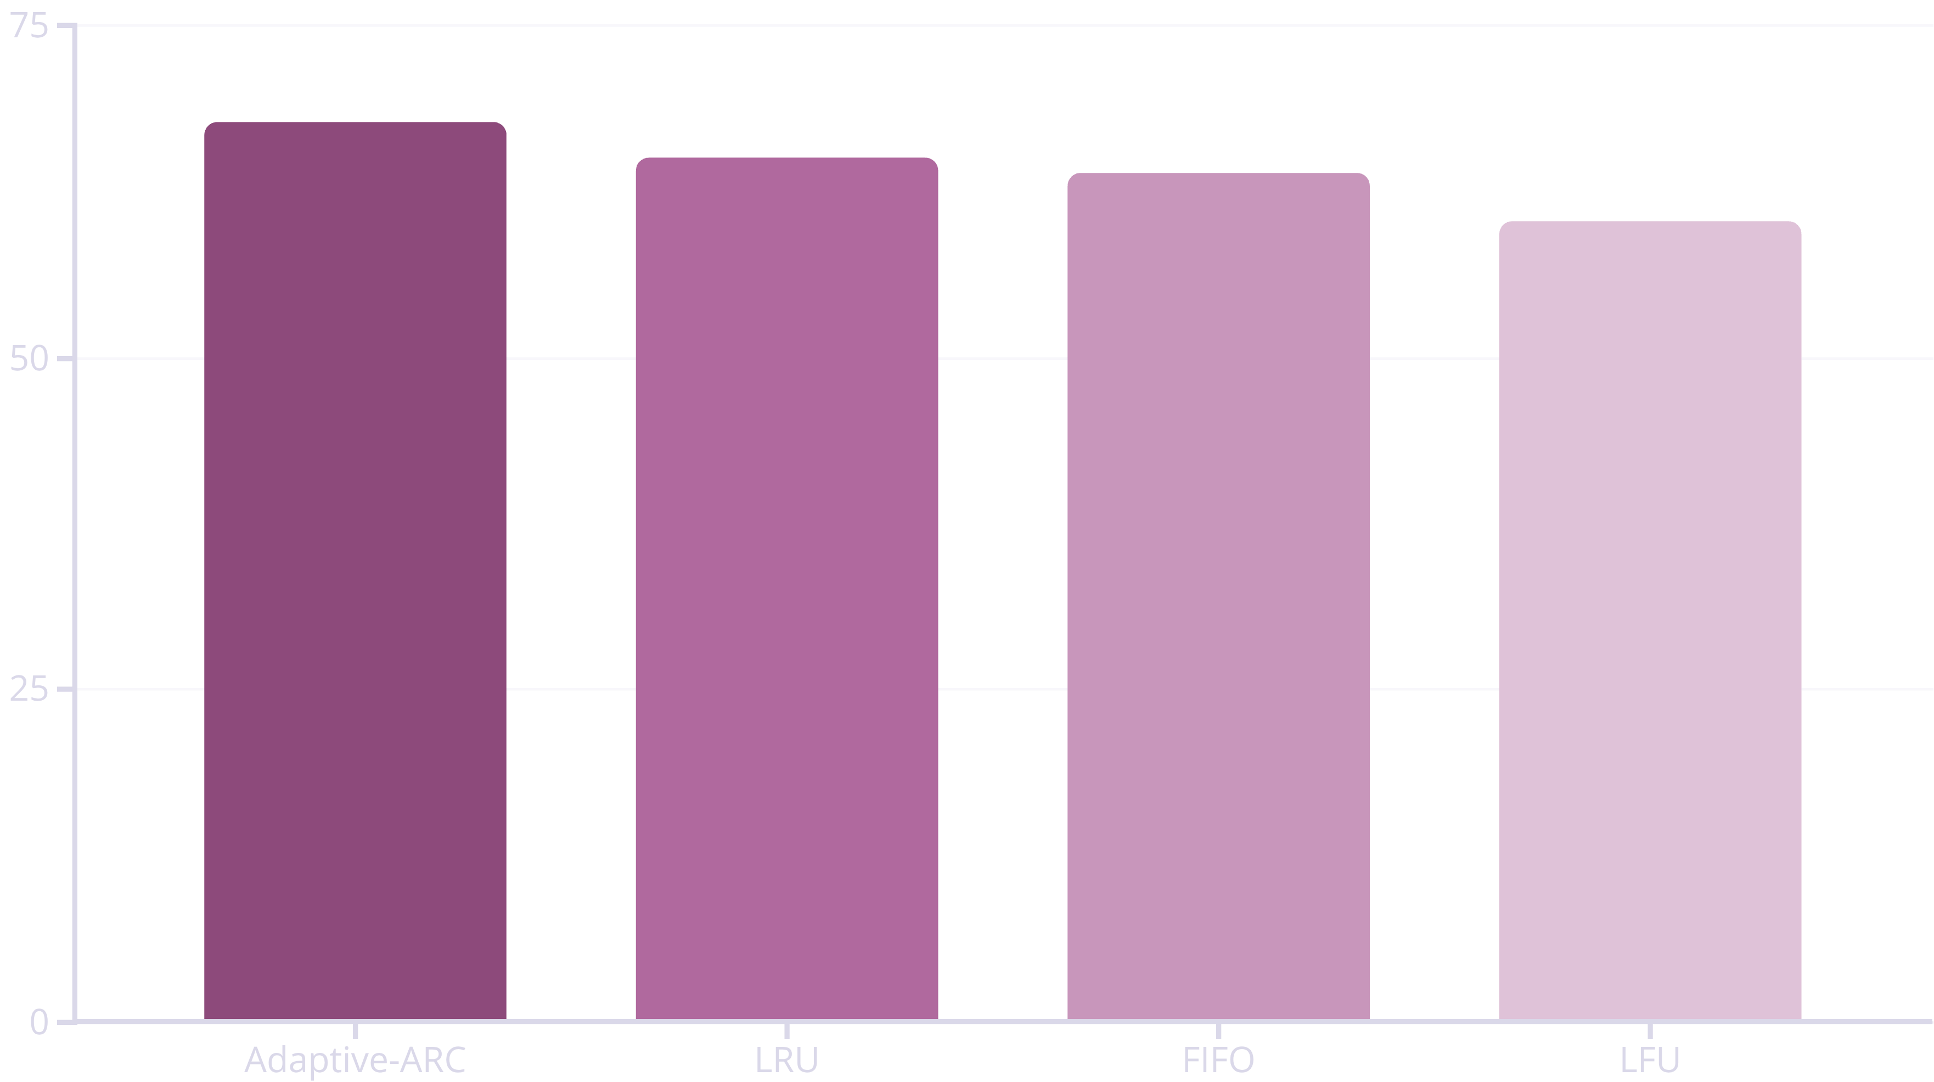
Performance Results
Comprehensive comparison across all four algorithms on three distinct workload patterns.

Slide 6
Performance Improvements
Adaptive-ARC demonstrates consistent advantages across all baselines.
+4.36%
+5.99%
+12.38%
vs LRU
vs FIFO
vs LFU
Higher hit rate demonstrates superior adaptivity to mixed workloads
Pattern-aware approach significantly outperforms position-based eviction
Eliminates cache pollution through intelligent item promotion mechanisms

Slide 7
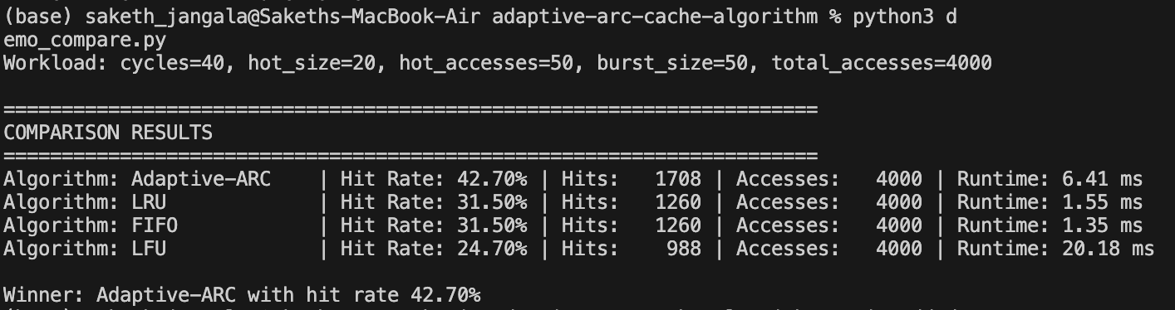
What we learnt?
This project demonstrates algorithm design principles through practical implementation and rigorous evaluation.
Algorithm Composition
Empirical Analysis
Complexity Excellence
By combination of LRU, LFU, and adaptive techniques we were able to get superior performance while maintaining the time complexity
We did comprehensive testing for all three workload patterns which validates our design choices and demonstrates robustness to real-world scenarios.
O(n) time complexity for all operations with O(capacity) space usage proves practical viability for production systems.

