Slide 1
The Problem
"The server is slow, the app keeps freezing, users can't connect from home —
where do we even start?"
⏱ MANUAL SEARCH
🧱 SILOED KNOWLEDGE
📉 NO PRIORITY SIGNAL
Engineers spend hours digging through thousands of historical tickets to find similar incidents.
Every team resolves the same recurring incident from scratch. Proven fixes aren't shared or surfaced.
No structured way to classify severity, predict resolution time, or route to the right specialist.
Result: Slower incident resolution · Higher MTTR · Repeated mistakes · Engineer frustration

Slide 2
Our Solution
An AI-powered Knowledge Base that lets engineers describe a problem in plain English and instantly retrieve proven historical resolutions.
🔍 SEMANTIC SEARCH
🤖 AUTONOMOUS TRIAGE
💬 GUIDED RESOLUTION
📊 QUALITY EVALUATION
Hybrid BM25 + vector search surfaces the most relevant past incidents in < 200ms — no keyword guessing needed.
A 3-tier AI agent (L1→L2→L3) classifies, investigates, and escalates incidents with no manual intervention.
Step-by-step chat interface walks engineers through proven fixes, capturing what works and what doesn't.
DeepEval LLM-as-Judge + custom metrics continuously measure and improve retrieval accuracy.
308 historical incidents · 10 categories · 38 problem types · Azure OpenAI · Qdrant · LangGraph · DeepEval

Slide 3
How It Works — Technical Approach
RETRIEVAL PIPELINE
AI TRIAGE AGENT (LangGraph)
1
User Query
L1: GPT-4o-mini → KB search + confidence gate (≥ 0.80)
L2: GPT-4o-mini + Tavily → web-augmented synthesis (≥ 0.55)
L3: Auto-creates escalation ticket → Postgres
Natural language incident description
2
Adaptive-K
Dynamic candidate count (3–20) based on query complexity
3
Hybrid Search
BM25 keyword + Ada-002 semantic search in parallel
EVALUATION + FEEDBACK
4
RRF + Rerank
DeepEval: Faithfulness · AnswerRelevancy · CtxPrecision
Custom: Fix accuracy · Resolution time MAE
Thumbs feedback in chat → Admin review queue
IT team resolution → live-ingested back to KB
Score fusion → cross-encoder reranker + recency signal
5
Resolution Aggregator
Clusters similar fixes · surfaces unique options with occurrence counts

Slide 4
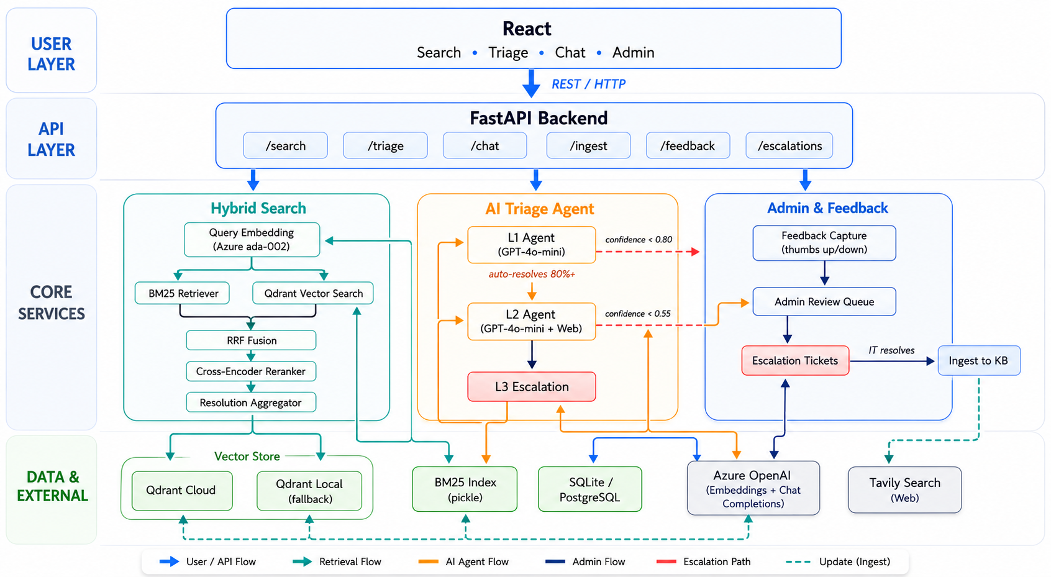
System Architecture

Slide 5
Feature 1 — Hybrid Search & Resolution Engine
WHAT IT DOES
IN THE DEMO — SEARCH PAGE
Engineer types a plain-English incident description
BM25 keyword + Ada-002 semantic search run in parallel
Reciprocal Rank Fusion merges and ranks both result sets
Cross-encoder reranker + recency decay refines the top results
Resolution aggregator clusters all similar fixes, showing the top-N unique solutions with occurrence counts
Type: "Database connections timing out after deployment"
→ Top 10 ranked incidents shown instantly
→ Resolution options panel: Fix 1 (×9 proven), Fix 2 (×4)
→ Filter by Category · Impact · Priority
KEY METRICS
< 200ms
NDCG@10
average search latency
ranking quality metric
Recall@10
5-stage
coverage rate
retrieval pipeline

Slide 6
Feature 2 — Autonomous Triage Agent (L1 → L2 → L3)
L1 Agent
L2 Agent
L3 Specialist
GPT-4o-mini
GPT-4o-mini + Web
No LLM
Searches KB
+ confidence gate
→
Tavily search
+ synthesis
→
Creates ticket
in Postgres
if < threshold
if < threshold
≥ 0.80 → resolve
≥ 0.55 → resolve
Escalated
IN THE DEMO — TRIAGE PAGE
KEY NUMBERS
Describe: "MediaServer crashing with high CPU under peak load"
→ L1 searches KB, shows confidence score + reasoning
→ If uncertain, L2 adds live web context automatically
→ If unresolved, ticket created — visible in Admin Portal
80%+ of incidents resolved automatically at L1
L1 threshold: 0.80 confidence · L2 threshold: 0.55
L3 tickets visible + resolvable in Admin Portal
Flan-T5 local fallback when API unavailable

Slide 7
Feature 3 — Guided Chat & Feedback Loop
THE USER JOURNEY
THE FEEDBACK LOOP
1
User describes the incident in natural language
👍 Thumbs up
Positive feedback recorded · Fix marked effective
2
System retrieves relevant fixes from KB (Fix 1 of N, verified M× historically)
👎 Thumbs down
Negative + reason captured · Pending admin review
3
User tries Fix 1 → clicks 👍 (resolved) or 👎 (didn't work)
🛡 Admin reviews
Verify or dismiss · See which fixes consistently fail
4
👎 opens a reason box → user explains what failed
✅ IT resolves
5
IT types resolution steps → instantly ingested into KB as a new searchable incident
System advances to Fix 2 automatically if needed
🔄 KB improves
6
All fixes exhausted → auto-escalated to IT with full context
Next engineer searching the same issue finds the real-world fix

Slide 8
Feature 4 — Evaluation Suite & Continuous Improvement
NDCG@10
Recall@10
MAP@10
Faithfulness
Fix Accuracy
Time MAE
Ranking quality
Coverage rate
Avg precision
LLM-as-Judge
Custom metric
Resolution hrs error
≥ 60%
≥ 60%
≥ 55%
≥ 70%
≥ 60%
Display
IN THE DEMO — ANALYTICS PAGE
CONTINUOUS IMPROVEMENT LOOP
Click 'Run Evaluation' — processes 30 ground-truth test cases
Each metric card shows score, threshold, pass/fail badge
Click any card → popup with 'Why this score' + improvement tips
LLM-as-Judge toggle runs DeepEval Faithfulness + Relevancy
1
Engineer uses chat
Searches and attempts fixes
2
Feedback captured
Thumbs up/down + optional reason
3
Admin reviews queue
Verifies or dismisses each item
4
IT team resolves ticket
DEMO — ADMIN PORTAL
Types what actually worked
5
Resolution ingested
Escalation Tickets tab: OPEN → IN PROGRESS → RESOLVED
'Mark as Resolved' → IT types steps → live KB ingestion
Upserted into Qdrant + BM25 live
6
KB grows organically
Next search surfaces the real fix
"The knowledge base gets smarter with every incident the team resolves."

