Slide 1
EMBEDDED SYSTEMS CASE STUDY
STM32-Based Knock Pattern Smart Door Lock
Keyless access using accelerometer-based knock rhythm analysis
AUTHORS
ACADEMIC AFFILIATION
V. Saketh — CB.SC.U4CSE24558
Y. Jothi Basu — CB.SC.U4CSE24559
T. Rohit Reddy — CB.SC.U4CSE24551
T. Kumar — CB.SC.U4CSE24552
Course: Embedded Systems
Department: CSE
Institution: Amrita Vishwa Vidyapeetham, Coimbatore

Slide 2
EMBEDDED SYSTEMS LAB
STM32 SMART LOCK
Keys and Cards Are Easy to Lose, Copy or Bypass
Conventional locks offer no protection against lost credentials and no alert after a failed attempt.
TRADITIONAL LOCK LIMITATIONS
SECRET KNOCK APPROACH
Keys can be lost, copied or stolen
PINs and cards can be forgotten or shared
Failed attempts do not alert the owner
Access depends on a rhythm only the owner knows
No keypad or visible hardware on the door
Wrong attempts trigger a Bluetooth alert on the phone
Limitation to note: a knock rhythm can be heard by others, so the design needs safeguards (see slide 14).
2

Slide 3
EMBEDDED SYSTEMS LAB
STM32 SMART LOCK
Project Objectives and Deliverables
01
Build a smart door lock on the STM32F401 Black Pill
DELIVERABLES
02
Detect knocks with an ADXL345 accelerometer over I²C
Working STM32F401 prototype
Knock detection and pattern recognition
Adjustable knock sensitivity
Servo-driven latch
LCD status display
Bluetooth status messages to phone
Manual emergency unlock and reset
Embedded C firmware (GPIO, ADC, I²C, UART, timer, PWM, EXTI)
Wooden demo door model
03
Recognise a secret pattern from knock count and gaps
04
Measure gaps between knocks with a hardware timer
05
Set knock sensitivity with a 10 kΩ potentiometer via ADC
06
Move the latch with an SG90 servo driven by PWM
07
Show access status on a 16×2 I²C LCD
08
Send status and rejection alerts to a phone via HC-05
09
Provide manual emergency unlock and reset with push buttons
3

Slide 4
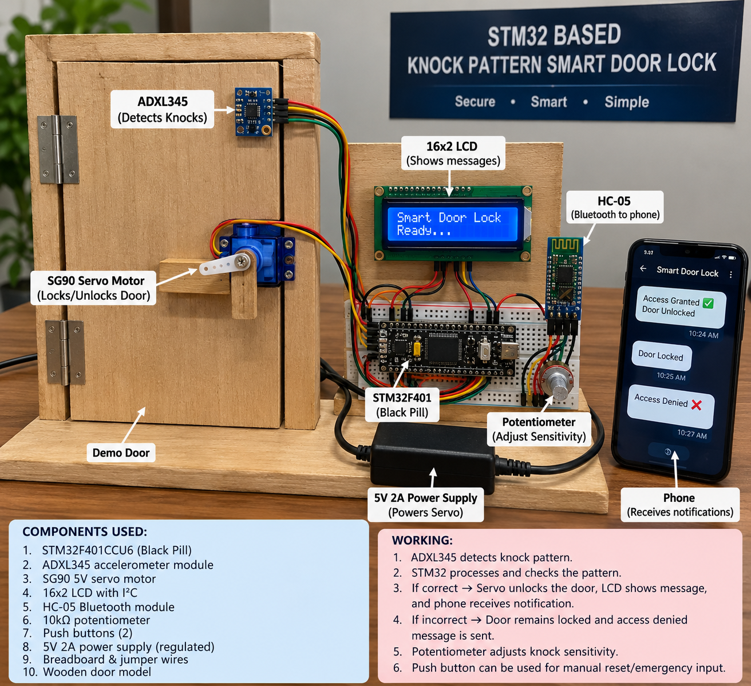
EMBEDDED SYSTEMS LAB
STM32 SMART LOCK
Working Prototype
Labelled photo of the demo door and electronics built for this project.
KEY MODULES
ADXL345 — detects knocks on the door
SG90 servo — locks and unlocks the latch
16×2 LCD — shows access messages
HC-05 — sends status to the phone
STM32F401 Black Pill — runs the pattern logic
10 kΩ potentiometer — sets knock sensitivity
5V 2A supply — powers the servo
4

Slide 5
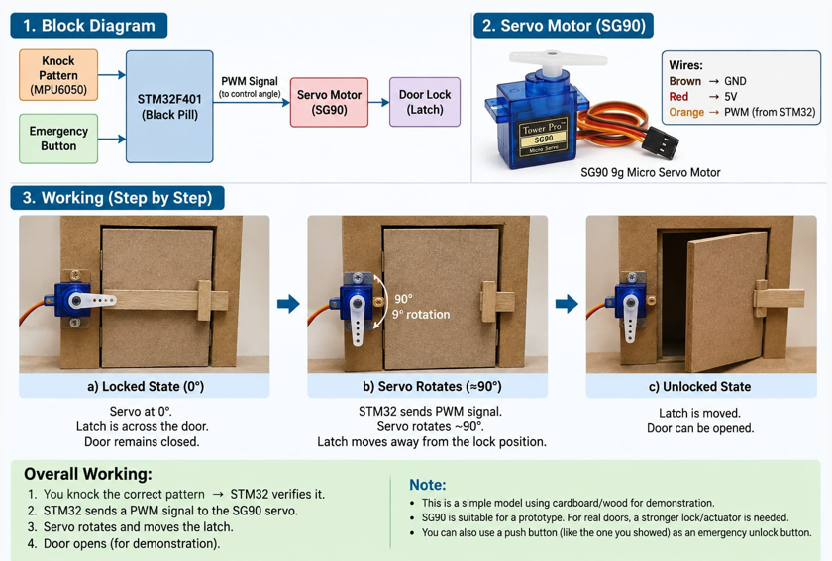
EMBEDDED SYSTEMS LAB
STM32 SMART LOCK
Servo Control and Unlock Workflow
Block diagram, servo wiring and the locked-to-unlocked sequence.
SG90 WIRING
Brown → GND
Red → 5V supply
Orange → PWM from STM32
SEQUENCE
Locked: servo at 0°, latch across the door
PWM rotates servo to about 90°
Latch moves clear; the door can open
5

Slide 6
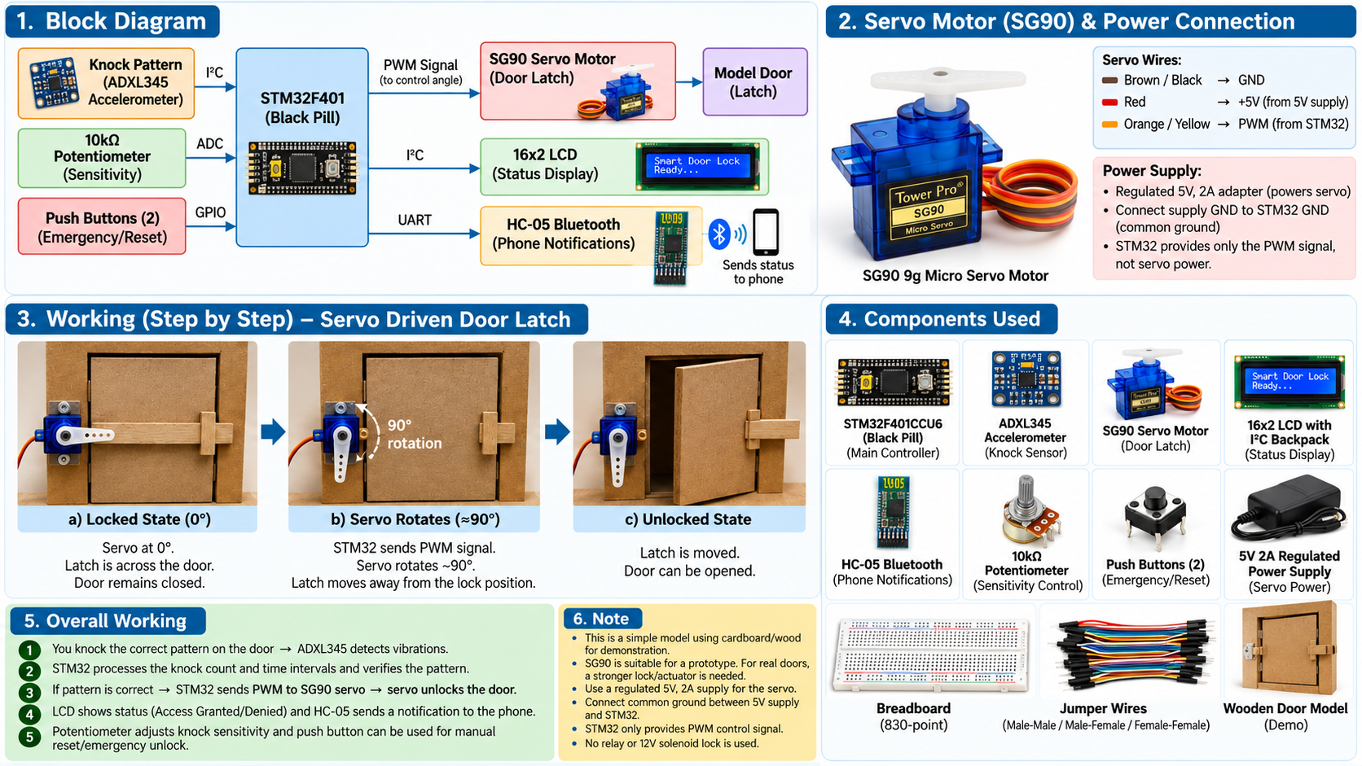
EMBEDDED SYSTEMS LAB
STM32 SMART LOCK
Complete Prototype Overview
Block diagram, servo and power wiring, working steps and the full component list.
KEY POINTS
The ADXL345 detects knocks; the STM32 checks the pattern.
The STM32 sends only a PWM signal to the servo.
A separate regulated 5V 2A supply powers the servo.
All grounds are common.
The LCD and HC-05 report access status.
6

Slide 7
EMBEDDED SYSTEMS LAB
STM32 SMART LOCK
System Architecture
The STM32F401 sits at the centre: it reads three inputs and drives three outputs.
ADXL345 accelerometer
Detects knocks on the door
I²C
PWM
SG90 servo
Turns the latch
STM32F401CCU6
Black Pill · ARM Cortex-M4
Knock count and gap analysis
Timer-based interval measurement
Access decision logic
10 kΩ potentiometer
Sets the sensitivity threshold
ADC
I²C
16×2 LCD
Shows access status
Push buttons
Emergency unlock and reset
GPIO / EXTI
UART
HC-05 Bluetooth
Sends alerts to the phone app
Power: a regulated 5V 2A supply drives the servo. All modules share one common ground with the STM32.
7

Slide 8
EMBEDDED SYSTEMS LAB
STM32 SMART LOCK
Hardware Components
Component | Role in the project | Interface
STM32F401CCU6 Black Pill | Main controller; runs the knock-pattern logic | GPIO, ADC, I²C, UART, timer
ADXL345 accelerometer module | Detects knock vibrations on the door | I²C
HC-05 Bluetooth module | Sends access status to a phone app | UART
16×2 LCD with I²C backpack | Shows system status and access result | I²C
10 kΩ potentiometer | Adjusts knock-detection sensitivity | ADC
SG90 5V servo motor | Turns the latch on the door model | PWM (timer)
Two push buttons | Emergency unlock and reset | GPIO / EXTI
Regulated 5V, 2A power supply | Powers the servo | Power
ST-LINK V2 | Programs and debugs with Keil | SWD
Breadboard and jumper wires | Prototype connections | —
Resistors (as required) | I²C pull-ups and button circuits | —
Wooden door model, servo bracket | Demonstrates the locking action | Mechanical
8

Slide 9
EMBEDDED SYSTEMS LAB
STM32 SMART LOCK
STM32F401 Peripherals in Use
Peripherals are features inside the microcontroller, so no extra hardware is needed for them.
GPIO
ADC
I²C
UART
Reads push buttons and drives status and reset signals.
Reads the potentiometer to set the knock threshold.
Shares one bus between the ADXL345 and the LCD.
Sends access messages to the HC-05 module.
Timer
PWM
NVIC / EXTI
SWD
Measures the gap between knocks with precise timing.
Timer output that sets the SG90 servo angle at 50 Hz.
Handles button presses by interrupt, without polling.
Programs and debugs the chip through the ST-LINK V2.
9

Slide 10
EMBEDDED SYSTEMS LAB
STM32 SMART LOCK
Proposed Pin Mapping
Suggested assignment for this build. Confirm it against the Black Pill pinout before wiring.
MCU pin | Signal | Peripheral | Connects to
PB6 | I²C1 SCL | I²C | ADXL345 SCL and LCD backpack SCL
PB7 | I²C1 SDA | I²C | ADXL345 SDA and LCD backpack SDA
PA0 | ADC1 input | ADC | Potentiometer wiper (centre pin)
PA9 | USART1 TX | UART | HC-05 RXD
PA10 | USART1 RX | UART | HC-05 TXD
PA6 | TIM3 CH1 (PWM) | Timer / PWM | SG90 signal wire
PB12 | GPIO input, EXTI | GPIO / EXTI | Button 1: manual emergency unlock
PB13 | GPIO input, EXTI | GPIO / EXTI | Button 2: reset
Both buttons use internal pull-up inputs; the I²C lines need pull-up resistors on the bus.
10

Slide 11
EMBEDDED SYSTEMS LAB
STM32 SMART LOCK
Knock Detection and Pattern Matching
1
Sample
Read acceleration from the ADXL345 over I²C at a fixed rate.
EXAMPLE VALID PATTERN
2
Threshold
short gap
long gap
A knock is a spike above the level set by the potentiometer.
3
Debounce
Short lockout after each knock, so ringing is not counted.
Knock 1
Knock 2
Knock 3
4
Record
Stored pattern (example values, to be tuned in testing)
3 knocks
Short gap ≈ 300 ms, long gap ≈ 800 ms
Tolerance ±100 ms
Count the knocks and store each gap, measured by the timer.
5
Match
Compare the count and gaps with the stored pattern, within a set tolerance.
11

Slide 12
EMBEDDED SYSTEMS LAB
STM32 SMART LOCK
Six-Step Workflow and Access Outcomes
STEP 1
STEP 2
STEP 3
STEP 4
STEP 5
STEP 6
Power on
Detect knock
Set threshold
Record pattern
Compare
Monitor again
Initialise sensor, LCD, UART, ADC, timer and GPIO
ADXL345 sends acceleration data over I²C
Potentiometer sets the knock threshold via ADC
Count knocks; the timer measures gaps between them
Firmware checks count and timing against the secret pattern
Show the result, finish the unlock interval, wait for the next knock
IF THE PATTERN MATCHES
IF THE PATTERN DOES NOT MATCH
LCD shows ACCESS GRANTED
Servo PWM turns the latch to unlock
HC-05 sends a status message to the phone
LCD shows ACCESS DENIED
Servo stays in the locked position
HC-05 sends a rejection alert to the phone
12

Slide 13
EMBEDDED SYSTEMS LAB
STM32 SMART LOCK
Power, Logic Levels and Wiring Rules
1
3.3 V logic on the MCU
2
Dedicated servo supply
STM32F401 pins are 3.3 V. Use a 3.3 V I²C LCD backpack, or a level shifter, so 5 V never reaches an MCU pin. Check the ADXL345 and HC-05 logic levels too.
The SG90 draws current spikes when it moves. Power it from the regulated 5V 2A supply, not from the Black Pill's 5V pin.
3
One common ground
4
Mount the sensor firmly
Join the grounds of the supply, STM32, ADXL345, LCD, HC-05 and servo. Without a shared reference, signals become unreliable.
Fix the ADXL345 to the wooden pad so knock vibration transfers into it. A loose mount weakens and distorts the readings.
13

Slide 14
EMBEDDED SYSTEMS LAB
STM32 SMART LOCK
Security Risks and Mitigations
Risk | Mitigation (planned design)
Pattern can be heard and copied | Use a longer, irregular pattern; add a lockout after repeated failures
Secret pattern hardcoded in firmware | Store the owner-set pattern in flash memory
Bluetooth link is unencrypted | Keep range short and require pairing; plan an encrypted BLE link
Footsteps or bumps trigger false matches | Debounce window and a tuned sensitivity threshold
Emergency button bypasses the lock | Define emergency unlock as held-to-open, and send a Bluetooth event on each use
Servo may stall under load | Use a light latch and check the servo's travel range during testing
Mitigations are proposed design changes and are not yet implemented in the prototype.
14

Slide 15
EMBEDDED SYSTEMS LAB
STM32 SMART LOCK
Testing and Evaluation Plan
Results will be recorded during testing. No measured figures are claimed in this deck.
Test | Method | Pass criterion
Correct pattern | 20 attempts with the stored pattern | Door unlocks on every attempt
Wrong pattern | 20 attempts with near-miss counts and gaps | Door stays locked on every attempt
Sensitivity | Knock soft, medium and hard at each potentiometer setting | Knocks counted consistently at each force
Timing tolerance | Vary gaps by ±50 ms and ±100 ms | Accepted tolerance measured and documented
Bluetooth range | Send status messages at 1 m, 5 m and 10 m | Every message received on the phone
Servo reliability | 20 lock and unlock cycles | Latch moves fully on every cycle
15

Slide 16
EMBEDDED SYSTEMS LAB
STM32 SMART LOCK
Conclusion and Future Work
CONCLUSION
The project demonstrates a keyless door lock that opens on a secret knock rhythm. The STM32F401 combines GPIO, ADC, I²C, UART, timer, PWM and interrupt features in one real-time system, using inexpensive, readily available modules.
FUTURE WORK
Store an owner-set knock pattern in flash memory
Add a lockout after repeated failed attempts
Use ADXL345 interrupts to reduce polling
Replace HC-05 with an encrypted Bluetooth LE link
Tune the unlock interval and emergency behaviour through testing
Build a sturdier latch for a full-size door
16

