Slide 1


19CSE453 Natural Language Processing
1
SMS SPAM DETECTION
Team_No: 08
Project Advisor:
Ms. Kavitha C.R. & Mr. Nippunn Kumaar A.A./ Asst. Prof.(Sr.Gr.) CSE Dept.
S.No | Reg.No | Name of the Student | Section
1 | BL.EN.U4CSE20046 | G.SAKETH REDDY | CSE A
2 | BL.EN.U4CSE20034 | D.MANIKANTA RAMACHANDRA RAJU | CSE A
3 | BL.EN.U4CSE20118 | P.CHARITHARTHA REDDY | CSE B

Slide 2
2
Problem Definition
Filtering SMS into spam/ham by creating spam detection model using Natural Language processing Techniques

Slide 3
Literature Survey
3
S.No | Author Name(s) | Full title of the paper with year | Inference from the paper (based on methodology, technology) | Open problem (for your proposed work)
1. | BollamPragna, M.RamaBai | Spam Detection using NLP Techniques[2019] | In this part, we compare the performance and accuracy of one algorithm with other algorithms, the spam message is best predicted by Support Vector Classifier with an accuracy of 98.49% | The proposed model need to be improved to understand sarcasm, context on the whole which could be essential while detecting spam
2. | Dr.Nancy Jasmine Goldena, T.Ancy Selciya | Spam detection approach for secure sms using machine learning algorithms[2022] | The phases of detection of spam involve preprocessing, feature extraction and selection and classification. | it is not enough to evaluate the performance based on the accuracy alone since the dataset is imbalanced; therefore, the precision, recall and f-measure of the algorithms must also be observed.

Slide 4
Literature Survey
4
S.No | Author Name(s) | Full title of the paper with year | Inference from the paper (based on methodology, technology) | Open problem (for your proposed work)
3. | Paras sethi, Vaibhav Bhandari, Bhavna kohli | SMS spam detection and comparision of machine learning algorithms[2017] | utilize four features derived from SMS text messages in order to be trained by. These features include the size, frequently occurring monograms in text messages | Naïve Bayes algorithm outperforms the other classifiers used in the study
4. | Pradeep Kumar Roya, Jyoti Prakash Singh, Snehasish Banerjee | Deep Learning to Filter SMS Spam[2011] | Therefore, the objective of this paper is to classify mobile text messages as Spam or Not-Spam using the CNN and the LSTM model. | CNN based model with the regularization parameter (dropout) on randomly sampled 10-fold cross validation data performed best

Slide 5
Software/Tools Requirements
13
Software Requirements: Google Colab, Jupiter Notebook
Libraries: Nltk, Sklearn, punkt,pickle
For Application/Backend: Flask,python
Front end :HTML,CSS

Slide 6
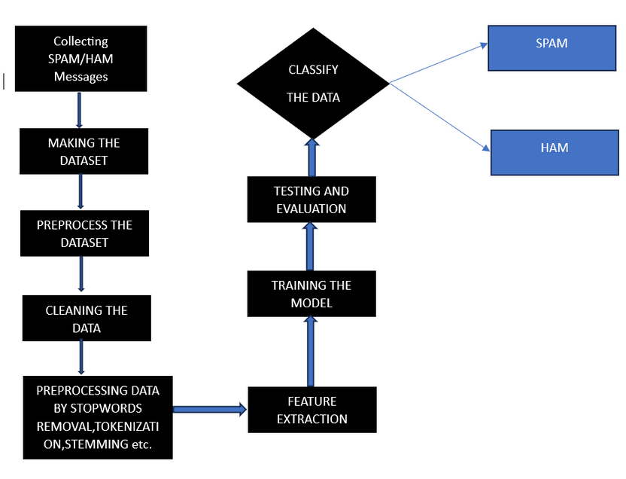
6
Architecture / Design

Slide 7
14
Data Set (If Applicable)
Source of data set: Kaggle
https://www.kaggle.com/datasets/uciml/sms-spam-collection-dataset
The SMS Spam Collection v.1 is a public set of SMS labeled messages that have been collected for mobile phone spam research. It has one collection composed by 5,574 English, real and non-enconded messages, tagged according being legitimate (ham) or spam.

Slide 8
Implementation
14
STEPS INVOLVED TO IDENTIFY SPAM DETECTION :
DATA CLEANING
EDA
TEXT PREPROCESSING
MODEL BUILDING
EVALUATION
RESULT

Slide 9
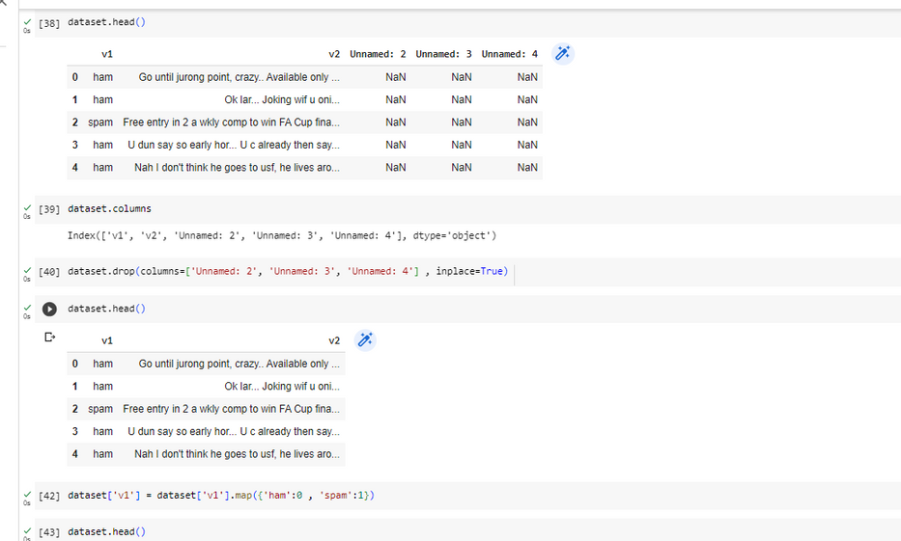
DATA CLEANING

Slide 10



EXPLORATORY DATA ANALYSIS
Exploratory Data Analysis (EDA) in NLP involves analyzing and visualizing textual data to gain insights and understanding.
EDA helps in understanding the characteristics, patterns, and relationships within the text data.
EDA techniques are used to preprocess and explore the textual data before applying NLP models or algorithms.

Slide 11
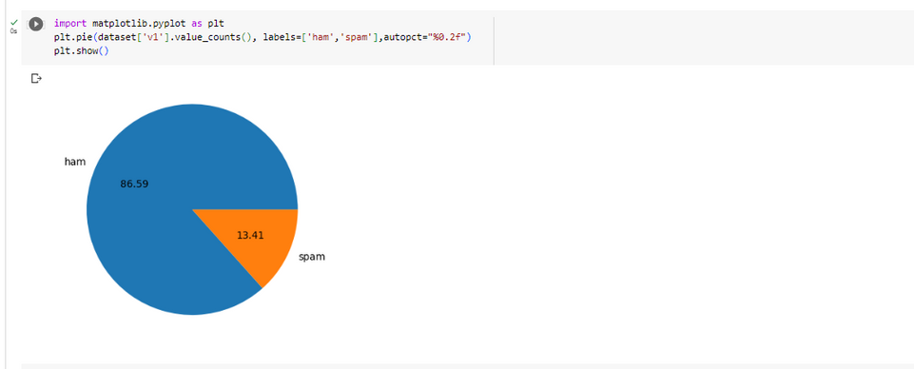
REPRESENTING THE DATASET
PERCENTAGE OF HAM AND SPAM MESSAGES IN THE DATASET

Slide 12
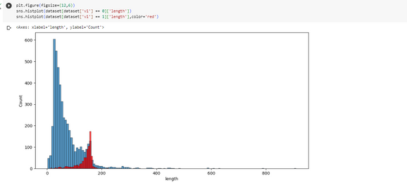

COUNT OF ALPHABETS IN BOTH SPAM AND HAM
COUNT OF WORDS IN BOTH SPAM AND HAM

Slide 13
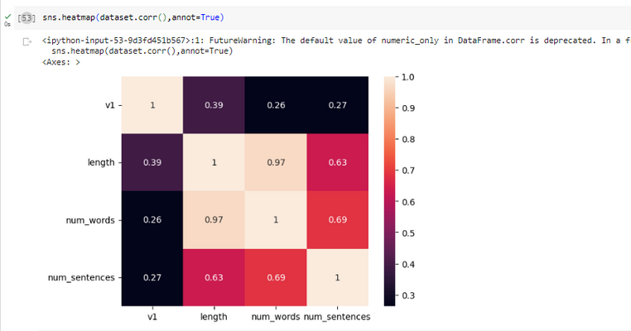
HEAT-MAP
Heat maps are commonly used to visualize various aspects of textual data, such as word frequency, sentiment intensity, or co-occurrence patterns.
Heat maps are commonly used to visualize various aspects of textual data, such as word frequency, sentiment intensity, or co-occurrence patterns.

Slide 14
TEXT PREPROCESSING
Text preprocessing is a crucial step in NLP that involves cleaning and transforming raw textual data into a suitable format for analysis or modeling.
Common text preprocessing techniques include lowercasing, removing punctuation, and tokenization.

Slide 15
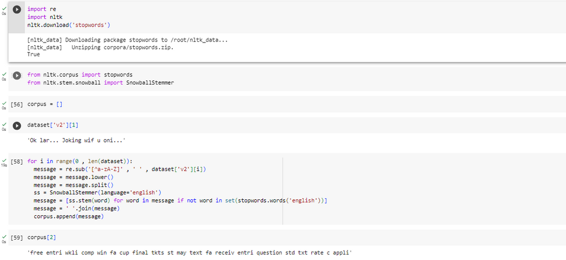

Slide 16
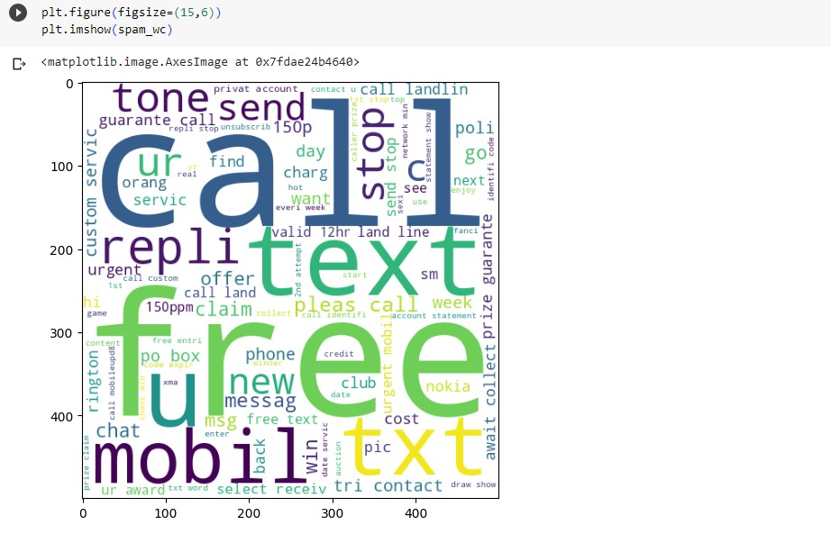
WORD CLOUD-SPAM

Slide 17
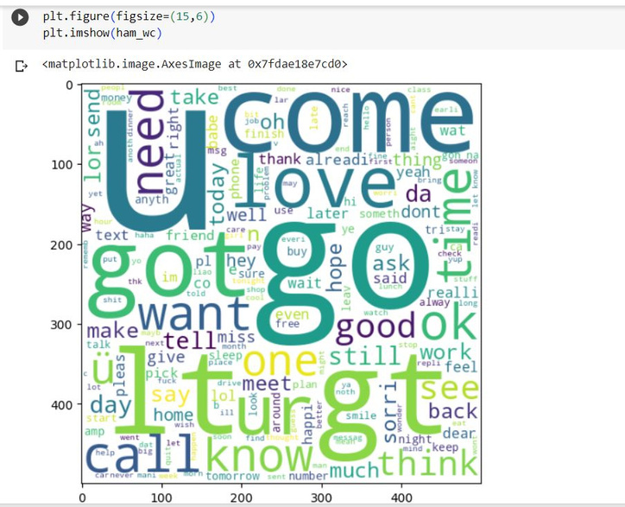
WORD CLOUD-HAM

Slide 18
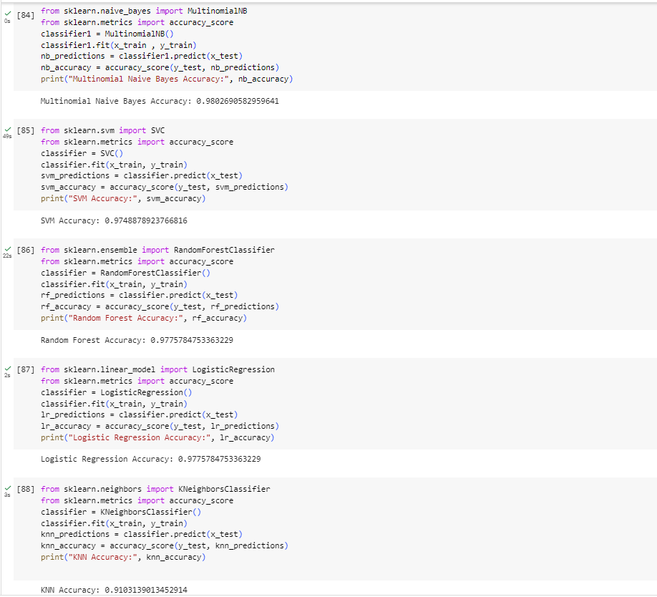
EVALUATION
CHOOSING THE BEST MODEL BASED ON ACCURACY
Evaluation in NLP involves assessing the performance and effectiveness of a model or system designed to solve language-related tasks.

Slide 19
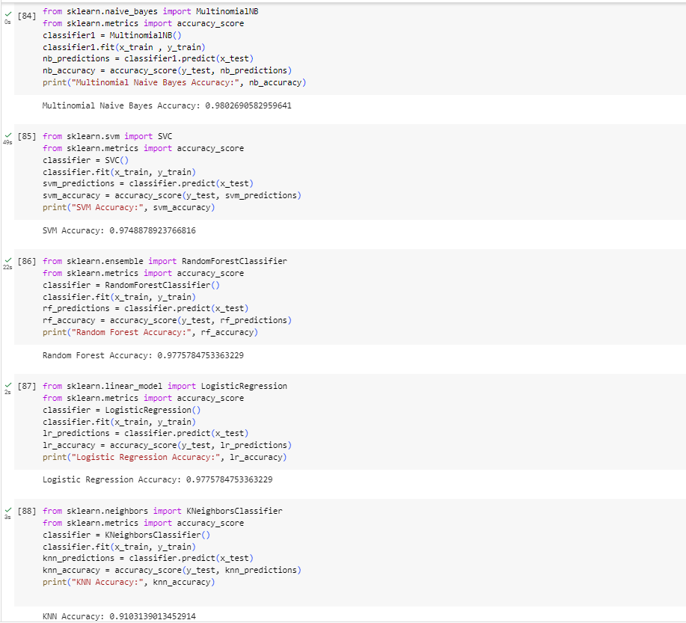

Slide 20
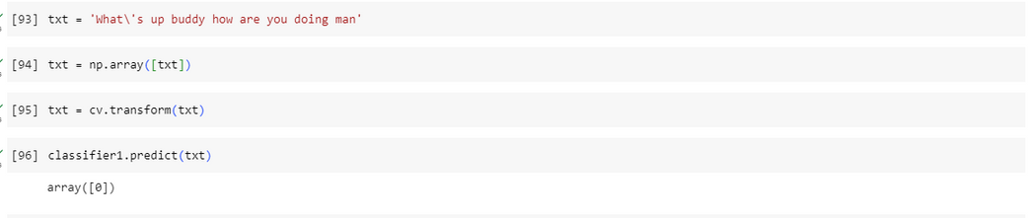
TESTING
14
Here we have given text as the input based on the accuracy of the dataset calculated by the classifier here we
Get the output as array[0] which is representation of Ham message.

Slide 21
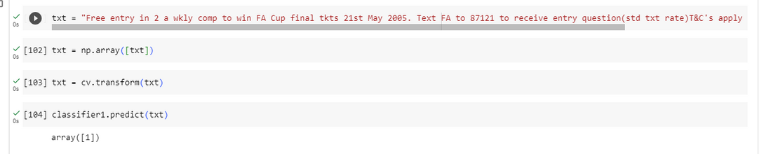
14
Here we have given text as the input based on the accuracy of the dataset calculated by the classifier here we
Get the output as array[1] which is representation of Spam message.

Slide 22
Result and Analysis
14
Multinomial Naive Bayes Classifier Accuracy:
The accuracy of the Multinomial Naive Bayes classifier on the test data is 98.02%. This means that the classifier correctly predicted 98.02% of the test samples.
2. Prediction of Spam and Ham:
You can predict whether a given input is spam or ham (non-spam) using the trained Multinomial Naive Bayes classifier.
The classifier utilizes the features of the input data to make the prediction.

Slide 23
Result and Analysis
14
Performance:
The Multinomial Naive Bayes classifier achieved the highest accuracy among the tested classifiers.
This suggests that the classifier was able to effectively learn the patterns and characteristics of the dataset.
2.Naive Bayes Assumption:
The Multinomial Naive Bayes classifier is based on the assumption of feature independence.
This assumption may or may not hold true for the given dataset, as it assumes that the presence of one feature is independent of the presence of other features.

Slide 24
25
Timeline
Abstract Submission
<03/04/2023>
Literature Survey
<03/04/2023>
Design [Front End, Back End]
<27/05/23>
Implementation
<25/05/23>
Testing
<25/06/23>
Document Submission
<09/06/23>

Slide 25
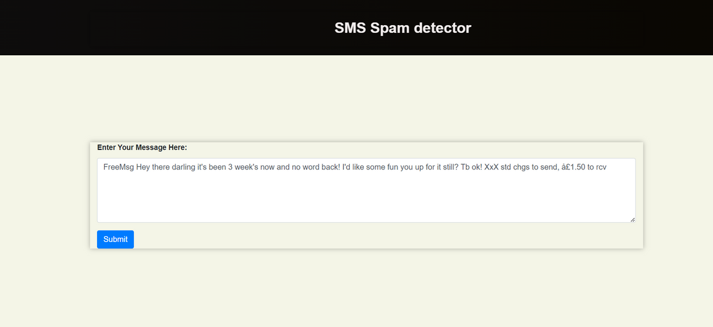
Demonstration
14
Here we can give any message it will take as input and click on submit.

Slide 26
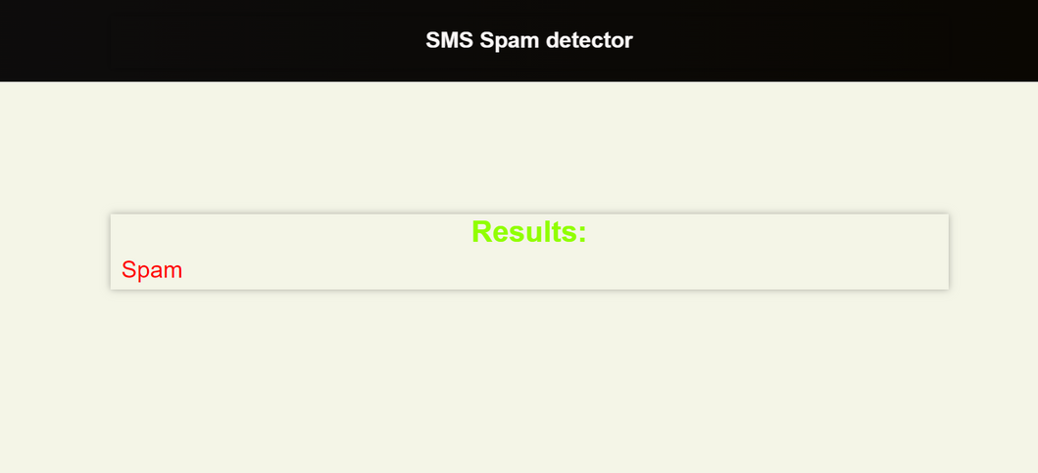
Demonstration
14
It will show the result as spam or ham as it was connected to our model.so based on the prediction we will get the result.

Slide 27
28
Conclusion and Future Enhancements
In this project, we developed a text classification model using the Multinomial Naive Bayes algorithm. We trained the model on a dataset of text messages, preprocessing the data by cleaning, stemming, and transforming it into numerical features. We split the dataset into training and testing sets and achieved a high accuracy score on the testing set.
We then built a Flask web application to provide a user interface for making predictions with our trained model. The application allows users to enter a text message and receive a predicted label based on the trained model. The model's predictions are generated by transforming the input message using a saved vectorizer and applying the trained model.

Slide 28
28
Conclusion and Future Enhancements
Overall, our project demonstrates the successful development and deployment of a text classification model for predicting labels of text messages. The Flask web application provides a user-friendly interface, making the model accessible and practical for real-world applications.

Slide 29
29
References
Bollam Pragna, M.Rama Bai, Spam Detection using NLP Techniques, International Journal of Recent Technology and Engineering (IJRTE), ISSN: 2277-3878, Volume-8, Issue-2S11, September 2019.
Dr.Nancy Jasmine Goldena, T.Ancy Selciya “Spam detection approach for secure sms using machine learning algorithms”[2022]
Sethi, P., V. Bhandari, and B. Kohli. (2017) “SMS Spam Detection and Comparison of Various Machine Learning Algorithms”, in 2017 International Conference on Computing and Communication Technologies for Smart Nation (IC3TSN). pp. 28–31

Slide 30
30
References
Mathew, K., &Issac, B. (2011). "Intelligent spam classification for mobile text message." Proceedings of 2011 International Conference on Computer Science and Network Technology

Slide 31
31
THANK YOU

