Slide 1

PROJECT REVIEW- 2
In
Predicting Brain Age and Anomalies in Brain Signals using Machine Learning Algorithms
BACHELOR OF ENGINEERING
IN
COMPUTER SCIENCE AND ENGINEERING
For the Academic Year 2023-24
Submitted by:
Under the Guidance of
Mrs.Poshitha A and Mrs. Swasti Sudha
Assistant Professor, Department of CSE
MVJ College of Engineering, Bangalore
Sushma M | 1MJ20CS213
V Saketh | 1MJ20CS229
Vimal Karthik L V | 1MJ20CS237
Approved by AICTE |Affiliated to VTU | Recognized by UGC with 2(f) & 12(B) status |Accredited by NBA and NAAC

Slide 2
CONTENTS
Abstract
Problem Statement
Objective
Status of the Project
System Architecture
Methodology

Slide 3
ABSTRACT
The Predicting brain age aims to leverage machine learning algorithms for two critical aspects in neuroscience: predicting brain age and identifying anomalies in brain wave signals. Understanding age-related changes in brain structure and function is vital for comprehending cognitive decline. Utilizing diverse neuroimaging data, including MRI and fMRI scans, this research delves into predicting brain age accurately. Concurrently, the study explores the potential of ML in analysing brain wave signals to detect anomalies, offering insights into neurological disorders or irregularities. By employing models like support vector machines, random forests, and deep neural networks, this project endeavors to establish robust predictive frameworks. Ethical considerations, interpretability, and transferability across diverse populations are integral aspects addressed within this research. The outcome aims not only to advance the intersection of machine learning and neuroscience but also to offer practical applications in clinical diagnostics and understanding brain health.
Approved by AICTE |Affiliated to VTU | Recognized by UGC with 2(f) & 12(B) status |Accredited by NBA and NAAC

Slide 4
PROBLEM STATEMENT
The project aims to develop a predictive model leveraging machine learning algorithms to estimate brain age and detect anomalies within brain wave signals. By employing advanced computational techniques, the study seeks to establish correlations between neural oscillations and chronological age while identifying deviations indicative of neurological irregularities. Through the analysis of electroencephalogram (EEG) data, the model will discern patterns, frequencies, and spatial characteristics to predict an individual's brain age and flag potential anomalies or deviations from expected brain wave patterns. The project's primary objective is to contribute to the field of neuro
informatics by providing a reliable tool for assessing brain health, potentially aiding in early detection of neurological disorders or age-related cognitive decline.

Slide 5
OBJECTIVE
The primary objective of this project is to develop a model to efficiently evaluate and predict brain
age and any anomalies present. Basically, in this project, we aim to:-
Gather the data for the projects from the datasets available for neurological research.
Use sufficient techniques for feature extraction and use an efficient ML working model for a sustainable prediction of brain age and anomalies.
Evaluate model performance and it’s workings to increase understanding of the different abnormalities in brain wave signals.
Use the model and make a website for neurological queries and to show to results of the conducted experiments.

Slide 6
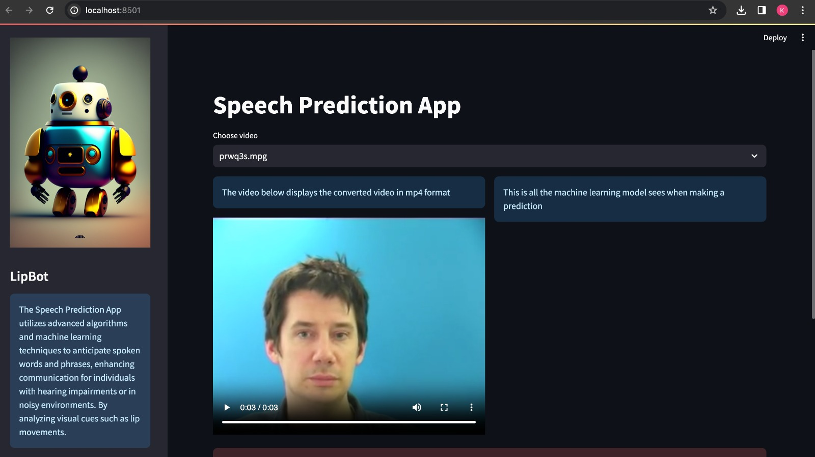
USER INTERFACE
Approved by AICTE |Affiliated to VTU | Recognized by UGC with 2(f) & 12(B) status |Accredited by NBA and NAAC

Slide 7
DESIGN AND DEVELOPMENT OF USER INTERFACE
Libraries and UI Frameworks:-
Libraries:
TensorFlow (for deep learning)
OpenCV (for image processing)
NumPy (for numerical computations)
pandas (for data manipulation)
UI Frameworks:
React JS
Programming Languages:-
Python (for all the machine learning parts of the project)
MySQL WorkBench(for the back end of the website)
HTML
CSS
JavaScript (For the front end of website)
Approved by AICTE |Affiliated to VTU | Recognized by UGC with 2(f) & 12(B) status |Accredited by NBA and NAAC

Slide 8
STATUS OF THE PROJECT
The project is currently in the development phase and a resonable progress in data collection, pre-processing and feature extraction. The focus is now on extracting the data as efficiently as possible to apply the training model and get the calculated testing result.
As of now, we have:-
The necessary datasets required for the project are found out and downloaded as required.
The dataset is being filtered to get the necessary features/information to be used.
The necessary tables that are required for the creation of the website are being created.
The front end - Creation of the website has started.
Approved by AICTE |Affiliated to VTU | Recognized by UGC with 2(f) & 12(B) status |Accredited by NBA and NAAC

Slide 9
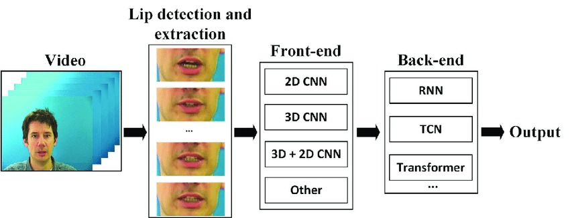
SYSTEM ARCHITECTURE

Slide 10
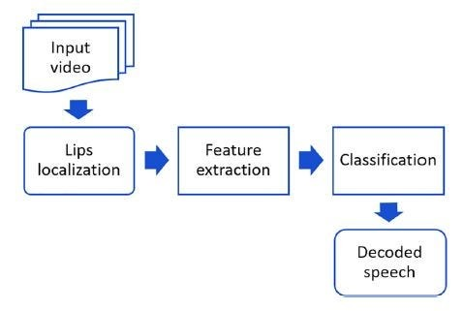



Slide 11
METHODOLOGY
1. Data Collection: We gather diverse datasets of brain wave signals from fMRI scans, which ensures a wide representation of ages and brain conditions.
2. Preprocessing: Cleaning and preprocessing the data to remove noise, standardize formats, and normalize signals to ensure consistency across the dataset.
3 Feature Extraction: Identifying relevant features from the brain wave signals, such as spectral power, coherence, or frequency bands, which will serve as input for the ML algorithms.
4. Model Development: Employing suitable ML algorithms—such as deep neural networks, support vector machines, or random forests—to train predictive models based on the extracted features.
5. Model Evaluation: Validating the models using cross-validation techniques and assessing their performance in predicting brain age and detecting anomalies in brain wave signals.
6. Comprehensive Documentation: Every stage of the project, from data collection to system deployment, will be thoroughly documented. This will include technical details of the model, training process, system architecture, and user interface design.

Slide 12
Thank You!

