Slide 1

Connect Four Extension
Final Project – CS-608 Algorithms and Computing Theory
Group 1
Architecture, Algorithms, and System Design

Slide 2
Project Overview
Full-featured extension of a midterm Connect Four console application
Supports AI gameplay, tournaments, persistence, and player accounts
Designed using modular software architecture principles
Demonstrates applied algorithms and data structures

Slide 3
System Objectives
Preserve
Preserve original midterm functionality and commands
Introduce
Introduce scalable AI and competitive tournament play
Ensure
Ensure maintainability through modular design
Provide
Provide efficient and user-friendly gameplay

Slide 4
High-Level System Architecture
User Interface / Command Parser
Game Engine (Board, Rules, Turn Control)
Player Account & Profile Manager
Artificial Intelligence Engine
Tournament Manager
Persistence Layer (File-Based Storage)

Slide 5
Module Interaction Flow
UI receives commands and validates input
Game Engine processes moves and updates board state
AI Engine generates moves when playing against computer
Player Manager updates statistics after each game
Persistence Layer saves updated profiles to disk

Slide 6
Game Engine Internal Architecture
Board Representation (2D Array)
Move Validation & Gravity Logic
Win / Draw Detection Algorithms
Move History Stack (Undo Support)

Slide 7
Gameplay Mechanics
6×7 board implemented using two-dimensional arrays
Gravity-based placement ensures correct disc behavior
Win detection checks horizontal, vertical, and diagonal patterns
Undo implemented with stack for constant-time reversal

Slide 8
AI Decision-Making Architecture
Random AI: Valid move generator
Medium AI: Heuristic evaluator
Hard AI: Minimax / Negamax recursion
Alpha-Beta pruning for search optimization

Slide 9
AI Algorithm Details
Minimax assumes optimal play by both players
Negamax simplifies minimax for zero-sum games
Alpha-Beta pruning eliminates unnecessary branches
Move ordering improves pruning efficiency

Slide 10
Tournament System Architecture
Tournament Registration Handler
Round-Robin Scheduler
Match Queue (FIFO)
AVL Tree Standings Manager

Slide 11
Tournament Workflow
Players register and join tournament
Round-robin schedule generated automatically
Matches executed sequentially using queue
Standings updated dynamically using AVL tree

Slide 12
Persistence Layer Architecture
Profile Loader
Statistics Updater
File Serializer
Atomic File Writer

Slide 13
Persistence and Security
Player profiles stored persistently in files
Statistics saved immediately after games
Login/logout manages session lifecycle
Prevents data loss across application restarts

Slide 14
Data Structures Mapping
2D Array → Board state representation
Stack → Undo move history
Queue → Turn management and match scheduling
Map → Player profiles and statistics
AVL Tree → Sorted tournament standings

Slide 15
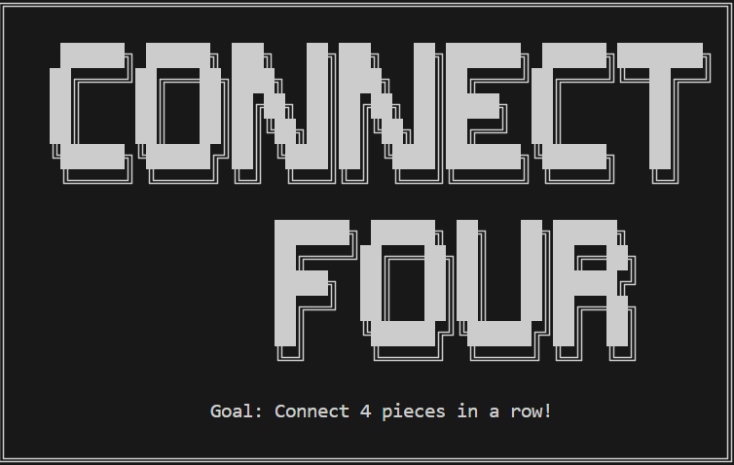
Application Startup Screen
ASCII-based title screen displayed when the application launches.

Slide 16
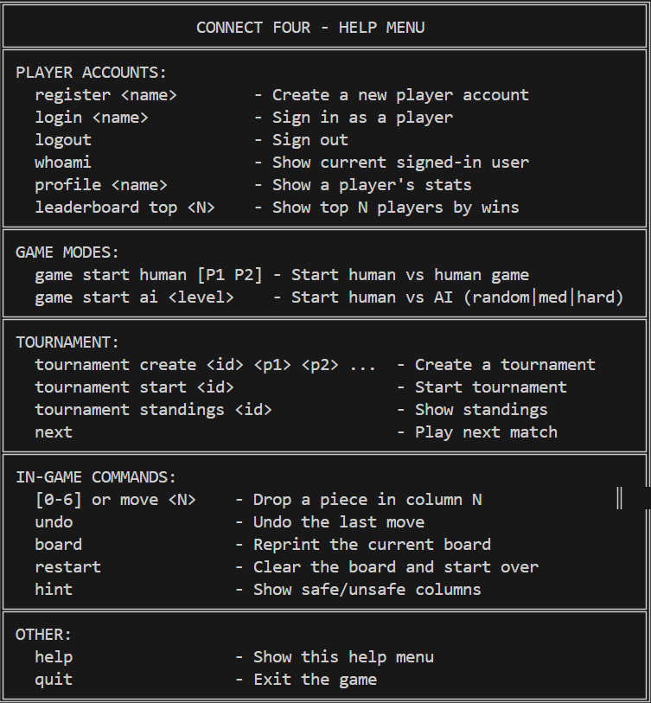
Help Menu and Command Interface
Shows all supported commands for players, gameplay, and tournaments.

Slide 17
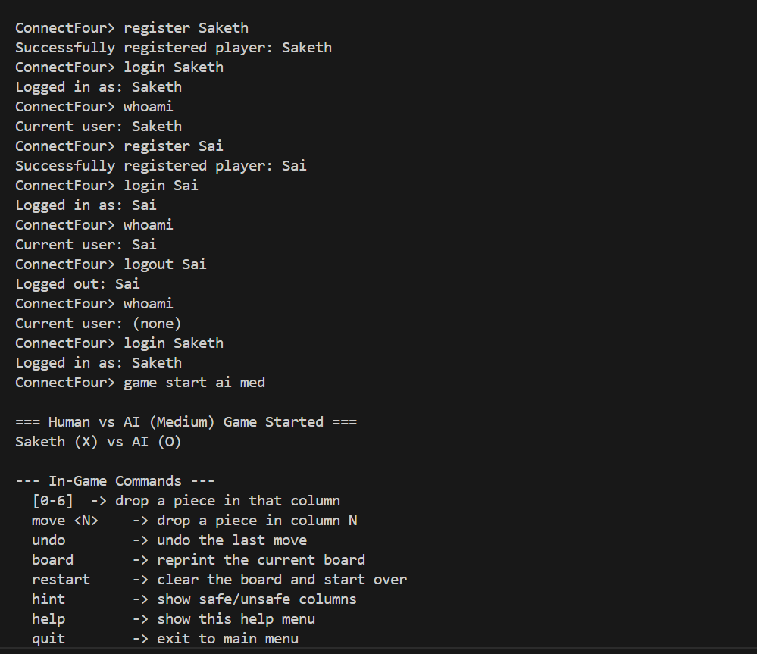
Player Registration and Login
Demonstrates persistent player account creation and session handling.

Slide 18
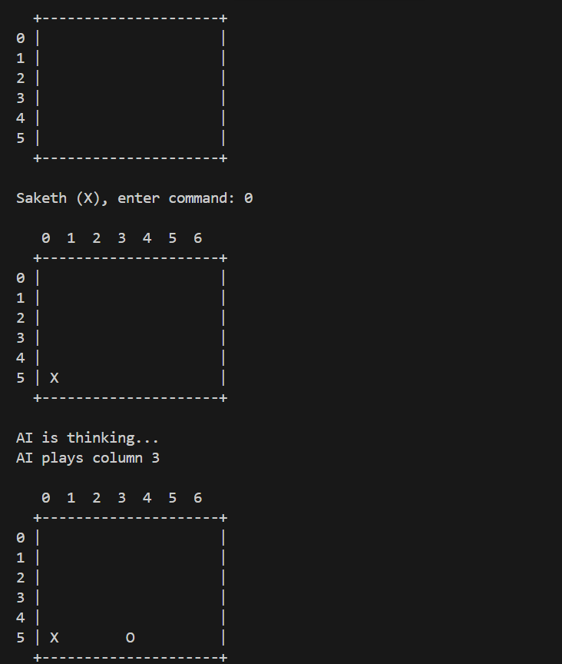
Human vs AI Game Initialization
Human vs AI (Medium difficulty) game start with available in-game commands.

Slide 19
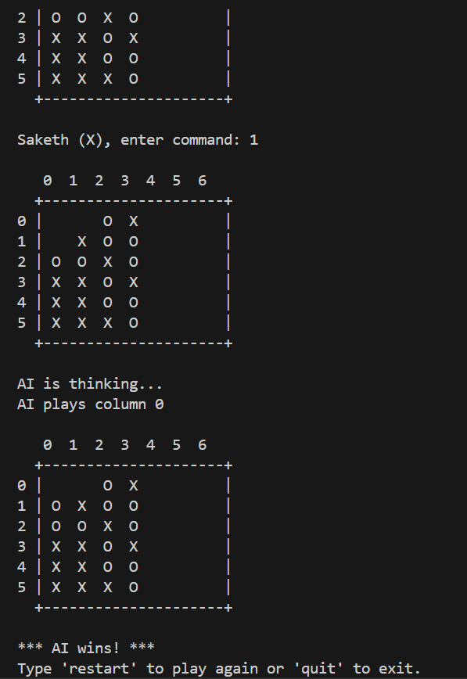
AI Win Detection
Final board state where AI successfully detects and completes a winning sequence.

Slide 20
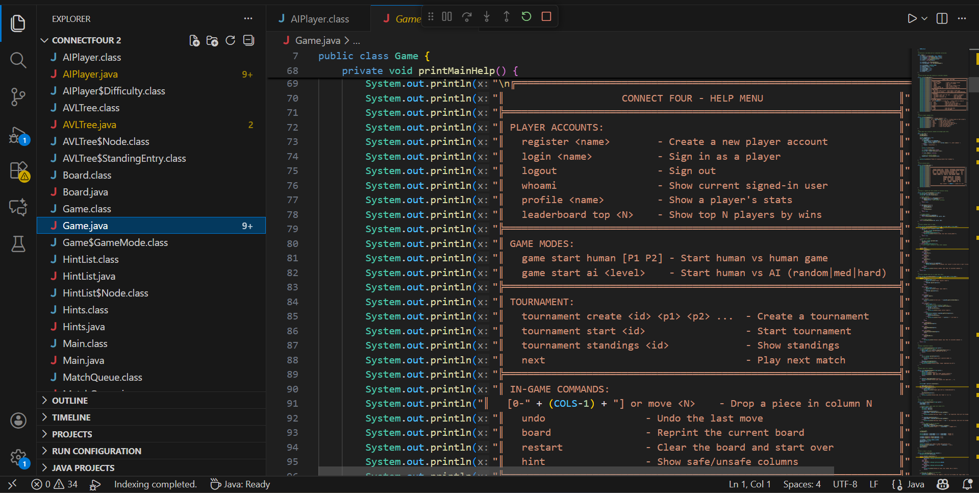
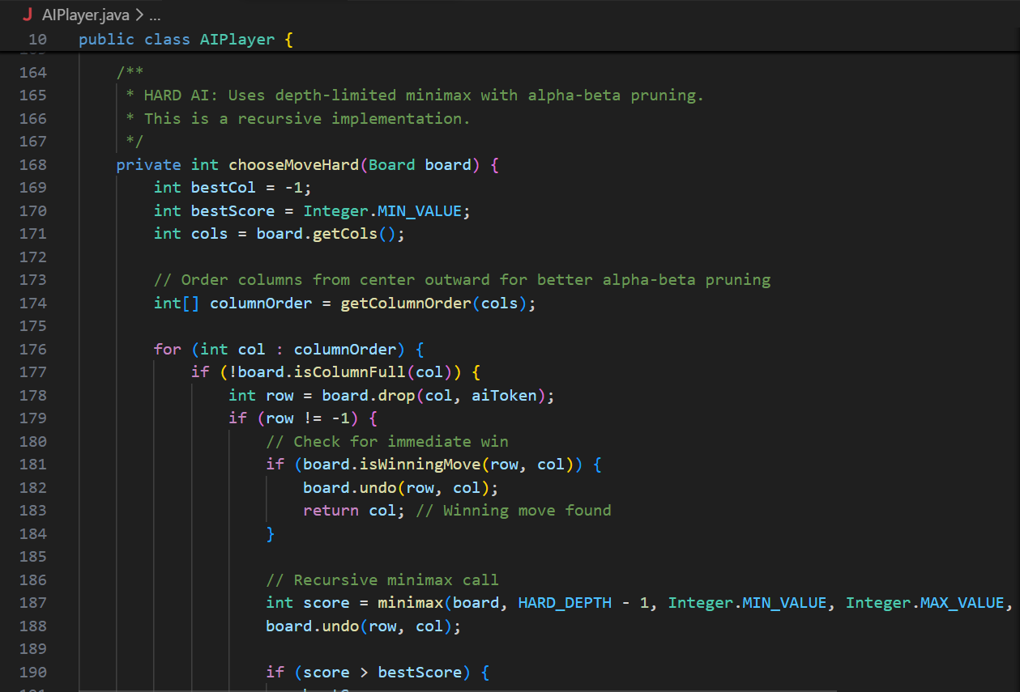
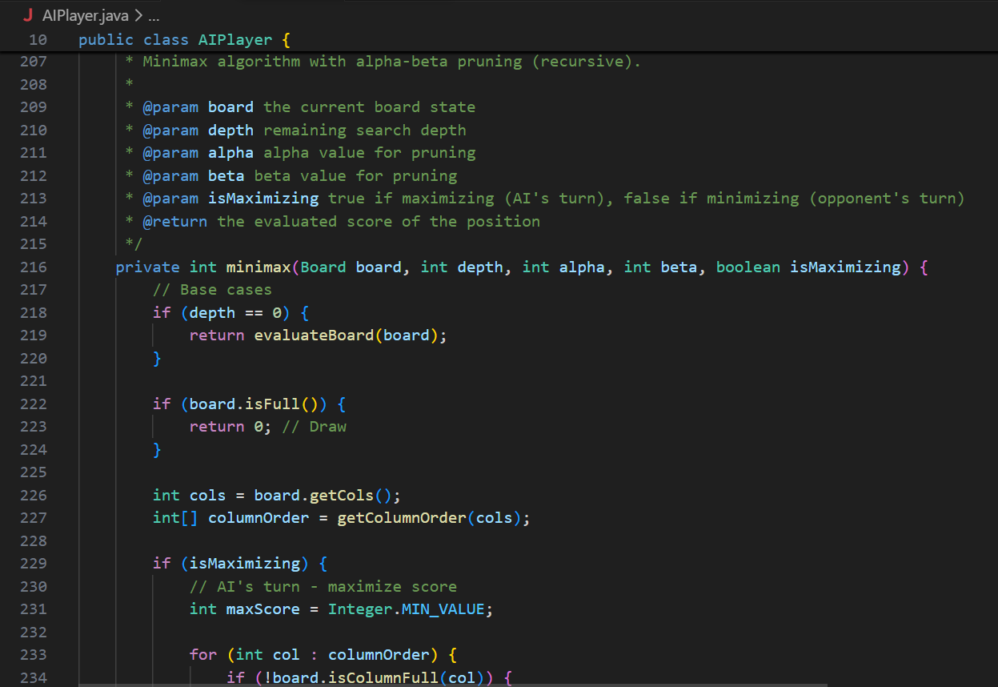
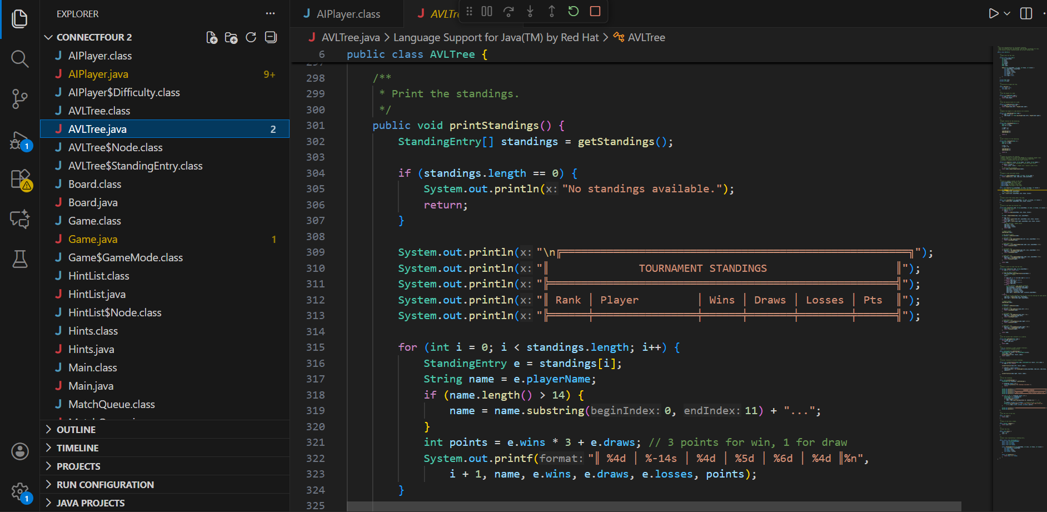
Source Code

Slide 21
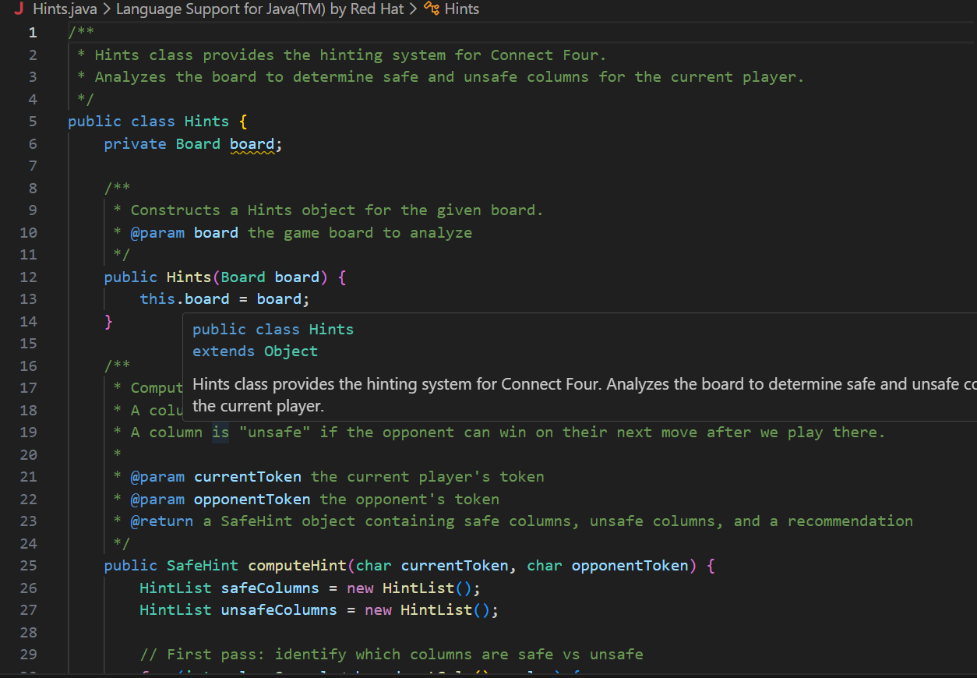
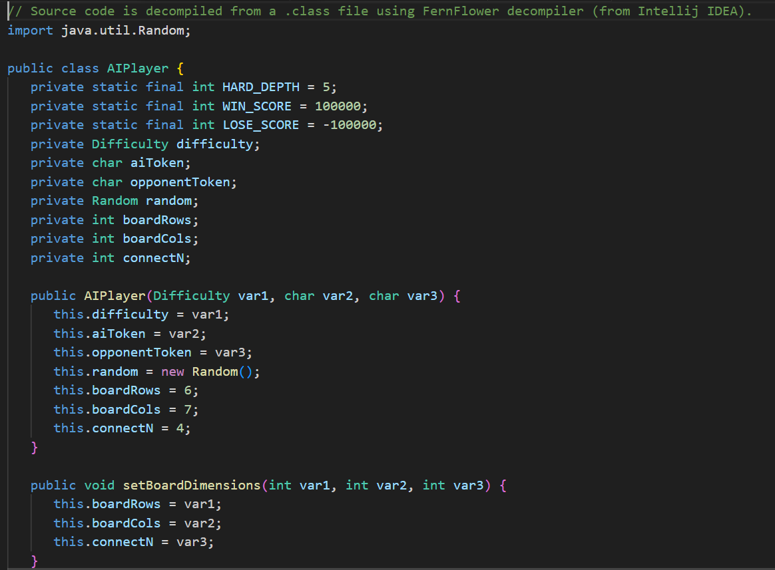
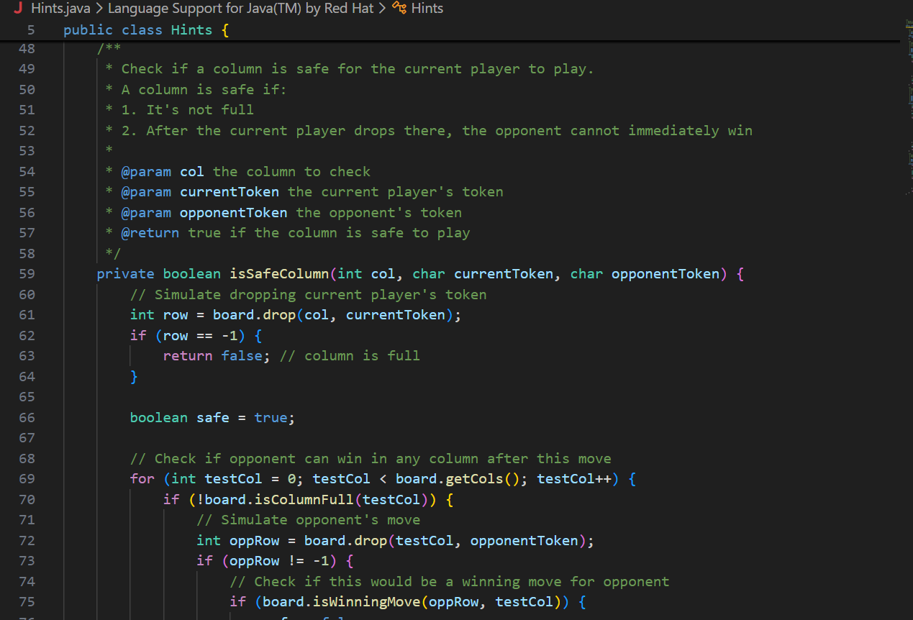
Source Code (Contn.)

Slide 22
Testing Strategy
Unit tests for board logic, AI, and persistence
Integration tests simulate full gameplay scenarios
Regression testing preserves midterm behavior
Ensures system reliability and correctness

Slide 23
Performance Analysis
O(1) move placement on board
O(n) win detection per move
AI complexity reduced using Alpha-Beta pruning
AVL tree ensures O(log n) tournament updates

Slide 24

Project Sources
Google Drive Link for the project:
https://drive.google.com/drive/folders/1uJCg_xWWoNACD5wS3YQBoyFz6SVMyPuD?usp=drive_link
GitHub URL for the project:

Slide 25
Conclusion and Future Work
Comprehensive Connect Four system with advanced features
Strong demonstration of algorithms and data structures
Architecture supports future GUI or network extensions
Project meets and exceeds course requirements

