Slide 1



Project
View in Power BI
Last data refresh:
5/8/2021 1:14:24 AM UTC
Downloaded at:
5/8/2021 1:22:58 AM UTC

Slide 2
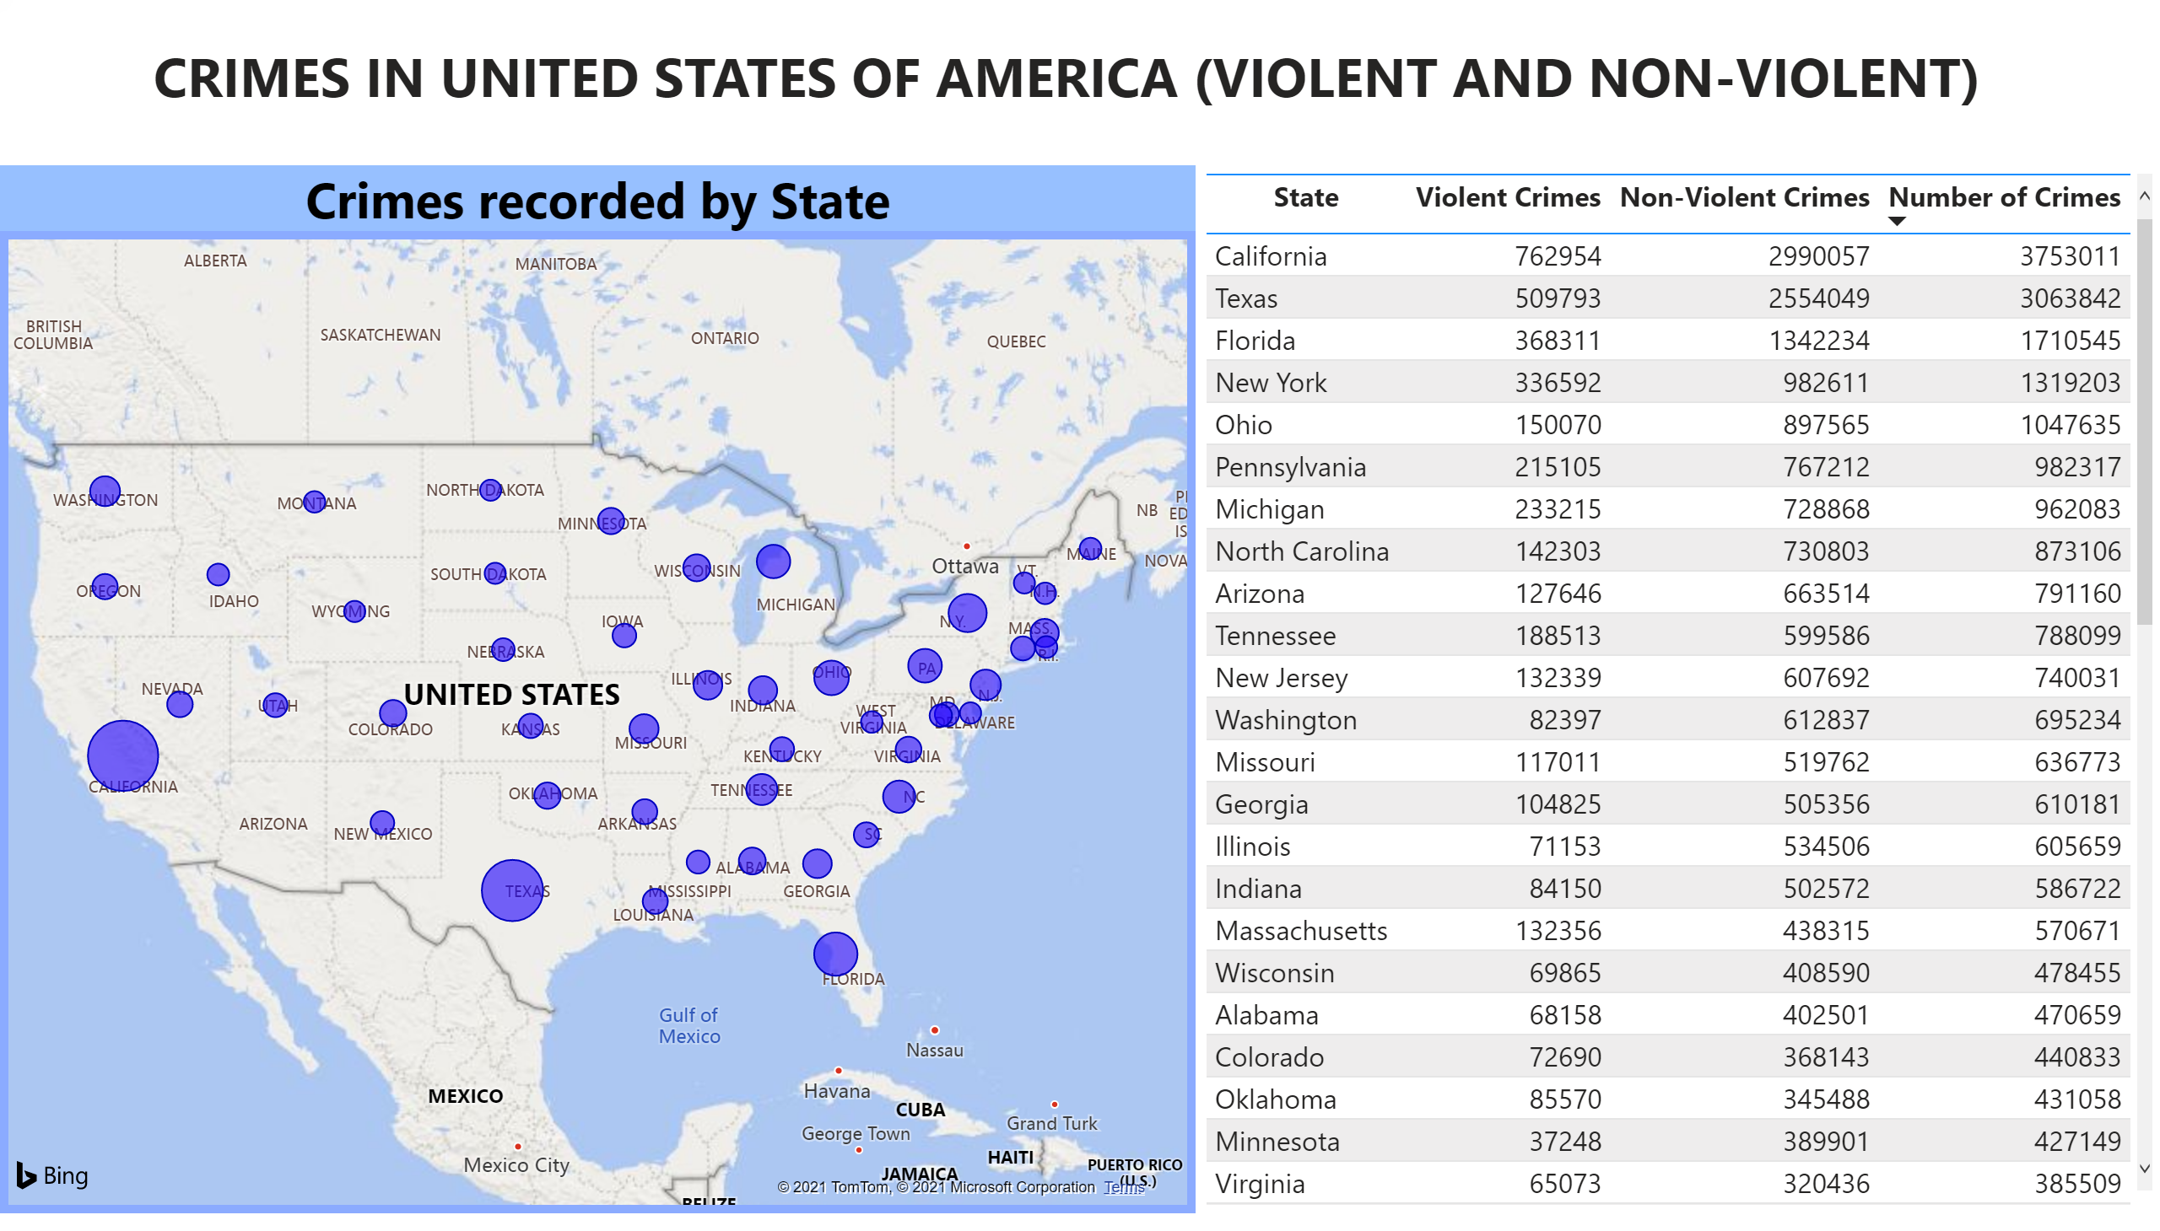
1
Notes:
Crimes recorded by State
No alt text provided.
tableEx
No alt text provided.
textbox
No alt text provided.

Slide 3
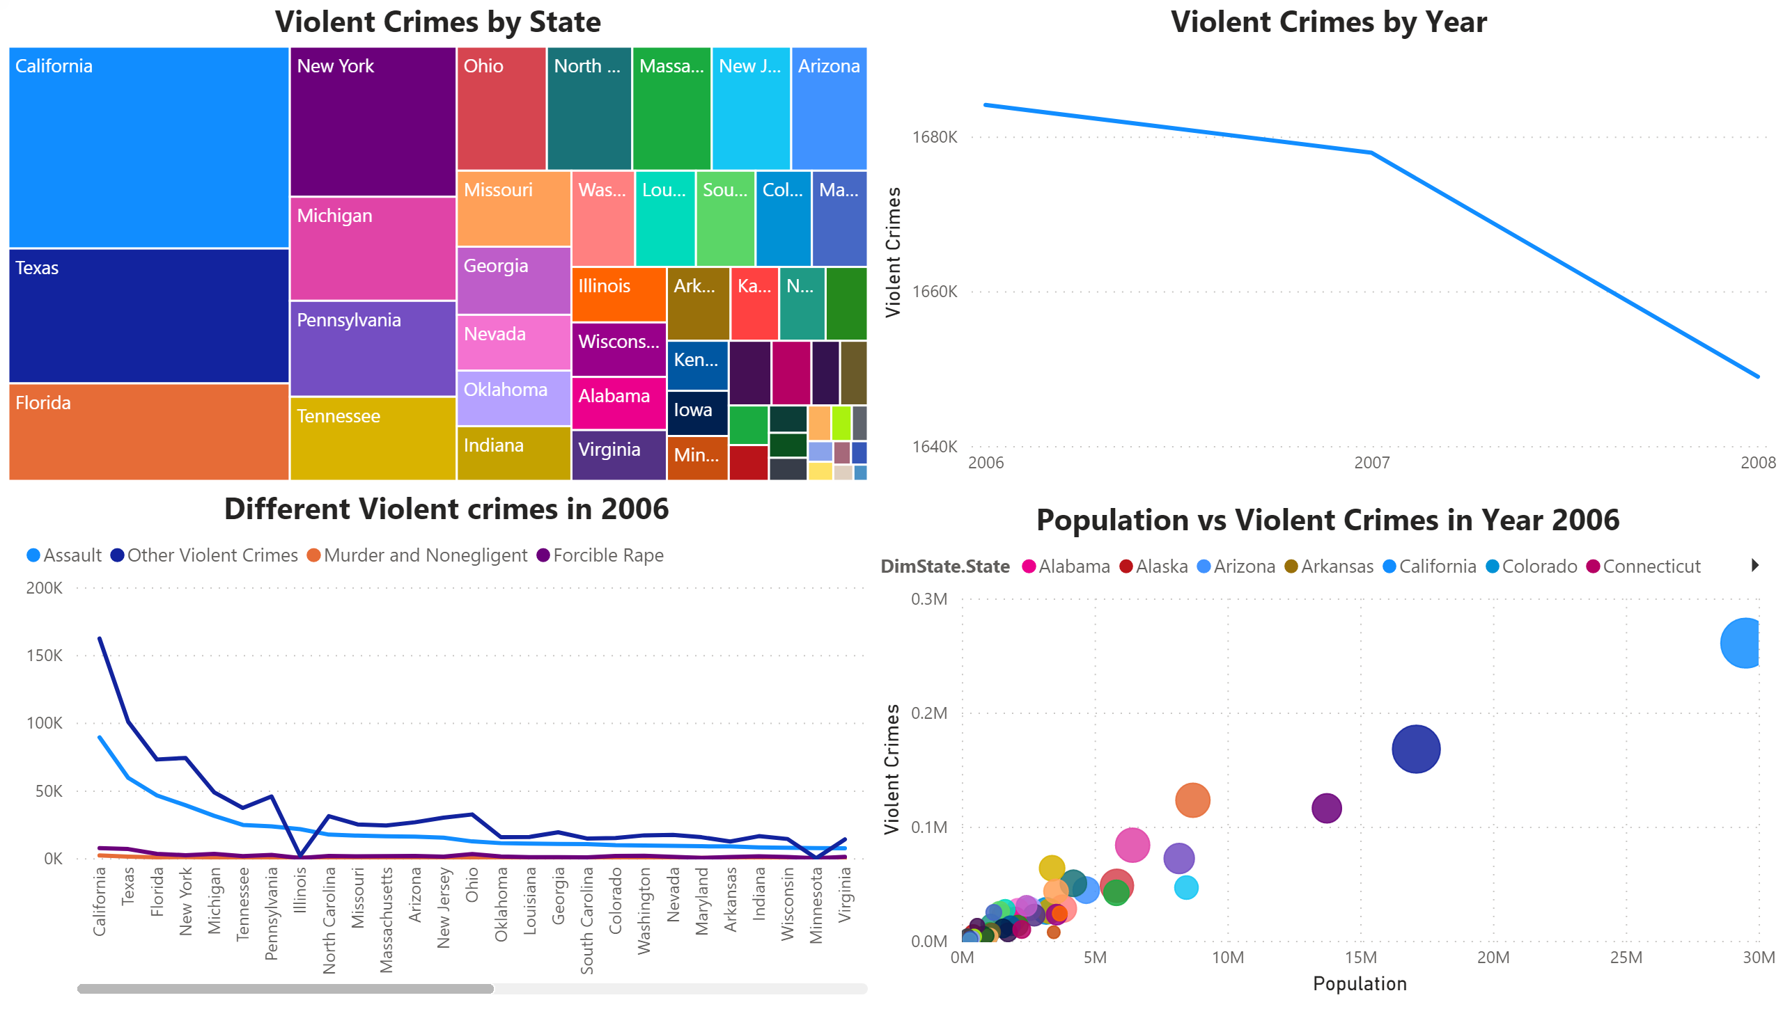
2
Notes:
Violent Crimes by Year
No alt text provided.
Violent Crimes by State
No alt text provided.
Population vs Violent Crimes in Year 2006
No alt text provided.
Different Violent crimes in 2006
No alt text provided.

Slide 4
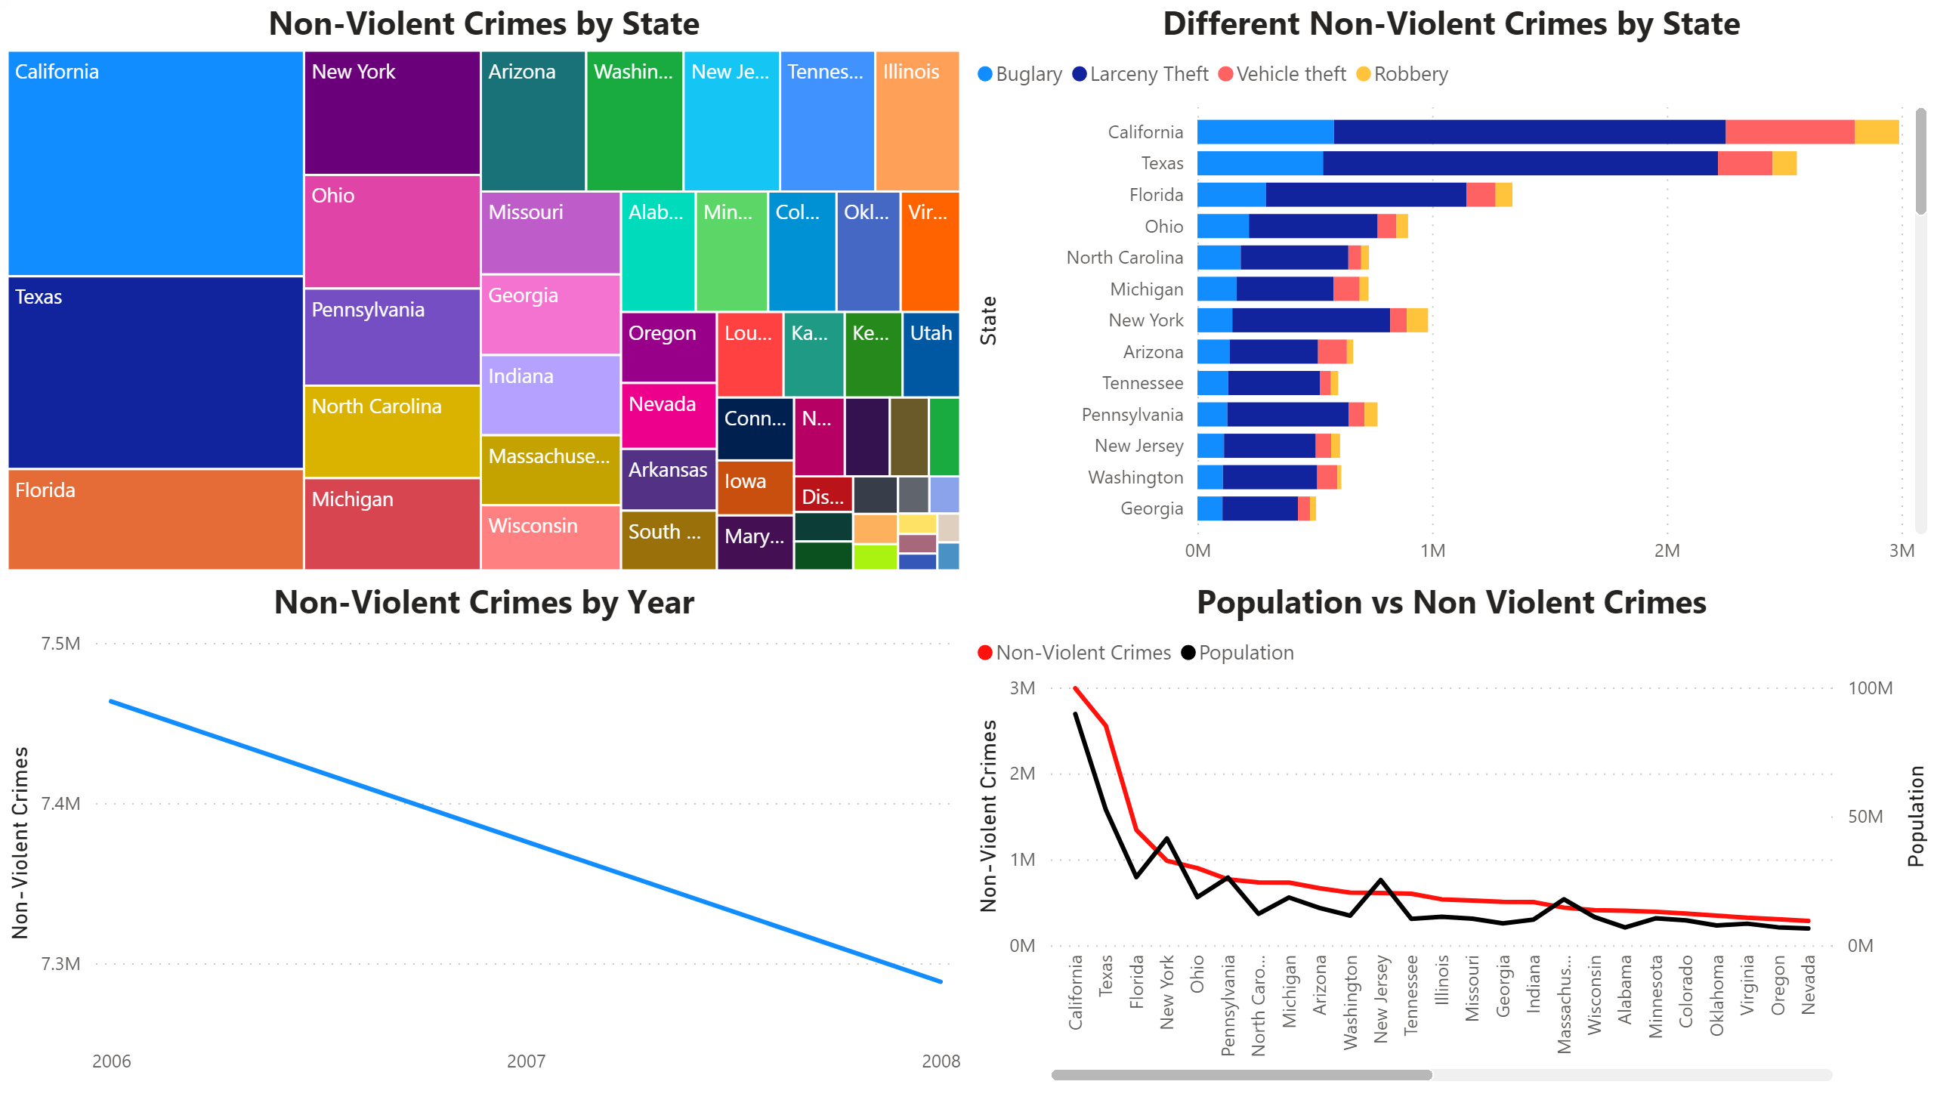
3
Notes:
Non-Violent Crimes by State
No alt text provided.
Different Non-Violent Crimes by State
No alt text provided.
Non-Violent Crimes by Year
No alt text provided.
Population vs Non Violent Crimes
No alt text provided.

Slide 5
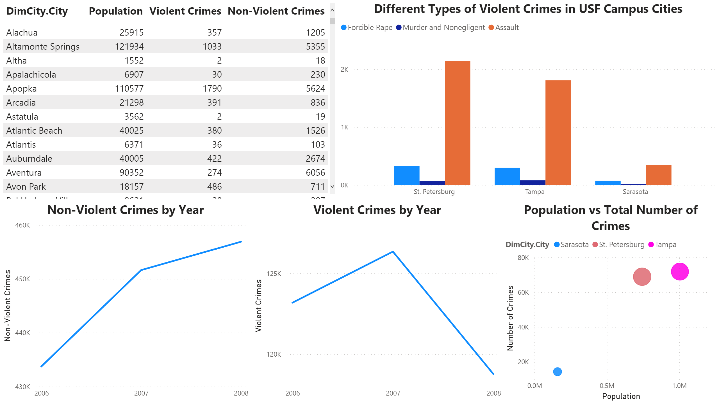
4
Notes:
tableEx
No alt text provided.
Non-Violent Crimes by Year
No alt text provided.
Violent Crimes by Year
No alt text provided.
Different Types of Violent Crimes in USF Campus Cities
No alt text provided.
Population vs Total Number of Crimes
No alt text provided.

