Slide 1


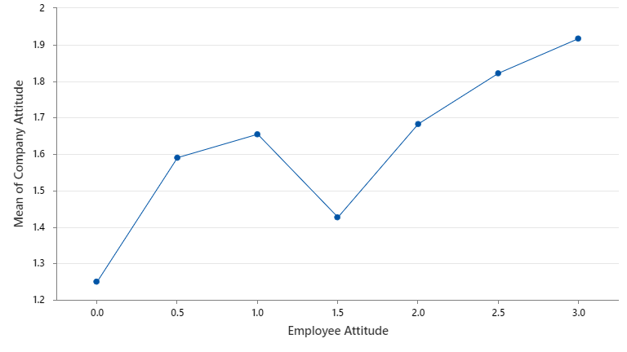
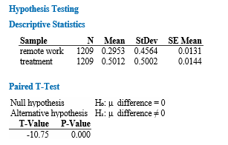
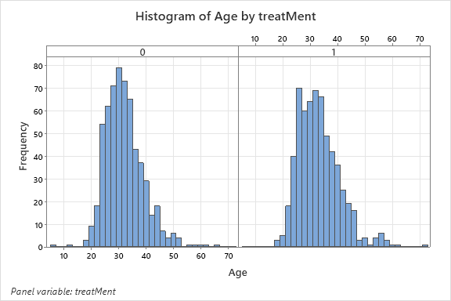
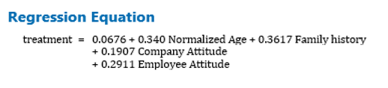
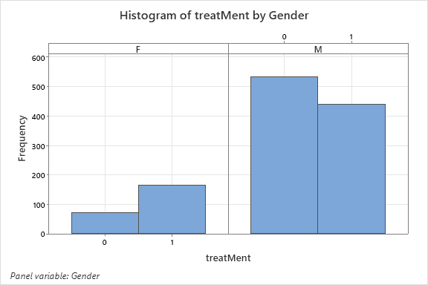
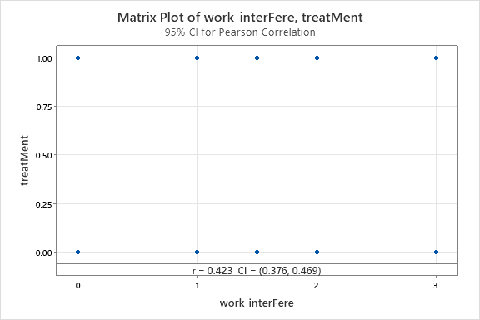

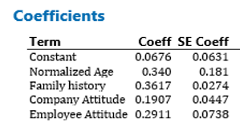

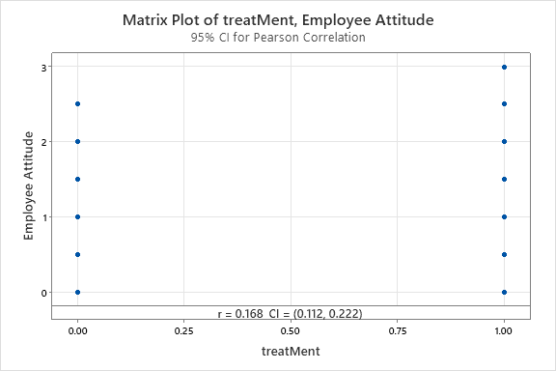

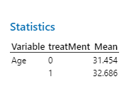
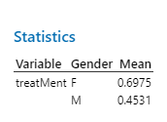
MENTAL HEALTH IN WORKPLACE
MTH-650, NORTHWOOD UNIVERSITY, MIDLAND, MI | MAR 2023
Introduction
Workplace Attitude Towards Mental Health
Effect of Remote Work Policy
Mental health issues currently affect 10.7% (2017) and has been increasing at a rate of 13%.
In the context of workplace mental health has been some what neglected. This poster aims to understand the impact of mental health issues specifically on employees working in tech companies and how to improve this situation.
Employees in companies with a positive and open attitude towards mental health are also open minded and less affected by mental health issues.
Now a days with remote working policies being widely used, we tested the hypothesis that remote working has an impact on mental health issues.
Age and Gender wise Distribution
The general distribution of mental health issues across age group and genders helps us identify specific areas of focus.
Employee Attitude is an indication of how open an employee is on discussing mental health issues.
Company Attitude is an indication of how helpful a company is to solve mental health issues of its employees.
From this we can reject the hypothesis that Remote work and Mental health issues are statistically related.
Factors affecting Mental Health
Effect of Mental Health Issues on Work
As a final step we tried to find all the major factors and their effect on mental health
In an effort to understand the impact of mental health issues and employee attitude on work productivity, we correlated the employees who were undergoing treatment, their attitude and productivity and we found an important detail.
Those who experienced mental health issues categorically say that these issues significantly affect their productivity.
Occurrence of mental issues is a function of age and family history but solving these issues depends on the attitude of the employees and the companies at which they work.
Conclusion
0 – No Treatment
1 – Treatment Taken
Mental issues are more evenly distributed across ages 20 to 40 and they are more likely to occur at higher ages.
Females have significantly higher chance of mental health issues when compared to male.
Special attention should be placed on these cohorts of people.
Through all these analysis we found a few significant areas of improvement to solve mental health issues at workplace.
To do this, companies should take policies more aligned towards solving mental health issues specifically for female employees to improve working conditions and increase productivity.
There is a positive correlation between employee Attitude and treatment. This indicates that a more open an employee about their mental health the greater are the chances that they take treatment and solve their issues, there by increasing productivity.
This poster presentation was prepared by Draksharam N V Priya Harshitha, Garimella Manoja, Gorla Venkata Saketh.

