Slide 1

Amazon E-Commerce Performance Analysis
Business Insights & Recommendations using Power BI
SAKET KUMAR JHA

Slide 2
Introduction
Amazon is a leading global e-commerce company that provides a wide variety of products and services, including online retail, cloud computing, and digital entertainment. Known for its strong focus on customer satisfaction, advanced technology, and efficient delivery network, Amazon has transformed the online shopping experience by making it simple, reliable, and easily accessible to customers around the world.

Slide 3
PROBLEM STATEMENT
Amazon is an e-commerce company that is currently performing well. The stakeholders want to maintain this strong performance while also improving it by introducing new strategies.
In addition to offering discounts and Prime membership benefits, the company is looking for new ways to identify and reward customers and further improve their overall shopping experience.

Slide 4


Data Overview
Dataset: Amazon E-Commerce (Orders & Customers)
Size: ~1,000+ records across multiple tables
Tables & Key Fields:
Orders → OrderID, Date, Status, Sale Price
Customers → CustomerID, Location, Purchase History
Preprocessing: Cleaned duplicates, fixed missing values, standardized dates & prices

Slide 5
Tools & Analysis Focus
Tools Used
SQL – Data extraction, transformation, table joins.
Excel – Quick exploration & validation checks.
Power BI – Dashboards, DAX calculations, visuals.
Analysis Focus
Cleaned and prepared data
Analyzed patterns (sales, returns, customer behavior)
Built interactive dashboard to derive insights

Slide 6
APPROACH
Revenue Distribution Analysis
Periodic And Geographical Analysis
Product Analysis
Customer Satisfaction Analysis

Slide 7
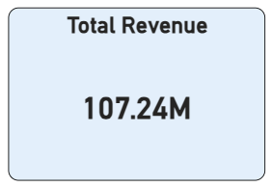
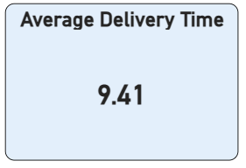
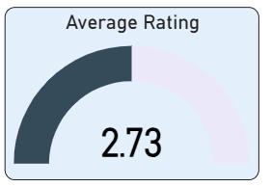
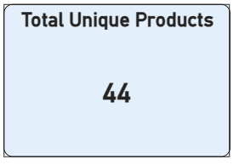
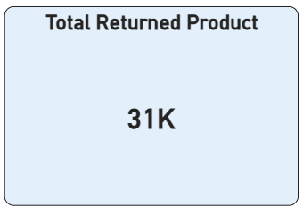
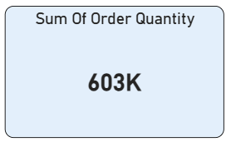
KEY PERFORMING INDICATORS
The total revenue generated
The total number of Unique Products
Total Products Returned
Average Delivery Time taken to deliver the products.
Overall Average Rating
Total Number of Order Quantity.

Slide 8
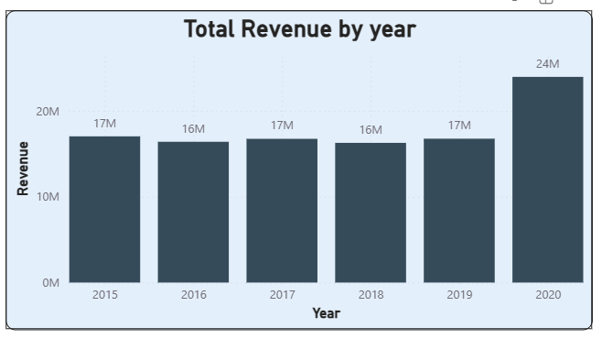
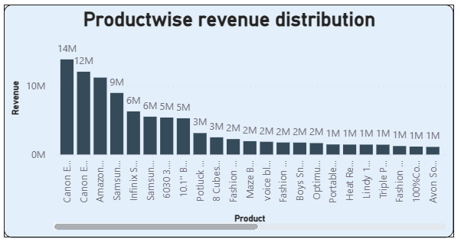
Revenue Distribution Analysis
With revenue distribution, we can understand which product contributing more to the revenue and also in which year revenue generated more.
Insights:
Revenue generated in the year 2020 is more compared to previous years.
Top revenue generated product is Canon EOS 600D 18MP DSLR Camera- Black with 14M sales.

Slide 9
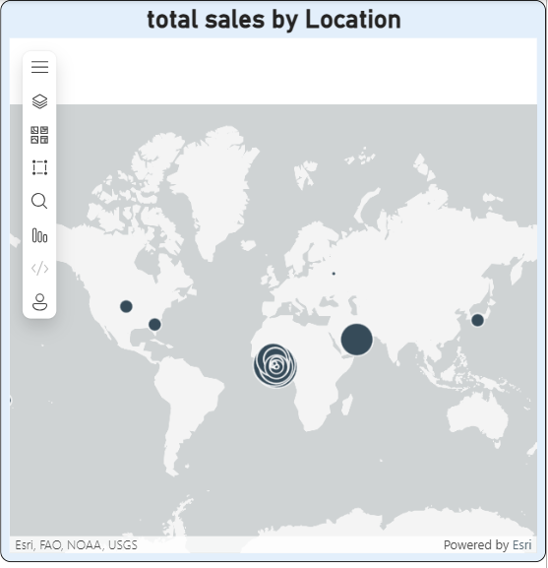
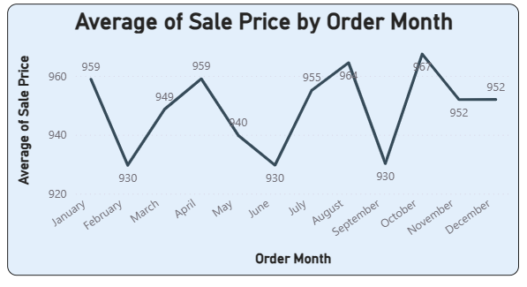
Periodic And Geographical Analysis
Periodic and Geographic analysis will help to devise target marketing and distribution strategies.
Insights:
The average sales value dropped for February, June and September.
North America and African regions are contributing more to revenue.
South America is the least revenue contributing region.

Slide 10
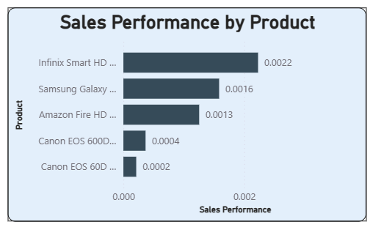
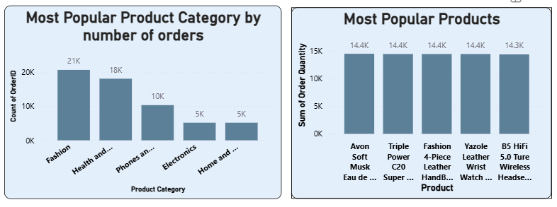
Product Analysis
In the product analysis, we can see the Most popular products and underperform products.
Insights:
We can see a clear distinction between the most popular, enjoying customer preference with high sales, and the underperforming products, indicating areas that may need targeted marketing efforts to enhance their overall sales.

Slide 11
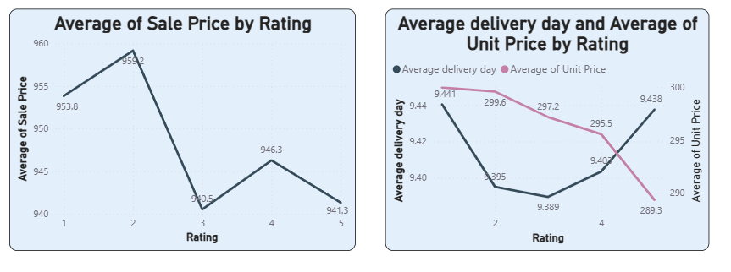
Customer Satisfaction Analysis
Customer satisfaction will help to understand how they are interested in the platform and how happy they are with shopping experience.
Insights:
Average rating given by customers is 2.73, which is above average.
Customers gave 4 & 5 rating for low unit price products
With less Delivery time, the ratings are very good compared to high delivery time.

Slide 12
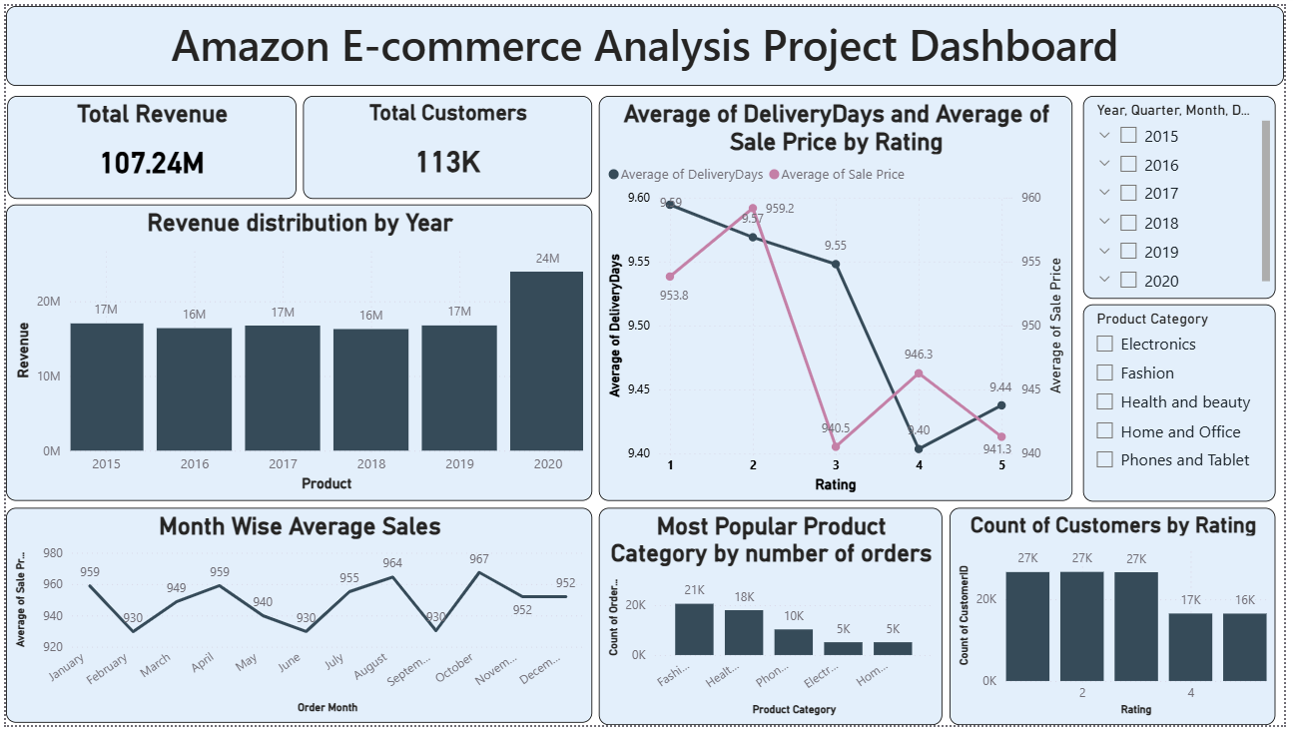
Report – Main Tab

Slide 13
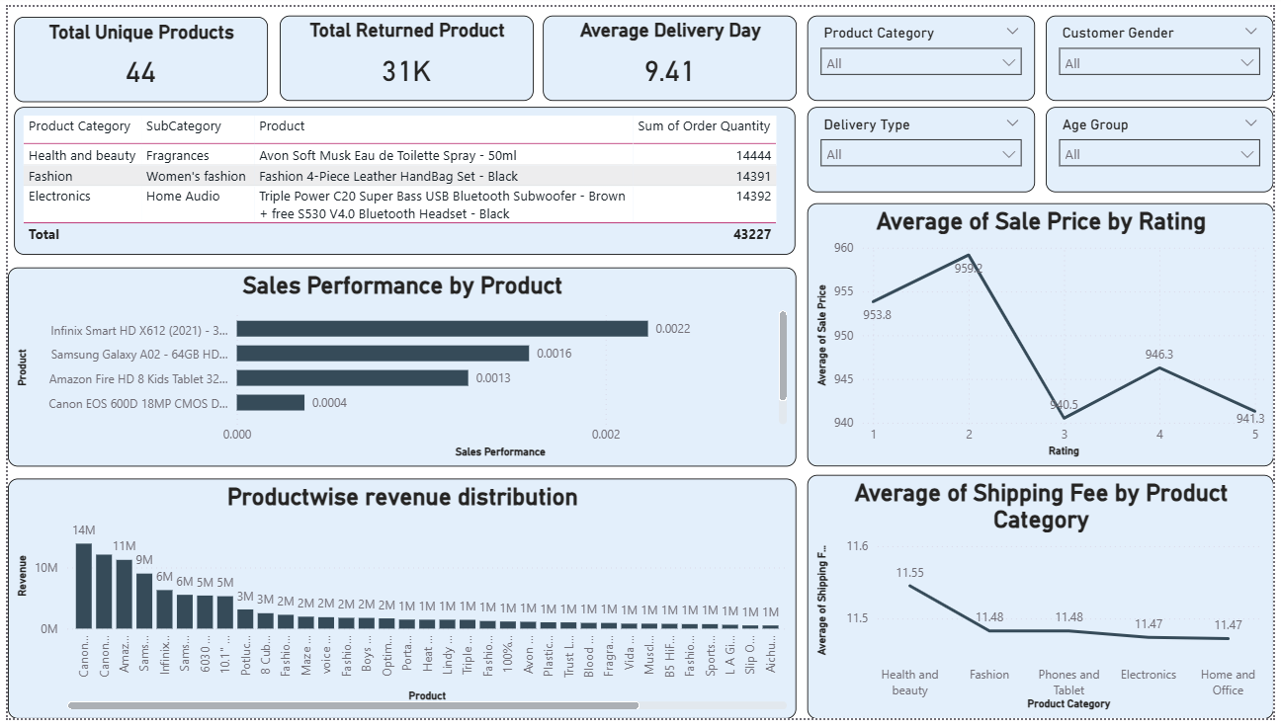
Product Tab

Slide 14
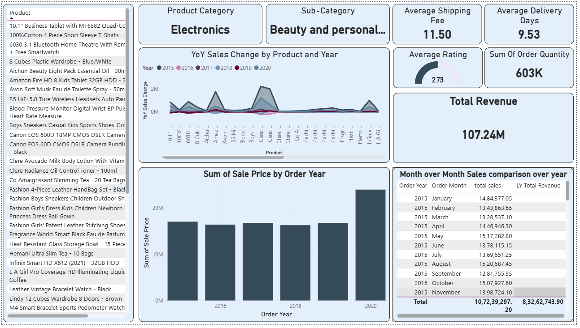
Individual Product Tab

Slide 15
Recommendation
Customer Retention: Launch loyalty programs that provide special benefits and rewards for regular customers.
Enhanced Value Proposition: Improve Prime membership by adding more benefits and personalized deals for users.
Data-Driven Insights: Use data analysis to identify valuable customers and improve marketing strategies.
Feedback Utilization: Use customer feedback to enhance service quality and product offerings.
Location-Specific Offers: Implement region-based promotions and partner with local brands for exclusive deals.
Innovative Engagement: Introduce features like gamification, flexible pricing, and interactive reward systems to increase customer engagement.

Slide 16
Conclusion
Amazon is performing well but should continue focusing on maintaining its competitive advantage and customer satisfaction.
Identifying and rewarding high-value customers with targeted benefits can help improve customer loyalty.
Using data analytics and customer feedback can support continuous improvement and enhance the shopping experience.
Expanding Prime membership benefits and offering personalized deals can help attract and retain customers.
A small percentage of customers and certain product categories contribute to the majority of total sales.
Higher revenue in May and June, along with strong-performing regions and categories, highlights good opportunities for targeted campaigns and future growth.

