Slide 1
DeepForms

Slide 2
Need
Currently filling of marks obtained by student in the database is done manually by teachers.
This wastes a lot of time of the teachers, which can be utilised instead in some productive activities such as research, designing new methodology for teaching etc.

Slide 3
Proposed Solution
Application which will take scanned copy of paper as a input and upload the data in database directly.
Application can also be used to compute and analyse fulfilment of course objectives using appropriate formulae.

Slide 4
Design Methodology
Pre-processing the image
Applying Convolutional Neural Network for digit and character extraction
Saving results to database

Slide 5
Objective
To study deep learning with neural network concepts
To obtain raw dataset and pre-process it
To study image processing concepts
To implement knowledge of software engineering processes in development

Slide 6
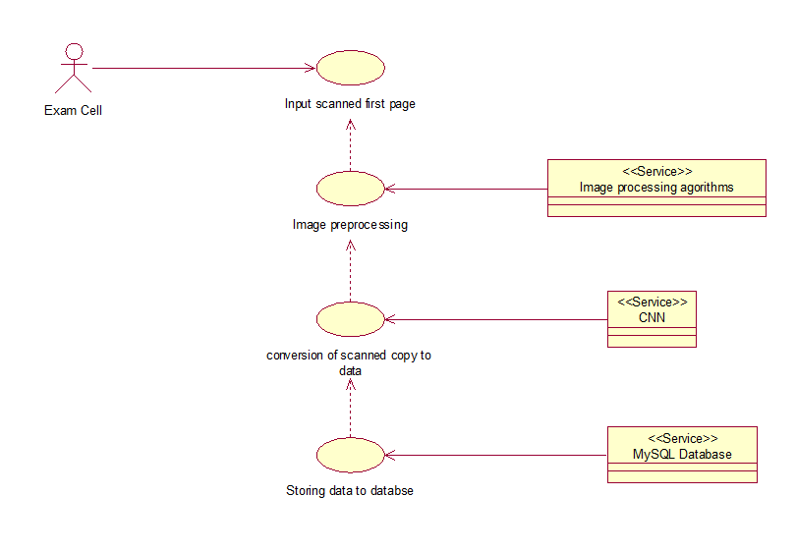
Use case diagram

Slide 7
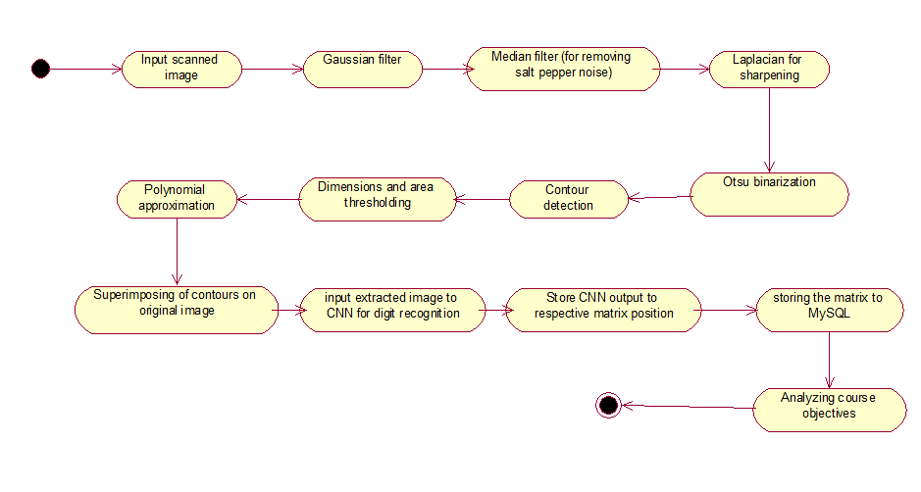
Activity diagram

Slide 8
Future Versions
Scale the application to handle any form provided a blank copy of the same.
Create Web-app and RESTful API for handling server requests for processing forms.

