Slide 1
JOB MARKET ANALYSIS
AND RECOMMENDATION SYSTEM
A data-driven study of job demand, compensation, emerging categories, forecasting, and personalized recommendations
Capstone Project Presentation

Slide 2
Project Overview
Objective: understand job-market demand, compensation patterns, emerging categories, and future trends.
Build a personalized recommendation engine for job seekers using TF-IDF and cosine similarity.
Provide an interactive Streamlit interface connected to a Flask API.
Use the provided Upwork job-posting dataset as the analytical source.
Job Market Analysis & Recommendation System | 2

Slide 3
Dataset & Preparation
Dataset shape: 244,828 rows and 8 columns.
Date coverage: November 2023 to March 2024.
Hourly midpoint = (hourly_low + hourly_high) / 2.
Fixed-price budgets were not mixed with hourly rates in salary analysis.
Missing values were handled according to each task.
Job Market Analysis & Recommendation System | 3

Slide 4
End-to-End Workflow
Load data → clean and validate → EDA → statistical analysis → forecasting → recommendation API → dashboard and UI.
Tools: Python, Pandas, NumPy, Matplotlib, Seaborn, Scikit-learn, Flask, and Streamlit.
Job Market Analysis & Recommendation System | 4

Slide 5
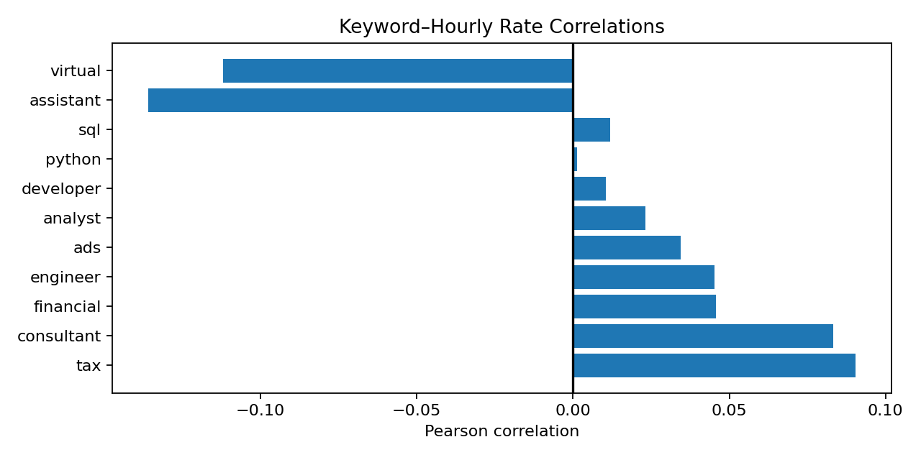
Keyword & Hourly Salary Analysis
Statistical relationship between job-title keywords and offered hourly rates
$29.71
Mean hourly rate
$22.50
Median hourly rate
$75
95th percentile
$135
99th percentile
Strongest positive associations were weak: tax (r≈0.091) and consultant (r≈0.083).
Python, SQL, JavaScript and React showed little linear association with hourly rate.
Correlation does not imply causation.
Job Market Analysis & Recommendation System | 5

Slide 6
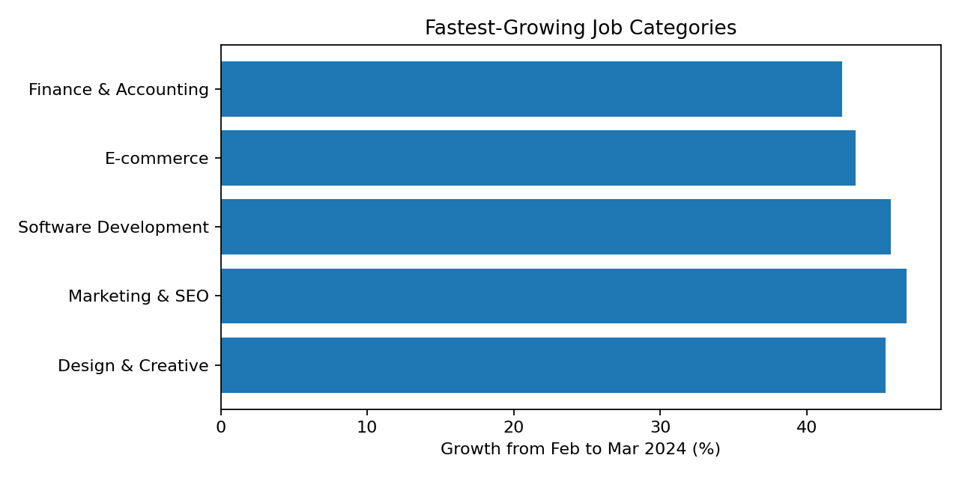
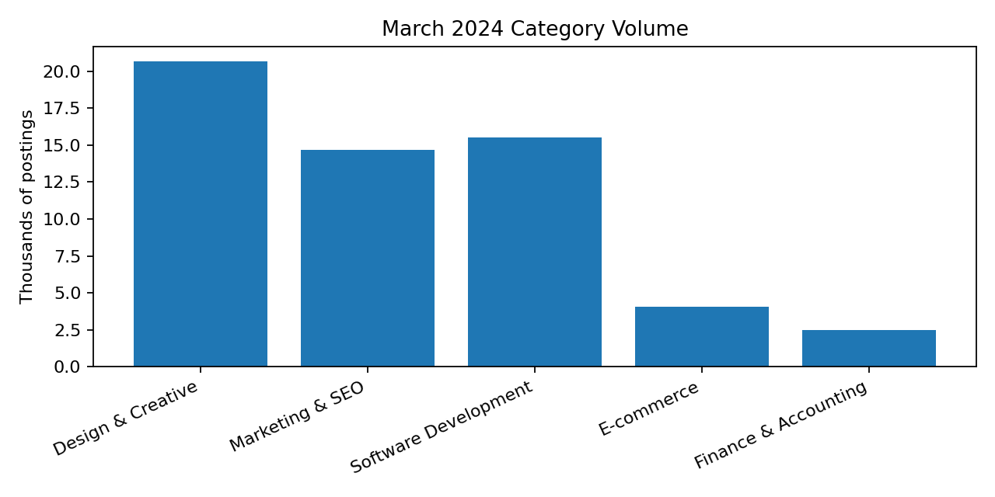
Emerging Job Categories
Posting frequency and growth between February and March 2024
Design & Creative: 14,198 → 20,643 (+45.4%).
Marketing & SEO: 9,982 → 14,655 (+46.8%).
Software Development: 10,640 → 15,507 (+45.7%).
Job Market Analysis & Recommendation System | 6

Slide 7
Predicting High-Demand Roles
Time-based demand modelling
Monthly category posting counts were used as the modelling dataset.
Training used earlier months and testing used the latest month to avoid random time leakage.
Random Forest regression was used for category-level demand prediction.
Reported metrics: MAE ≈ 2,980; RMSE ≈ 4,717; R² ≈ 0.449.
Forecast output was converted into a ranked chart of predicted high-demand categories.
2,980
MAE
4,717
RMSE
0.449
R²
Job Market Analysis & Recommendation System | 7

Slide 8
Country-Level Hourly Rates
Hourly jobs were isolated and midpoint rates were calculated.
Average hourly rate was grouped by country after removing missing country/rate values.
Deliverable: ranked country comparison chart or interactive Plotly map.
Country sample size should be considered when interpreting averages.
Job Market Analysis & Recommendation System | 8

Slide 9
Personalized Job Recommendation Engine
Input: desired role/skills, country, job type, and number of recommendations.
Model: TF-IDF vectorization of job titles plus cosine similarity.
Filtering is applied before ranking.
Output includes title, country, compensation, similarity score, and original job link.
Prototype uses Flask API and Streamlit UI.
Job Market Analysis & Recommendation System | 9

Slide 10
Monthly Job Market Dynamics Dashboard
Dashboard cards: total postings, hourly-posting share, average hourly rate, and top category.
Monthly filters compare categories and countries.
The dataset is heavily concentrated in February and March 2024.
Future refresh: replace the CSV with a new monthly extract and rerun aggregation.
Job Market Analysis & Recommendation System | 10

Slide 11
Remote Work Landscape
The dataset has no dedicated remote/on-site field.
A defensible remote-work percentage or forecast cannot be calculated directly from the current schema.
Recommended extension: add a remote flag from job descriptions or a richer job-posting source.
Then track remote share by month and country.
Job Market Analysis & Recommendation System | 11

Slide 12
Future Job Market Trends
Monthly total job postings are modelled using month_index.
Linear Regression provides a transparent baseline.
Historical predictions are compared with actual monthly totals.
Next-month demand is generated from the fitted model.
Because the historical window is short and uneven, forecasts are directional rather than guaranteed.
Job Market Analysis & Recommendation System | 12

Slide 13
Key Findings & Business Insights
Demand is concentrated in Design & Creative, Marketing & SEO, and Software Development.
Keyword presence alone is not a strong predictor of hourly compensation.
Personalized matching is more useful when skills, location, job type, and similarity are combined.
Forecasts should be refreshed as new monthly data arrives.
Country comparisons should include posting counts and medians to reduce misleading outliers.
Job Market Analysis & Recommendation System | 13

Slide 14
Limitations & Future Improvements
The dataset is a historical extract, not a live real-time feed.
Only job titles are available for text matching; descriptions and skills would improve recommendations.
Early months have very few postings, while February–March dominate the sample.
Remote-work forecasting needs a remote/on-site attribute.
Future work: scheduled ingestion, richer NLP, confidence intervals, model monitoring, and Docker deployment.
Job Market Analysis & Recommendation System | 14

Slide 15
CONCLUSION
The project combines descriptive analytics, forecasting, and an interactive recommendation system.
The strongest practical outcome is a reusable workflow that turns job postings into actionable recommendations.
With monthly refreshes and richer job attributes, the system can support more reliable market intelligence.
Job Market Analysis & Recommendation System | 15

