Slide 1
Mobile Price Prediction Using Machine Learning
Project Presentation

Slide 2
Introduction
Smartphones have various specifications such as RAM, storage, battery, and processor.
These features influence the overall price of the device.
Machine learning can analyze these specifications and predict the price of a mobile phone.
Project Objective
The objective of this project is to predict smartphone prices using machine learning algorithms.
The model uses phone specifications such as RAM, storage, battery, camera, and processor. Identify key features affecting smartphone prices.
Build a machine learning model to predict mobile phone prices.

Slide 3
Dataset Description
Dataset contains 541 smartphone records.
Each record includes specifications and price.
Main features include Memory, RAM, Battery, Cameras, Processor, and Price.
Data Preprocessing
Converted camera values from text format (e.g., '13MP') to numeric values.
Removed unnecessary columns.
Checked for missing values and duplicates.
Encoded categorical variables for machine learning.

Slide 4
Exploratory Data Analysis
Analyzed distributions of RAM, Memory, and Price.
Most smartphones fall in the ₹8000–₹20000 range.
RAM mostly ranges from 4GB to 8GB.
Storage ranges from 16GB to 256GB.
Model Building
Target variable: Price
Input features: phone specifications.
Data split into training (80%) and testing (20%).

Slide 5
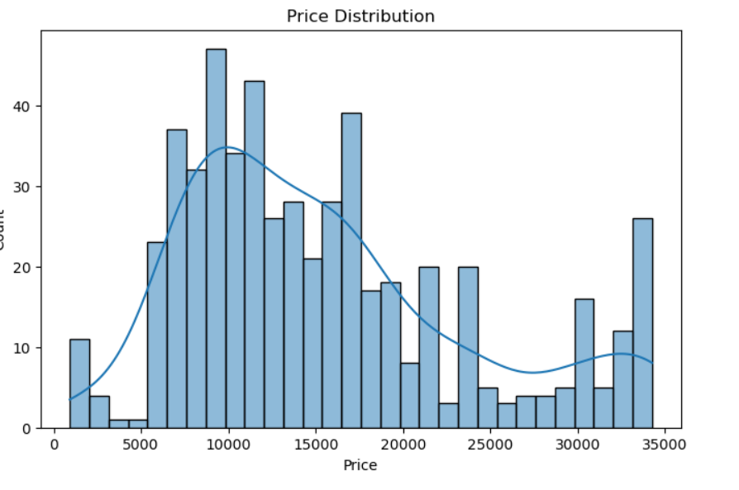
Price Distribution
A histogram was created to visualize the distribution of mobile prices in the dataset.
KDE curve was added to observe the overall trend of price distribution.
Most mobile prices are concentrated in the mid-price range, while fewer phones exist in very low or very high price ranges.

Slide 6
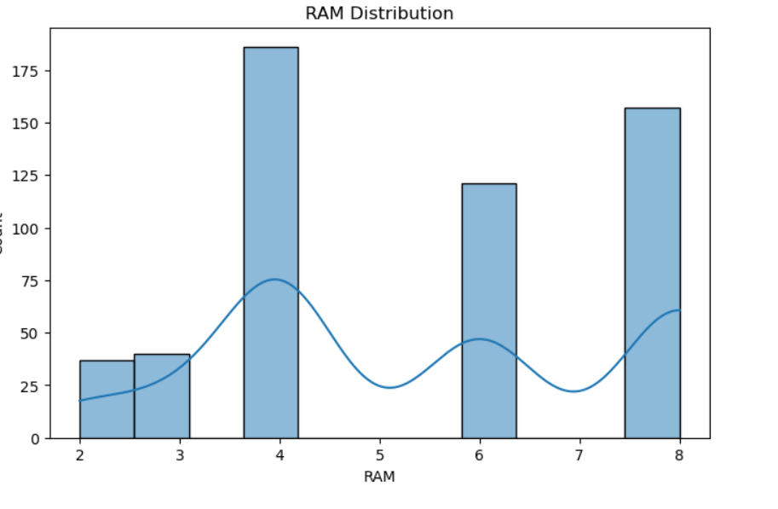
RAM Distribution
A histogram was used to analyze the distribution of RAM values in the dataset.
The chart shows that most smartphones have 4GB to 8GB RAM.
Lower RAM values appear less frequently in the dataset.

Slide 7
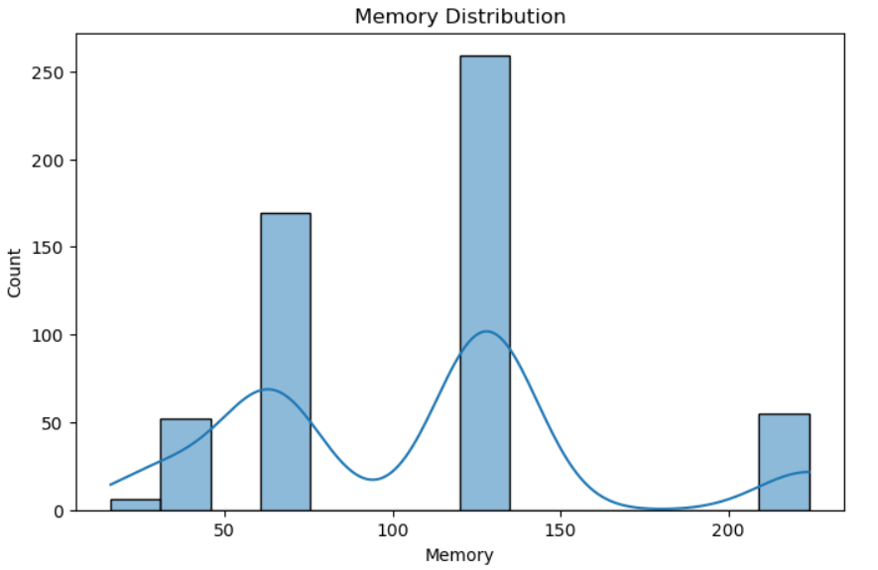
MEMORY Distribution
A histogram was created to visualize the distribution of internal storage (memory).
Most smartphones in the dataset have 64GB to 128GB storage.
Very low or very high storage options appear less frequently.

Slide 8
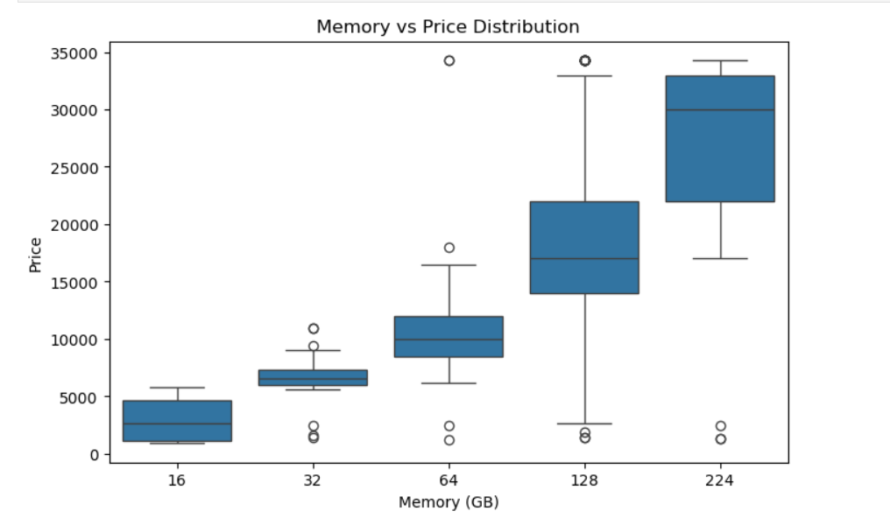
Memory vs Price Distribution
A boxplot was used to analyze the relationship between mobile storage (Memory) and price.
Phones with higher storage (128GB–256GB) generally have higher prices.
Lower storage phones such as 16GB or 32GB are mostly found in lower price ranges.
This indicates a positive relationship between memory and price.

Slide 9
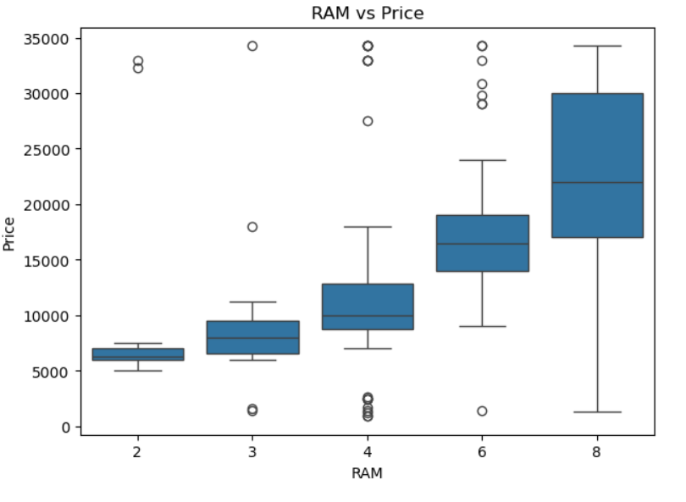
RAM vs Price Distribution
This shows that RAM plays an important role in determining smartphone prices.
Smartphones with higher RAM (6GB–8GB) generally have higher prices.
A boxplot was created to study the relationship between RAM and mobile price.
Devices with 2GB–3GB RAM are mostly in the lower price range.

Slide 10
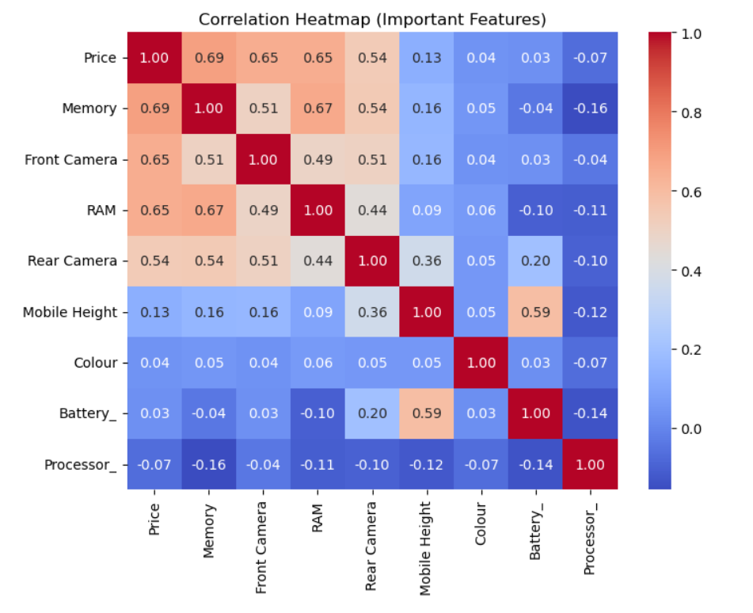
Correlation Analysis
A correlation matrix was used to identify relationships between mobile features and price.
Memory, RAM, and Front Camera show a strong positive correlation with price.
Rear Camera shows a moderate correlation with price.
Other features like Colour, Battery, and Processor show weak correlation.

Slide 11
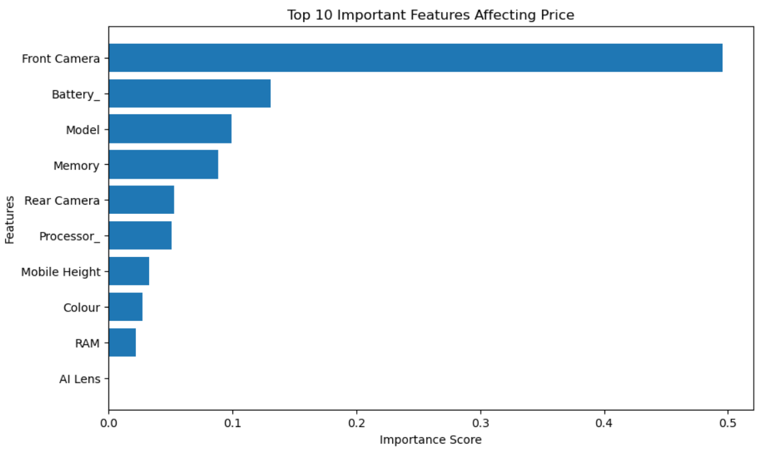
Feature Importance
Front Camera is the most influential feature affecting mobile price.
Battery capacity and Model also have significant impact on price prediction.
Memory and Rear Camera show a moderate influence on the price.
Processor and Mobile Height have smaller contributions.
RAM and AI Lens have very low importance in the model.

Slide 12
Machine Learning Models Performance
1. Linear Regression
A Linear Regression model was trained to predict mobile prices.
The model achieved an R² score of ~0.87, indicating good predictive performance.
MAE ≈ 1573 and RMSE ≈ 2775 show a moderate prediction error.
This model was used as a baseline model.
2. Decision Tree Regressor
A Decision Tree model was applied to capture nonlinear relationships in the data.

Slide 13
The model achieved an R² score of ~0.87.
MAE ≈ 874, which is lower than Linear Regression, indicating better accuracy.
The Decision Tree performed slightly better on this dataset.
3. Random Forest
A Random Forest model, which combines multiple decision trees, was also trained.
It achieved an R² score of ~0.85.
MAE ≈ 1406 and RMSE ≈ 2994 indicate slightly higher prediction errors compared to the Decision Tree.

Slide 14
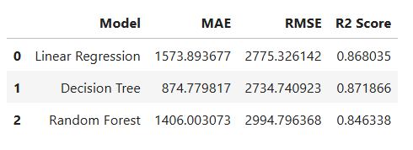
Compare All Models
✅ Conclusion: Among all models, the Decision Tree Regressor performed the best, achieving the lowest error and the highest R² score for mobile price prediction.

Slide 15
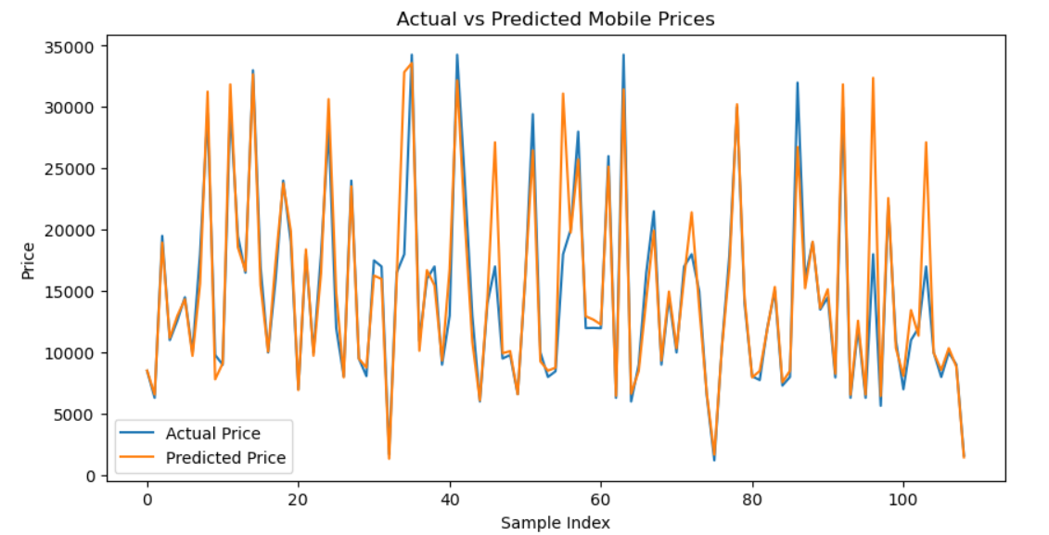
Actual vs Predicted Prices
Compared actual mobile prices with predicted prices.
Predicted values closely follow actual values with small deviations.

Slide 16
Recommendations
Smartphones with higher RAM and memory can be priced at a premium because they strongly influence mobile prices.
Camera quality (front and rear) plays an important role in price, so phones with better cameras can be positioned in higher price segments.
Most smartphones in the dataset fall in the ₹8000–₹20000 range, so companies should focus on this mid-range segment to attract more customers.
Battery capacity and processor performance should also be improved in higher-priced models to justify the price.
Machine learning models can help the company predict optimal prices for new smartphones based on their specifications.

Slide 17
Final Conclusion
Machine learning can effectively predict smartphone prices.
Features like RAM, memory, camera, and battery strongly influence price.
Decision Tree provided the best prediction performance.

